Slide 1

An Android Hacker’s Toolbox
Iain @ipb

Slide 2
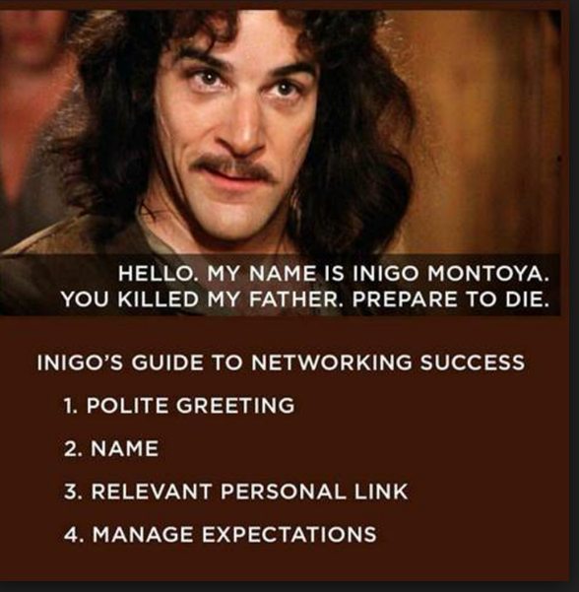
Notes:
Hello
My Name is iain
3. I’m a former software engineer and now a security analyst / Pen tester. My company has started adding mobile apps into our products
4. Manage expectations – I am not an android or mobile expert. What I’m going to show you are a few tools I have discovered and used in my day to day testing. The demos focus on Android.

Slide 3
Agenda
Mobile vulnerabilities
Vulnerability Assessments
Attacking mobile applications
Tooling
Demos
Notes:
This talk is going to look at common mob vulns
Ways to attack mobile applications
Some tools you can use

Slide 4
OWASP Mobile Top Ten (part 1)
Improper Platform Usage
Insecure data storage
Insecure data communication
Insecure authentication
Insufficient / broken crypto
Notes:
Platform – not using or misusing security features & controls provided by your system, eg Android Intents / Keychain. Can allow access to sensitive data.
Insecure data storage – store sensitive or PII in unprotected sql lite . Xml. Use of SD card, sensitive data. Incorrect use or ignore the secure storage
Insecure comms – lack of transport level encryption / lack of cert pinning where appropriate/ (Side note: proxy it, found a file mgr app sending encrypted data to Chinese ip)
Insecure Auth – possible to bypass authentication, anonymous exec of api calls, password policies
Crypto – use of weak or deprecated crypto systems, RYO crypto, bad key management, hardcoded keys in app

Slide 5
OWASP Mobile Top Ten (part 2)
Insecure authorisation
Client code quality
Code tampering
Reverse engineering
Extraneous functionality
[OWASP Mobile Top 10 2016]
Notes:
Insecure AuthZ – insecure transmission of roles / permission models, Access to hidden methods, Method level controls, Presence of IDOR vulns, Config file auth sets
Code quality – bit of a catch all OWASP say – buffer overflow, code and command injection , memory leaks,
Tampering – is it dubuggable, can I modify configs, can I rebuild the binary, can I execute intents? Can other apps interact?
RE – can it be compiled into readable code, all your secrets are revealed, all security vulnerabilities exposed, loss of intellectual property, potential compromise of other systems
Extraneous functionality – hidden features admin modes / / dev & test modes / excessive log data. The kkarger your attack surface, the easier it is to attack. Keep it out of production.

Slide 6
Goals
Think like an attacker:
Steal data
Modify data
Privilege escalation
Service interruption

Slide 7
Attack surface
Abuse the application
Abuse the device
Abuse the API
Abuse the communication
Notes:
Application – exposed methods/ intents, code flaws / databases, log files
Device – rooting / filesystem / secure storage
API – forget the device, attack the API directly
Comms – intercept communication between app & api – standard attacks, fuzzing, idor etc, param tampering

Slide 8
Tools
Static Analysers – Assess manifests, permissions, disassembled code
Dynamic analysers – Assess / interact with running application
Proxies – MITM communications with APIS
ADB
MAKA
Drozer
Super
ClassyShark

Slide 9
MobSF
Static Analysis
Manifest analysis
URLs
Strings
DEMO
…
Notes:
About 45 sec to run sf

Slide 10
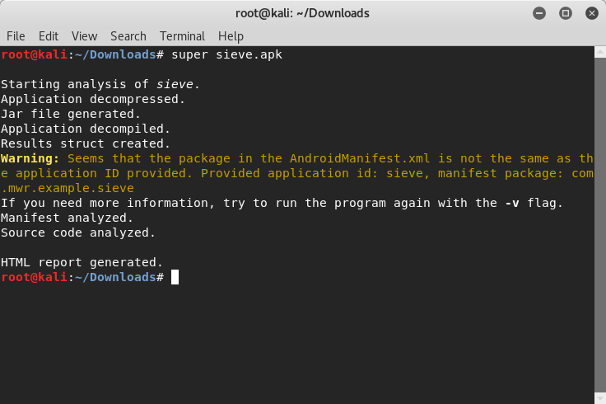
Super (Static Analysis)
Notes:
So, some of these tools do take a while to run, to reduce some of the wait time, I’m going to show you just the output from a few of them and demo some of the more interesting ones.
SHOW HTML REPORT C:\Users\iain.baughen\Documents\OWASP\com.mwr.example.sieve

Slide 11
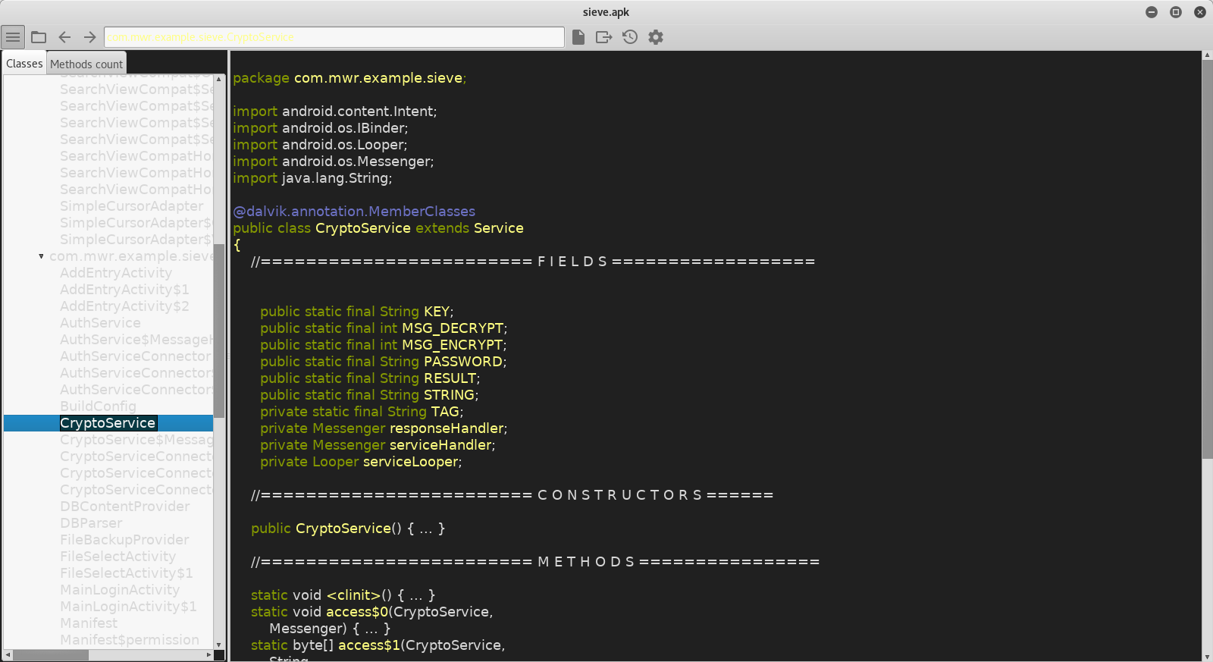
ClassyShark (Code Review)
Android / Java executable viewer – shows dependence & structure
Notes:
Classy shark is aandroid / java executable viewer, that shows your code, dependencies and structure, it gives a nice way to enumerate libraries included in the distributable and review the code.

Slide 12
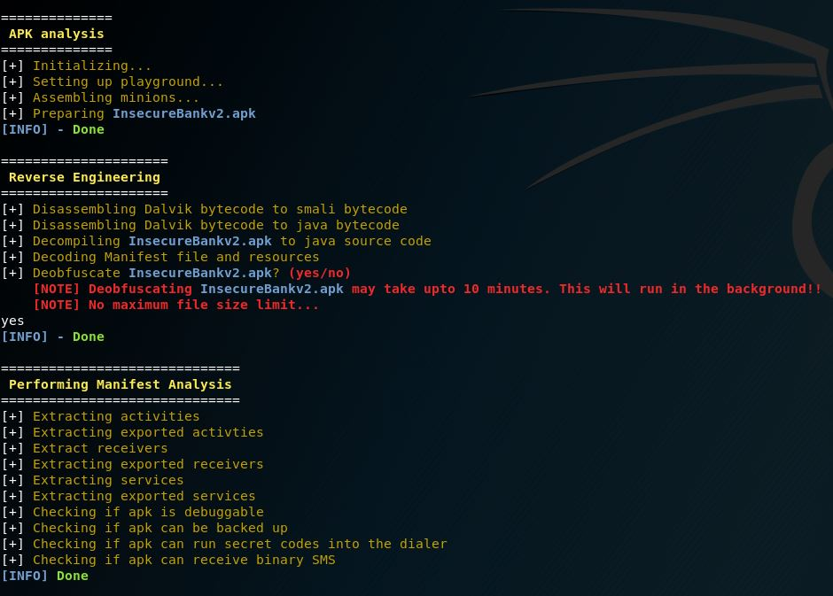
MARA
Notes:
Reverse Engineering & vulnerability assessment. I’ve run this on a deliberately insecure banking application. We’re going to kick the process off, but it takes around 15 minutes so instead of watching all of it – screenshot of highlights
Stage 1 – reversing the apk and assessing manifest, checking what activities, recoevers, services etc. Debug / backup – explain these, secret codes – explain these, binary sms, explain this

Slide 13
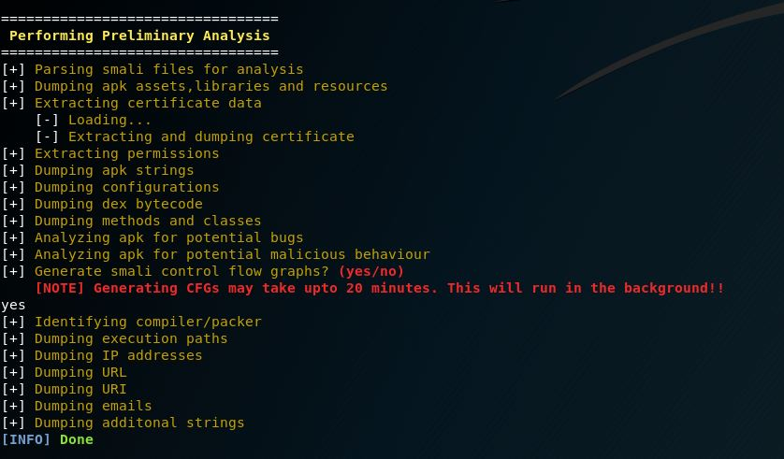
MARA

Slide 14
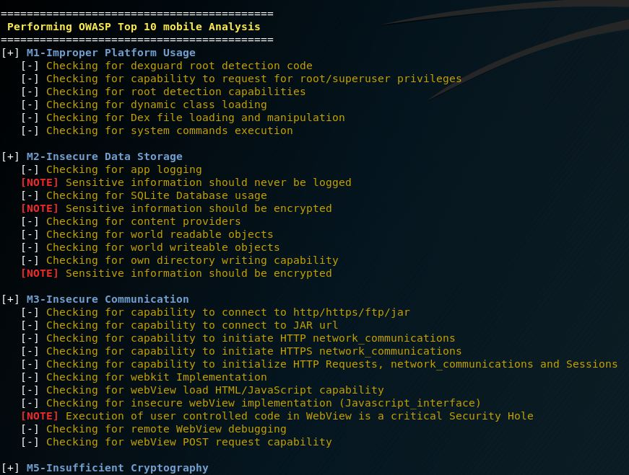
MARA

Slide 15
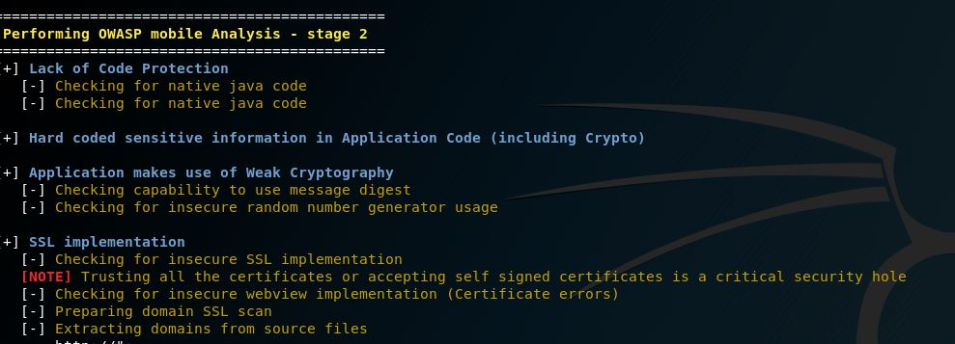
MARA
Notes:
OWASP top ten analysis

Slide 16
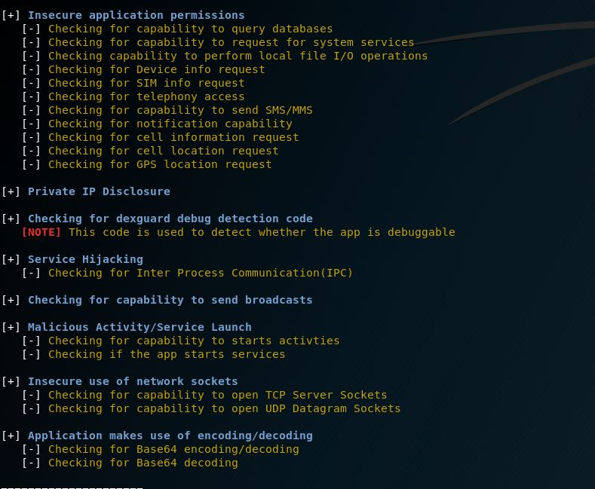
MARA
Notes:
More OWASP analysis

Slide 17
MARA Output
Quick review of MARA output

Slide 18
Mob SF Continued
Mob SF report Review

Slide 19
Drozer
Discover package info
Enumerate permissions
Map attack surface
Interact with applications
Query data stores
Read Files
SQL Injection

Slide 20
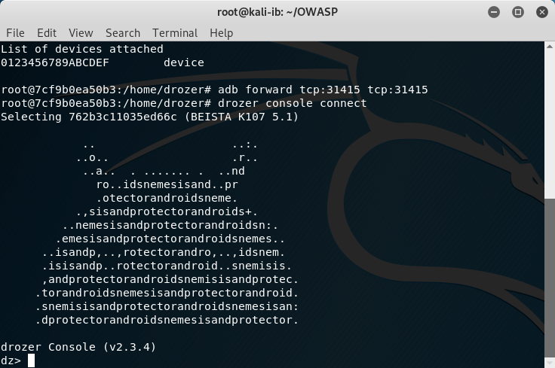
The following slides are screenshots from the live demo of the Drozer dynamic analysis tool,
They have been included here as Drozer was a core part of the presentation, they show the
core commands and output

Slide 21
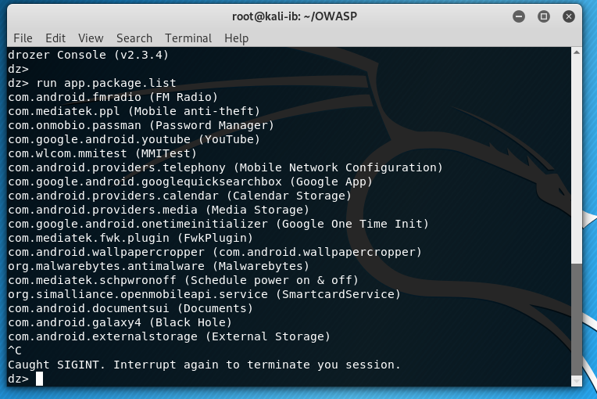
run app.package.list can show all apps on our device, even those hidden by our OEM

Slide 22
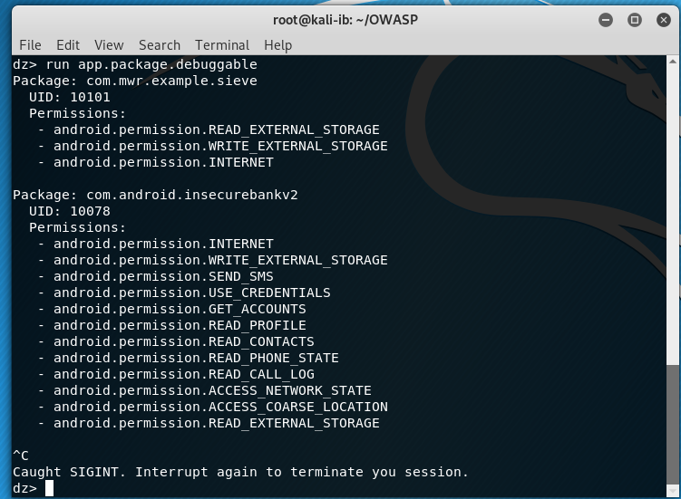
We can use app.package.debuggable and app.package.backup to find apps we can attach to or
Extract data from via their backup facility

Slide 23
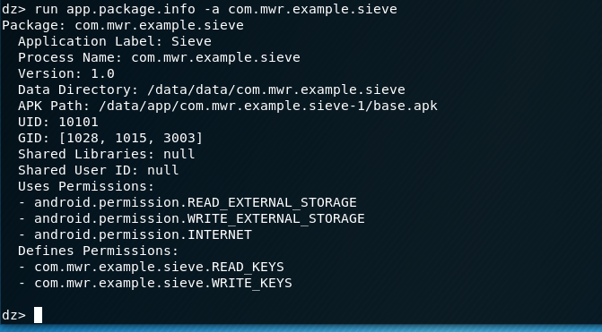
From our package listing we can find the full name of applications, using that name we
can query it for further info. We are interrogating a deliberately vulnerable password safe.

Slide 24
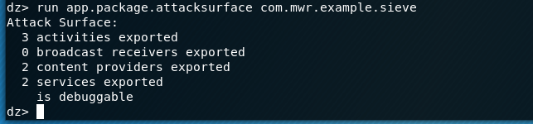
We can use app.package.attacksurface to find exposed services, content providers and other things we may be able to exploit

Slide 25
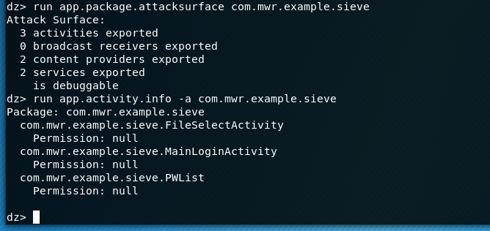
We can now ask drozer to list the activities
We can see the PWList activity has no permissions required, we are able to launch this activity
with app.activity.start and perform an authentication bypass.

Slide 26
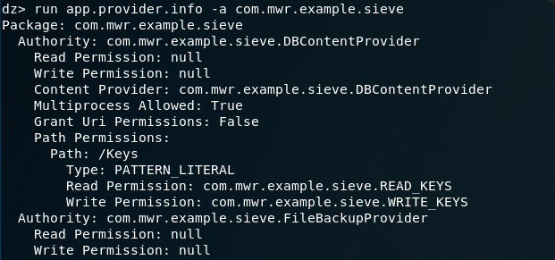
From mapping our attack surface we know we have content providers,
We can enumerate them app.provider.info

Slide 27
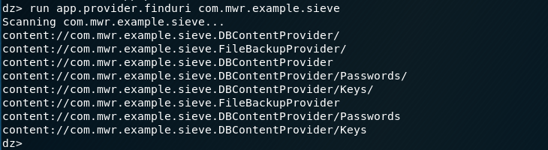
Drozer can provide the URIs we use to address these content providers

Slide 28
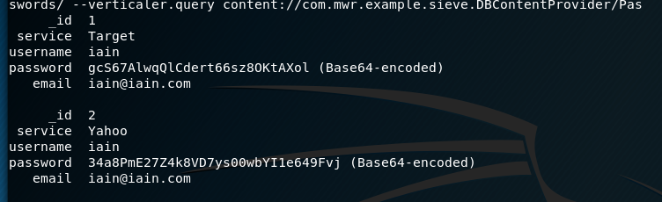
We can query these content providers, starting with the Database provider. We
Know the table names from the previous finduri. We query tables like this
run app.provider.query content://com.mwr.example.sieve.DBContentProvider/Passwords/ --vertical
We have dumped the passwords table

Slide 29
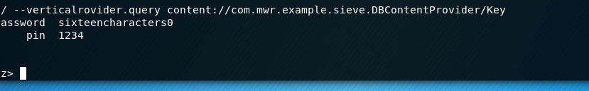
We have dumped the keys table leaking the master password & pin
Insecure authentication
Sensitive info disclosure
Broken / insufficient crypto

Slide 30
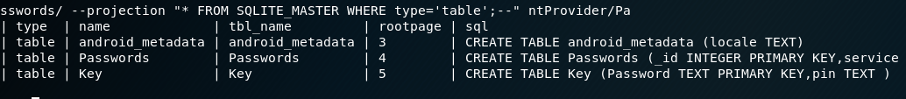
We can also use Drozer to launch sql injection attacks:
run app.provider.query content://com.mwr.example.sieve.DBContentProvider/Passwords/
--projection "* FROM SQLITE_MASTER WHERE type='table';--"
We have dumped the SQLLite_Master table

Slide 31
We can also exploit file content providers
run app.provider.read content://com.mwr.example.sieve.FileBackupProvider/etc/hosts

Slide 32
End of Drozer demo

Slide 33
Countermeasures
Implement appropriate permissions
Minimise exposed methods services
Encrypt communications
Use crypto and use it well
Sanitise inputs
Code obfuscation
Use the security features provided
Secure AP (TLS, method level auth, rate limit)

Slide 34
Build your own toolkit
MobSF [Docker] (https://github.com/MobSF/Mobile-Security-Framework-MobSF)
Drozer [Docker] (https://hub.docker.com/r/ryanstanley1/drozer/ )
MARA (https://github.com/xtiankisutsa/MARA_Framework)
Super (https://github.com/SUPERAndroidAnalyzer/super)
Classy Shark (https://github.com/google/android-classyshark)

