Slide 1
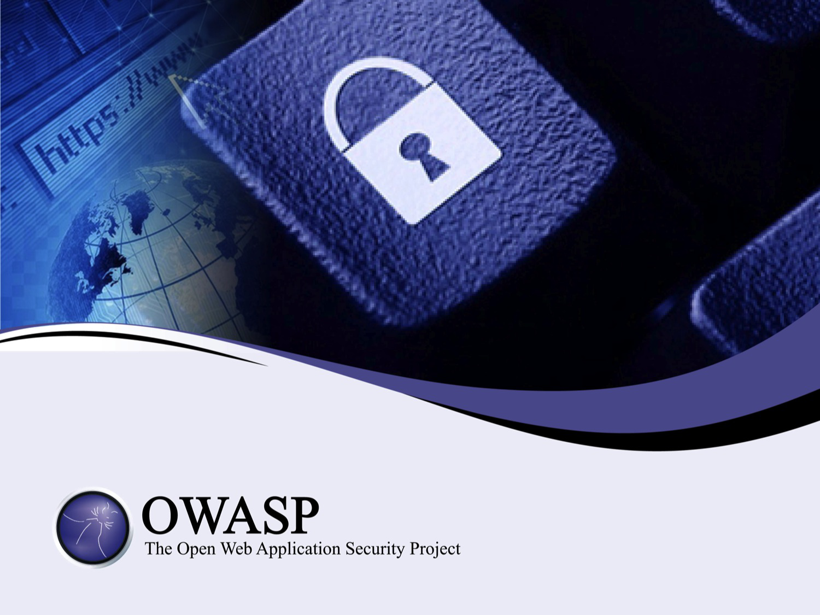

Slide 2
A Short Introduction to Threat Modeling
as part of a secure software development lifecycle

Slide 3
About Me
Jon Gadsden
Embedded software engineer and security advocate
… product security and secure development lifecycle activities. In his spare time he likes to help organise security conferences and contribute to open source projects - the latest being the OWASP Threat Dragon modeling tool.

Slide 4
What will be covered
Threat models
The tools
Why they are useful
Open source Threat Dragon
Cup Cake!

Slide 5

What is a threat model?
Essentially a data flow diagram
Protected assets
Attack vectors
Attack surfaces
… that lists possible threats
Notes:
Show of hands

Slide 6
Who models threats?
It can be diagrammatic
It can be a spreadsheet
It can be descriptive
… so, who already uses threat modeling?
Notes:
Show of hands

Slide 7
Recap on vulnerability, asset, threat
Vulnerability
an exploitable weakness in a system or its design
Asset
anything that is valuable to an organization
Threat
potential danger to an asset
Vector
method to realise an exploit
Trust boundary
change in level of trust for information or execution

Slide 8
OWASP
OWASP top ten threats
OWASP top ten remediations
OWASP threat modeling cheat sheet(s)

Slide 9
OWASP Top Ten (2013 Edition)
A1: Injection
A2: Broken Authentication and Session Management
A3: Cross-Site Scripting (XSS)
A4: Insecure Direct Object References
A5: Security Misconfiguration
A6: Sensitive Data Exposure
A7: Missing Function Level Access Control
A8: Cross Site Request Forgery (CSRF)
A9: Using Known Vulnerable Components
A10: Unvalidated Redirects and Forwards
Notes:
A9 is the only new item in the top 10 for 2013.

Slide 10
OWASP Top 10 Proactive Controls
C1 Verify for security often and early
C2 Parameterize Queries
C3 Encode Data Before Use
C4 Validate all Inputs
C5 Establish Authentication and Identity Controls
C6 Implement Appropriate Access Controls
C7 Protect Data
C8 Implement Logging And Intrusion Detection
C9 Leverage Security Frameworks and Libraries
C10 Error and Exception Handlin

Slide 11
OWASP cheat sheets
OWASP threat modeling cheat sheet(s)
DRAFT CHEAT SHEET - WORK IN PROGRESS
Introduction
The objective of this cheat sheet is to provide guidance to developers, reviewers, designers and architects on conducting successful threat modeling. The main goal of threat modeling is to understand the controls needed for a software system. This is a complex endeavor that will involve investigations into:
The trust boundaries to and within the solution that we build
The actors that interact within and outside of the trust boundaries
etc

Slide 12





Actors, Processes and Trust Boundaries
Threat Model components
Actor
Process
Storage
Data flow
Trust boundary

Slide 13
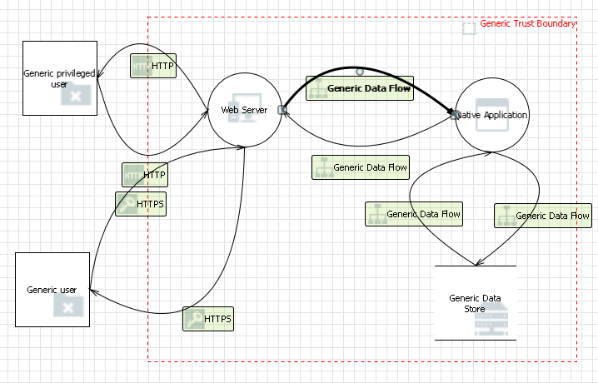
Microsoft Threat Model Tool
33 possible threats automatically identified

Slide 14
Something is better than nothing
The days of 'the whip' are very last century
More tact and carrot
Think hard before modeling existing systems
Incremental threat modeling

Slide 15
Some threats can never be modeled
Government agencies
Service provider
Back doors
The human (wet ware)

Slide 16
Questions (and answers)
Questions?
(and maybe some answers)
… before the Threat Dragon demo

Slide 17

Demonstration of Threat Dragon
Welcome! (0.1.26)
Free, open source threat modeling tool
OWASP incubator project
Web application
Desktop application for local use
Mike Goodwin

Slide 18
OWASP Threat Dragon
0 threats identified (needs work)

Slide 19
Cupcake's call for contributors
Contribute
Have a github account?
Node.js
Angular
Electron
MongoDB (well, not yet)

