Slide 1


Slide 2
OWASP Threat Dragon
An OWASP thumbs-up incubator project

Slide 3
Jon Gadsden
ForgeRock: Identity and Access Management
Embedded software and security engineer
Contributor to OWASP Threat Dragon project

Slide 4
OWASP Threat Dragon project
Context in the SDLC
What is threat modeling
Modeling with Threat Dragon
Short demo

Slide 5
OWASP secure software development lifecycle
Training: secure coding and security training
Requirements: risk evaluation and requirements
Design: security reviews and threat modeling
Implement : secure coding and testing
Validation : penetration and security testing
Release/maintenance : vulnerability management and incident response

Slide 6
Vulnerability
an exploitable weakness in a system or its design
Asset
anything that is valuable to an organization
Threat
potential danger to an asset
Vector
method to realise an exploit
Trust boundary
change in level of trust for information or execution

Slide 7
STRIDE and DREAD
Spoofing
Tampering
Repudiation
Information disclosure
Denial of service
Elevation of privilages
Damage
Reproducibility
Exploitability
Affected users
-Discoverability

Slide 8
Some threats can never be modeled
Government agencies
Service provider
Back doors
Wet ware (the human)

Slide 9
Microsoft Threat Modeling Tool (TMT)
OWASP Threat Dragon
PyTM
Mozilla Sea Sponge
Trike – Tryke!
Proprietary (IriusRisk, cisco Threat Builder, etc)

Slide 10
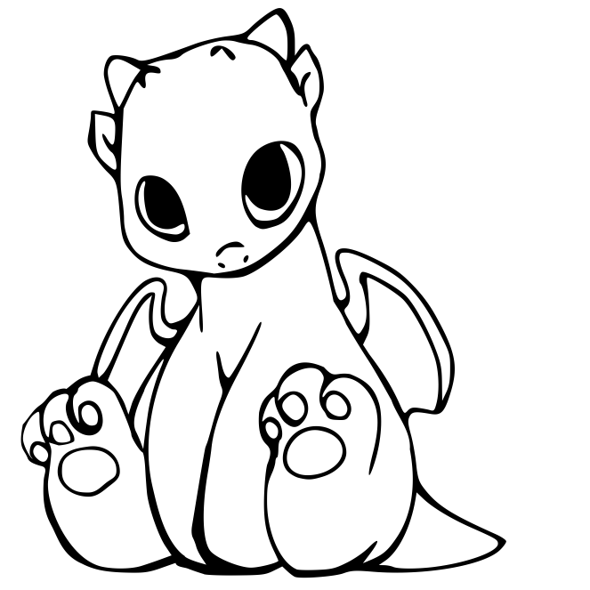
Threat Dragon (0.1.26)
Free, open source threat modeling tool
OWASP incubator project
Web application
Desktop application for local use
Mike Goodwin

Slide 11

Threat model is a data flow diagram that
Analyses security requirements
Reduces attack surface
Notes:
Show of hands

Slide 12





Threat Model components
Actor
Process
Storage
Data flow
Trust boundary

Slide 13
It is not a system diagram
Keep it simple
Think hard before modeling existing systems
Incremental threat modeling
It is not a system diagram

Slide 14
Contribute
Have a github account?
Node.js
Angular
Electron
MongoDB (well, not yet)

Slide 15
Demo time!

