Slide 1
Contributing to OWASP projects
Presentation to Bristol (UK) Chapter

Slide 2
Who am I?
C/C++ developer for 25 years
Security engineer for over 10 years
But more importantly:
Leader + contributor to OWASP Threat Dragon project
Co-leader + contributor for OWASP Developer Guide project
Co-Leader of Bristol (UK) OWASP Chapter
Notes:
Please choose an upcoming AppSec Global, and any local regional or chapter events

Slide 3
OWASP projects
There are a lot of them >322, classified as:
15 Flagship projects, eg WSTG
5 Production projects, eg CSRFGuard library
Lab projects
  71 ‘Code’ projects, eg Threat Dragon
  60 Documentation projects, eg OWASP Cheat Sheets
Incubator projects
OWASP Project Wayfinder
Notes:
Please choose an upcoming AppSec Global, and any local regional or chapter events

Slide 4
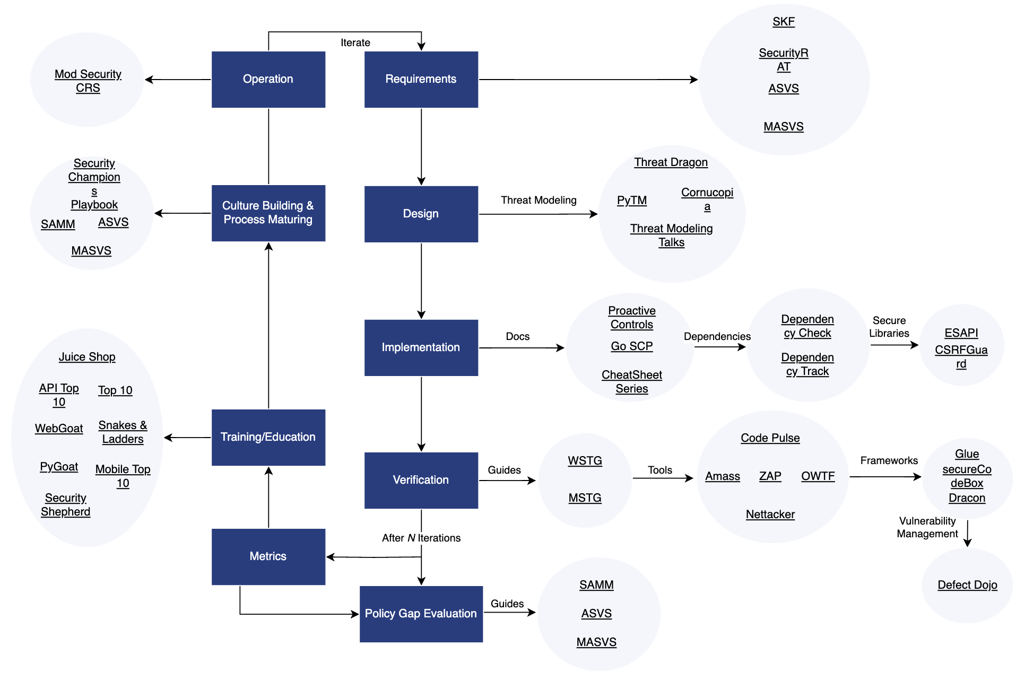
Notes:
Please choose an upcoming AppSec Global, and any local regional or chapter events

Slide 5
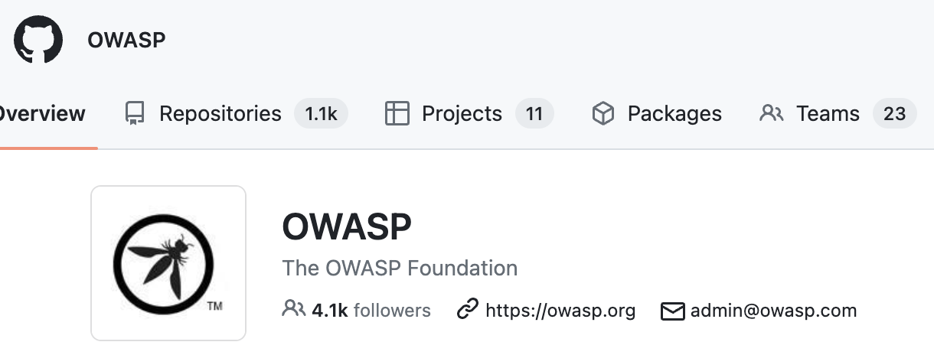
OWASP repositories
Mostly as code and documentation markup
Github OWASP organization github.com/OWASP
Over 1100 repos
Submit by pull request
Join the community!
Notes:
Please choose an upcoming AppSec Global, and any local regional or chapter events

Slide 6
Why do it?
For the pleasure of contributing to the open source community?
Opportunity to do that coding you always wanted to do?
Your company really needs that tool?
Respect from your peers?
Looks good on your CV?
Trust = credibility + reliability + intimacy + alignment
Notes:
Place the logo and their support level in this slide. It should be the only place in which it appears in a presentation

Slide 7
What is it like?
But the world can see my code!
  yes, but you are within a supportive community
How do I know what to do?
  every project has open issues with tags
Where can I start?
  the flagship projects are busy; try lab / incubator projects
Will it take over my life?
  maybe ;)
Notes:
Place the logo and their support level in this slide. It should be the only place in which it appears in a presentation

Slide 8

Case study: Developer Guide
Along with the OWASP Top Ten, the Developer Guide is one of the original resources published soon after OWASP was formed in 2001
Version 1.0 of the Developer Guide was released in 2002
Last version was 2.0 in 2005
Rebooted in 2023 with version 4.0
Notes:
Place the logo and their support level in this slide. It should be the only place in which it appears in a presentation

Slide 9
Developer Guide: contribute
“I am a developer; I need a reference source to navigate the numerous OWASP projects, which also provides an introduction to the activities that I am supposed to be doing”
Contributions welcome
Notes:
Place the logo and their support level in this slide. It should be the only place in which it appears in a presentation

