Slide 1
Your personal information exposed in under 2 minutes
D. Ivory, D. Gan
Cyber-SAFE Research Centre
University of Greenwich

Slide 2
Current Landscape
Twitter users = 328 million active users per month
Facebook = 1.94 billion users daily in first Q 2017
Instagram users is predicted to reach 83.6 million by 2018 in the US alone
60 million photos uploaded to Instagram per day
Careless posts to Twitter and Instagram
Users reveal information about themselves without thinking
Notes:
34bn people which is 37% of the worlds population now using some form of social media

Slide 3
Notes:
Birth certificate
Instagram

Slide 4
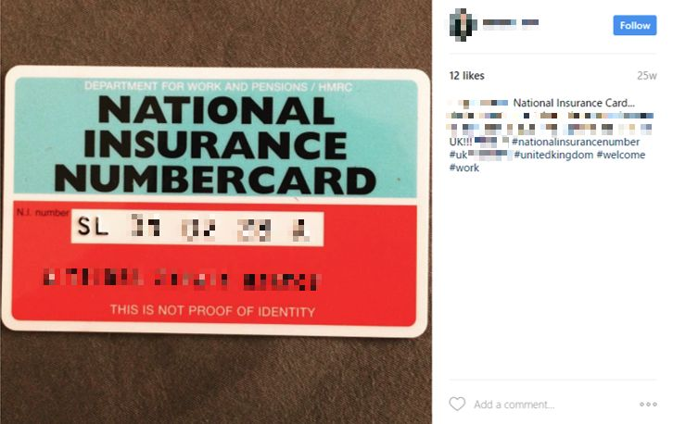
Notes:
National Insurance Number
Instagram

Slide 5
Notes:
UK Driving Licence
Instagram
name date and place of birth
Photo
Address
signature

Slide 6
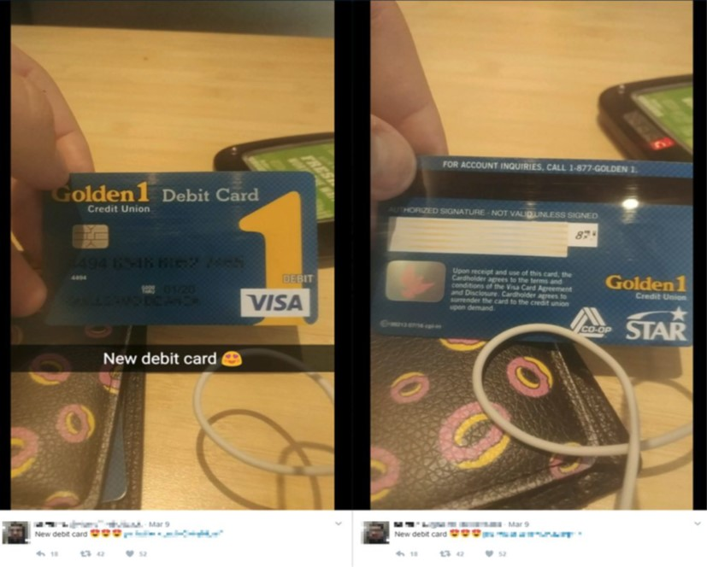
Notes:
New Debit Card
Front and Back
Twitter

Slide 7
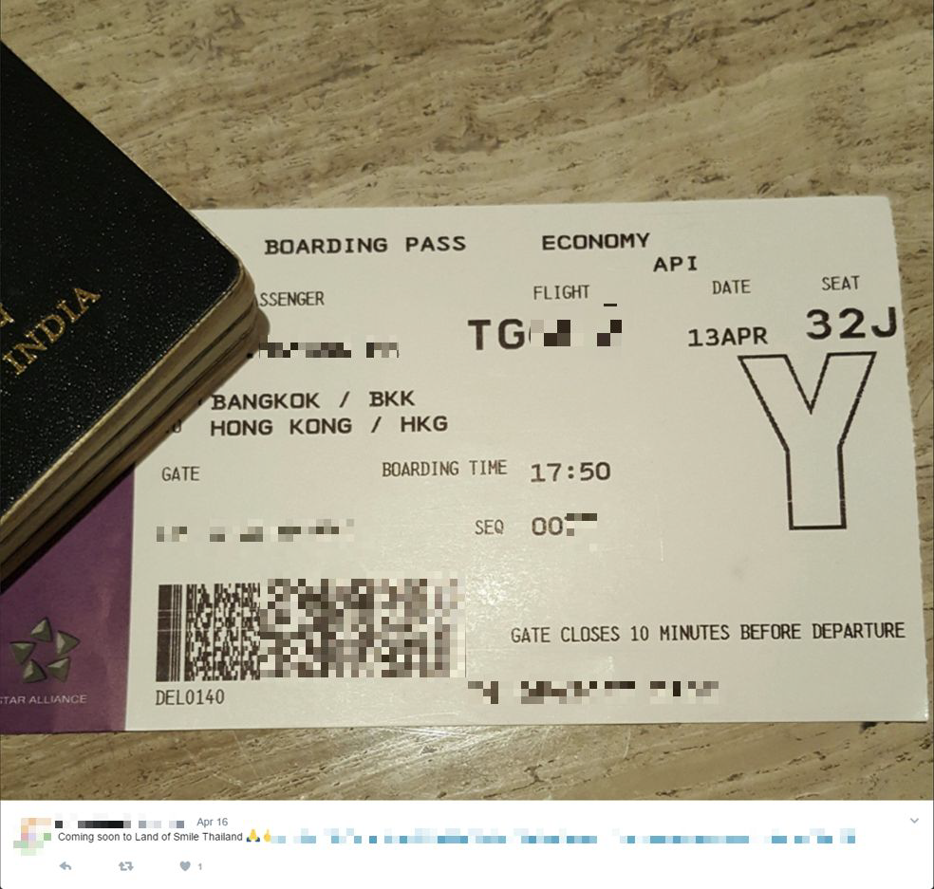
Notes:
Boarding Pass
Twitter
Barcode holds frequent flyer number
Which can allow for PIN or password resets

Slide 8
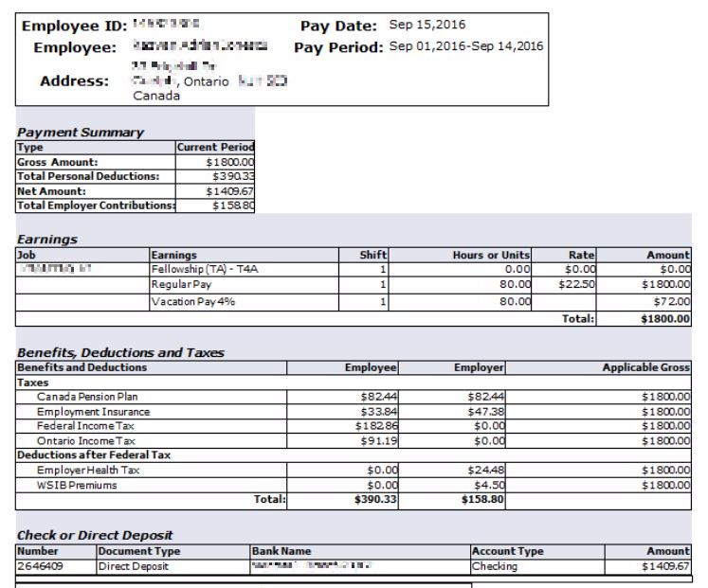
Notes:
Pay Slip
Docs.com
Income

Slide 9
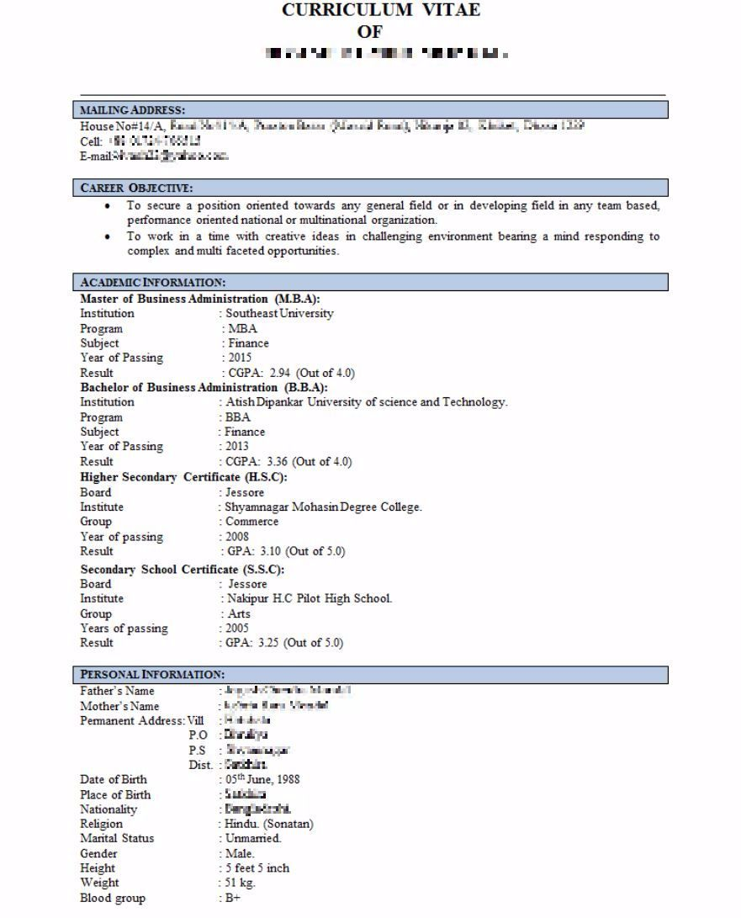
Notes:
Persons CV
Docs.com
Full Name
Mobile Number
Home Address
Date of Birth
Place of Birth
Religion
Nationality
Martial State
Gender
Height
Weight
Blood Group
Parents Names

Slide 10
The Survey
Aim of this work was to determine how individuals perceived their own online privacy and identify how accurate this was
Students studying at University of Greenwich Maritime campus were surveyed
Survey asked participants identify
what personal information they thought was freely available to others
what they thought was private
what information they have knowingly published
252 complete responses received
Notes:
Ethical approval for the work and the students were aware of it happening

Slide 11
The Survey
Survey created using Google Forms
The types of questions that were asked were:
Demographics
What information about yourself do you think can be found online by someone you have no connection with?
What information have you voluntarily published online?
Notes:
Demographics
- Male/Female
- Age
- Studying or not if yes what year
What information you think can be found from three perspectives
What information do you know you have published

Slide 12
Demographics
Year of Study | % of sample
1st year | 36.9%
2nd year | 22.5%
Final year | 32%
Master Degree, PhD student or a Researcher | 8.6%
largest group were in the age ranges 18 – 23
but included five people in the range 51 to 60
Notes:
Talk about age spread
AGE
18-19 26.20% 66
20-21 27.80% 70
22-23 22.60% 57
24-25 7.90% 20
26-30 6.70% 17
31-40 5.60% 14
41-50 1.20% 3
51-60 2% 5
61+ 0% 0

Slide 13
Demographics
146 female respondents (58.4%)
103 male respondents (41.2%)
43% of participants were on a computer orientated degrees
57% on other degrees
Social networks regularly used by participants
Facebook 86.5%
Instagram 69.4%
Twitter 48%
Tumblr 18.7%
used others 20%

Slide 14
The Investigation
Using only each subject’s first and last names
searches were undertaken using:
Google,
Facebook,
Twitter,
LinkedIn,
the BT Phonebook website
FindMyPast
information was found on 79% of survey respondents

Slide 15
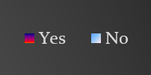
Survey Results
Full name DoB Home Pic Email Phone Family Visited Current

Slide 16
Information Revealed
Notes:
FULL NAME – Relatively easy to find
DOB – Hard to find, blue is partial so missing a part
HOME ADDRESS – potentially hard to find due to being students
PICTURE – Easy to find
EMAIL – Hard to find
PHONE NUMBER – hard to fined most found through LinkedIn and Facebook (Facebook account creating using mobile number) hard to find because don’t have land line
FAMILY – easy to find through Facebook – find through friend list one normalay has poor settings same surname
RECENT LOCATIONS VISITED – twitter
CURRENT LOCATION – Twitter
Other information found such as:
YouTube accounts + videos of the person
Snapchat accounts
Personal websites
Blogs
Blackberry messenger accounts
Skype accounts
Amazon recent orders and wish lists orders from the reviews which were for everything
Ask.fm anonymous questions asked and answered

Slide 17
Survey Results - Secondary Leakage

Slide 18
Survey Results - Secondary Leakage
Full name DoB Home Pic Email Phone Family Visited Current

Slide 19
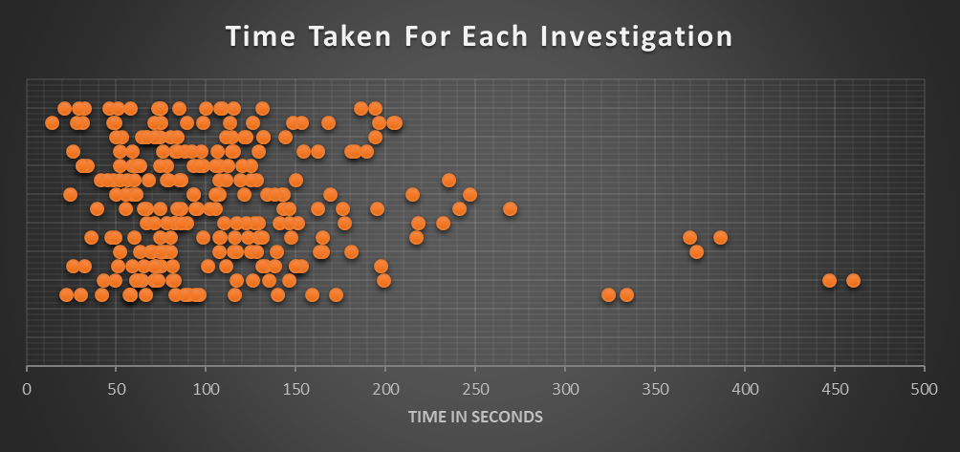
Time taken to reveal personal data
Searches were undertaken against the clock
average time taken for each search was 1 minute 49 seconds
Very few searches took longer than 200 seconds
Notes:
Red line is 2 minute mark
Average was 1:49
The longest time taken for an investigation was 460 seconds / seven minutes forty seconds

Slide 20
Time taken for the searches
fastest exploit took 14 seconds
full name
places that they had visited
longest time taken was 7 minutes 40 seconds
full name,
partial date of birth (incomplete),
exact home address,
picture
close family members names
Notes:
Longest one was a friend of mine, set myself a challenge of finding his information that’s why more time was spent
Some other reasons for longer time was due to coming from different countries

Slide 21
Time taken for the searches
Time Taken | Number Exploited
Less than 1 min | 48
Between 1 to 2 mins | 118
Between 2 to 3 mins | 57
Between 3 to 4 mins | 18
Between 4 to 5 mins | 3
Between 5 to 6 mins | 3
+ 7 minutes | 4
66% of the total number of participants in the survey had their personal details exposed in less than 2 minutes by someone who had no connection or link with them in cyber space
Notes:
Maybe live demo
Facebook before and after logging in
bemo@ethersports.org
!”£123Password
Start with Facebook – look at family and other connections
Talk about other profiles
192.Com - first profile - Sittingbourne from family on facebook – rough age – parents full names
Find my past – if paid for service look at birth certificate record

Slide 22
Conclusion
Still issues with personal online privacy
Mainly due to lack of awareness of online privacy
These results have shown that the majority of people participating in the survey did not perceive their online privacy accurately
Notes:
Other notes:
Students emailing Diane instead of me 9 in total. Unware of who was emailing them or who they were replying to

Slide 23

Questions?

