Slide 1




Navigating Brexit and GDPR 25th January 2017 Paul Rowley Head of Information Services Havebury Housing Partnership

Slide 2
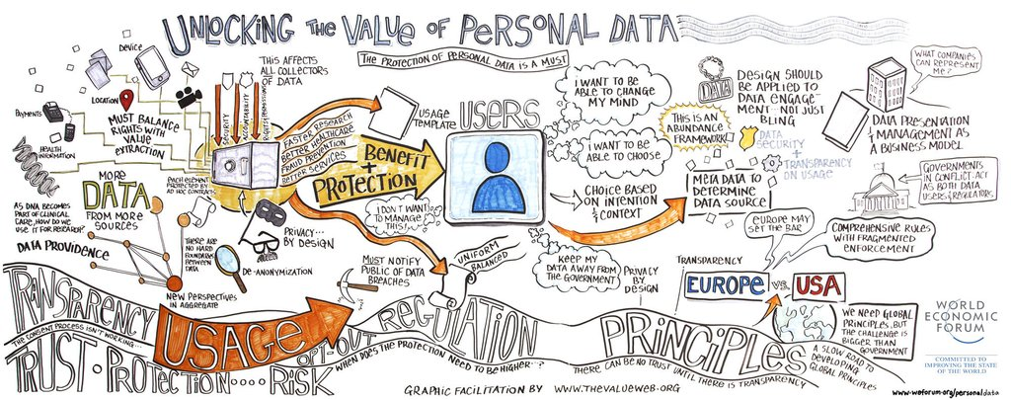

The Rosetta Stone of Data Protection

Slide 3
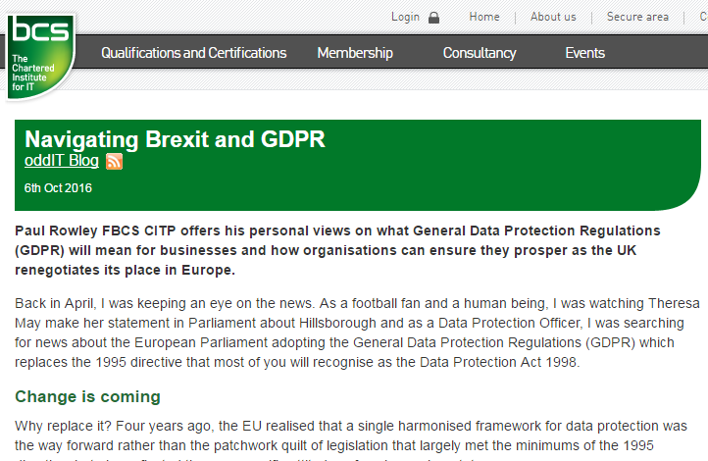

Slide 4
“Government promises £2bn extra R&D investment”
Theresa May
21 November 2016
“Post-Brexit UK success depends on securing benefits of the digital age”
Antony Walker, CEO, TechUK
17 January 2017
"We could have led on the Digital Single Market, but instead we will be having to follow. The Government must address this situation, to stop investor confidence further draining away, with firms relocating into other countries in Europe to take advantage of the Digital Single Market“
House of Commons
July 2016
"Our primary conclusion is that the UK’s future success outside the EU will be underpinned by our choices on major digital issues“
British Computer Society
November 2016

Slide 5




Digital Single Market
Function
Protection
Digital
Single
Market
GDPR
NIS

Slide 6
Do we need to follow GDPR?
Yes!
Up to when we leave. And then…
“If you are doing business in Europe, whether that is selling to European customers, accepting their membership signups, or collecting data on them for professional purposes, you need to be in full compliance with GDPR”

Slide 7
Do we need to follow GDPR, if we don’t do business in Europe?
Yes!
Existing UK Data Protection Act nearly 20 years old
GDPR responds well to current needs – nothing fundamentally wrong with it at all
We need to be mindful of the Digital Single Market

Slide 8
Is data protection all about GDPR?
No!
Think about the role you play

Slide 9

Cultural change is vital

Slide 10
Why do we collect personal data?
To service the contract you have with customers
To make better decisions about your business
To invite them or others to buy more from you
Demand
Request
Beg or Mislead

Slide 11
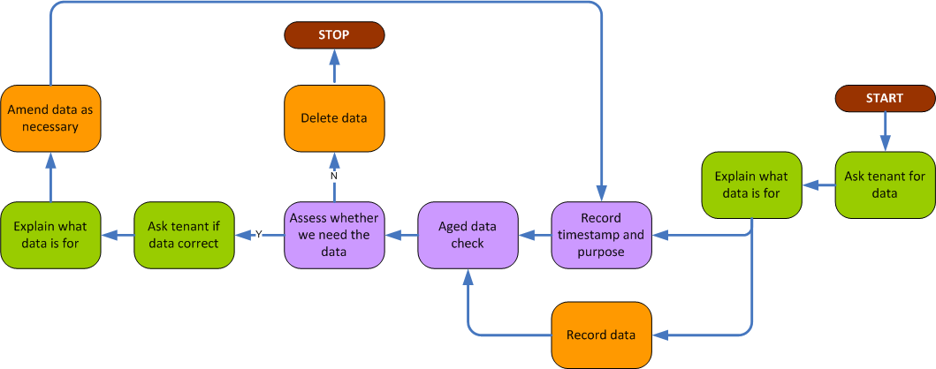
Personal data lifecycle

Slide 12
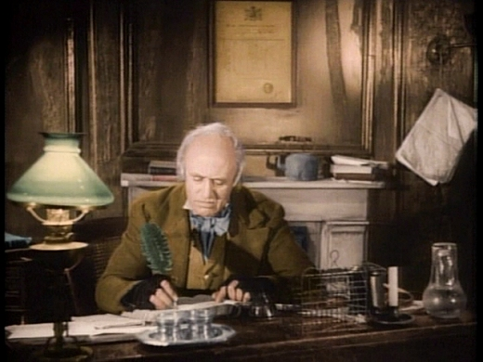
We all have Finance departments

Slide 13

What is ‘Data Protection’ culture?

Slide 14
Digital Economy Bill
Capability
Assurance
Digital
Economy
Bill
Culture
GDPR
NIS

Slide 15

Thank you Paul Rowley, Head of Information Services paul.rowley@havebury.com 01284 722217
@PaulRowleyFBCS

