Slide 1
Myths and Truths: Cyber Threat Hunting and Intelligence in IoT Environments
Ali Dehghantanha; www.AliD.info; ALID@ALID.info

Slide 2
Who am I?
Nobody important, nobody special!
MC IIF and Dr. of SiC!
A classical career track (software developer, security analyst, forensics investigator, higher education, next?)
Blog: www.alid.info
Twitter: @alidehghantanha
Email: AliD@AliD.info
Goal: just to enjoy having a conversation!

Slide 3
What We Do?
Applied research in collaboration with EU-wide LEAs and SMEs in cyber security, forensics and malware analysis.
Some of our recent projects :
Automated detection of Crypto Ransomware in Android mobile devices based on energy consumption footprints
Machine learning aided Android malware analysis
Automated detection of compromised ATM machines based on their encrypted network communication
An anomaly-based intrusion detection and threat hunting in IoT backbone networks

Slide 4
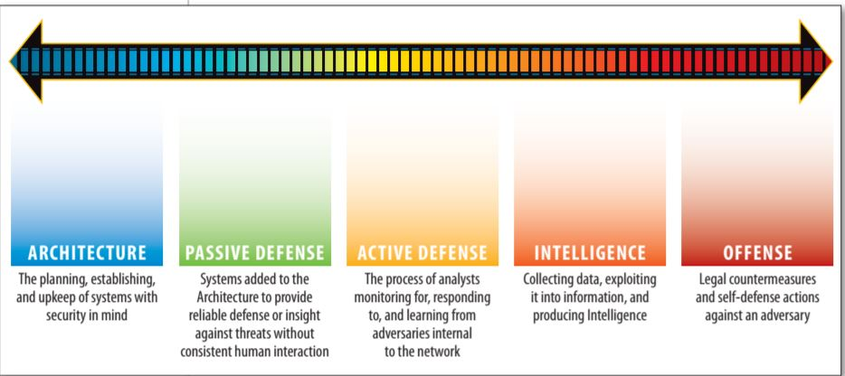
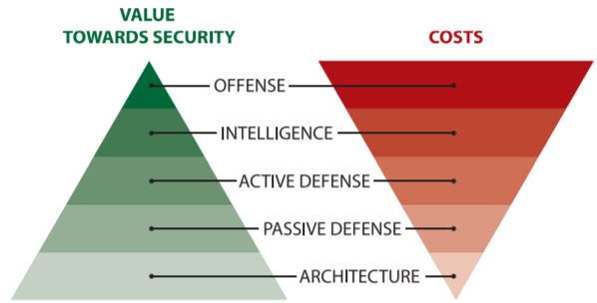
The Sliding Scale of Cyber Security
Image Source: Rob M Lee, Dragos Security

Slide 5
Where to Invest?!

Slide 6
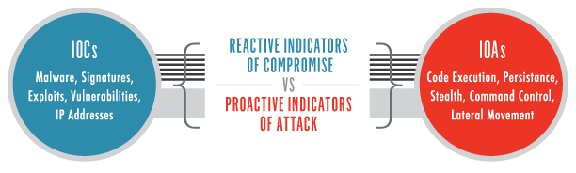
IoCs, IoAs are NOT not Snort Rules!
Use IoCs to scope and hunt with IoAs but NOT for detection! And throw them away after their short life time! Do NOT treat your IoAs/IoCs as Snort rules!
CTI is very valuable BUT nothing costs more than bad intel driving your processes!
The future of industry is in Cyber Threat Analytic – finding attackers pattern of activities
Malicious patterns are always malicious regardless of tools or techniques!

Slide 7

IT Security View of IoT/ICS Security
IoT/ICS environments are not having as many users and not so many changes/update – so should be easy to secure, right? Just do following:
Deploy Anti Virus on your IoT/ICS network!
Change default password and make more complex customized password
Secure programming
Patch IoT/ICS devices (i.e. through HMI or automatically)

Slide 8
AVs in ICS/IoT?
Does your AV scans ICS folder path; ICS processes and ICS Registry path? I bet not or better not!
The AV is not protecting ICS portion of your network!

Slide 9
IoT/ICS Secure Programming Myth!
Unless you do it, you won’t know it!
Unknown input format
Unknown deployment context
Unknown date of first deployment
Should have no functionality flaw!
So many recovery options!

Slide 10
IoT & Complex, Unique Password
Which one is more risky:
Your ICS operator can not remember the password and since the password is changed, the vendor can not remotely connect too! So you can not timely recover a faulty controller and restore the operation.
Russian hackers found vendor password and remotely get access to your controller?

Slide 11
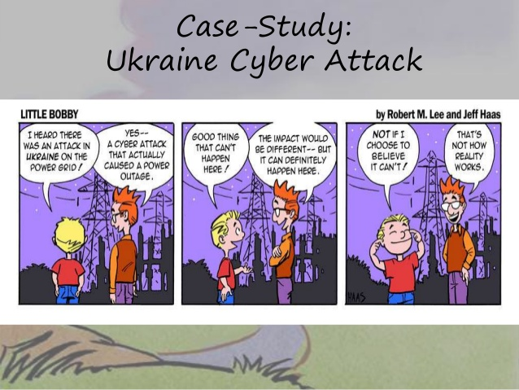
IoT/ICS Patching Curse!
What are we actually patching?

Slide 12
IoT/ICS Patching Curse!
90% of ICS vulnerabilities do NOT increase organisational risk (see: Dale Peterson research in S4)!
Remote access to HMI port and root privilege on PLC – so what?!
The big question is can you jump to other places in the network (the remaining 10%)?

Slide 13
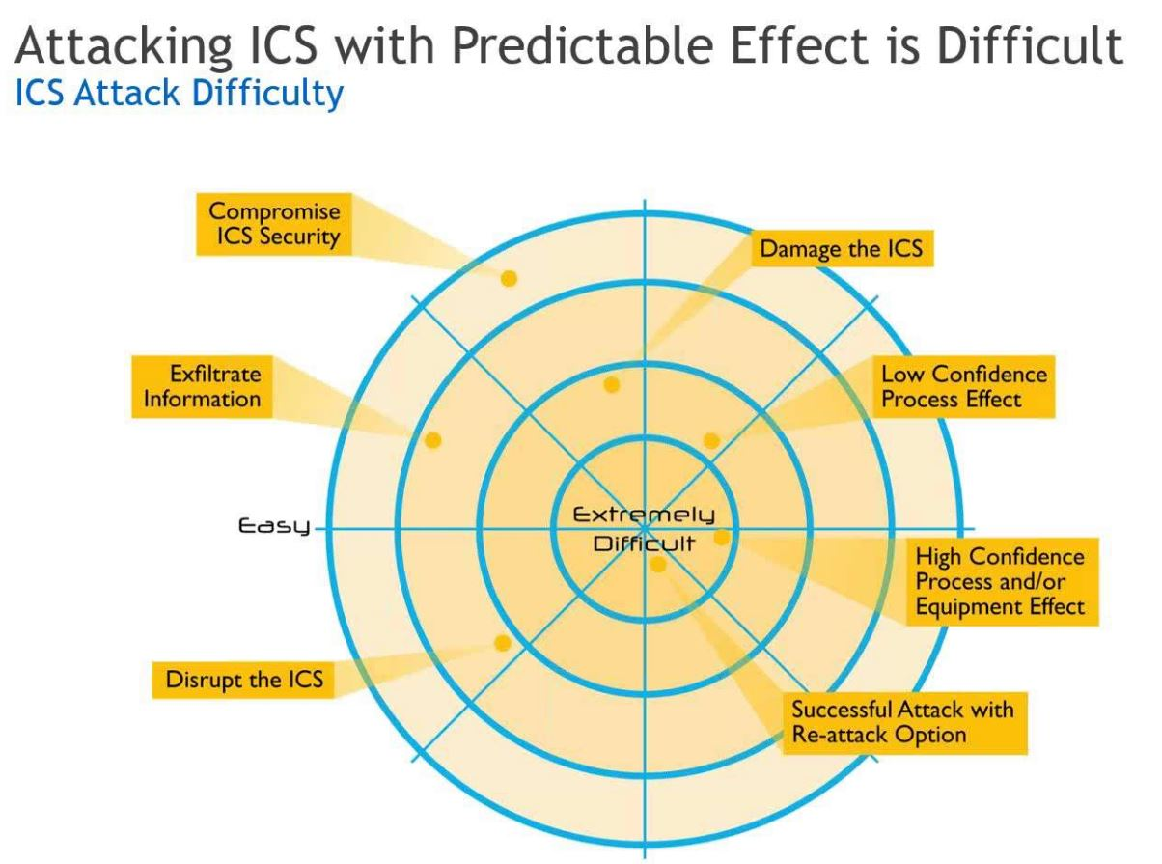
How Easy It Is to Attack IoT/ICS
Image source: Webinar: End-to-End Cyber Security Strategies: Protecting Critical ICS Assets

Slide 14
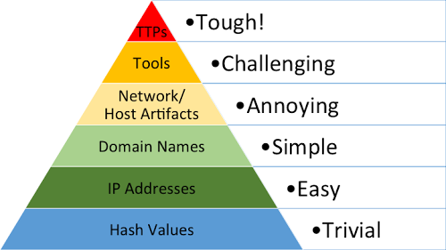
Pyramid of Pain!
Pyramid of Pain
(David Bianco- Mandiant)

Slide 15
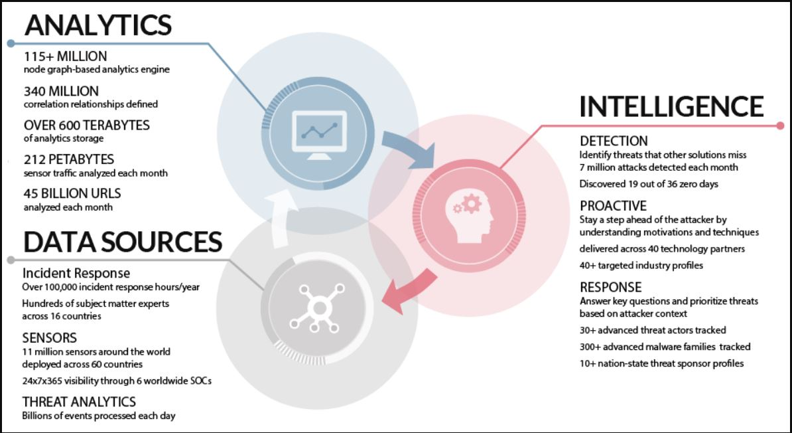
AI & Cyber Threat Pattern Intelligence in IoT
Image source: https://vpnservice.reviews/understanding-threat-intelligence-role-cyber-security/
IoT environments are having a huge number of nodes with very predictable (rarely changing) pattern of behaviour and (usually )the main purpose of compromise is pivoting to other nodes in the network (visible out of norm pattern!)
An ideal environment for AI agents!

Slide 16
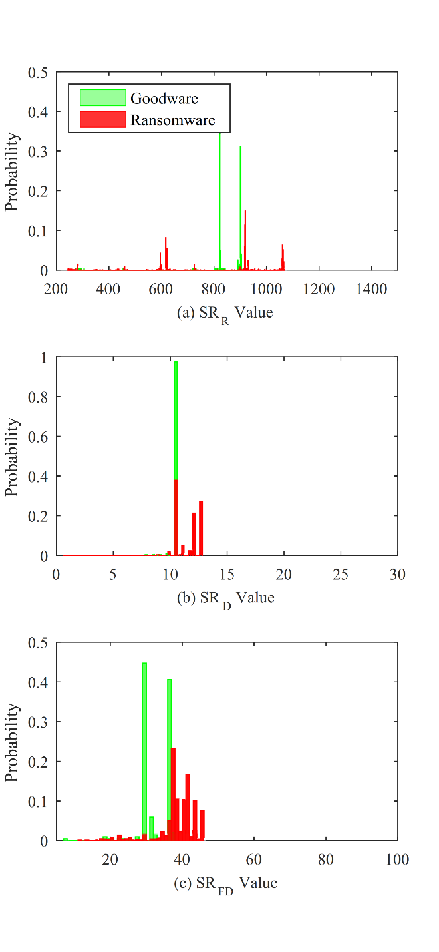
Case Study1: Detecting Ransomware Based on Abnormal Pattern of Activities

Slide 17
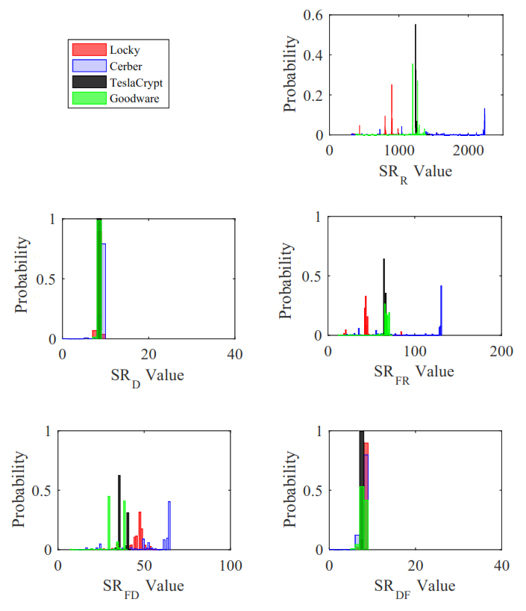
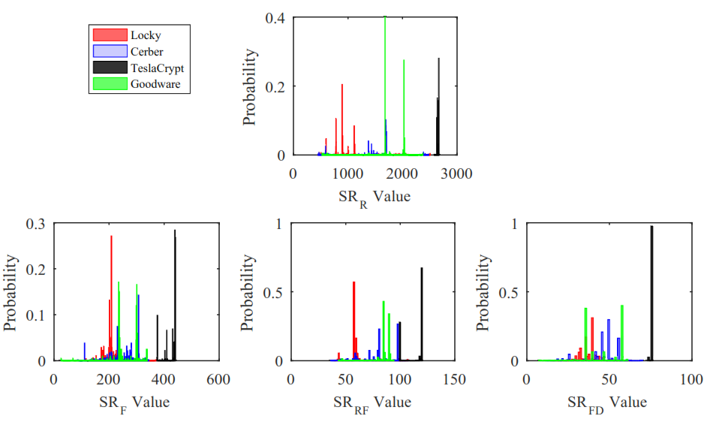
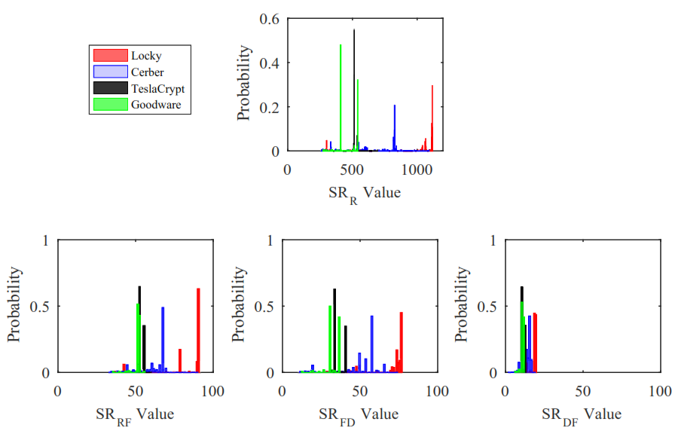
Case Study1: Detecting Ransomware Based on Abnormal Pattern of Activities
TeslaCrypt
Cerber
Locky

Slide 18
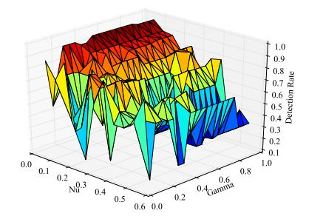
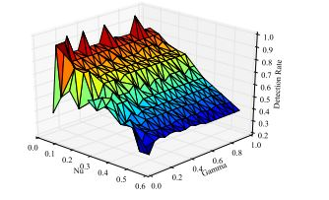
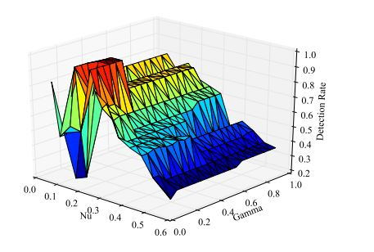
Case Study1: Detecting Ransomware Based on Abnormal Pattern of Activities
Cerber
TeslaCrypt
Locky

Slide 19
Case Study1: Detecting Ransomware Based on Abnormal Pattern of Activities
 |  | TPR | FPR | Accuracy
Ransomware Detection | Bagging (seen ransomware) | 0.994 | 0.039 | 97.7%
 | LSTM (unseen/new ransomware) | 0.996 | 0.001 | 99.6%
Family Detection | RandomForest | 0.983 | 0.006 | 98.3%
 | LSTM (unseen ransomware) | 0.972 | 0.027 | 97.8%

Slide 20
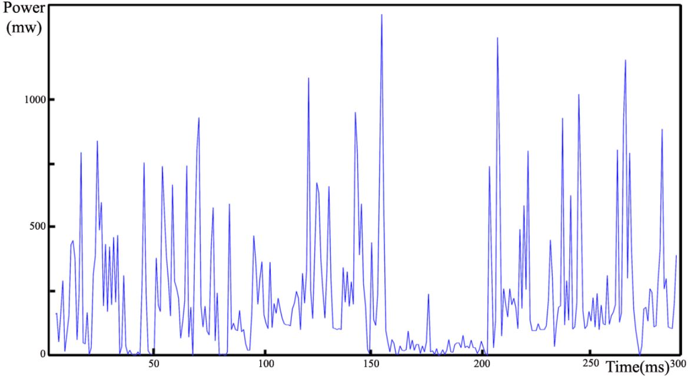
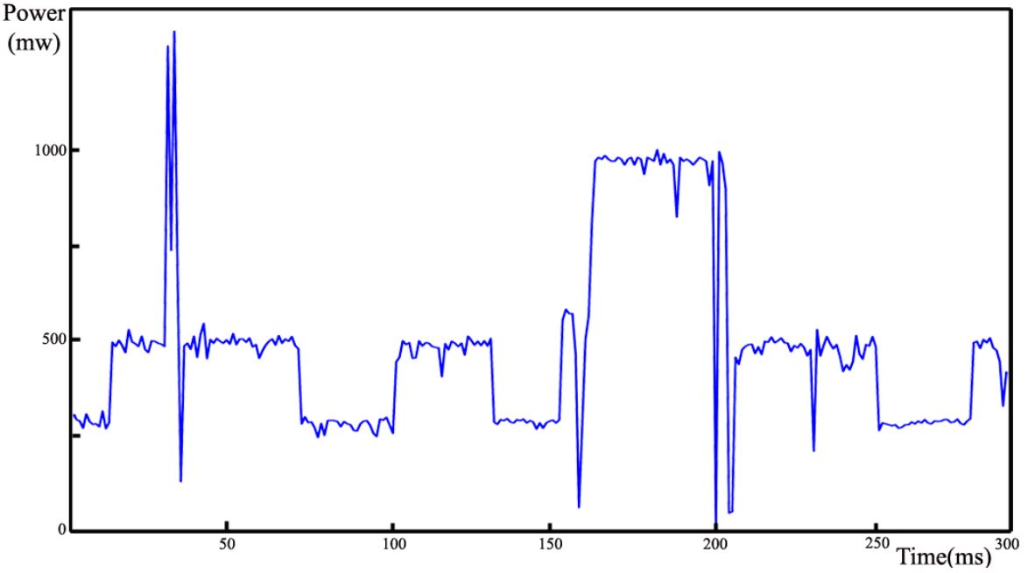
Case Study2: Detecting Ransomware on IoT Nodes based on Pattern of Power Consumption
raspberry pi power usage pattern with a normal application
raspberry pi power usage pattern when infected by a ransomware
 | Accuracy
KNN | 83.70%

Slide 21



Call for Arms
Regardless: We are looking for collaboration!

Slide 22
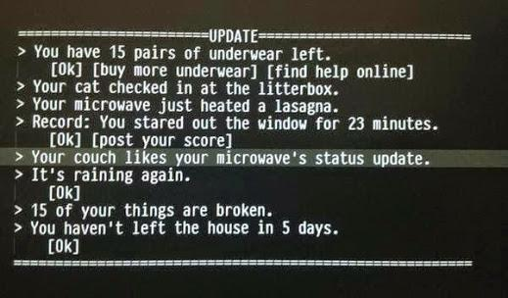
And Still IoT Devices are at Risk
Source: @bruces
“At one point, the penetration into the [US] Chamber of Commerce was so complete that a Chamber thermostat was communicating with a computer in China. Another time, chamber employees were surprised to see one of their printers printing in Chinese.”
21 Dec 2011 – ABC News!

Slide 23

Thanks!
Blog: www.alid.info
Twitter: @alidehghantanha
Email: AliD@AliD.info

