Slide 1


Cyber Skill Building
Toby Amodio
A/g CISO Australian Taxation Office

Slide 2
Acknowledgement to country
We wish to acknowledge the traditional custodians of the land we are meeting on, the Ngunnawal people. We wish to acknowledge and respect their continuing culture and the contribution they make to the life of this city and this region. We would also like to acknowledge and welcome other Aboriginal and Torres Strait Islander people who may be attending today’s event.
Cyber Skill Building – Toby Amodio

Slide 3
House keeping
The Open Web Application Security Project (OWASP) is an online community that produces freely-available articles, methodologies, documentation, tools, and technologies in the field of web application security
Canberra chapter has been on and off – Akshay and I have rebooted.
Intention is to have monthly sessions – alternating between speakers and social drop ins (all virtual at the moment).
Focus will be on web application security and promoting cyber security through people, process and technology.
We welcome speakers who would be interesting / interested.
Cyber Skill Building – Toby Amodio
Notes:
Disclaimer any opinions shared are those of my own and not those of my work place.
There are many benefits to membership including:
Discounts at our global and participating regional conferences
Training discounts
OWASP email address and Google Workplace access
Hands-on application security training through the SecureFlag Platform
Networking and directory access
Flexible online learning discounts
Professional mentoring programs
Exclusive, industry-specific offers

Slide 4
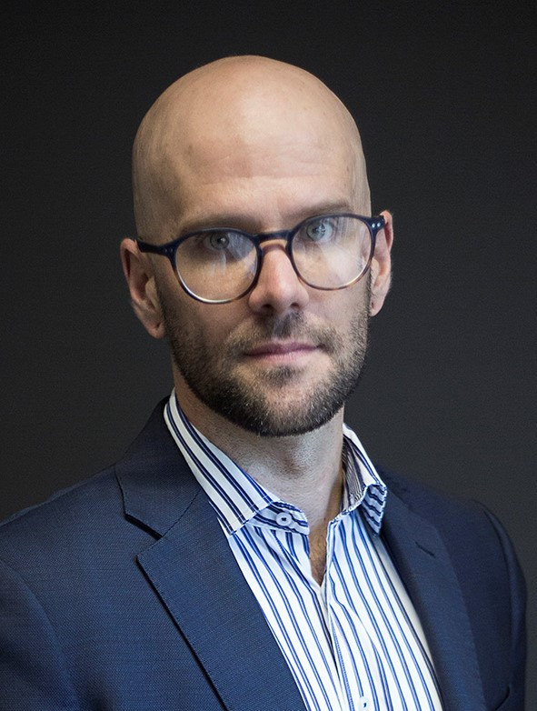
Who am I
Toby is a trusted public servant and leader with a proven history of building strong capabilities aligned to tomorrows challenges. He has led large, diverse and geographically dispersed teams of over 120 security professionals to protect, detect and respond to cyber challenges. He is a people focused leader with a deep technical background with achievements that include establishing the first Strategic Security Architecture for the Australian Taxation Office. He is proven to deliver, has a relentless drive for improving his teams and is laser focused on building enduring effective relationships.
****
10+ years cyber experience | Acting CISO | CISM | CISA | CDPSE
Heavy metal tragic | Loves cats
Cyber Skill Building – Toby Amodio

Slide 5
Agenda
Cyber Skill Building
You
Your team
Your Organisation
Questions
Cyber Skill Building – Toby Amodio

Slide 6

You
Baseline your IT knowledge
Align your knowledge plan to your goals
Incorporate your cyber learning into your role
Certifications
Continual Learning
Cyber Skill Building – Toby Amodio

Slide 7
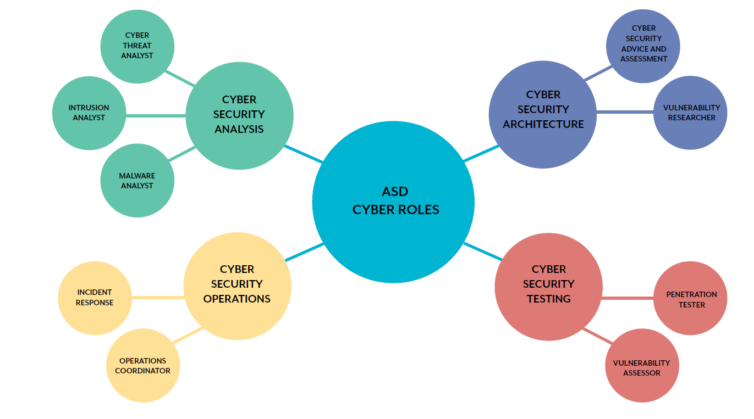
Cyber Skill Building – Toby Amodio

Slide 8
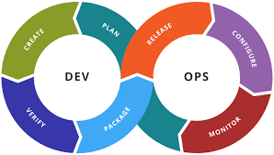
Your Team
Baseline the capabilities within the team.
Align the skills investment to the field you work in.
Nourish subject matter experts (we cant all be best at everything)
Invest in continual learning to maintain currency
Ensure team diversity to avoid
Shift Security Left
SEC
Cyber Skill Building – Toby Amodio
Notes:
TEAM – Together We Achieve More
Project Achilles

Slide 9
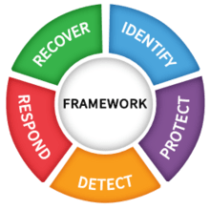
Your Organisation
Baseline the organisational cyber capability against a framework
Undertake gap analysis
Drive awareness outside of IT / cyber
Hygiene
Cyber Skill Building – Toby Amodio
Notes:
Cyber champions
Phishing training
Cyber sprints
Knowledge sharing sessions

Slide 10
Thankyou! Questions, suggestions and reflections!
Next Sessions
Please join our meetup group to stay updated on latest events. All Our Online events will be usually scheduled via Zoom and face to face events venues may vary. Please follow OWASP Canberra Chapter (this) page and OWASP Canberra Meetup Group page for more upto date details of all the events.
Event: Drop In Session - Canberra OWASP Online Meet and Greet Date: 16th Jun 2021 6:00 pm - 7:00 pm
Event: Online Presentation - Insights into Cyber Assessment - TBC Proposed Date: 21st July 2021 - 6:00 pm - 7:00 pm
Event: Drop In Session - Canberra OWASP Online Meet and Greet Date: 18th August 2021 6:00 pm - 7:00 pm
Cyber Skill Building – Toby Amodio

Slide 11
Resources
You:
https://owasp.org/
https://owasp.org/membership/
OWASP – YouTube - https://www.youtube.com › user › OWASPGLOBAL
https://www.isaca.org/
https://www.sans.org/
https://www.sans.org/cyber-security-career-roadmap
https://www.cyber.gc.ca/en/cyber-security-learning-pathways
Team
Project Achilles - https://rework.withgoogle.com/print/guides/5721312655835136/
Cyber games - https://cyberescaperoom.com.au/, https://www.mooveteam.com/market/hacked/
https://www.devsecops.org/blog/2015/2/15/what-is-devsecops
ASD Cyber Skills framework
Organisation
https://www.cyber.gov.au/
https://www.nist.gov/cyberframework
https://www.iso.org/isoiec-27001-information-security.html
Cyber Skill Building – Toby Amodio

Slide 12


Cyber is a team sport - Together wE Achieve More

