Slide 1
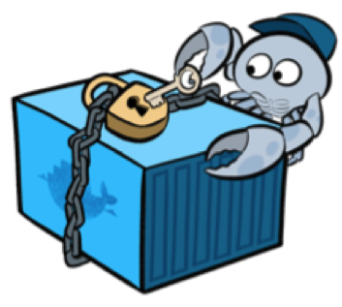
Container Security Unveiled: Understanding and Tackling OWASP Docker Top 10
Threat 8: Integrity of Images
Securing Containerized Environments for Robust Application Deployment
Arbind Shakya

Slide 2
About Me Arbind Shakya Security Researcher and Teaching AssistanT (Softwarica College) DevOps Enthusiast

Slide 3

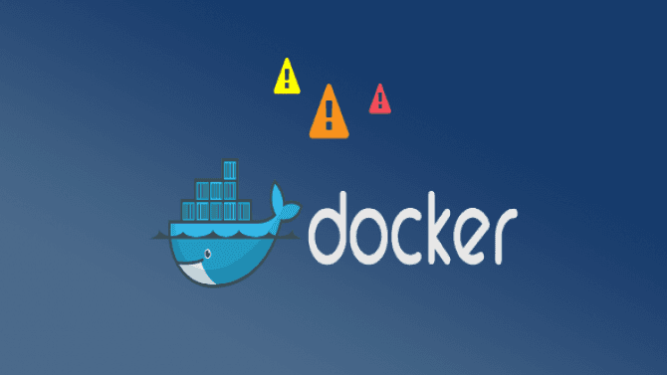
Agenda
Introduction to Containers and Container Security
Overview of OWASP Docker Top 10
Overview of Threats in Docker Environments
OWASP Docker Top 10
D01: Secure User Mapping
D02: Patch Management Strategy
D03: Network Segmentation and Firewalling
D04: Secure Defaults and Hardening
D05: Maintain Security Contexts
Conclusion

Slide 4
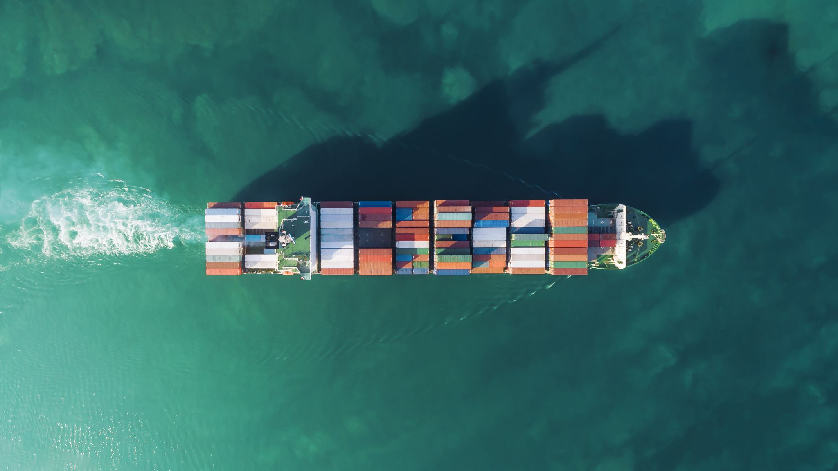
Introduction to containers and Container Security
Benefits of containerization: scalability, efficiency, and portability
The Need for Container Security
Vulnerabilities in containers can lead to unauthorized access, data breaches, and service disruptions

Slide 5
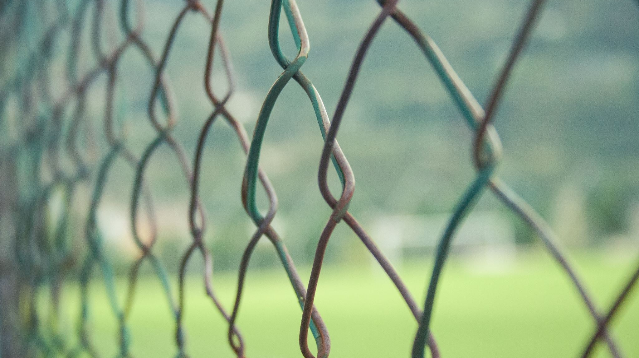
Isn’t docker secure by itself ?

Slide 6
Overview of OWASP Docker Top 10
OWASP Docker Top 10 focuses specifically on the security challenges and vulnerabilities associated with Docker containers
Objectives and Value of OWASP Docker Top 10

Slide 7

Threat Modeling
Introduction to Threat Modeling
Threat modeling as an approach to securing environments by analyzing them from an attacker's perspective.

Slide 8
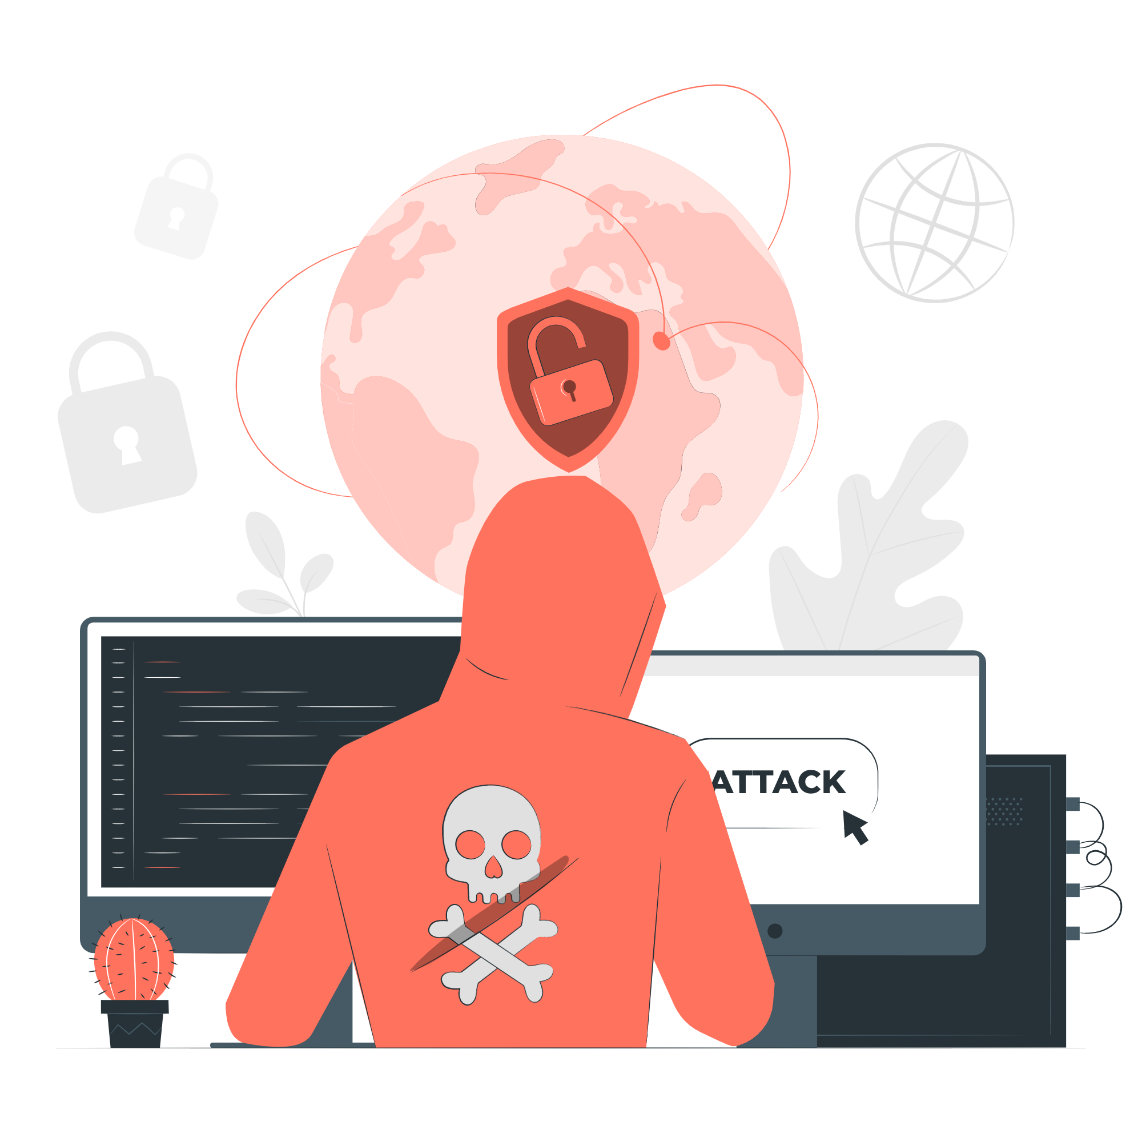
Overview of Threats in Docker Environments
Threat 1: Container Escape (System)
Threat 2: Other Containers via Network
Threat 3: Attacking the Orchestration Tool via Network
Threat 4: Attacking the Host via Network
Threat 5: Attacking other Resources via Network
Threat 6: Resource Starvation
Threat 7: Host compromise
Threat 8: Integrity of Images

Slide 9
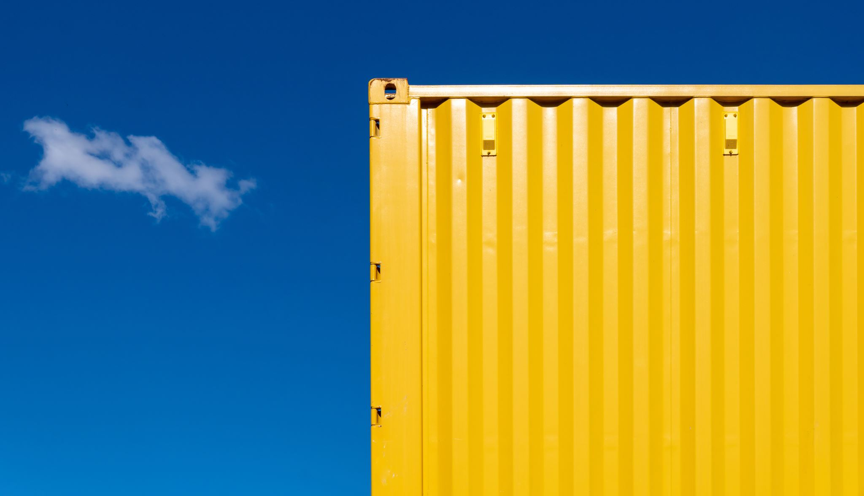
OWASP Docker Top 10
Secure User Mapping
Patch Management Strategy
Network Segmentation and Firewalling
Secure Defaults and Hardening
Maintain Security Contexts
Protect Secrets
Resource Protection
Container Image Integrity and Origin
Follow Immutable Paradigm
Logging

Slide 10
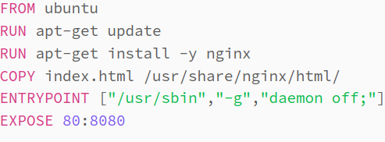
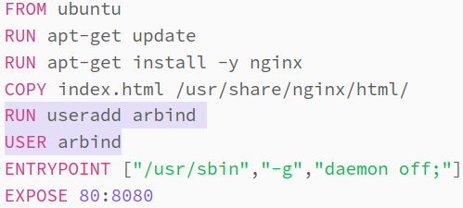
D01 Secure User Mapping
Threat scenario
While running the container as privileged user, if the microservice has vulnerabilities, an attacker who exploits them could have full privileges within the container.
Prevention measures
Avoid using the --privileged flag
Configure your container to run the microservice under a non-root user
Use of namespaces
If a binary in the container requires root privileges for specific tasks, consider granting it only the necessary capabilities using the setcap command, rather than running the entire container as root
How to find out
Check configuration or build file of the container
Check the value for Config/User key while using docker inspect

Slide 11

D02 Patch Management Strategy
Patch Management Strategy is often the task of an ISO.
Patch Domains
Images: the container operating distribution
Container software: eg. Docker
Orchestration software: eg. Kubernetes
Host Operating System
Patching timely makes sure that your software you are using for your infrastructure is always secure and you avoid known vulnerabilities.
Define a patching strategy for each component and handle regular and emergency patches. Automate the patching process as much as possible. Execute patch cycles and monitor their success and failures. For critical vulnerabilities, define a policy for emergency patches that need to be applied promptly.

Slide 12
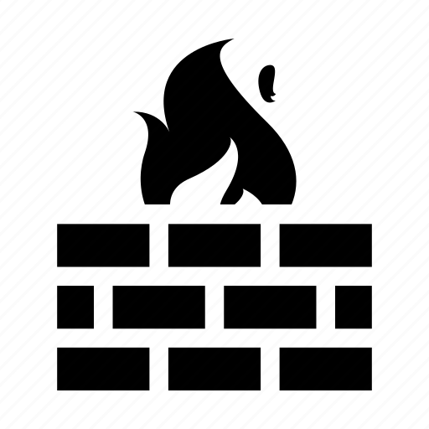
D03 Network Segmentation and Firewalling
Threat scenario
Containerization revolutionized networking, erasing traditional zone divisions and enabling microservice communication, but also introducing security risks like exposed management interfaces, unnecessary service exposure, shared networks between tenants, and potential host network access for attackers.
Prevention measures
Implementing a multi-layer network defense with whitelisted communication, proper network planning, segmenting the DMZ, separating tenant networks, protecting management frontends/APIs, and securing the host through whitelisting.
How to find out
Use of nmap from different source IPs

Slide 13
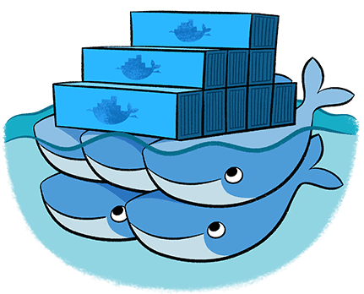
D04 Secure Defaults and Hardening
Threat scenario
The threat scenarios for secure defaults and hardening involve services running in three domains:
interfaces from the orchestration tool
interfaces from the host
interfaces within the containers
Prevention measures
For Orchestration Tool Know what service is running and whether it is protected properly or has a weak default configuration | For the Host Pick the right distribution, and install a minimal distribution | For the Container Do not install unnecessary packages

Slide 14
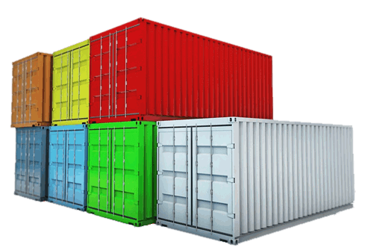
D05 Maintain Security Contexts
Threat scenario
The threat scenario involves mixing containers with different security contexts or statuses on the same host. This can lead to potential security risks, especially when containers with lower security levels are deployed alongside containers with higher security levels.
Prevention measures
Separate Production Containers
Context-Based Separation
Use Virtual Machines (VMs)
How to find out
System Architecture Review

Slide 15
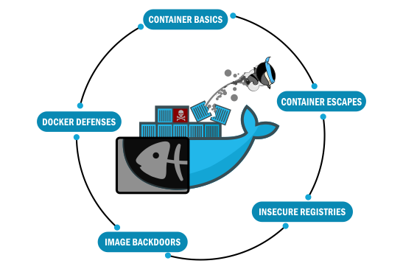
Conclusion
Significance of Container Security
Value of the OWASP Docker Top 10 as a framework for identifying and mitigating common container security risks
Actionable steps for enhancing container security, such as implementing security best practices, conducting regular vulnerability assessments, and staying informed about emerging threats

Slide 16

Any QuestionS?

Slide 17
References
https://github.com/OWASP/Docker-Security https://owasp.org/www-project-docker-top-10/ https://docs.docker.com/engine/security/ https://wiki.owasp.org/index.php/Security_by_Design_Principles#Principle_of_Least_privilege https://www.bmc.com/blogs/docker-security-best-practices/ https://www.section.io/engineering-education/best-practices-to-secure-a-docker-container/ https://youtu.be/k90Zq5xjtqQ https://docs.docker.com/develop/develop-images/dockerfile_best-practices/

Slide 18

Thank YOU

