Slide 1
The Art of evasion and detection
Samip Pokharel

Slide 2
#WhoAMI
@maskop9
-ECXD, EWPTXv2, CSA
Security Analyst @ Cotiviti
-Internal Pentests, Purple Teaming.
Faculty @ Softwarica
-Reverse Engineering / Exploit Dev

Slide 3
Introduction
Explore the techniques employed by attackers to bypass defenses.
Explore difficulties in detection of spear phishing.
Explore difficulties in detection of lateral movement.

Slide 4
Spear phishing
Type of phishing campaign that targets a specific person or group and often will include information known to be of interest to the target. Spear phishing has grown in complexity, making it crucial for us to understand its intricacies to safeguard against potential breaches.

Slide 5
Spear Phishing (Evasion)
In this scenario, an attacker compromises your client to send you a spear phishing from sales@client.com with an html attachment to phish email credentials.
The html file contains contents(images, fonts and style sheets) from genuine email page like outlook.
It contains a heavily obfuscated JS which sends the login form data to application/services controlled by the attacker.
The attacker-controlled application/service acts as a reverse proxy which lures the victim to provide MFA token and authenticates the victim and steal cookies and session token.

Slide 6
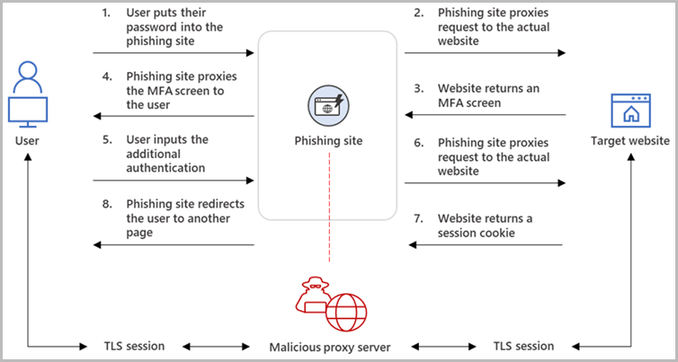
Spear Phishing (Evasion)
Reverse Proxy:

Slide 7
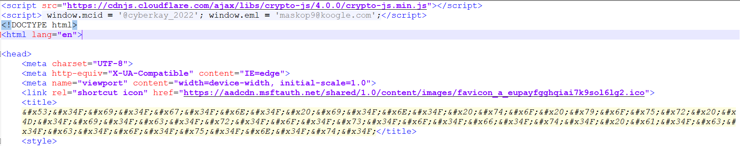
Spear Phishing (Evasion)
Example:

Slide 8
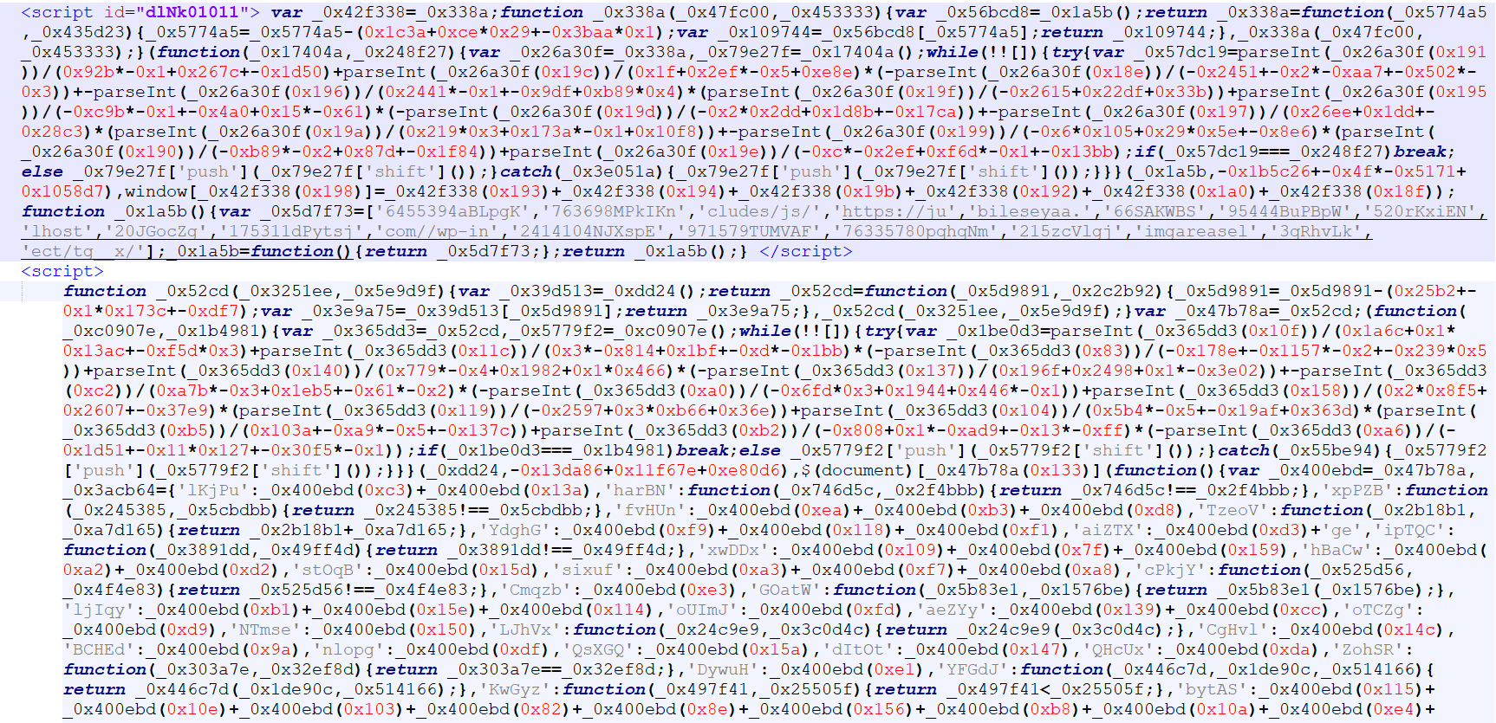
Spear Phishing (Evasion)
Example:

Slide 9
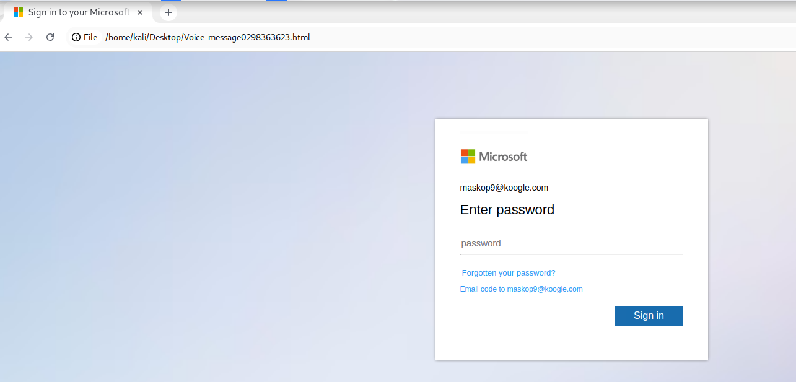
Spear Phishing (Evasion)
Example:

Slide 10
Spear Phishing (DETECTION)
Spear-phishing emails usually contain no malware and are almost never spam, which is why they often easily bypass traditional security mechanisms.
Tools | Detection
MailServer(SPF-Sender Policy Framework, DKIM-DomainKeys Identified Mail ) | NONE
Email Security Gateway | NONE
Attachment Analysis (EDR) | NONE
Web Gateway (Proxy) | NONE

Slide 11
Spear Phishing (Detection)
Education and Awareness.
Verify URL.
Be cautious of urgency and threats.
Analyze and verify email content.
Check links and attachments.
Verify requests for personal information.
Donot provide sensitive information on local html files.

Slide 12
Lateral Movement
Technique used by an attacker to move horizontally across a compromised network. Once an attacker gains initial access to a system or network, they attempt to escalate privileges and move laterally to other systems or accounts within the network, searching for valuable information or expanding their control.

Slide 13
Lateral Movement
Scenario: Penetration test of XYZ organization with matured Security Posture with proper SOC.
GitHub Recon -> disclosed credentials
Valid credentials -> LSASS dump
LSASS dump -> local admin NTLM
Local admin NTML password spray -> pwned multiple servers
LSASS dump -> svc_abcd password
svc_abcd -> Enterprise admin privilege
svc_abcd -> Dump NTDS.dit
Entire Organization compromised.
***No single alert triggered***

Slide 14
HOW?!

Slide 15
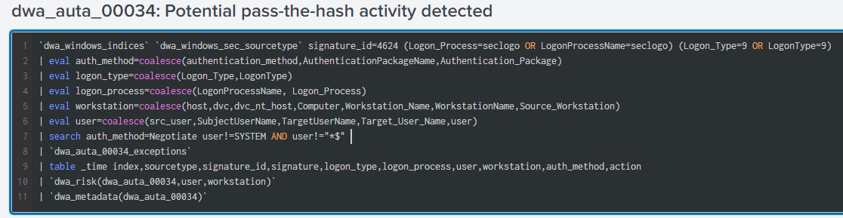
Lateral Movement
Pass-the-Hash
Pass the Hash (PtH) is a technique used in cybersecurity attacks where an attacker steals hashed passwords from one system and reuses them to authenticate on other systems without having access to the original plaintext passwords.

Slide 16
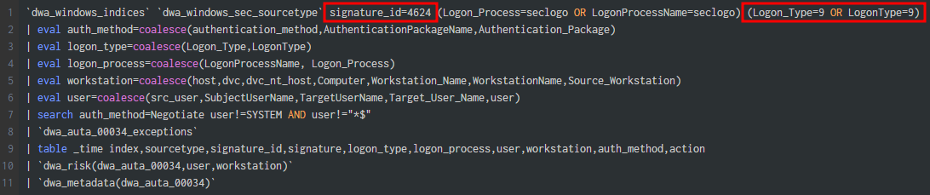
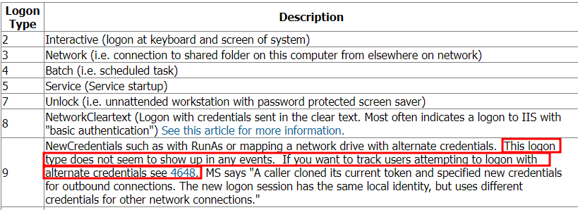

Slide 17
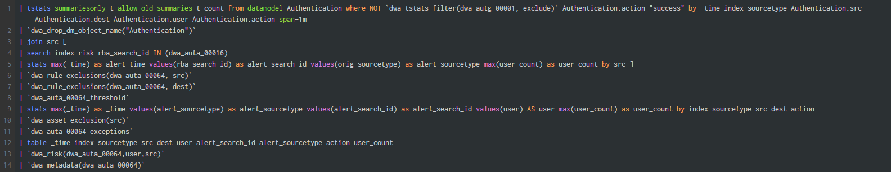
Lateral Movement
Password Spray
Type of brute-force attack that involves attempting a small number of commonly used passwords or a specific set of passwords against many user accounts.
Most rules donot detect brute-force(password spray) if attacker tries 1 credentials per device.

Slide 18
Lateral Movement
Password Spray
Type of brute-force attack that involves attempting a small number of commonly used passwords or a specific set of passwords against many user accounts.
Most rules donot detect brute-force(password spray) if attacker tries 1 credentials per device.

Slide 19
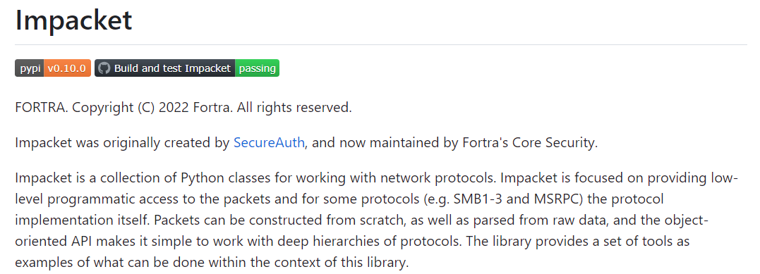
Lateral Movement
Impacket Scripts: (https://github.com/fortra/impacket)
Impacket is a collection of Python scripts and modules that provide a set of tools for interacting with network protocols, performing network reconnaissance, and exploiting vulnerabilities. It is widely used in the field of penetration testing, security research, and red teaming. Developed by Core Security Technologies, Impacket is designed to simplify the process of working with network protocols and building custom network-based security tools.

Slide 20
Lateral Movement
Impacket – secretsdump.py
Performs various techniques to dump secrets from the remote machine without executing any agent. For SAM and LSA Secrets (including cached creds) the tool will try to read as much info as possible from the registry, then save the hives in the target system (%SYSTEMROOT%\Temp directory) and then read the rest of the data from this location. For DIT files, it will dump NTLM hashes, Plaintext credentials (if available) and Kerberos keys using the DL_DRSGetNCChanges() method. It can also dump NTDS.dit via vssadmin.exe
Six events generated in Windows Security Logs.
Special Logon – 4672 (2)
Logon – 4624 (2)
Logoff – 4634 (2)

Slide 21
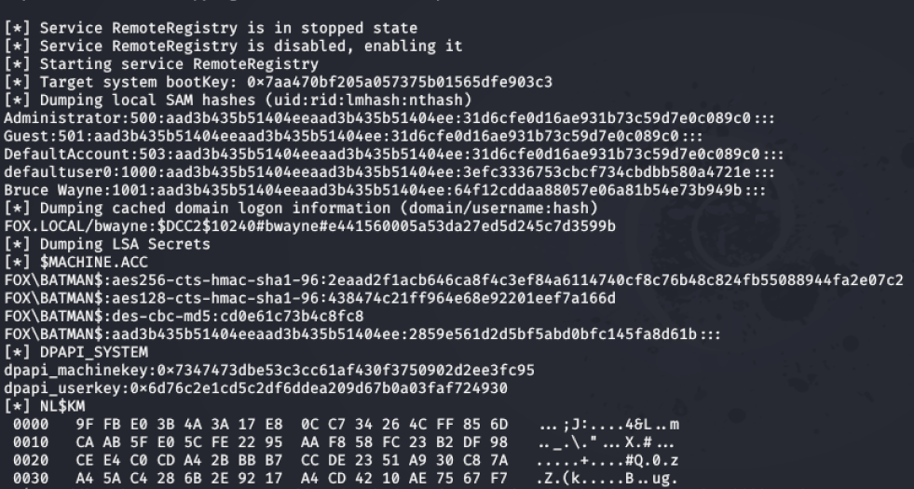

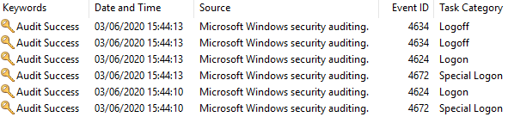


Slide 22
Lateral Movement
Mimikatz
Mimikatz is a powerful post-exploitation tool that allows attackers to extract credentials and perform various attacks against Windows-based systems, such as harvesting passwords and manipulating security protocols. It is commonly used in penetration testing and security assessments to demonstrate the vulnerabilities of systems and highlight the importance of robust security measures.
Nine events generated in Windows Security Logs.
Special Logon – 4672 (3)
Logon – 4624 (3)
Logoff – 4634 (3)

Slide 23
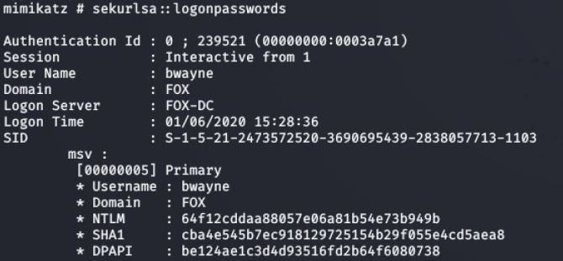
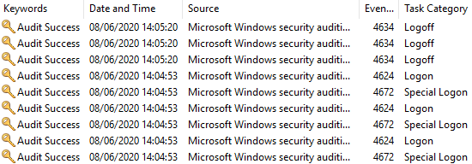

Slide 24
Lateral Movement
SMB Client
SMB client lets you list shares and files, rename, upload and download files and create and delete directories, all using either username and password or username and hashes combination.
Two events generated in Windows Security Logs.
Special Logon – 4672 (1)
Logon – 4624 (1)

Slide 25
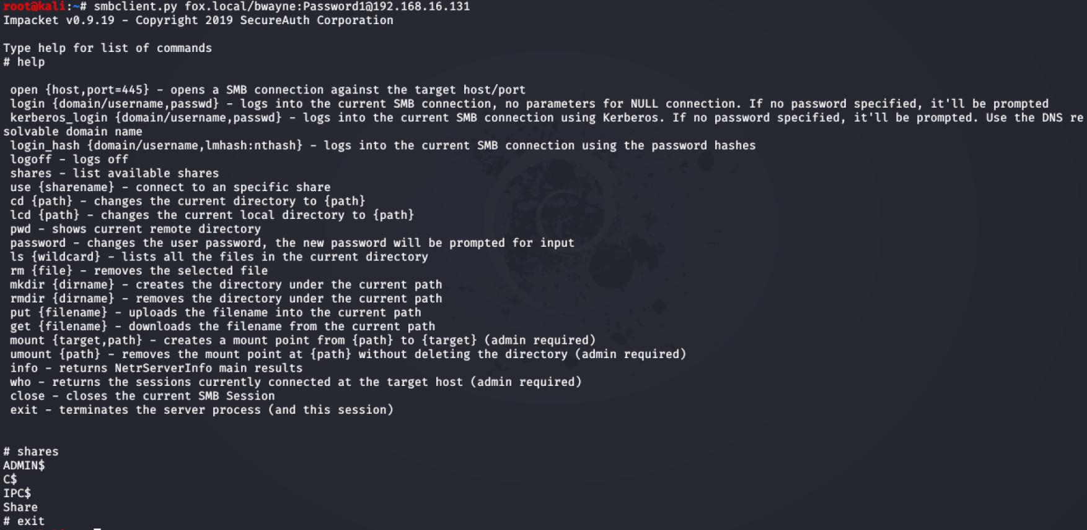


Slide 26
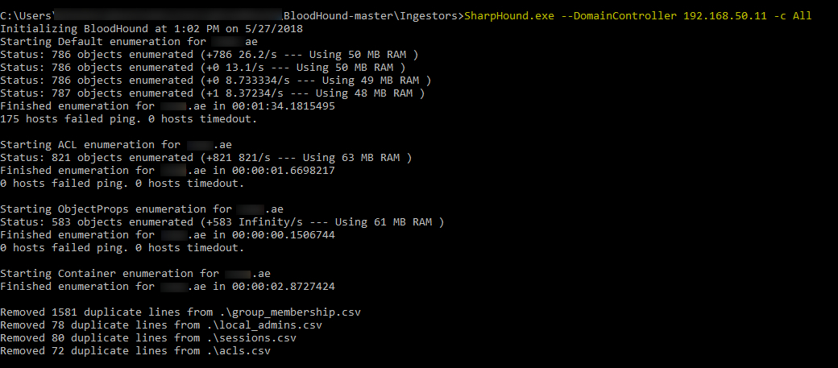
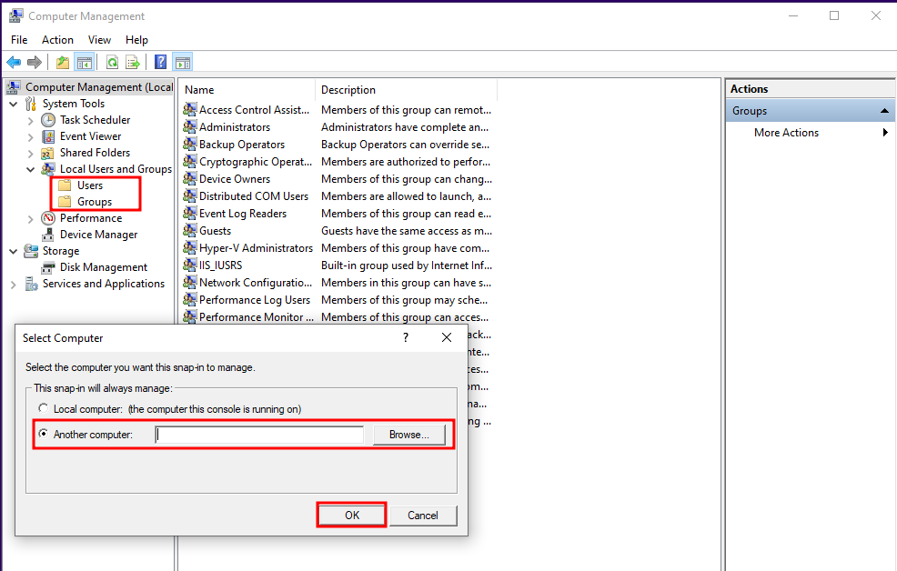

Slide 27
SUMMARY
Detecting spear phishing attacks can be a complex task that is not entirely foolproof, as attackers employ sophisticated techniques.
User Awareness plays an important role in mitigating spear phishing.
Leveraging behavioral detection and correlation methods can help identify lateral movement within a network, mitigating the challenges posed by potential false positives and enhancing overall security measures.

Slide 28
THANK YOU
Samip Pokharel
mas_kop9@protonmail.com
www.samipp.com.np

