Slide 1
About Me
Smaran Chand
AppSec Pentester @Eminence Ways Pvt Ltd
OWASP Kathmandu Leader
Microsoft Azure Security Engineer, AWS Security Specialist
Synack Red Team member, Occasional Bug Bounty Hunter
Noob Programmer, Tech explorer, Opensource Cybersecurity community contributor.
Interested in solving problems on earth.

Slide 2
Famous webapp with international customers.
Found misconfigured CORS but not lucky enough to exploit successfully.

Slide 3
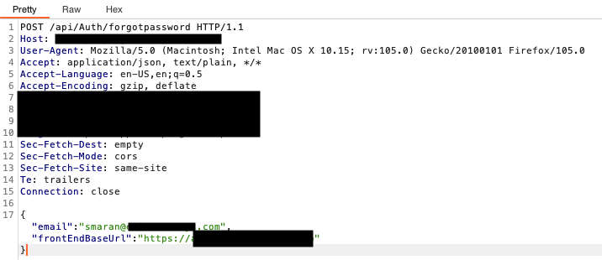
Seems Interesting, Right?

Slide 4
We pentesters love to tamper parameters.
Don’t we?

Slide 5
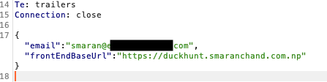

Changed and observed

Slide 6
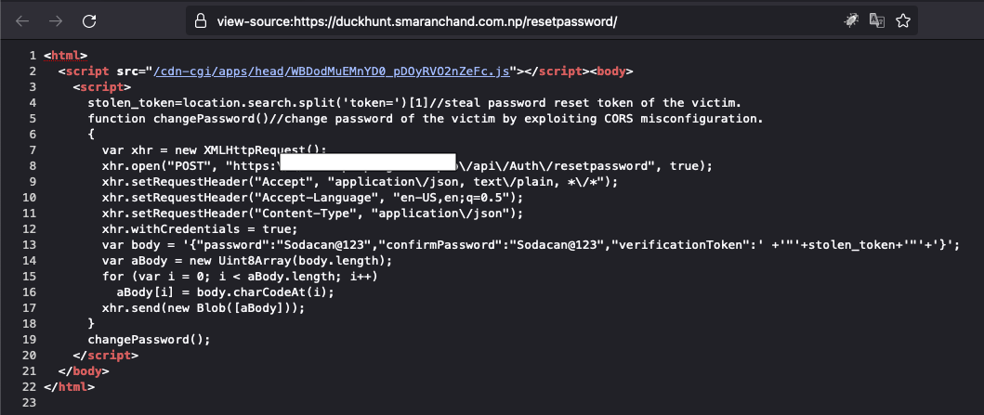
Exploit to steal the token and perform password reset of victim on a single click.

Slide 7
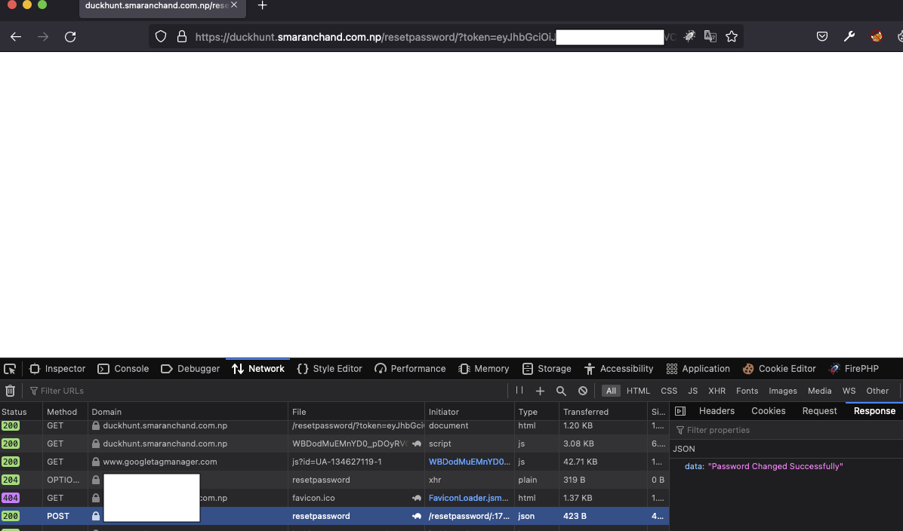
And it worked Magically

Slide 8

Account Enumeration
Got no luck with @vulnerablewebsite.com

Slide 9
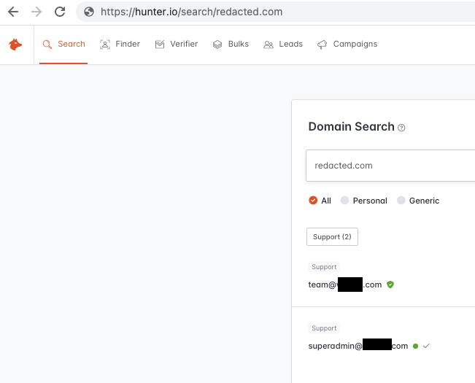
Found Parent company of an organization.

Slide 10
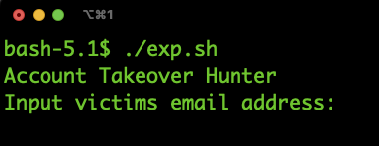
Wrote a simple script to deliver spoofed password reset link

Slide 11

And then I waited.

Slide 12
Waited again

Slide 13
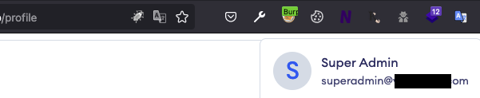
Admin Account Takeover

Slide 14
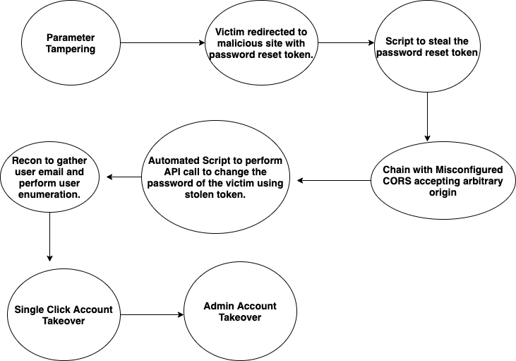
Scenario Explained

Slide 15
Chained Bugs
User Enumeration+No Rate limiting+ Misconfigured CORS/CSRF+Parameter Tampering = Single Click Account Takeover

Slide 16
Takeaways
Enforce Server Sided Validation/Do not expose unnecessary parameters at client side.
Security Headers are important.
Always look for the improvement.
Security Assessment of the product before public deployment is most ignored thing.

Slide 17
Thankyou
SinQ/CosQ

Slide 18


Questions?

