Slide 1
Recon like a pro
- Nirmal Thapa (@tnirmalz)

Slide 2
$ whoami
Nirmal Thapa (mpz)
Full time Security stuffs @ Cotiviti
Part time Bug Bounty Hunter and CTF player
Acknowledged by Apple, Facebook, Google, US DoD, Instacart, Grab, AT&T, Swisscom, Zomato, Coinbase, etc

Slide 3
Topics we’ll cover today
Infra recon (ASN, IP ranges, port scanning)
Reverse whois
Domain/Subdomain enumeration
Shodan Recon
Content discovery
VHOST Fuzzing
Hunting for secrets in android apps
Data leaks in code sharing websites (github, dockerhub, gitlab, codepen, pastebin, jsfiddle)

Slide 4
What is recon?
Short for “Reconnaissance”
From google – “military observation of a region to locate an enemy or ascertain strategic features.
In pentest & bug bounties – Understanding infra of the target, how things are setup, how the app works, finding possible entry points and so on.

Slide 5
Infra recon
ASN? Autonomous System Number
Big orgs like Google, Apple have their own ASN and IP ranges
Easy for us to map our targets

Slide 6
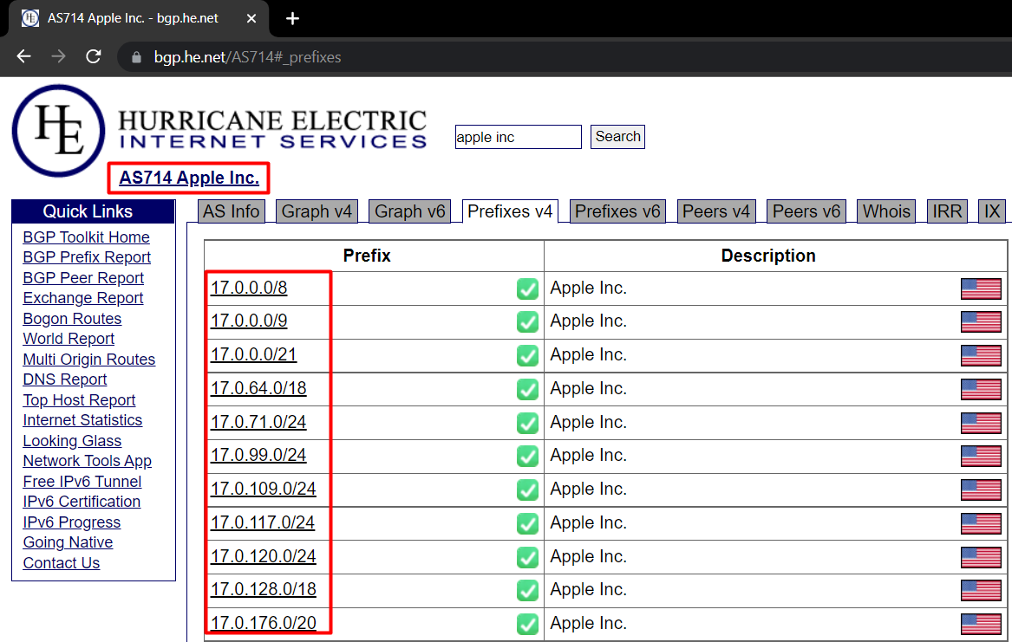
Example: Apple Inc, ASN: AS714, IP range: 17.0.0.0/8

Slide 7
/8 of Apple contains 16M+ IP addresses
We can divide it into smaller /24s and look for potential targets
For demo - 17.120.252.6/24
Masscan can be used for quick port scan
masscan 17.120.252.6/24 -p 80,443 --rate 2000

Slide 8
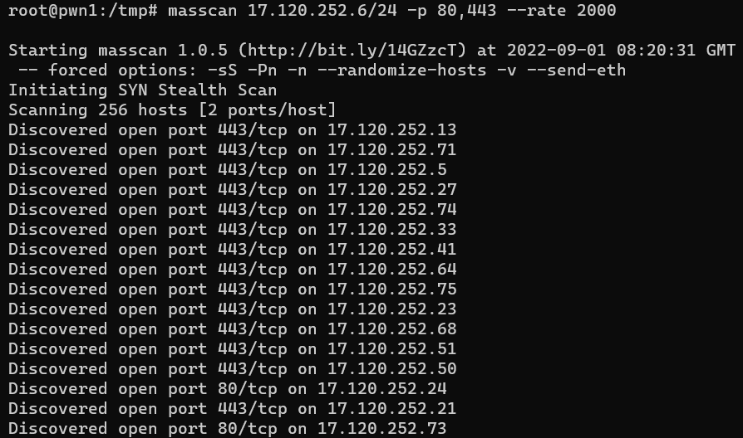
Tips:
Scan for other web ports like 3000,5000,8000,8080,8888 etc.
Perform full port scan with masscan and pass the result to nmap

Slide 9
Scanning ssl certs from ip ranges
https://github.com/arbazkiraak/certasset
This tool can be used to scan IP ranges to gather more domains/subdomains
IP range -> masscan port 443 -> if open -> parse SSL certs and output hosts

Slide 10
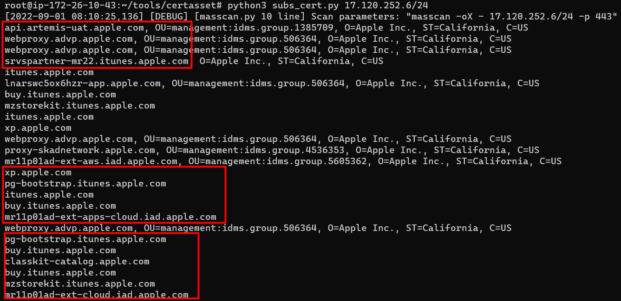

Slide 11
Reverse whois
Whois lookup = Identify owner of a domain (gives info like owner/org name, email, phone number, name servers, etc.)
Reverse Whois lookup = Identify domains from name servers and owner’s info like org name, email etc.
https://viewdns.info/reversewhois/
https://tools.whoisxmlapi.com/reverse-whois-search

Slide 12
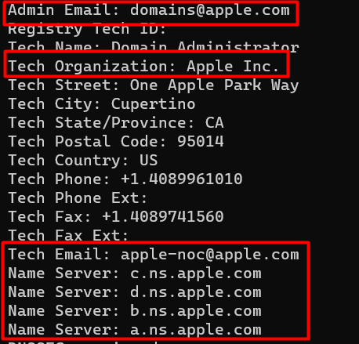
$ whois apple.com

Slide 13
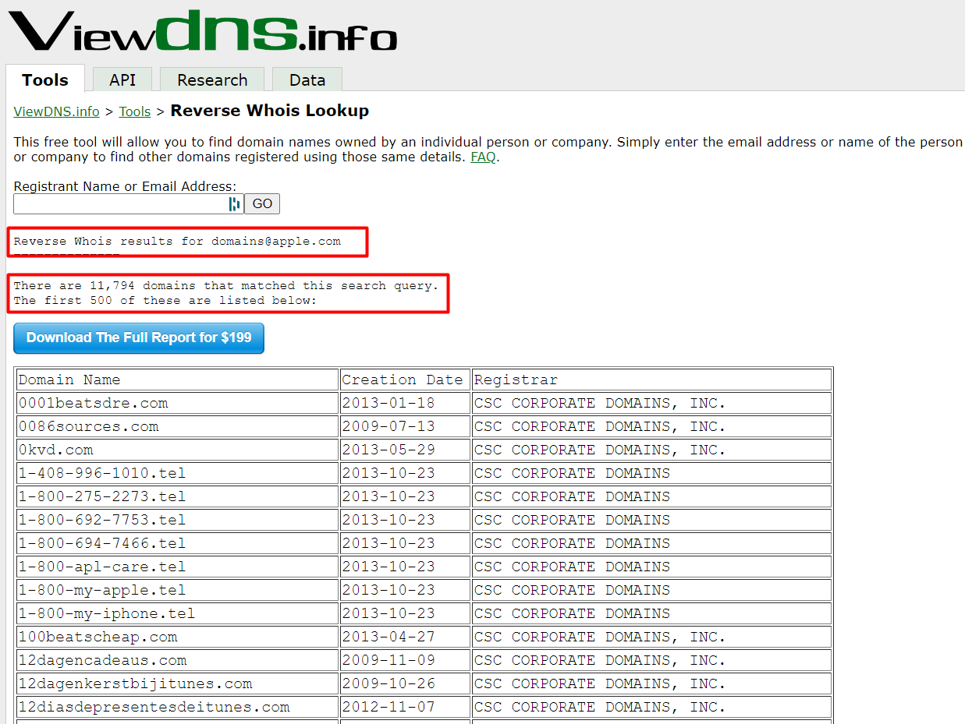

Slide 14
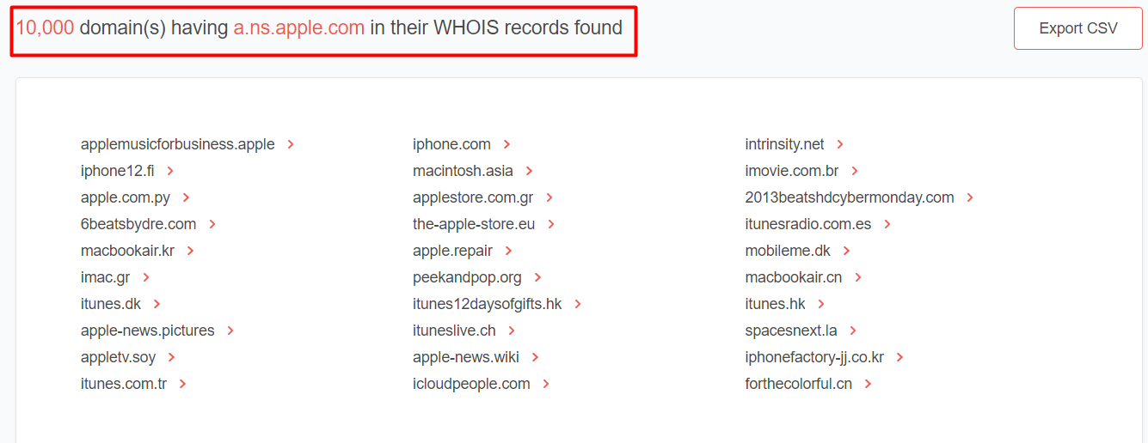

Slide 15
Shodan recon
Search engine for internet connected devices and systems
With right filters and queries we can find juicy hosts of our target
Some common filters: all, asn, city, country, org, ip, ssl, ssl.cert.subject.cn, http.title, http.component, etc.
https://www.shodan.io/search/filters
Examples:
Asn:AS714
country:”US”
Org:apple
Ip: 17.188.199.148
Ssl:apple
Ssl.cert.subject.cn:corp.apple.com
http.title:admin
.. And so on

Slide 16
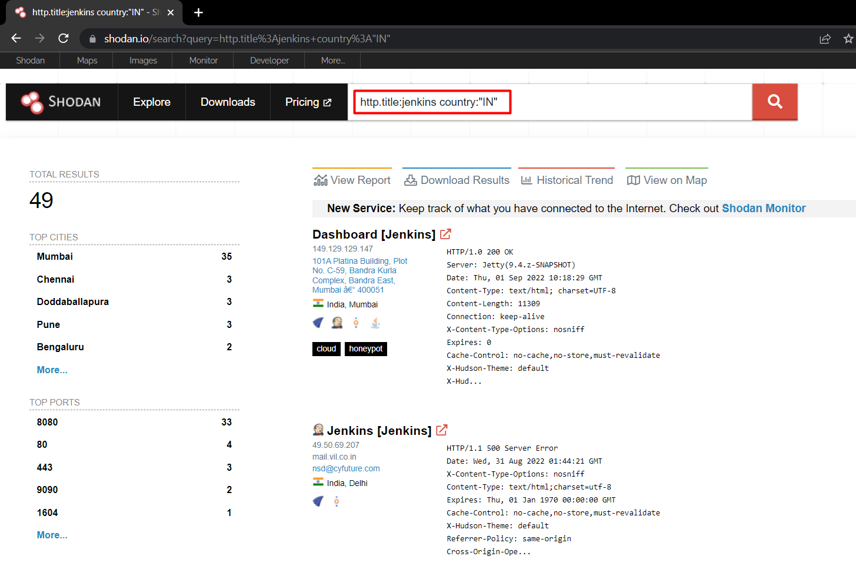

Slide 17
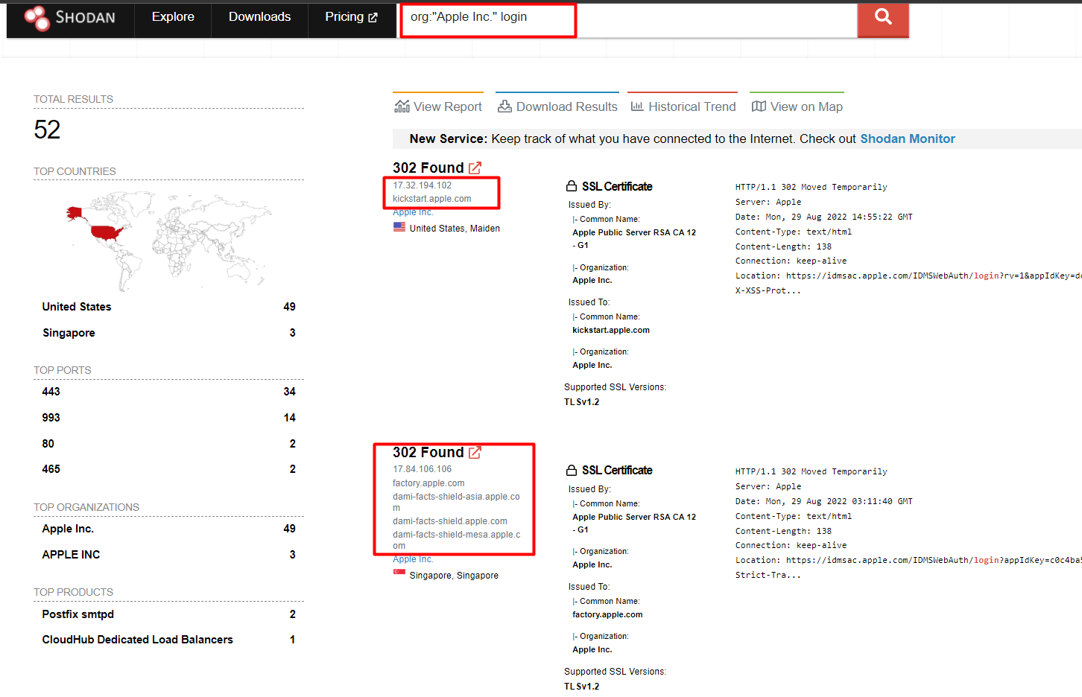

Slide 18
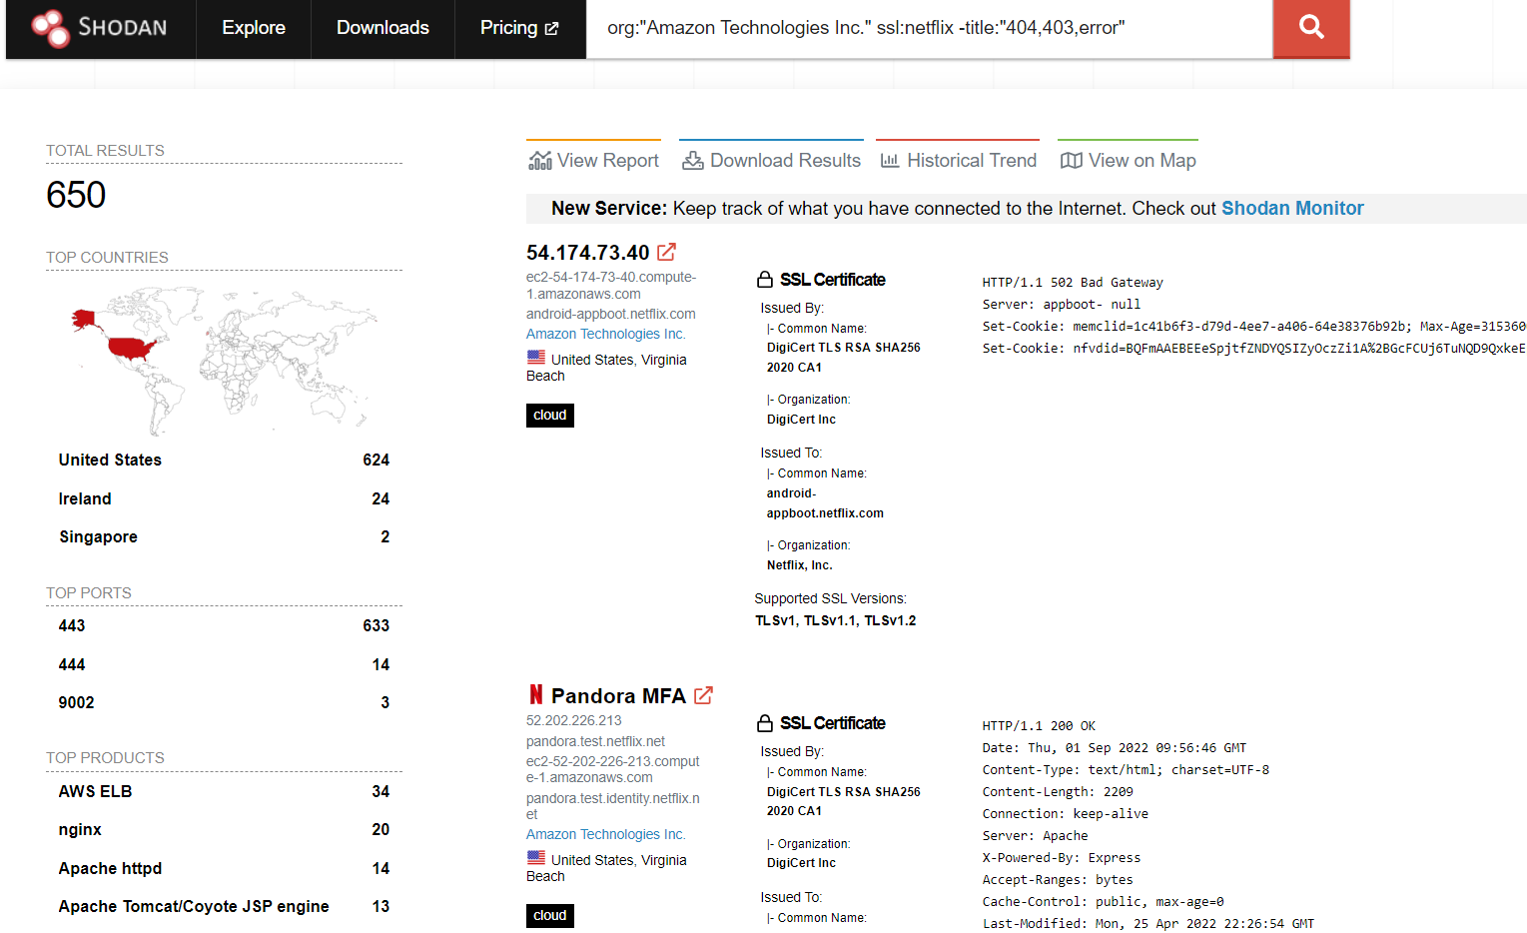
Combining multiple filters and filtering the result

Slide 19
At this point, you should have a bunch of domains and subdomains
Enumerate more subdomains with tools like amass, subfinder, findomain, knockpy
Bruteforce/Resolve with massdns/puredns/shuffledns, dnsx, etc.
When you have a list of resolved or “alive” hosts, probe for web ports 80,443 with tools like httprobe, httpx
https://github.com/projectdiscovery/httpx
https://github.com/tomnomnom/httprobe

Slide 20
Content discovery
For effective content discovery, use curated wordlists
Understand the technology used by your target and use respective wordlist
No point bruteforcing wordpress wordlists in Django targets
https://wordlists.assetnote.io/
https://github.com/ayoubfathi/leaky-paths

Slide 21
Hunting for endpoints in jS files
JS files are goldmines for discovering new endpoints for the target
They often contain API endpoints, URLs, hardcoded secrets, etc.
Subjs tool can be used to fetch javascript files in bulk (https://github.com/lc/subjs)
The obtained js files can now be parsed with LinkFinder (https://github.com/GerbenJavado/LinkFinder)
Gather js files from multiple subdomains with subjs -> generate wordlist with linkfinder -> sort and combine them all -> You have a target specific wordlist now

Slide 22
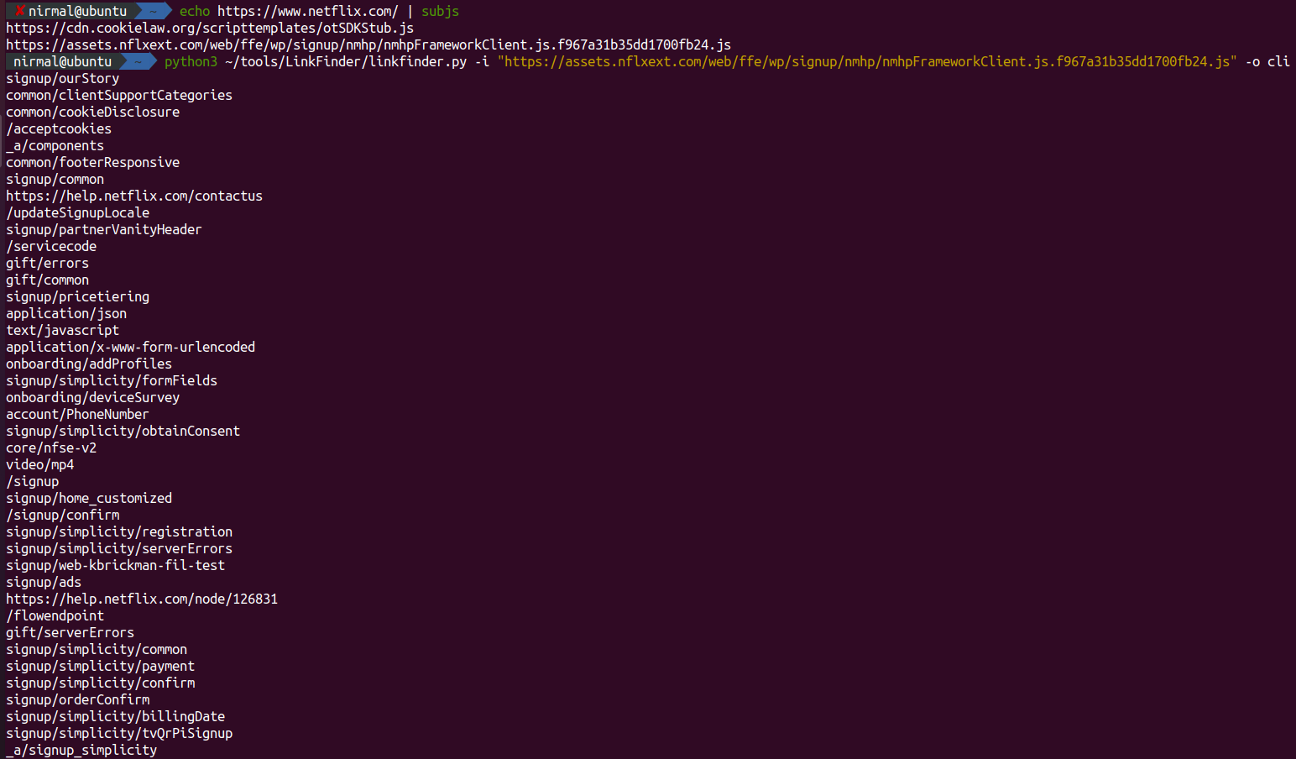

Slide 23
VHOST Fuzzing
One server can have multiple domains associated with it
For example, ip 192.168.1.1 can host app.example.com and staging.app.example.com too
Curl http://192.168.1.1 –H “Host: app.example.com”
Curl http://192.168.1.1 –H “staging.app.example.com”
Ffuf (https://github.com/ffuf/ffuf) can be used to fuzz the host header

Slide 24
Hunting for secrets in android apps
Decompile the apk with tools like apktool, jadx
Check files like AndroidManifest.xml, manifest.xml, strings.xml
Recursive grep for secrets and keywords like password, token, Authorization: Bearer, jwt, jwt_secret and so on..
Easy as that!

Slide 25
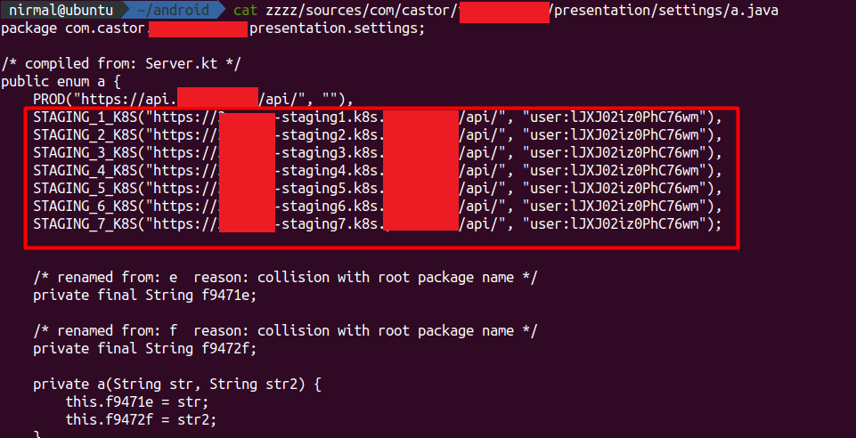

Slide 26
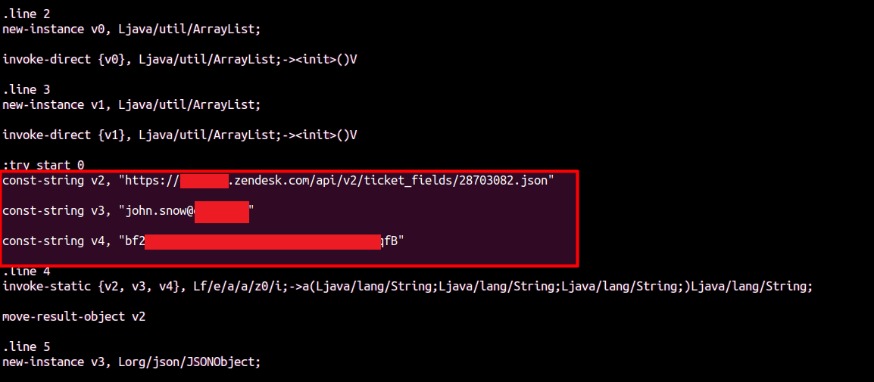

Slide 27
Data leaks in code sharing websites
Many developers push their internal source codes in public code sharing websites like github, gitlab
For quick testing they even use public sandbox like jsfiddle, dotnetfiddle, codepen
We can use google dorks to find these code leaks which often contains hardcoded secrets or internal URLs
Site: jsfiddle.net “corp.apple.com”
Site: dotnetfiddle.net “prod.apple.com”
Site: codepen.io “internal.apple.com”

Slide 28
Github recon
Check the organization page of the target
Check repos one by one and note all the users who have pushed commits to the org repos
When you have a list of users, check for keywords like password, username, secret, secret_key, jwt_key, admin, ssh, ftp, mongodb, postgres_password, docker_password etc.
More dorks and keywords: https://github.com/techgaun/github-dorks
Also look for branches of the repo and commit history
Often developers remove password from git but still it can be obtained from git commits.

Slide 29
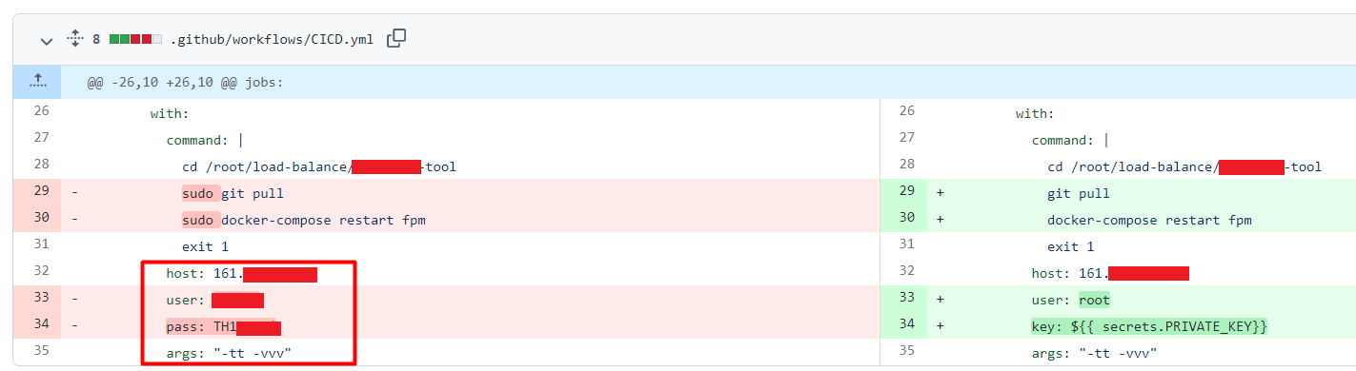

Slide 30
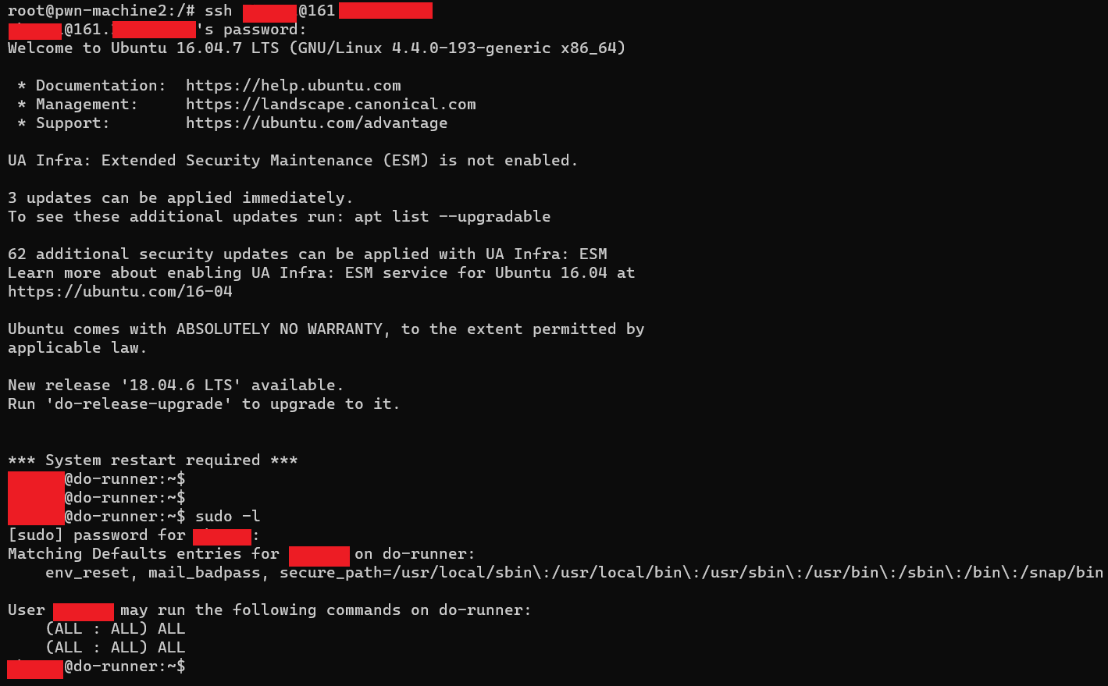

Slide 31
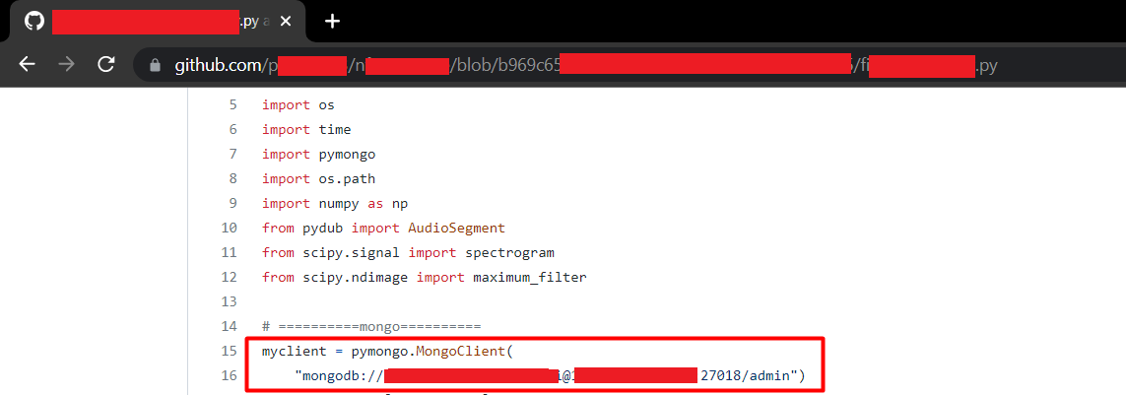

Slide 32
Thank you ☺

