Slide 1
Threat Modelling
Kick start your application security with Threat Modelling

Slide 2
Tonight's agenda
Our focus is always somewhere else
A Secure Development Lifecycle?
Threat Modelling
Taking it in your STRIDE
How to get everyone involved
How to win at Poker
Q & A
Fin

Slide 3
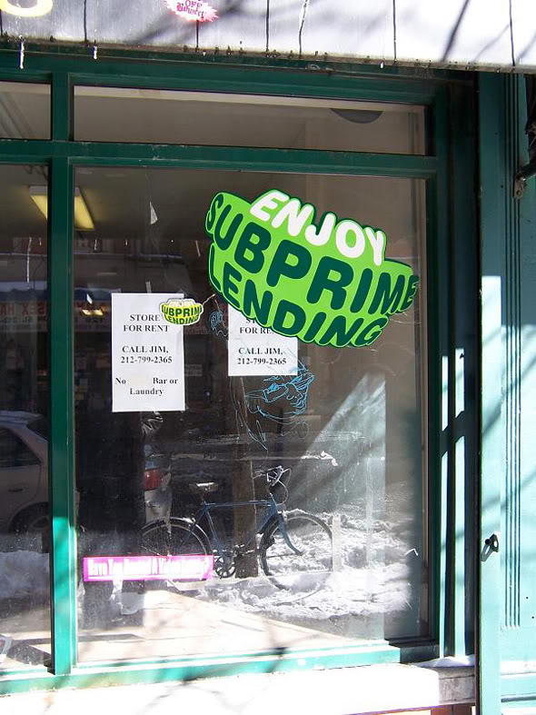
No-one mentioned Armageddon at the subprime meeting

Slide 4
No-one mentioned Armageddon at the subprime meeting
Testers focus was on proving 2+2=4
Developers focus was on collecting garbage java beans
Architects focus was on mysterious hard stuff
Product Manager focus was on the Gantt chart
Vice presidents focus was on her meeting calendar
CTO’s focus was on his back
Everyone's focus was on this years bonus
No-one noticed how bonkers the idea was

Slide 5

Specifically focussing on security
Denial Anger Bargaining Depression and Acceptance – Damien Hurst

Slide 6
Specifically focussing on security
Start Now
You are the evangelist
It’s an easy sell
Resources are plentiful
You can wear sunglasses at your desk
Start with Threat Modelling
Change the culture

Slide 7
Threat modelling
Examining your application from a Security PoV
Identifying leaks, bodges, ignorance, laziness and presumptions
Exploring where your customers data flows
Identifying trust boundaries
Looking at defences
Opening your eyes to the hole you’re in

Slide 8
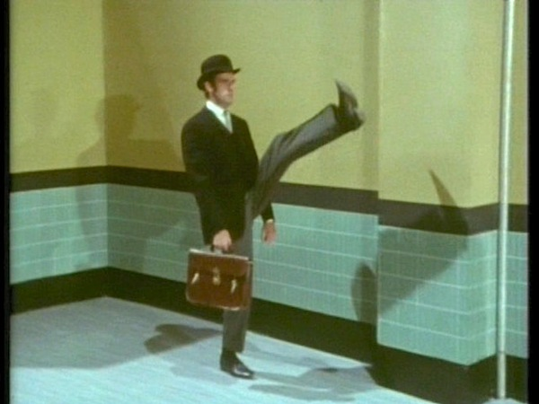
Taking it in your stride

Slide 9
Stride classification
Spoofing - Impersonating someone or something else
Tampering – Modifying data or code
Repudiation – It wasn’t me governor
Information Disclosure – Exposing information that should not be available
Denial of Service – Showing off your hax0r skills
Elevation of Privilege – Getting at admin features

Slide 10
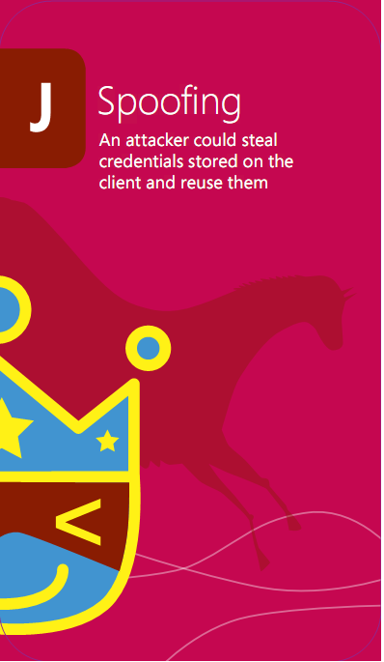

Slide 11
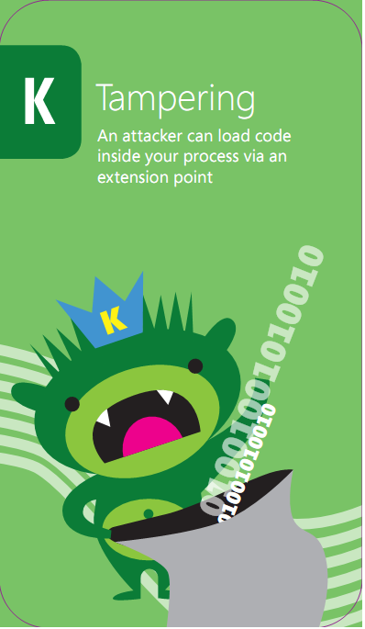

Slide 12
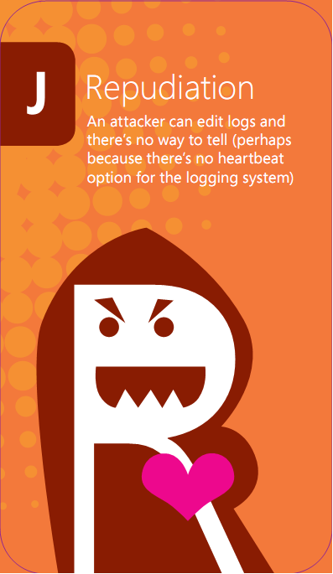

Slide 13


Slide 14
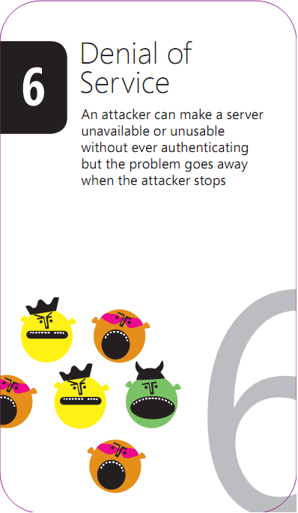

Slide 15
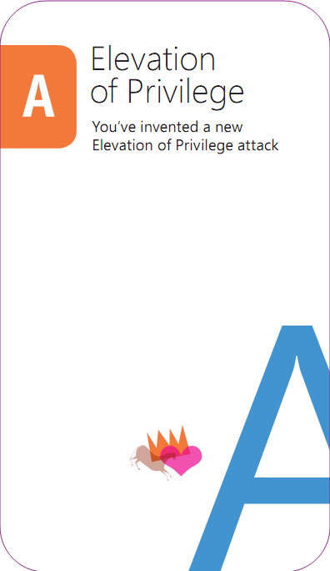

Slide 16
Microsoft’s TM findings
Even with the SDL TM Tool…
Threat models often pushed to one person
Less collaboration
One perspective
Sometimes a junior person
Meetings to review & share threat models
Experts took over meetings
Working meetings became review meetings

Slide 17
Elevation of privilege
Inspired by
Protection Poker by Laurie Williams, NCSU
Serious games movement
Threat modeling game should be
Simple
Fun
Encourage flow

Slide 18
Draw on Serious Games
Field of study since about 1970
“serious games in the sense that these games have an explicit and carefully thought-out educational purpose and are not intended to be played primarily for amusement.” (Clark Abt)
Now include “Tabletop exercises,” persuasive games, games for health, etc
Also includes work from previous initiatives
Windows 7 Language Quality Game

Slide 19
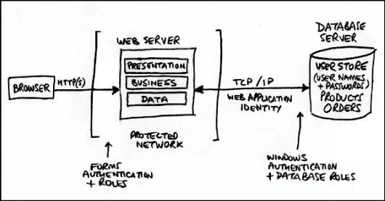
Draw a diagram

Slide 20
A round of cards
Deal out all the cards
Play hands (once around the table)
Connect the threat on a card to the diagram
Play in a hand stays in the suit
Play once through the deck
Take notes:
Player Points Card Component Notes
_____ ____ ____ _________ ______________
_____ ____ ____ _________ ______________

Slide 21
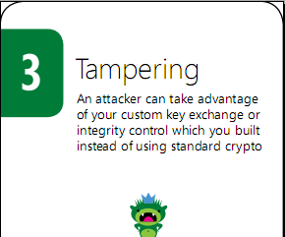
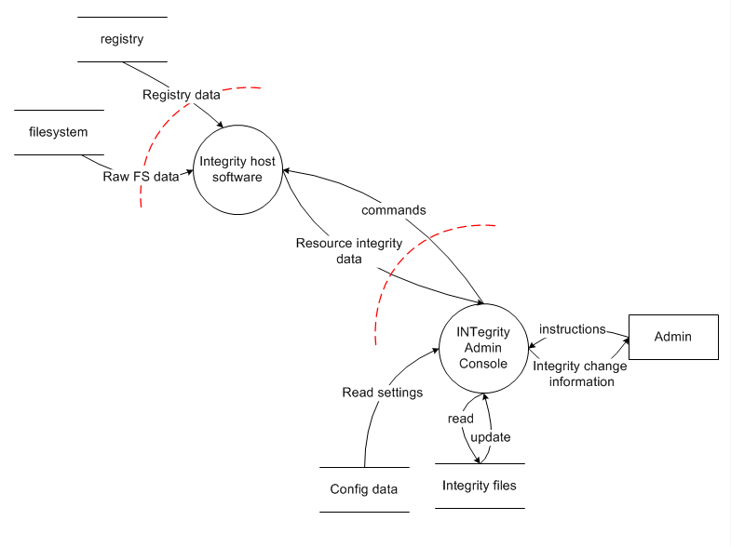
Example

Slide 22
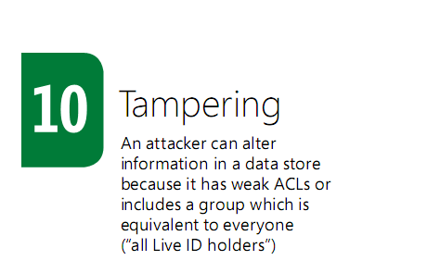
Kate plays 10 of tampering

Slide 23
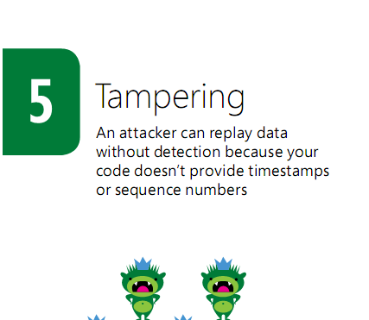
Will plays 5 tampering

Slide 24
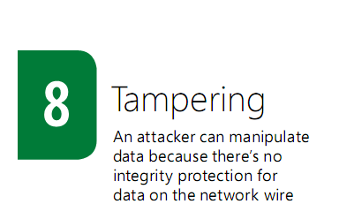
Nic plays the 8 tampering

Slide 25
The Rules
Must play in suit if you can
High card wins the hand
Unless there’s a trump (elevation of privilege card)
Aces are for threats not listed on the cards
1 point for each threat, 1 for the hand

Slide 26
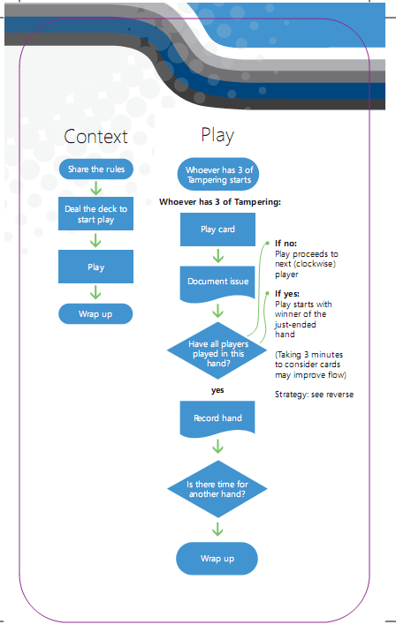
Why does the game work as a tool?
Attractive and cool
Encourages flow
Requires participation
Threats act as hints
Instant feedback
Social permission for
Playful exploration
Disagreement
Produces real threat models

Slide 27
It’s free
Licensed under Creative Commons Attribution
http://www.microsoft.com/security/sdl/eop/

Slide 28
Lets Play!

Slide 29
My new site: Smarmy.com
Social network for those we love to hate
The next stage in Celebrity
A central place for all those annoying Facebook posts
Promotes smarmiest people into the most important job

Slide 30
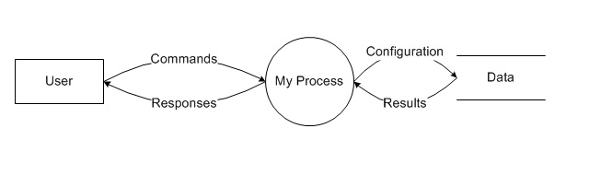
Actors, dataflow and processes

Slide 31
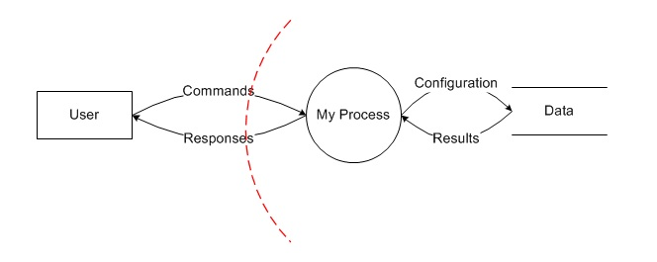
Trust boundaries

Slide 32
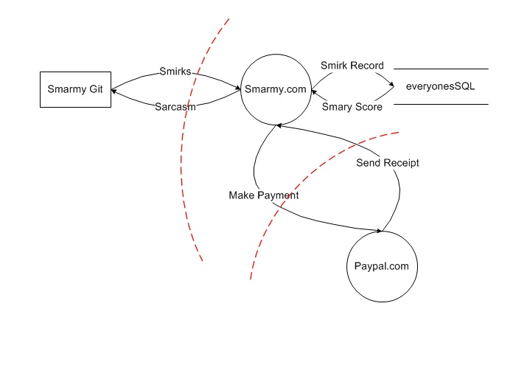
Smirking

Slide 33
Secure development lifecycle
A number of documented processes
Build it into your existing development processes
The source of evidence to record you took things seriously
Record the threats
Record Mitigations as ‘bug’s or other backlog items
Documentation feeds other operations

Slide 34
Where can I find all of this stuff
Microsoft SDL
OWASP
EofP

Slide 35
Questions?

Slide 36
Thank you
@neildixley
www.neildixley.com

