Slide 1
Honeypot Tactics
From Research
To Enterprise

Slide 2

speaker@owasp-newcastle$ whoami
Andrew Waite
Onyx Group – Ex-Hosting Monkey
InfoSanity Research – Security Researcher
[New Father - Twice]
Onyx Group – Security Consultant
@infosanity
MASSIVE Geek

Slide 3
Why am I here?
Not just free pizza (honest)
Introduce Honeypot capabilities
Honeypots without the honeypots
(hopefully) convince you to investigate Active Defense further

Slide 4
Important things first
Usual employer disclaimers
IANAL
Bad things can happen when you poke the bears....

Slide 5
What is a honeypot?
“a trap set to detect, deflect, or, in some manner, counteract attempts at unauthorized use of information systems”^{[1]}
Detect
Deflect
Counteract
[1]: https://en.wikipedia.org/wiki/Honeypot_(computing)
Notes:
High Interaction
Low Interaction
Canaries
Honeytokens
Low/No value to enterprise
Zero false positives
Old technology – Stohl's Cuckoo Egg

Slide 6
What ISN'T a honeypot?
Silver Bullet to make you instantly secure
Replacement for:
  ^{Firewall(s)}
  ^{Anti Virus}
  ^{Patch management}
  ^{System Hardening}
  Actually monitoring your infrastructure
Notes:
High Interaction
Low Interaction
Canaries
Honeytokens
Low/No value to enterprise
Zero false positives
Old technology – Stohl's Cuckoo Egg

Slide 7
Why use Honeypots?
Protect your enterprise
  Another tool in the toolkit
Sysadmins?
  Mess with auditors
  Board-level credibility
Auditors/Pentesters?
  Know when sysadmins are messing with you
Notes:
High Interaction
Low Interaction
Canaries
Honeytokens
Low/No value to enterprise
Zero false positives
Old technology – Stohl's Cuckoo Egg

Slide 8
Traditional Honeypots
Clean Install & Unpatched Windows
Honeyd – Service Emulation
LaBrea - Tarpit
Nepenthes/Dionaea – Windows Services
Glastopf – Web Applications
Kippo – SSH Server
Cuckoo – Malware Sandbox

Slide 9
Enterprise Deployment
Traditional
  Build host OS
  Compile Honeypot from source
  Debug compilation errors
  Slam head against desk
  …..
Works, but business ROI?

Slide 10
Enterprise Deployment
Getting Better
  Pre-built ISOs
    ADHD – Offensive Counter Measures Book (Strand)
    Stratagem
    HoneyDrive
    REMnux
    T-POT → Docker
  Automated Platforms
    Modern Honey Network
Commercial Options
  Canary.tools

Slide 11
Anatomy of an Attack
Reconnaisance
Weaponisation
Delivery
Exploitation
Installation
Command and Control (C2)
Actions on Objectives
http://www.lockheedmartin.co.uk/content/dam/lockheed/data/corporate/documents/LM-White-Paper-Intel-Driven-Defense.pdf

Slide 12
Honeypots without the Honeypot?
DNS Records
  Boring?
Legit Records
  www. web01. mail. ftp. ?
Fake records?
  www0[2/3/4/etc]. mail0[1/2/3/4]. ?
Malicious Records?
  ;rm%20-rf%20/

Slide 13
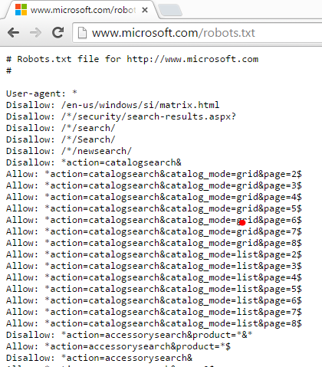
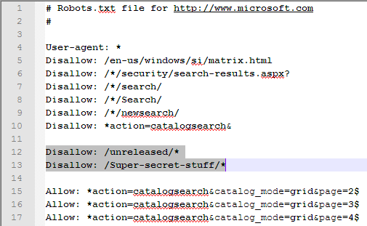
Honeypots without the Honeypot?
Robots.txt
*Weblabrinth

Slide 14
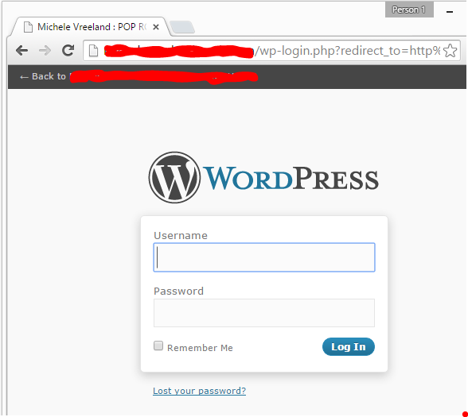
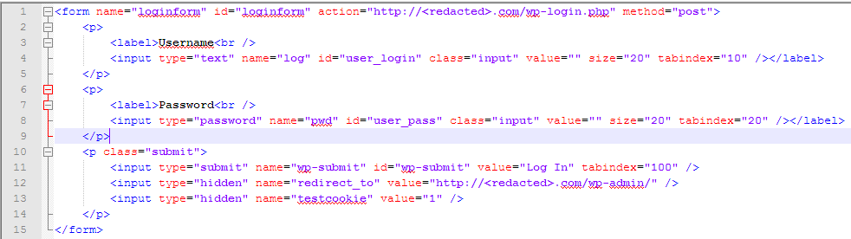
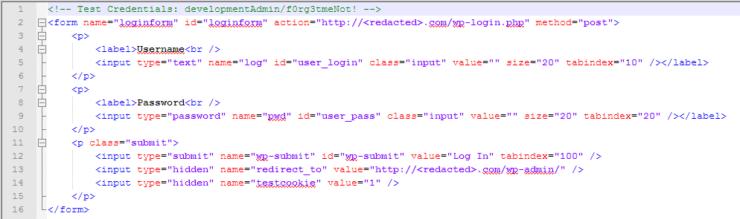
Honeypots without the Honeypot?
Source Code 'Leaks'

Slide 15
Utilising 'Threat Intelligence'
Research!
  Great for hobbyists and researchers
But for Enterprise?
    Expensive (-ish)
    Technical Resources
    Hard to measure ROI

Slide 16
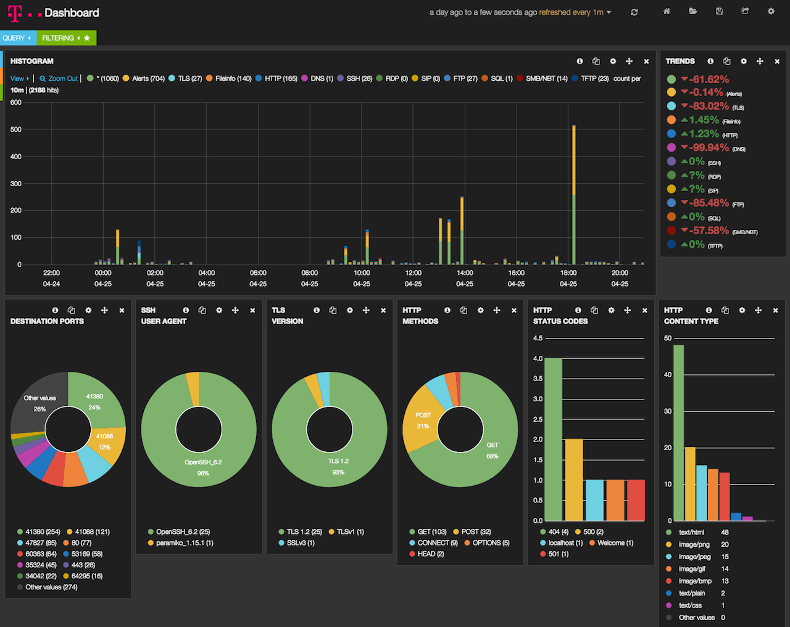
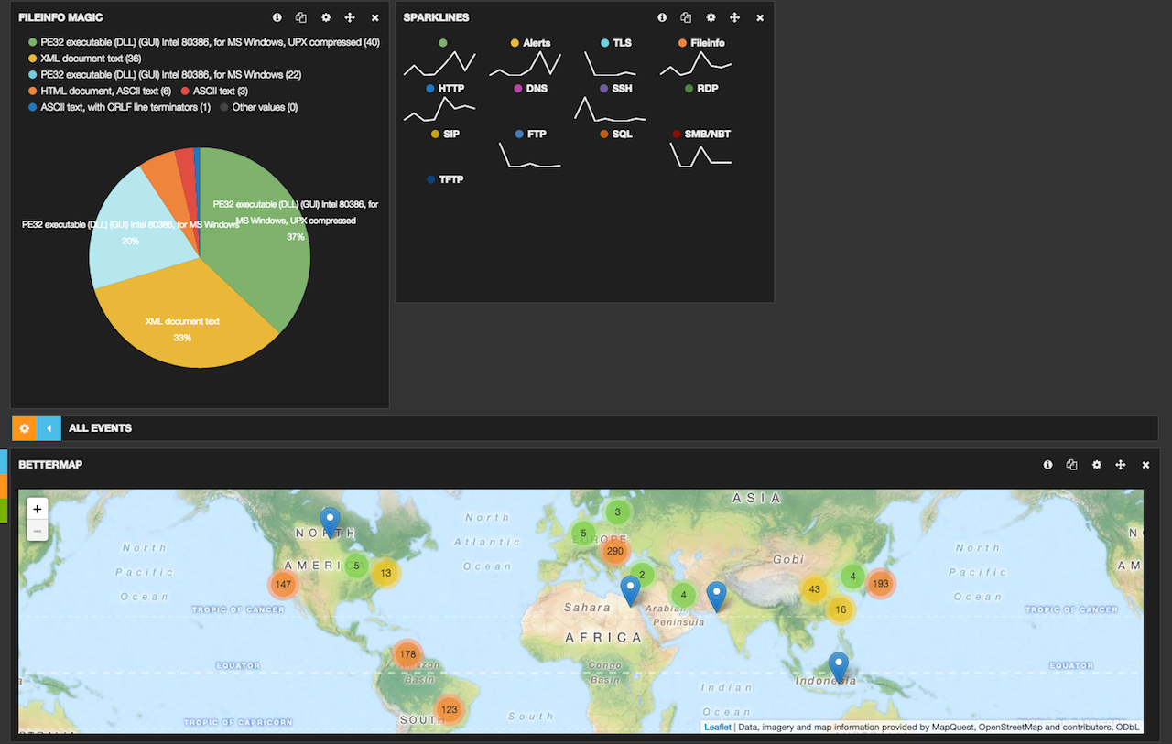
Utilising 'Threat Intelligence'
Dashboards!
http://blog.takanabe.tokyo/2015/04/24/293/

Slide 17
Utilising 'Threat Intelligence'
Actionable defenses?
  Intrusion Prevention System
  Network Access Control
  fail2ban
Offensive Capbilities?
  Discussion for another day

Slide 18
Fail2ban Overview
RDPGuard for MS-centrix infrastructure
Fail2ban scans log files (e.g. /var/log/apache/error_log) and bans IPs that show the malicious signs -- too many password failures, seeking for exploits, etc. Generally Fail2Ban is then used to update firewall rules to reject the IP addresses for a specified amount of time, although any arbitrary other action (e.g. sending an email) could also be configured.
Out of the box Fail2Ban comes with filters for various services (apache, courier, ssh, etc).
http://www.fail2ban.org/wiki/index.php/Main_Page

Slide 19
Anatomy of an Attack – Crossing streams
Reconnaisance
Weaponisation
Delivery
Exploitation
Installation
Command and Control (C2)
Actions on Objectives
Intrusion blocked
http://www.lockheedmartin.co.uk/content/dam/lockheed/data/corporate/documents/LM-White-Paper-Intel-Driven-Defense.pdf

Slide 20
Offensive Options
Reminder: IANAL; in NO way recommended
Trojaned 'Loot'
  Msfvenom (venom vs poison)
  BeEF / HoneyBadger
Digital 'mines'
  Discussed with DNS records
'mirror' Honeypots
  Bounce the attack back to attacker
  Attack source likely a compromised patsy host

Slide 21
Goals Achieved?
Do you understand Honeypot concepts?
Could you benefit from Active Defense tactics in your org?
Would you like to know more?

Slide 22


Questions?
?
uk.linkedin.com/in/andrewwaite
twitter.com/infosanity

