Slide 1
OWASP Mobile Security Project Top 10 Mobile security threats 2014
Neil Dixley
@neildixley
www.neildixley.com
29 Sept 2015

Slide 2
Introduction
Previously:
In a movie ‘fly me to heaven’ with Cat from Red Dwarf
Platform Team for First Union National Bank
Tombola
Sage
Currently:
at Atom Bank in Durham

Slide 3
Tonight's Agenda
Mobile Security?
OWASP Mobile Security Project
A run down of the top ten mobile threats
Interspersed with some of the other resources available from OWASP
Go to the pub

Slide 4
OWASP Mobile Security Project
…is a centralized resource intended to give developers and security teams the resources they need to build and maintain secure mobile applications
The OWASP Mobile Security project was announced in Q3 2010
Top 10 Mobile Threats Emmy's
Tools
Cheat Sheets

Slide 5
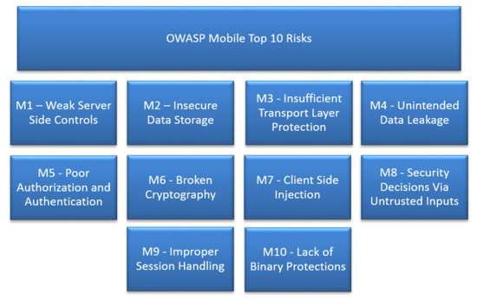

Slide 6
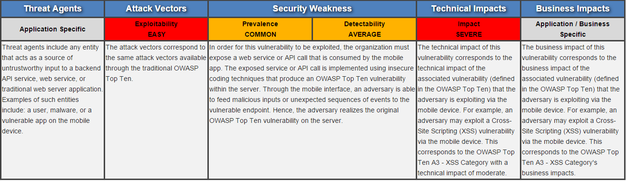
M1 - Weak Server Side Controls
Basically its the server team's fault
Implement a SDLC on the server team
Start with the OWASP Top 10

Slide 7
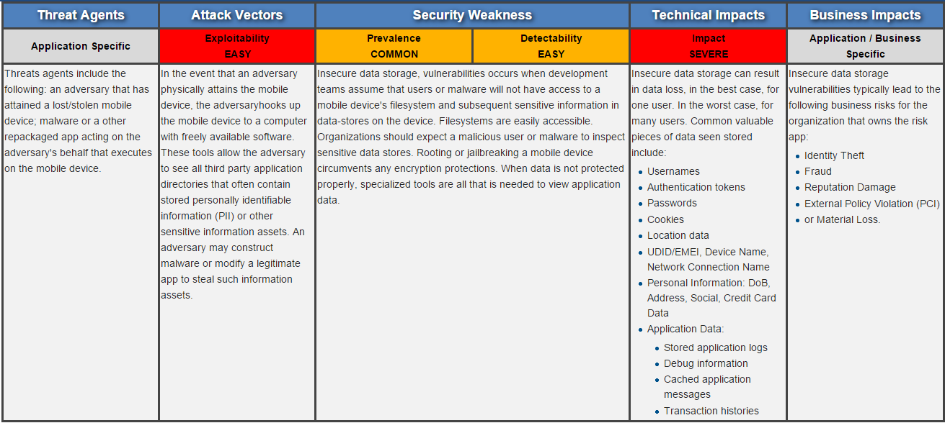
M2 - Insecure Data Storage
Don't store anything on the device
Use OAuth 2 for authentication

Slide 8
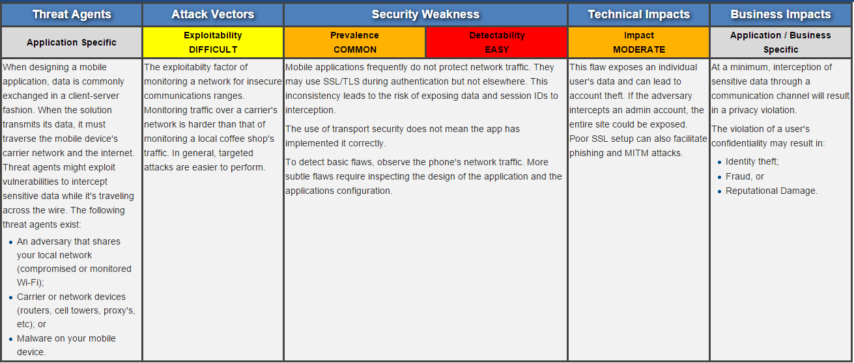
M3 - Insufficient Transport Layer Protection
Know and trust your certificates
Don't use insecure channels like SMS
Certificate Pinning

Slide 9
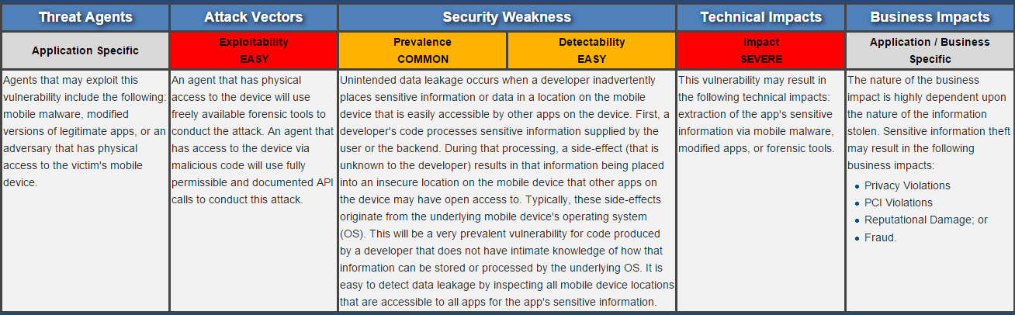
M4 - Unintended Data Leakage
What are you logging?
String Constants
Cryptography Keys

Slide 10
Tools Part 1
iMas
MobiSec
Slaughtered Goats

Slide 11
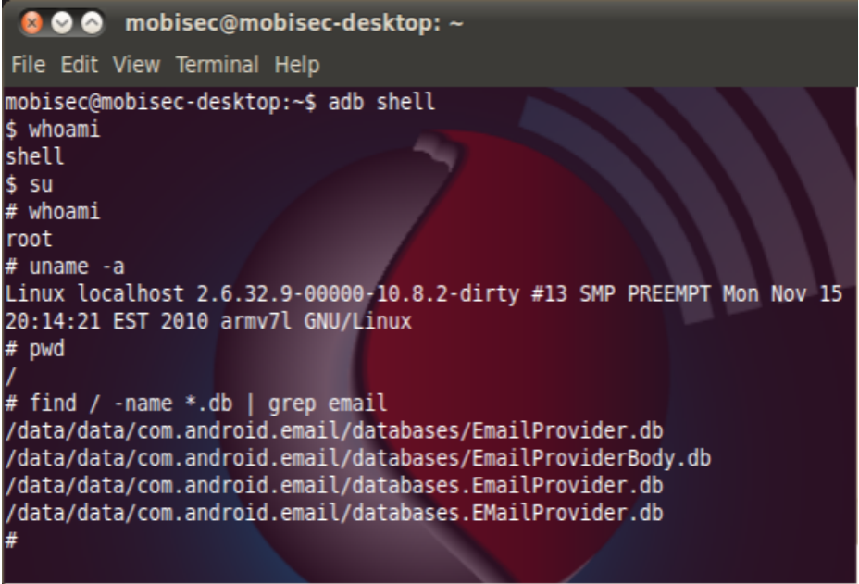
MobiSec

Slide 12
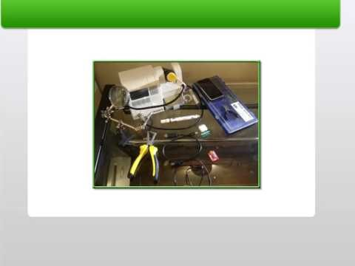
iMAS - iOS Mobile Application Security

Slide 13
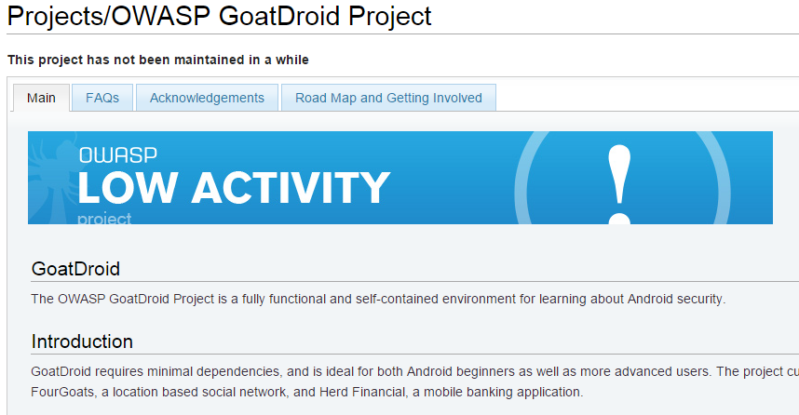
Slaughtered Goats

Slide 14
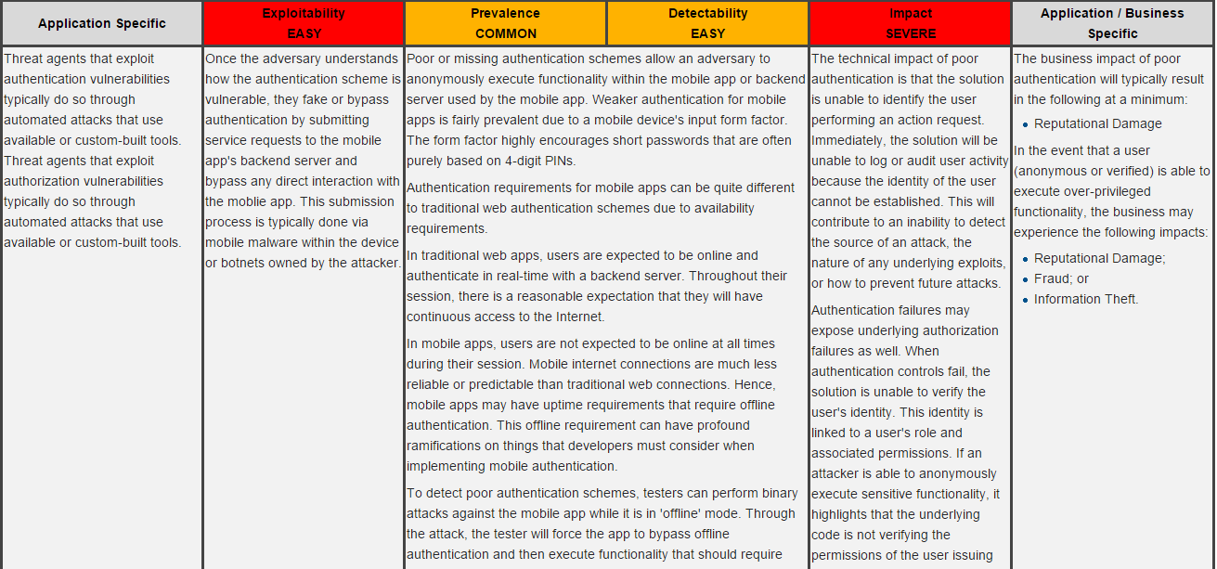
M5 - Poor Authorisation and Authentication
No local authentication
Use device specific token
Avoid spoof-able metrics

Slide 15
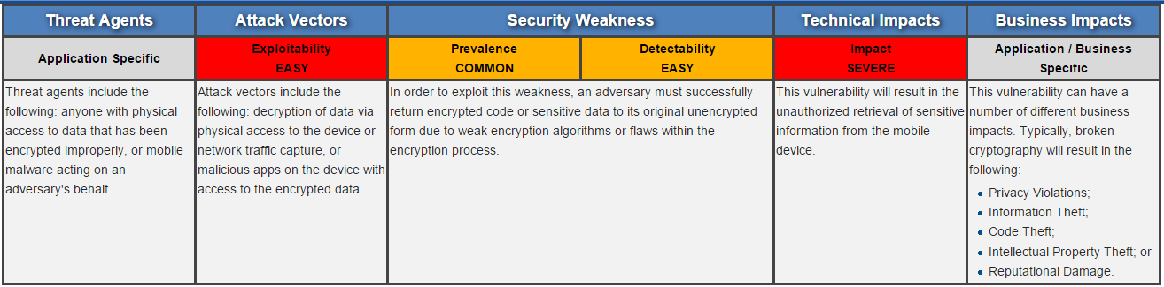
M6 - Broken Cryptography
You didn’t make up your own did you?
Hard coded keys
Depreciated Algorythms

Slide 16
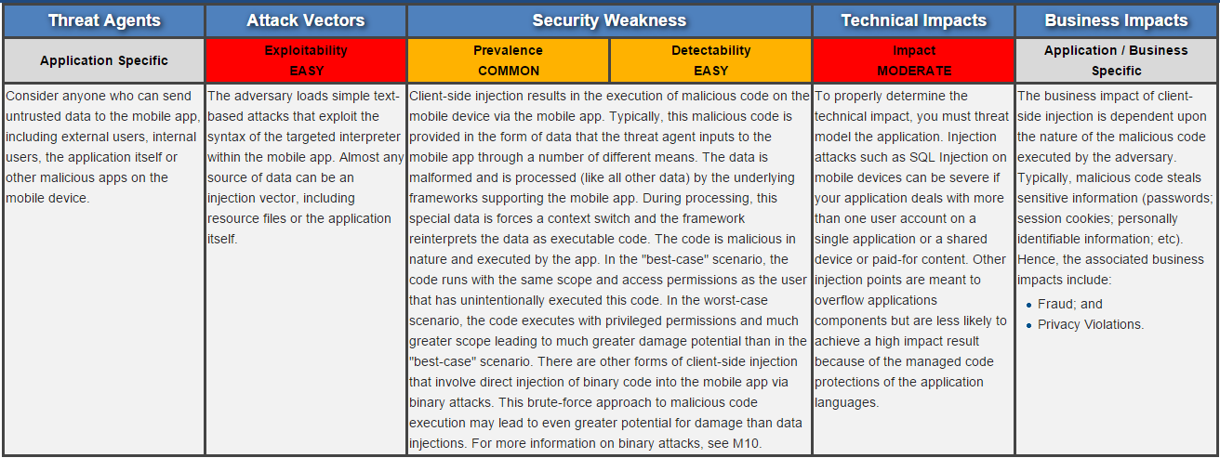
M7 - Client Side Injection
Webviews still vunerable
Data read from SQLLite or local databases
Classic ‘C’ code overruns

Slide 17
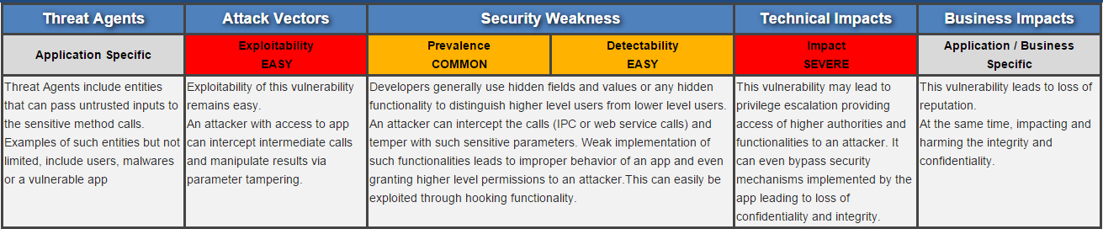
M8 - Security Decisions by Untrusted Inputs
Inter Process Communication vulnerabilities
Workflow resources
Serialization

Slide 18
Tools Part 2
NowSecure Lab: Community Edition
OWASP SeraphimDroid Project
Cheat Sheets

Slide 19
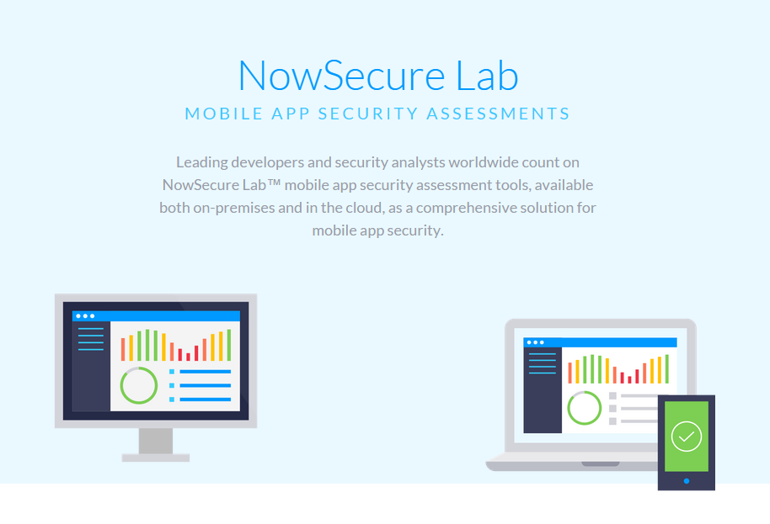
NowSecure Lab: Community Edition

Slide 20
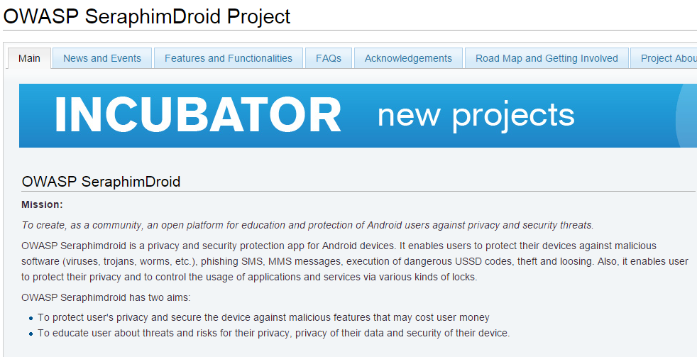
OWASP SeraphimDroid Project

Slide 21
Cheat Sheets
Cheat sheets provide the information most relevant to a developer or security engineer with minimal "fluff"
Device specific mitigations

Slide 22
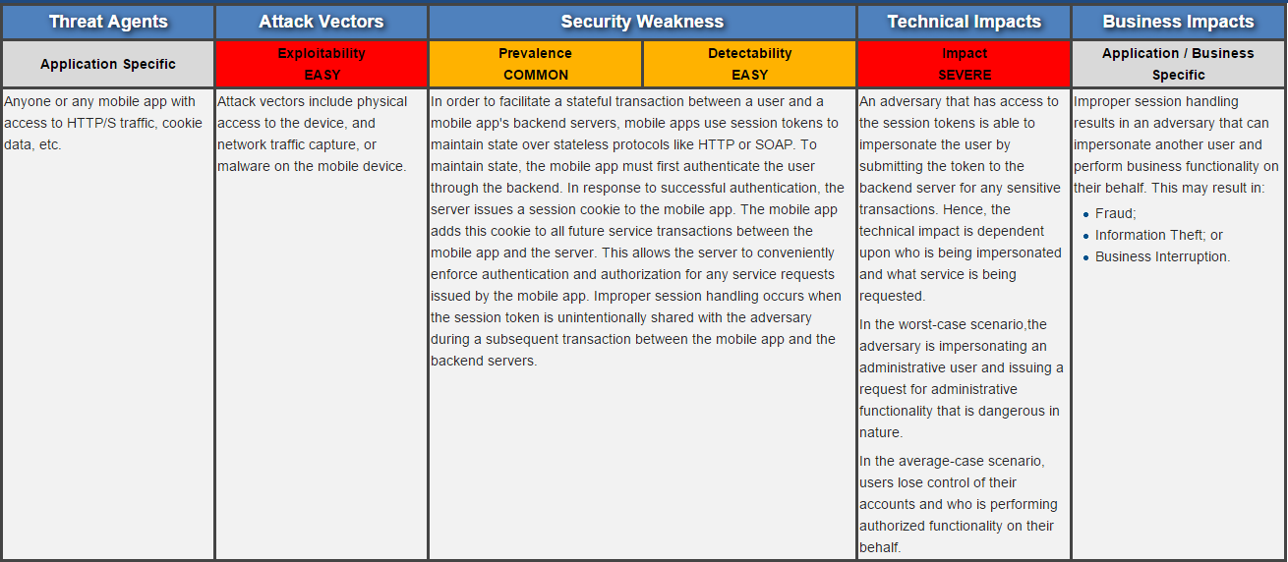
M9 - Improper Session Handling
Failure to invalidate sessions
Timeout and background handling

Slide 23
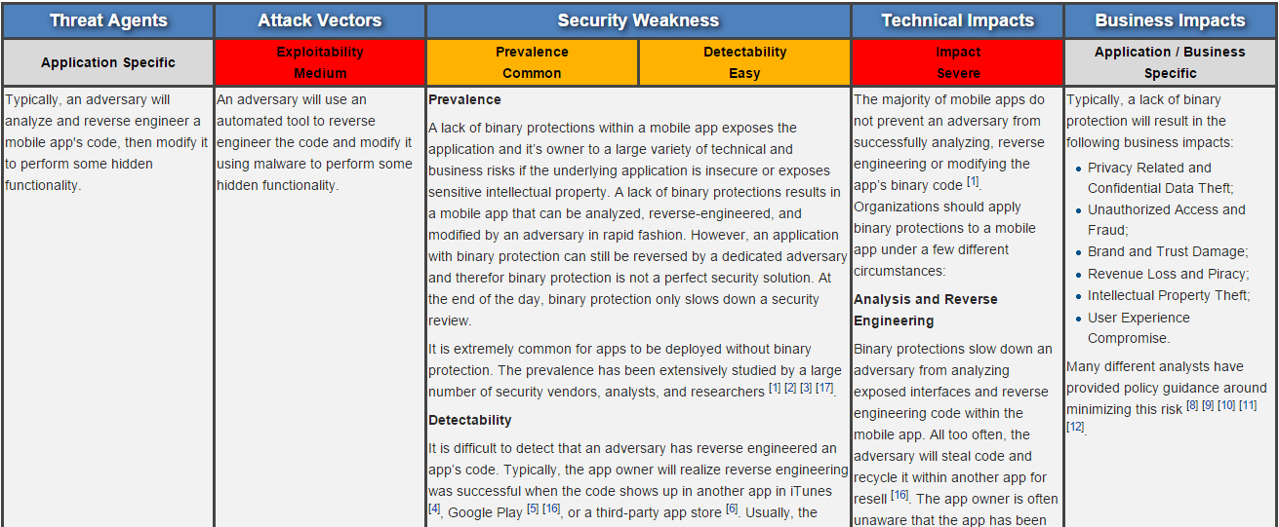
M10 - Lack of Binary Protections
Obfuscation is difficult
OWASP RECMPP

Slide 24
Get Involved!
Join the mailing lists
Submit to the mailing lists
Write Open Source Code
Present at an OWASP Chapter

Slide 25
Conclusion
I only do this for the free beer

