Slide 1
real world defence-in-depth (part 1 of several)
mike goodwin

Slide 2


Slide 3


Slide 4


Slide 5
example 1: least privilege execution

Slide 6


Slide 7
novice: work out the minimum set of permissions you need and only use them

Slide 8



LocalService
NetworkService
LocalSystem

Slide 9
ninja: only assume permissions when you need to use them and then give them up afterwards

Slide 10
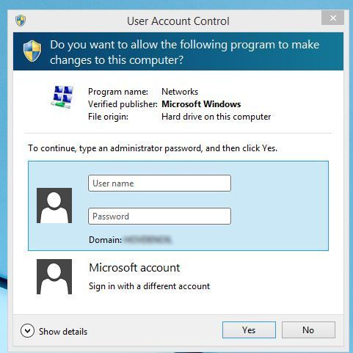
we all love this, right?

Slide 11


security monkey is
cooler though
https://github.com/Netflix/SimianArmy/wiki
https://github.com/Netflix/security_monkey

Slide 12
{
"Statement":
[
{
"Effect": "Allow",
"Action": "sts:AssumeRole",
"Resource": <high privilege role>
}
]
}

Slide 13
{
"Statement":
[
{
"Action": [
"cloudwatch:Describe*",
"cloudwatch:Get*",
… <blah blah blah> …
"sqs:ListQueues",
"sqs:ReceiveMessage" ],
"Effect": "Allow",
"Resource": "*"
}
]
}

Slide 14
# Create an STSConnection object that represents a live
# connection to AWS.
sts_connection = STSConnection()
# Call the assume_role method of the STSConnection object
# and pass the role ARN and a role session name.
assumedRoleObject = sts_connection.assume_role(
role_arn="arn:aws:iam::account-of-role-to-assume:
role/name-of-role",
role_session_name="AssumeRoleSession1“
)

Slide 15
example 2: certificate pinning

Slide 16
why?

Slide 17
the problem with trusted certificate authorities is that they can’t be trusted
Notes:
My vanilla Firefox installation has 91 trusted CAs

Slide 18
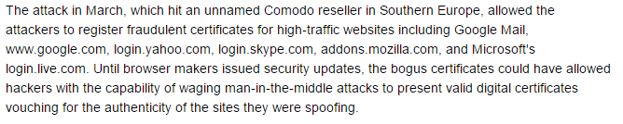

Notes:
I have 91 Cas in my trusted CA list in firefox

Slide 19
when?

Slide 20
you should pin anytime you want to be relatively certain of the remote host's identity or when operating in a hostile environment. since one or both are almost always true, you should probably pin all the time.
- OWASP certificate pinning guidance

Slide 21

an example of a Safe Environment

Slide 22

a Hostile Environment

Slide 23

or even worse*
*other hot beverage vendors are equally hostile

Slide 24
how?

Slide 25
when connecting to a server, check that the certificate public key is as you expect it to be

Slide 26
public final class PubKeyManager implements X509TrustManager {
private static String PUB_KEY = "30820122300d06092a864886f70d0101"
...
+ "e0b7a5bc860966dc84f10d723ce7eed5430203010001";
public void checkServerTrusted(X509Certificate[] chain, String authType) throws CertificateException {
// Perform customary SSL/TLS checks
...
RSAPublicKey pubkey = (RSAPublicKey) chain[0].getPublicKey();
String encoded = new BigInteger(1 /* positive */, pubkey.getEncoded()).toString(16);
final boolean expected = PUB_KEY.equalsIgnoreCase(encoded);
if (!expected) { throw new CertificateException(…); }
}
}

Slide 27

(big) but…

Slide 28
think very carefully about practicalities…
certificates expire – support 2 certificates simultaneously
certificates get compromised – maybe 2 won’t be enough
avoid pinning in apps that can’t be easily updated
alternatives to pinning the public key - the CA?
OWASP guidance is going to be updated…
as usual, balance risk vs. other factors

Slide 29




thank you for listening
https://www.owasp.org/index.php/Certificate_and_Public_Key_Pinning
https://www.owasp.org/index.php/Pinning_Cheat_Sheet

Slide 30
Certificate pinning
Encryption of protected data
Signing of security critical config, binaries etc.
End-to-end security – message level encryption and signing
Password anti-pattern – separating keys from data
Log chaining (is it practical?)
Two factor authentication
Password/key rotation
Least privilege execution
Murder in the cloud prevention
API request signing
XSS multi-level protection

