Slide 1
Security Requirements Identification
Using the OWASP Cornucopia Card Game
Colin Watson
Cornucopia Project Co-Leader
OWASP Cornucopia - Ecommerce Website Edition
Helps developers identify security requirements from the OWASP Secure Coding Practices - Quick Reference Guide
Some suppliers/vendors are mentioned
OWASP does not endorse or recommend commercial products or services

Slide 2

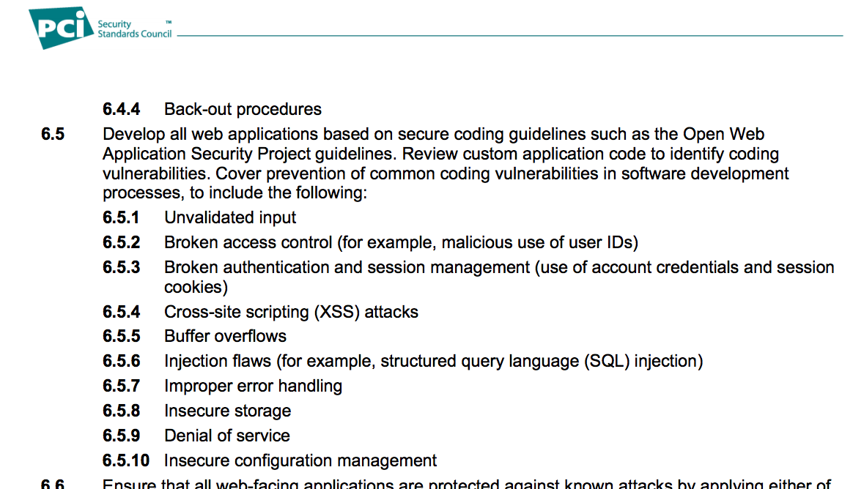
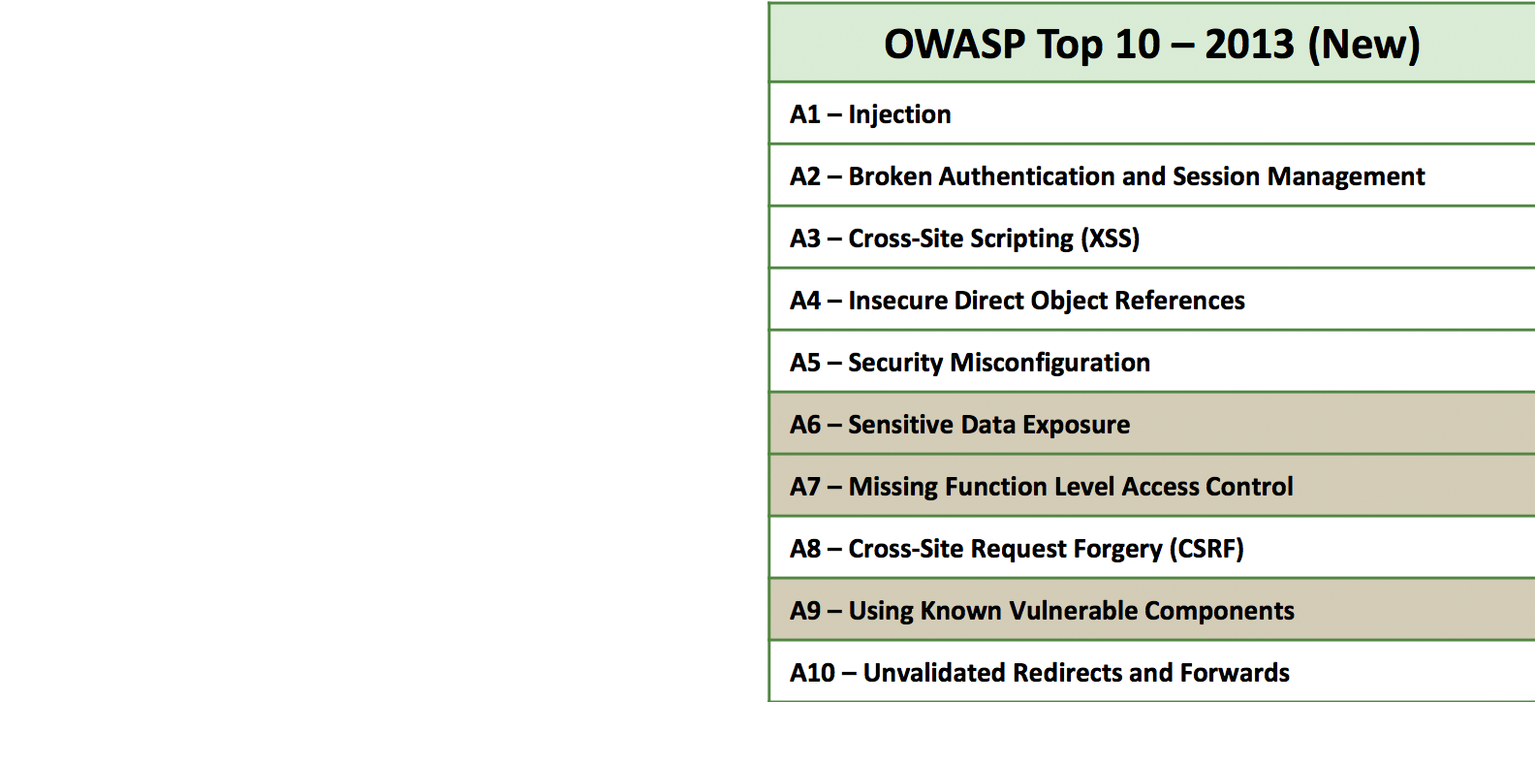
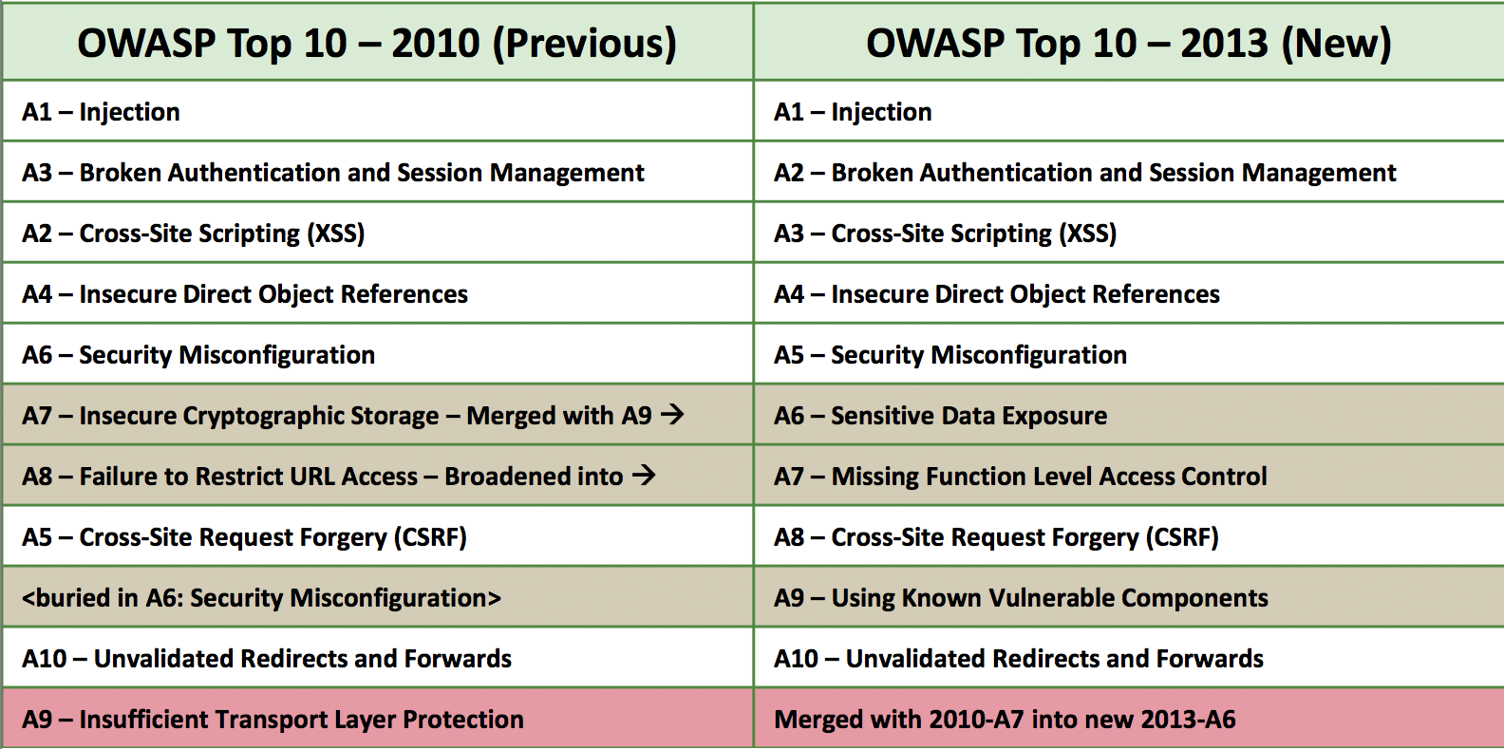
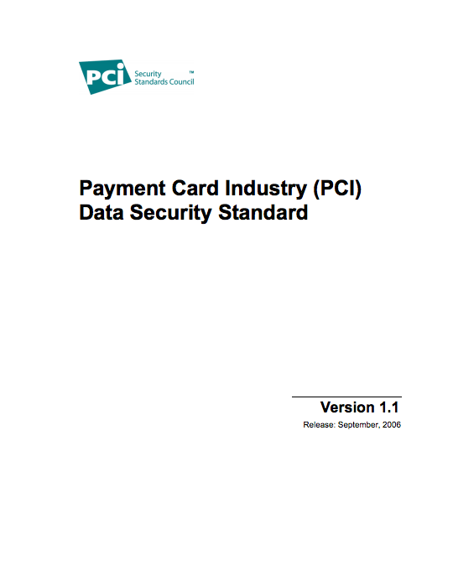
OWASP Top Ten – Most Critical Web Application Security Risks
https://www.owasp.org/index.php/Top_10_2013

Slide 3
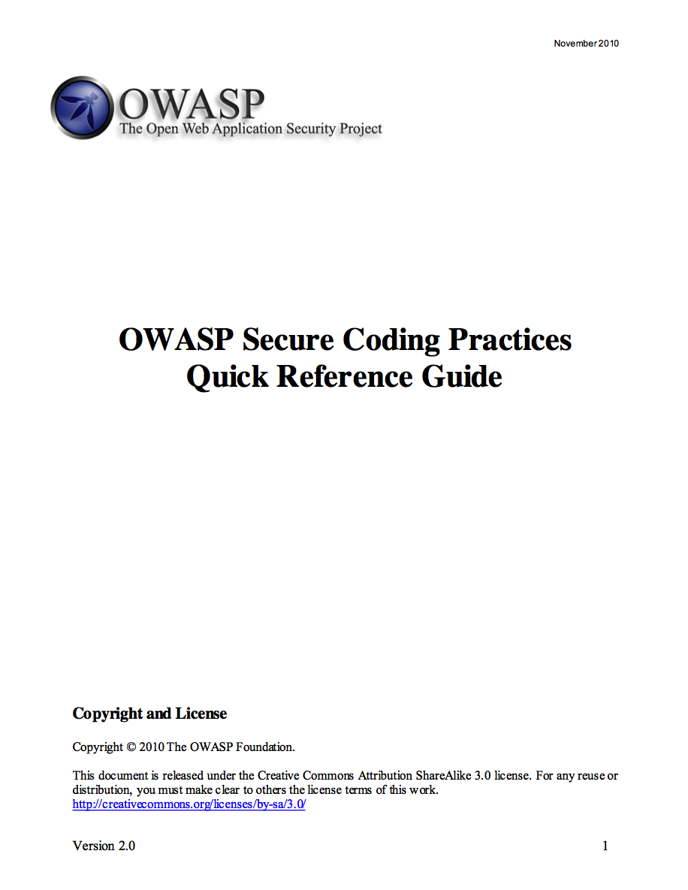
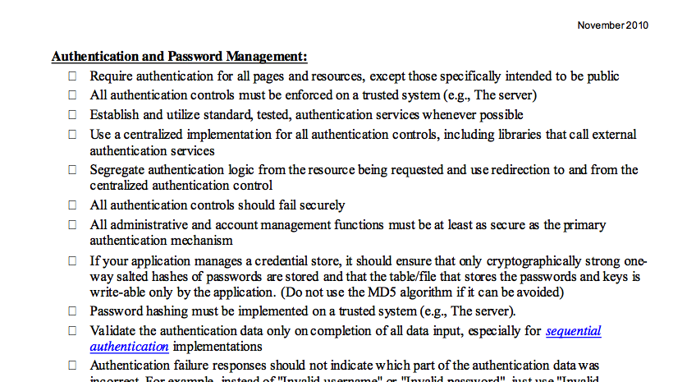
OWASP Secure Coding Practices – Quick Reference Guide
https://www.owasp.org/index.php/OWASP_Secure_Coding_Practices_-_Quick_Reference_Guide

Slide 4
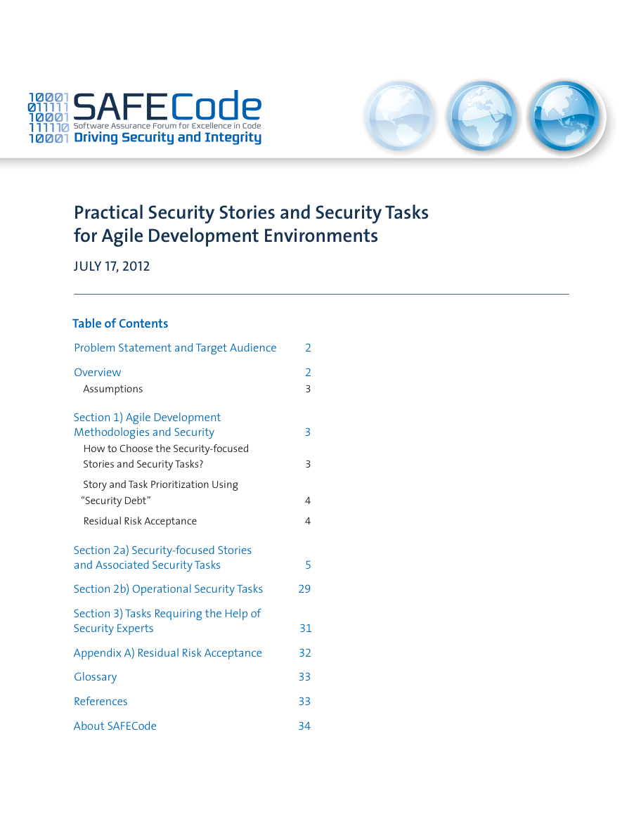
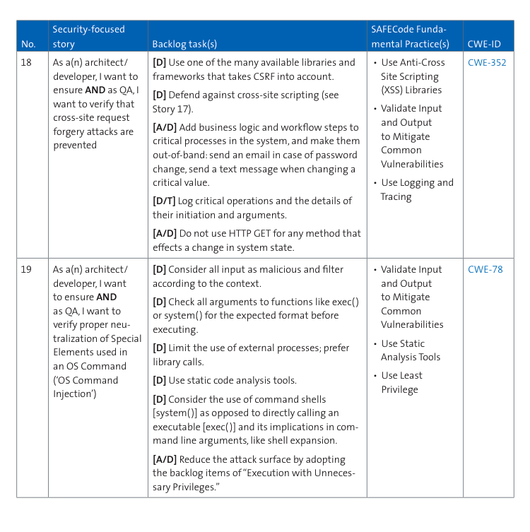
SAFECode - Practical Security Stories and Security Tasks for Agile Development Environments
http://www.safecode.org/publications/SAFECode_Agile_Dev_Security0712.Pdf

Slide 5

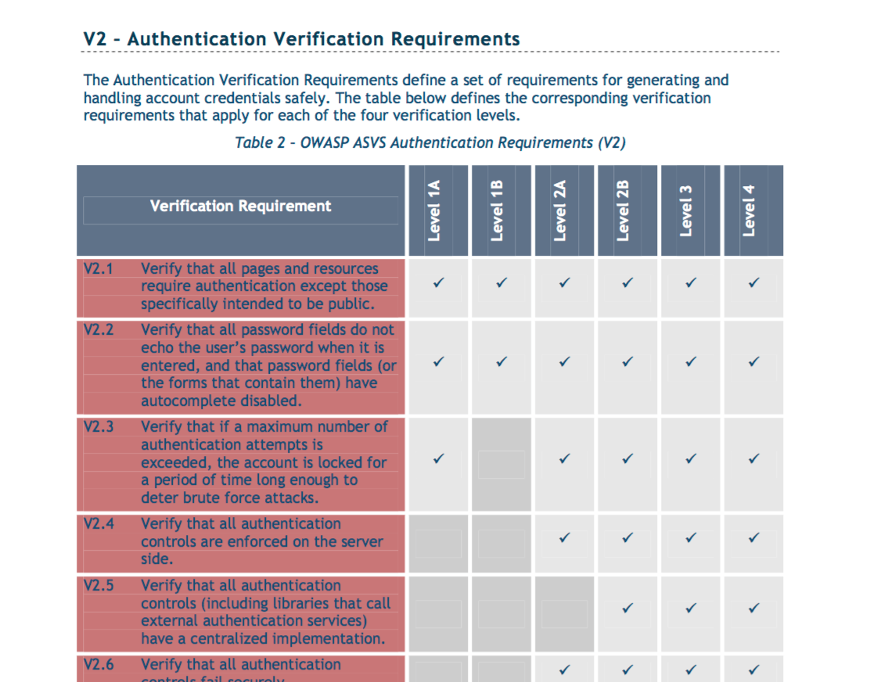
OWASP Application Security Verification Standard
http://www.safecode.org/publications/SAFECode_Agile_Dev_Security0712.Pdf

Slide 6
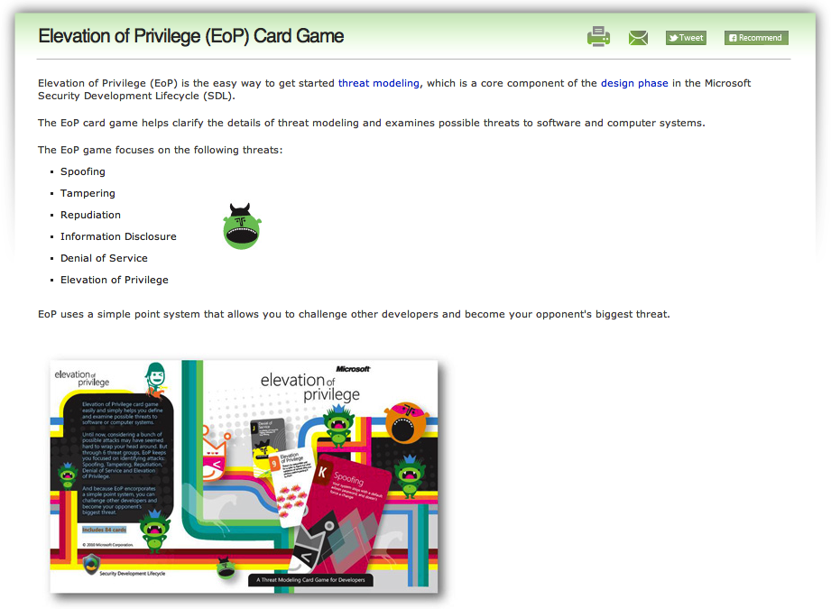
Microsoft Elevation of Privilege (EoP) Card Game
http://www.microsoft.com/security/sdl/adopt/eop.aspx

Slide 7
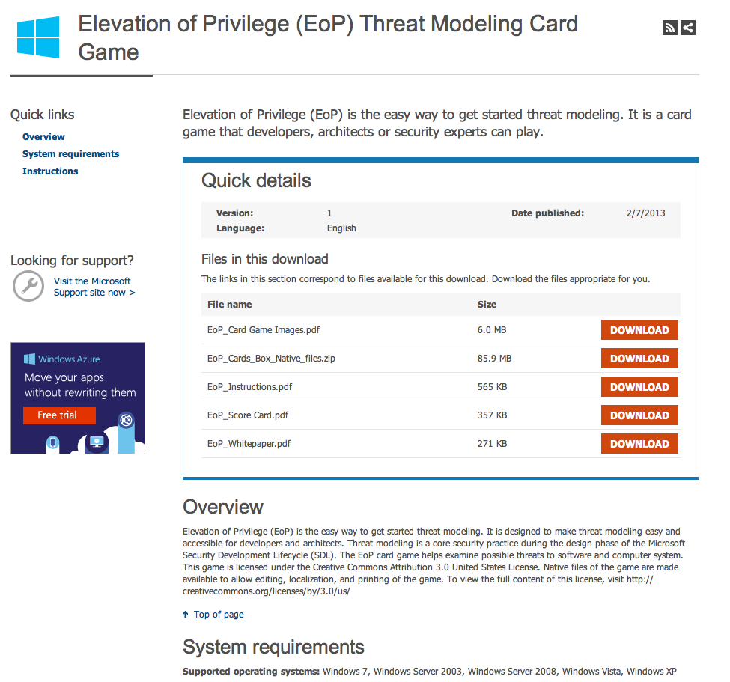
Downloads for EoP
http://www.microsoft.com/en-us/download/details.aspx?id=20303

Slide 8
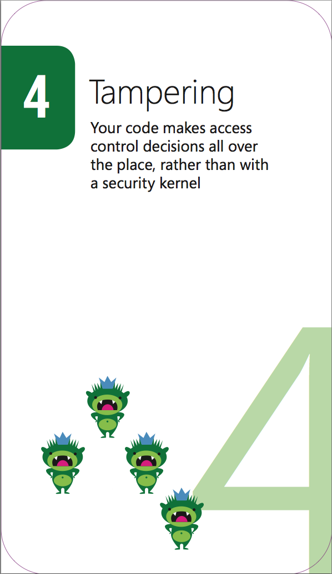
EoP is excellent, but a few things I wasn't so keen on
Not web application specific enough
A few Microsoft-isms
Less up-to-date
No cross-referencing
Impersonal
(Limited operating system support)
OWASP does not endorse or recommend commercial products or services

Slide 9
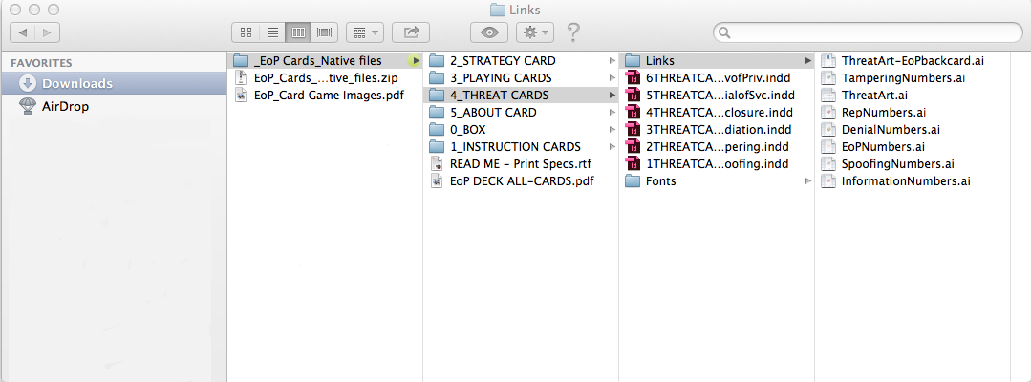
Resource constraints
No desktop publishing software
(Adobe InDesign and Illustrator)
No designer
No budget
Not much time
OWASP does not endorse or recommend commercial products or services

Slide 10
More web application relevant
ü
EoP examples
An attacker could squat on the random port or socket that the server normally uses
An attacker can confuse a client because there are too many ways to identify a server
An attacker can make [your authentication system|client|server] unusable or unavailable [without ever authenticating] [but the problem goes away when the attacker stops|and the problem persists after the attacker goes away] (10 cards)
An attacker can provide a pointer across a trust boundary, rather than data which can be validated
Cornucopia examples
Gary can take over a user's session because there is a long or no inactivity timeout, or a long or no overall session time limit, or the same session can be used from more than one device/location
Marce can forge requests because per-session, or per-request for more critical actions, strong random tokens or similar are not being used for actions that change state
Eduardo can access data he does not have permission to, even though he has permission to the form/page/URL/entry point

Slide 11
More coverage of web security requirements
ü
EoP suits = STRIDE
Spoofing
Impersonating something or someone else
Tampering
Modifying data or code
Repudiation
Claiming to have not performed an action
Information Disclosure
Exposing information to someone not authorized to see it
Denial of Service
Deny or degrade service to users Elevation of Privilege Gain capabilities without proper authorization
Cornucopia suits
Data validation and encoding
Input and output data validation and escaping
Authentication
Verification of identity claims and related processes
Session management
Maintenance of user state
Authorization
User/role permission controls
Cryptography
Hashing, digital signatures, encryption and random number generation processes and their usage including key management
Cornucopia (everything else)
Including information leakage, data loss, dependencies, abuse of trust, non-repudiation, configuration management, function misuse, denial of service
http://STRIDE

Slide 12
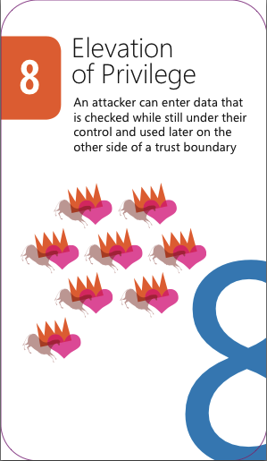
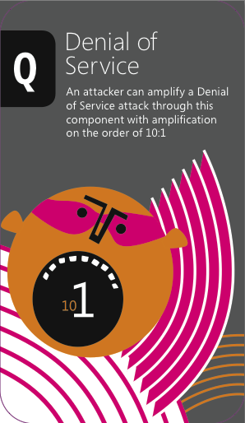
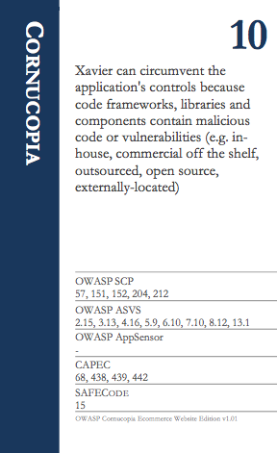
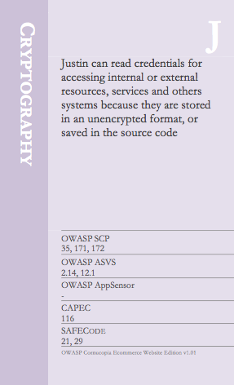


Less colourful and less pictorial
û
ü
EoP playing cards
Cornucopia playing cards

Slide 13
Less vendor specific and more webapp/OWASP specific
ü
EoP examples
An attacker could take advantage of .NET permissions you ask for, but don’t use
An attacker can alter information in a data store because it has weak ACLs or includes a group which is equivalent to everyone (“all LIve ID holders”)
Cornucopia examples
Bob can influence, alter or affect the application so that it no longer complies with legal, regulatory, contractual or other organizational mandates
You have invented a new attack of any type
  Read more about application security in OWASP’s free Guides on Requirements, Development, Code Review and Testing, the Cheat Sheet series, and the Open Software Assurance Maturity Model
You have invented a new attack against Authorization
  Read more about this topic in OWASP’s Development and Testing Guides

Slide 14
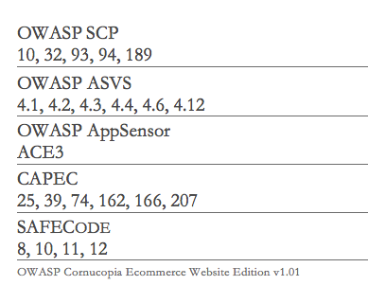
More information rich
ü
EoP
Suit name (e.g. Denial of Service)
Attack description
Ranking (card number)
Cornucopia
Suit name (e.g. Authentication)
Attack description
Ranking (card number)
Cross-referencing
Security requirements, security verification checks, attack detection points, attack patterns and Agile user stories

Slide 15
More individual
ü
EoP
An attacker could steal credentials stored on the server and reuse them (for example, a key is stored in a world readable file)
An attacker can manipulate data because there’s no integrity protection for data on the network
An attacker can provide or control state information
An attacker can say “I didn’t do that,” and you’d have no way to prove them wrong
Cornucopia
Shamun can bypass input validation or output validation checks because validation failures are not rejected or sanitized
Kyun can access data because it has been obfuscated rather than using an approved cryptographic function
Keith can perform an action and it is not possible to attribute it to him

Slide 16
What's in a name?
ü
The “names” can represent
External or internal people
Aliases for computer system components
  The application itself
  Other applications
  Services
  Operating systems
  Infrastructure
Jim can undertake malicious, non-normal, actions without real-time detection and response by the application

Slide 17
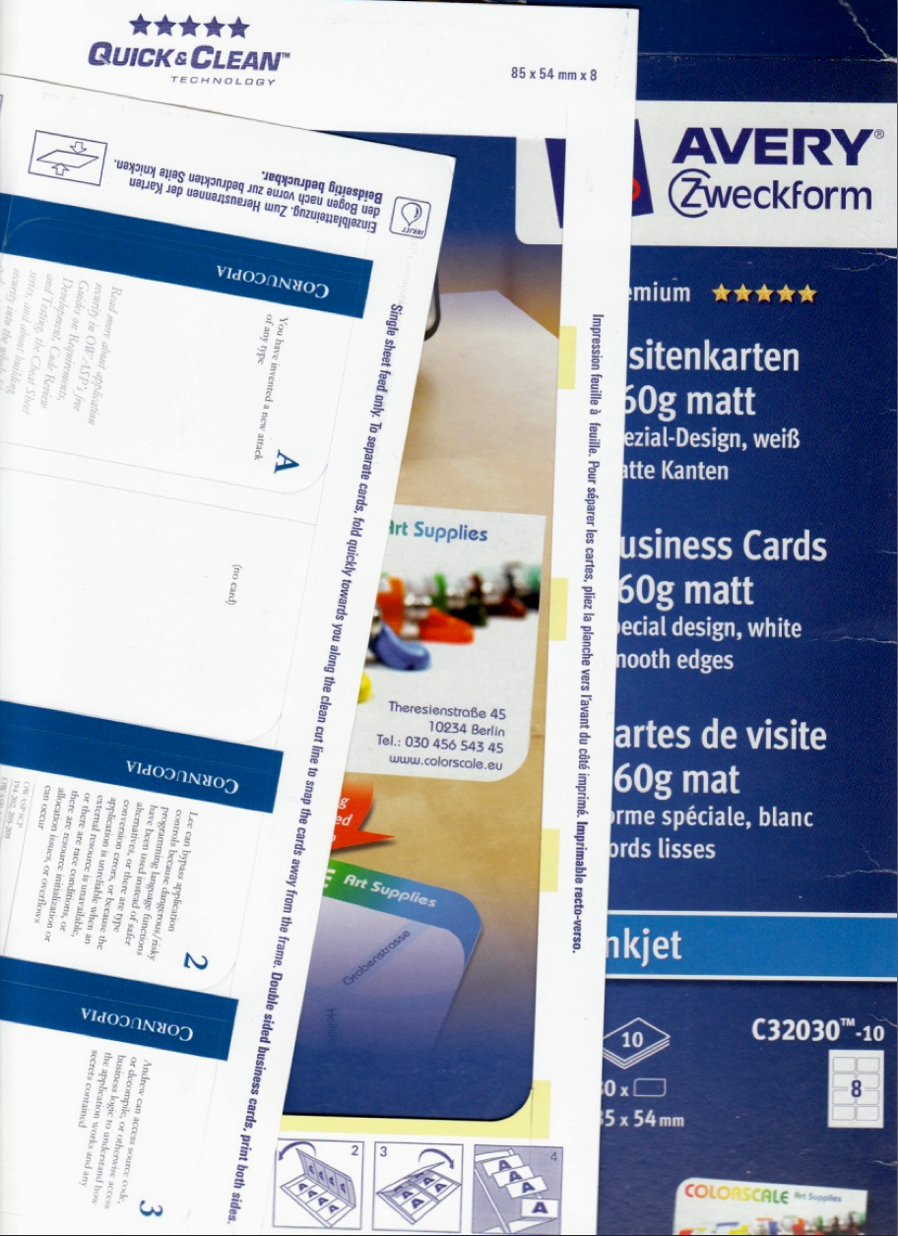
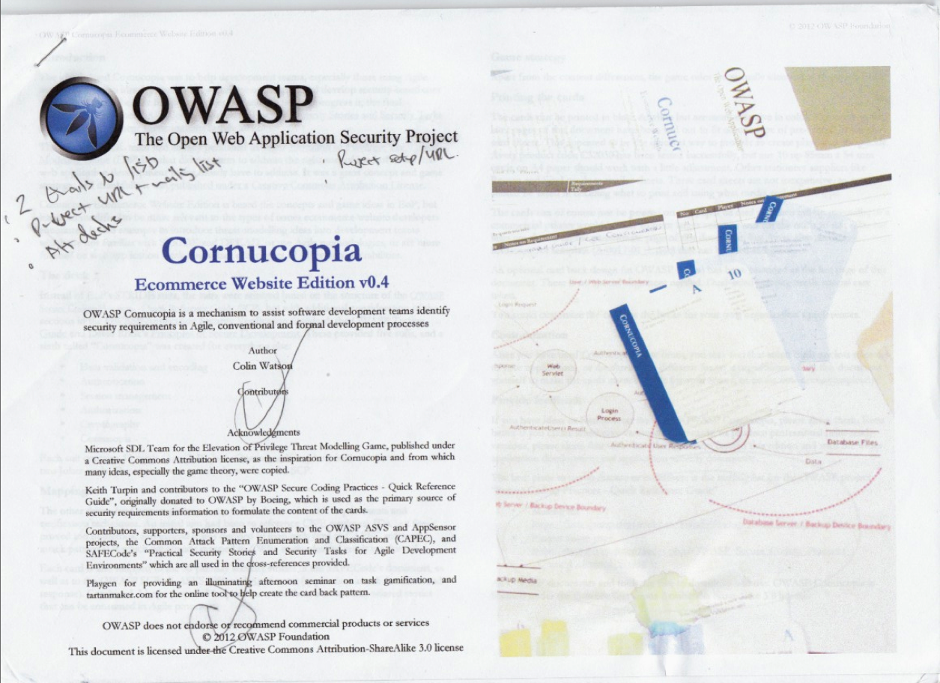
Print your own
Word document
Media
  Business card pre-scored sheets
  Other card (and knife/scissors)
Colour printer
Some time
OWASP does not endorse or recommend commercial products or services

Slide 18
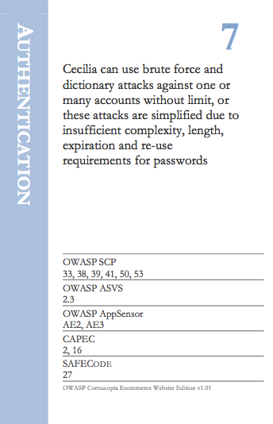
Identifying requirements with each card played
Suit and value
Attack description
Cross-referencing
Is this a viable attack for the function/system under consideration?
Document the attack
Subsequently use the cross-references to help create security requirements:
  User stories
  Unit tests
  Configurations
  etc

Slide 19
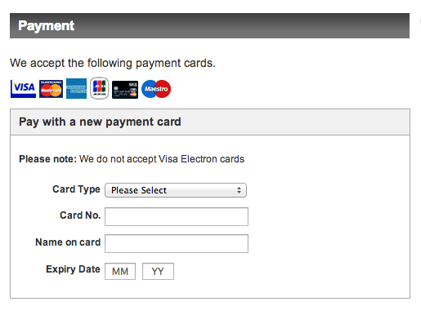
Example: Third party hosted payment form 1/2
Common e-commerce implementations
Merchant-managed e-commerce implementations
  Proprietary/custom developed shopping cart/payment application
  Commercial shopping cart/payment application
Shared-management e-commerce implementations
  Third-party embedded application programming interfaces (APIs) with Direct Post
  An inline frame (or “iFrame”) that allows a payment form hosted by a third party to be embedded within the merchant’s page(s)
  Third-party hosted payment page which redirects the consumer to a page on an entirely different domain for payment entry
Wholly outsourced e-commerce implementations

Slide 20
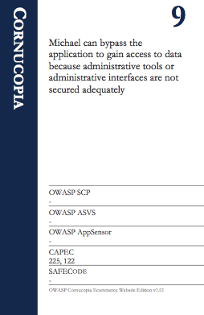
Example: Third party hosted payment form 2/2
The template hosted at the third party Payment Service Provider could be modified by an attacker
  Direct attack on the PSP's systems
  Compromise of the template customisation method

Slide 21
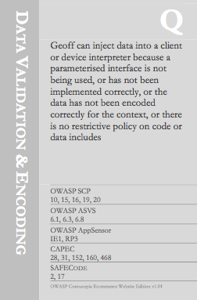
Example: Third party hosted payment form 3/3
Content on the page is included from a less trusted source
  JavaScript
  CSS
  Images
Another third party (e.g. metrics, hosted JavaScript library)
First party (i.e. merchant)

Slide 22
Deal the deck of cards
Yui
Adrian
Outcomes:
Players have the same number of cards each
Randomly select one player to lead the play for the first round
e.g. Adrian
10
J
9
8
4
K
5
7
8
J
A
Q
7
A
9
10
4
8
2
2
Imogen
Steven

Slide 23
Let play commence – First round
1
0
Requirements
Rounds
1
1
Requirements
Rounds
0
0
0
0
10
7
8
7
3
J
K
J
A
8
Schedule of requirements
Yui
Adrian
Assume every player Except “Imogen” identified a security requirement, thus 1 point each for the others
“Adrian” won the round with the King so he gets an additional 1 point, and leads the play for the next round
Imogen
Steven
8
4
Q
9
2
9
5
A
10
2
0
0
Requirements
Rounds
0
0
Requirements
Rounds
1
0
0
0

Slide 24
Second round
1
0
Requirements
Rounds
2
1
Requirements
Rounds
1
0
1
1
10
7
7
3
J
J
A
8
Schedule of requirements
Yui
Adrian
Only “Adrian” and “Imogen” identified new requirements and they each receive 1 point
“Steven” won the round with the Ace so he gets 1 point for that, and leads the play for the next round
Imogen
Steven
8
4
Q
9
9
5
A
2
1
0
1
0
Requirements
Rounds
0
0
Requirements
Rounds
1
1

Slide 25
Third round
2
0
Requirements
Rounds
3
1
Requirements
Rounds
1
0
2
1
10
7
7
J
A
8
Schedule of requirements
Yui
Adrian
Everyone identified new requirements and they each receive 1 point
“Imogen” won the round with the Queen so she gets 1 point for that, and leads the play for the next round
Imogen
Steven
8
Q
9
9
5
2
1
1
Requirements
Rounds
2
1
Requirements
Rounds
2
1
1
0

Slide 26
Fourth round
3
0
Requirements
Rounds
4
2
Requirements
Rounds
2
0
3
1
10
7
J
A
Schedule of requirements
Yui
Adrian
Everyone identified new requirements and they again each receive 1 point
“Adrian” won the round with the Jack so he gets 1 point for that, and leads the play for the final round – he also has the most points so far
Schedule of requirements
Imogen
Steven
8
9
5
2
2
1
Requirements
Rounds
3
1
Requirements
Rounds
3
1
2
1

Slide 27
Fifth and final round
3
0
Requirements
Rounds
5
2
Requirements
Rounds
3
0
4
2
10
A
Schedule of requirements
Yui
Adrian
Everyone except “Yui identified new requirements and they each receive 1 point
“Imogen” won the round with the 8 (trumps) so she gets 1 point for that
Overall Adrian wins the game with a total of 7 points
Schedule of requirements
Imogen
Steven
8
2
3
1
Requirements
Rounds
4
2
Requirements
Rounds
4
1
3
1

Slide 28
Choose your deck of cards
Cornucopia suits
Data validation and encoding
Input and output data validation and escaping
Authentication
Verification of identity claims and related processes
Session management
Maintenance of user state
Authorization
User/role permission controls
Cryptography
Hashing, digital signatures, encryption and random number generation processes and their usage including key management
Cornucopia (everything else)
Everything else including information leakage, data loss, configuration management, denial of service
Full deck

Slide 29
Application-specific decks
Cornucopia suits
Data validation and encoding
Input and output data validation and escaping
Authentication
Verification of identity claims and related processes
Session management
Maintenance of user state
Authorization
User/role permission controls
Cryptography
Hashing, digital signatures, encryption and random number generation processes and their usage including key management
Cornucopia (everything else)
Everything else including information leakage, data loss, configuration management, denial of service
Public information website
Extranet

Slide 30
Development-specific decks
Cornucopia suits
Data validation and encoding
Input and output data validation and escaping
Authentication
Verification of identity claims and related processes
Session management
Maintenance of user state
Authorization
User/role permission controls
Cryptography
Hashing, digital signatures, encryption and random number generation processes and their usage including key management
Cornucopia (everything else)
Everything else including information leakage, data loss, configuration management, denial of service
Organisation's coding and configuration standards
or
Compliance requirements (e.g. PCIDSS)
Framework X

Slide 31
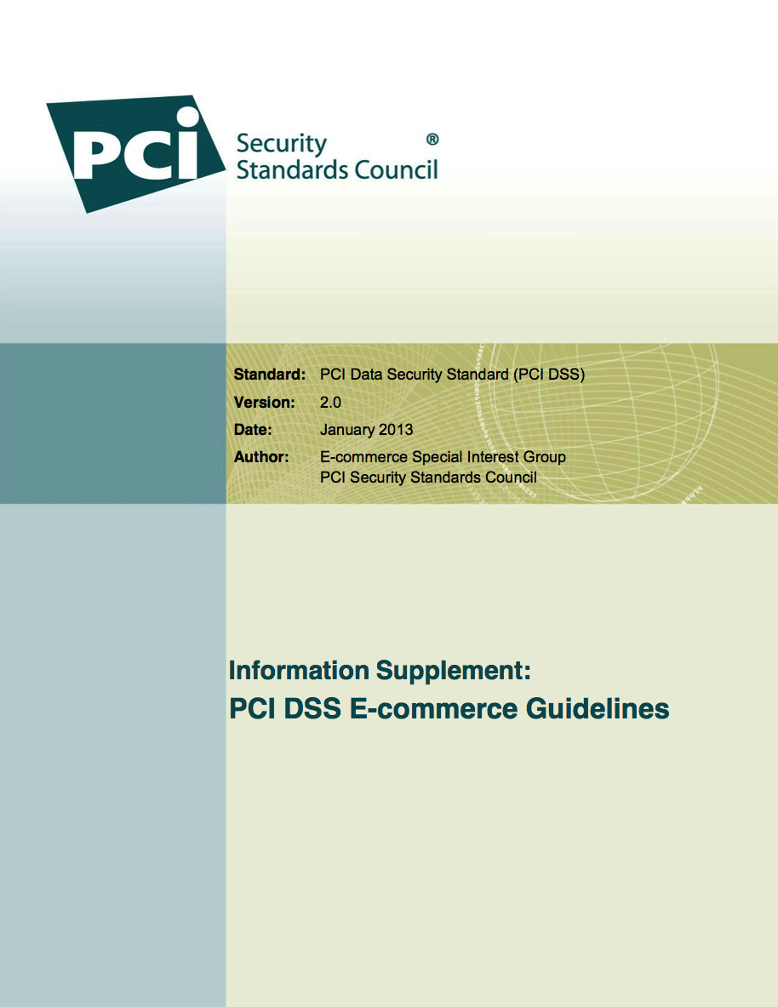
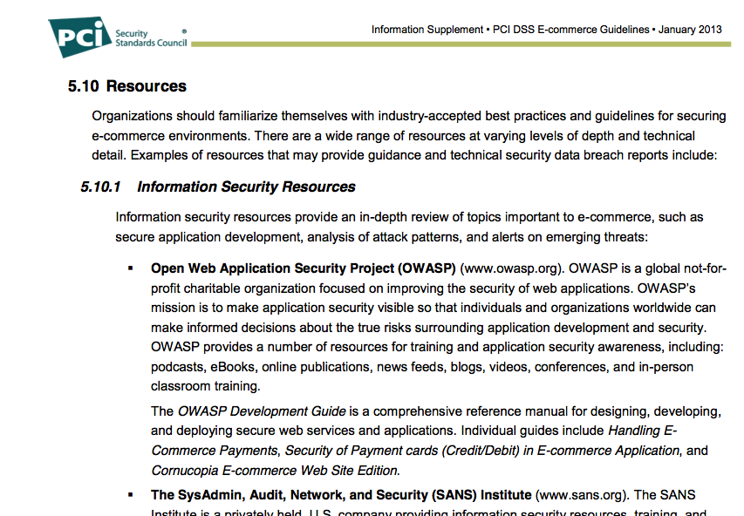
Who cares?

Slide 32
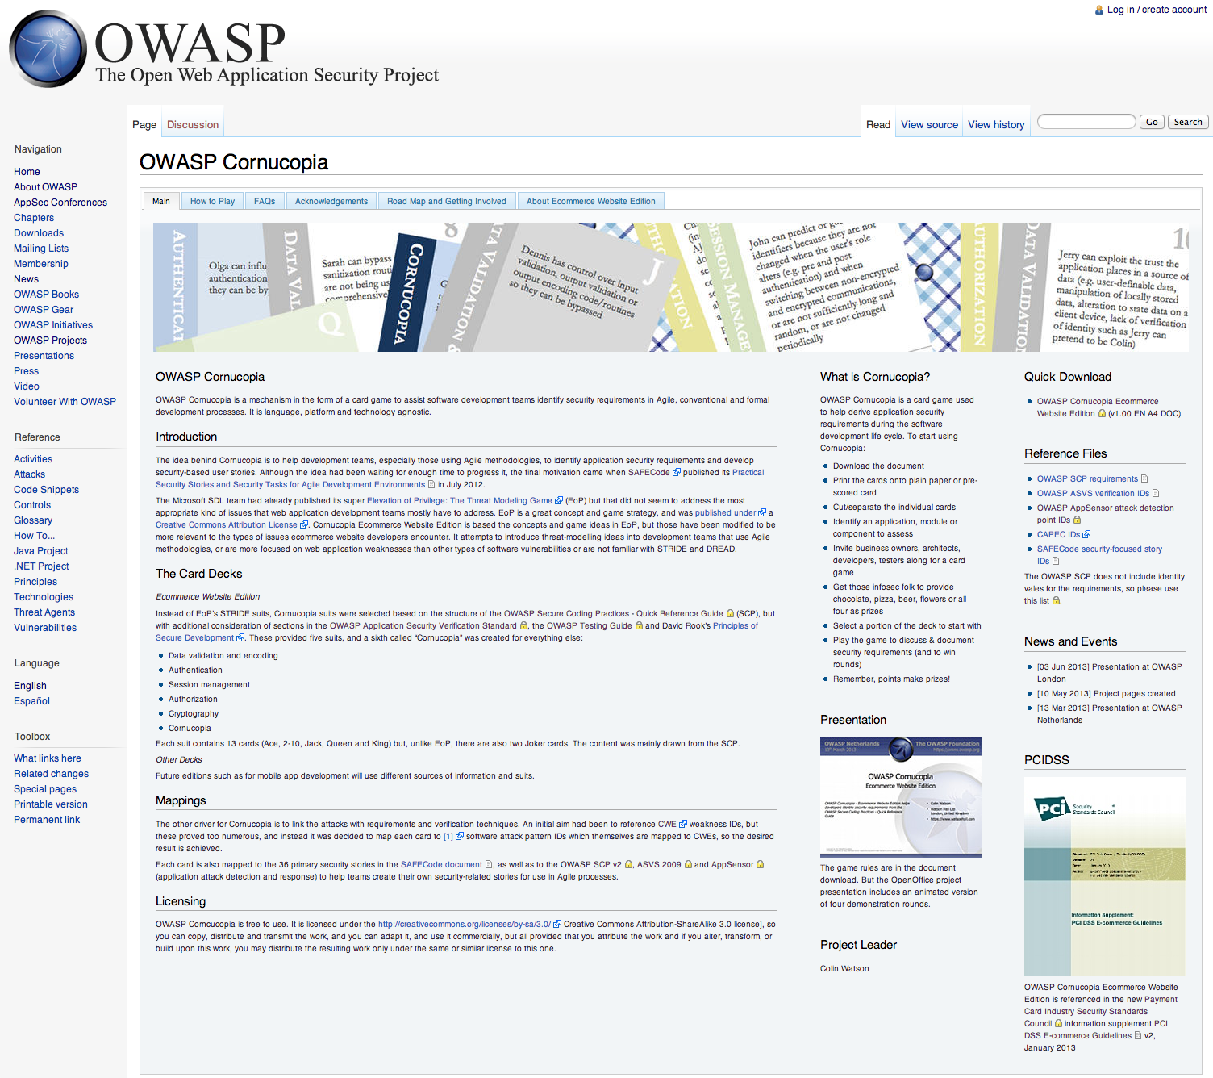
Project on the OWASP wiki
https://www.owasp.org/index.php/OWASP_Cornucopia

Slide 33
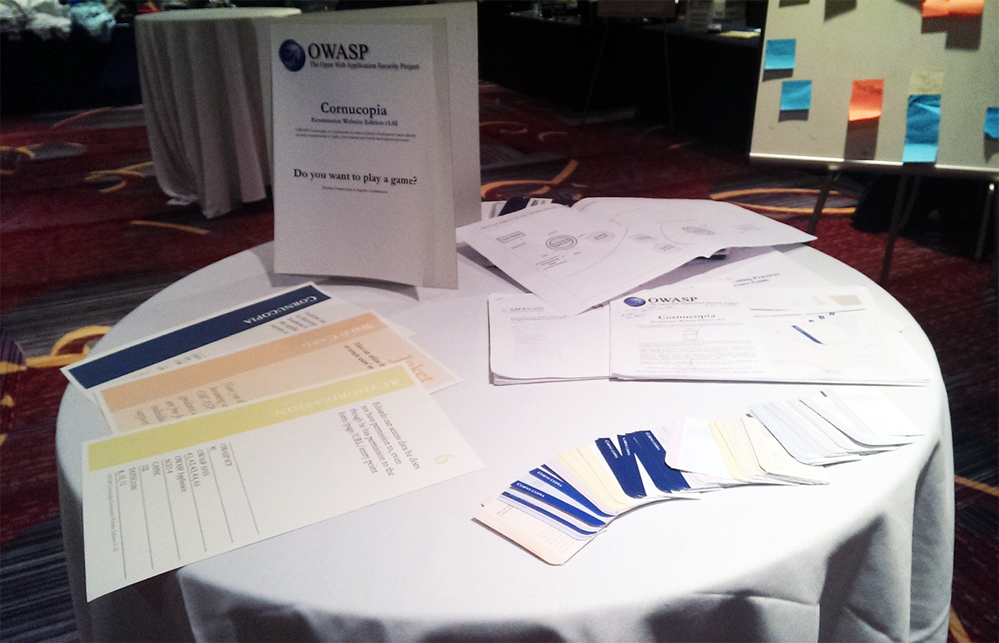
Pop up Cornucopia

Slide 34
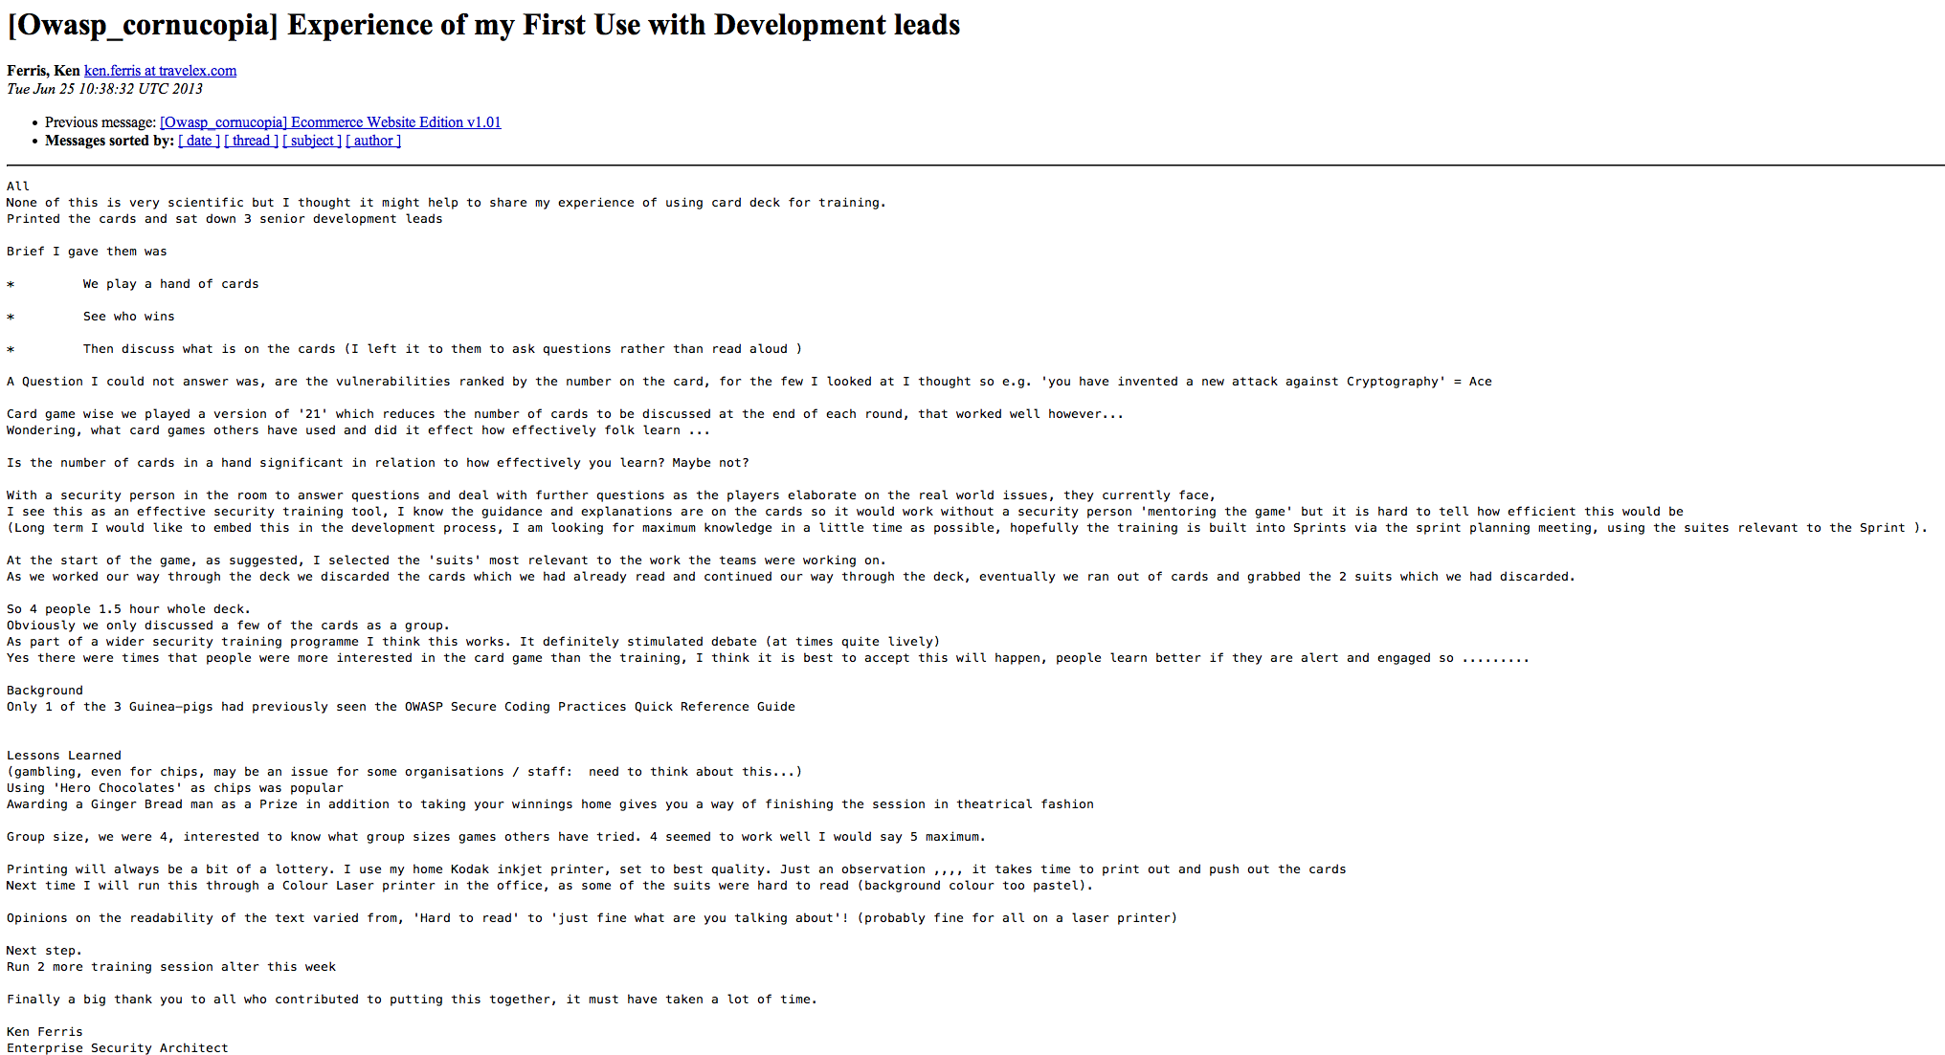
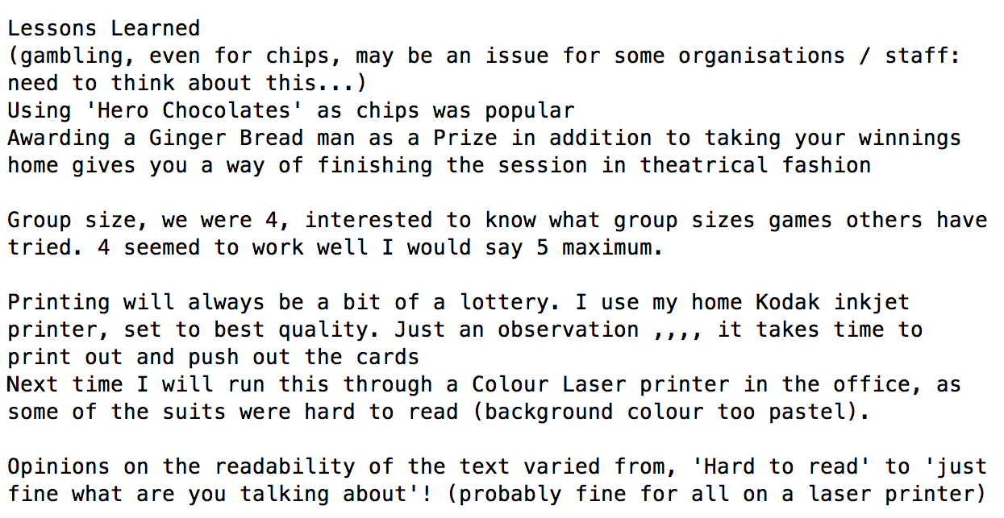
Feedback via mailing list
https://lists.owasp.org/mailman/listinfo/owasp_cornucopia

Slide 35
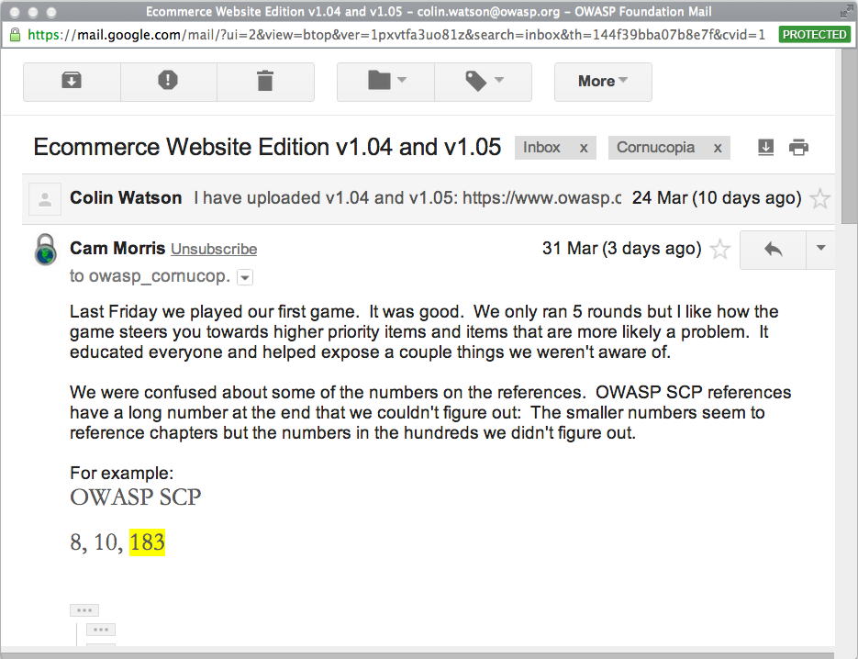
Feedback on mailing list this week

Slide 36
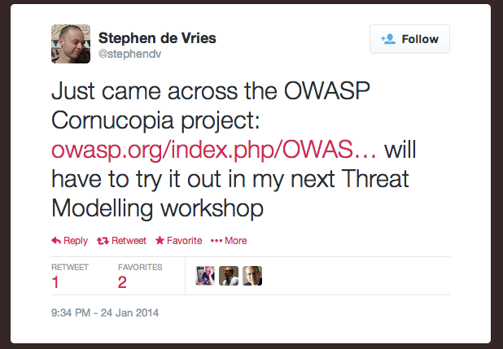
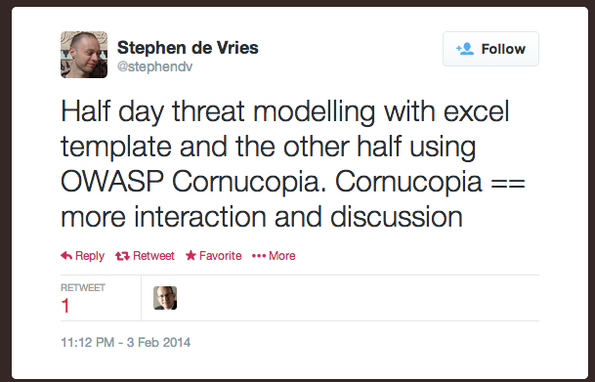
Feedback via Twitter

Slide 37
Project plan
Improvements
Framework-specific card decks
Enhance text and mappings
Further developer feedback
Issue further releases
Translations
Other editions
(Ecommerce website)
Web services
Mobile app
Other... e.g. smart meter

Slide 38
Other ways to print/obtain the cards
OWASP Cornucopia is free to use
Creative Commons Attribution-ShareAlike 3.0 license
  You are free to
    Share - copy and redistribute the material in any medium or format
    Adapt - remix, transform, and build upon the material
  for any purpose, even commercially.
  Under the following terms
    Attribution
    ShareAlike
2013 - Blackfoot
  Create source image files and PDF print-ready designs
    Gifted these files back to the project
  Printed 100s card decks
    Gifted 250 to OWASP
    Giving the others away free of charge through their website
2014 - OWASP
  OWASP-branded boxes
  Online store / chapter funds
2015 - OWASP
  Online store
OWASP does not endorse or recommend commercial products or services

Slide 39
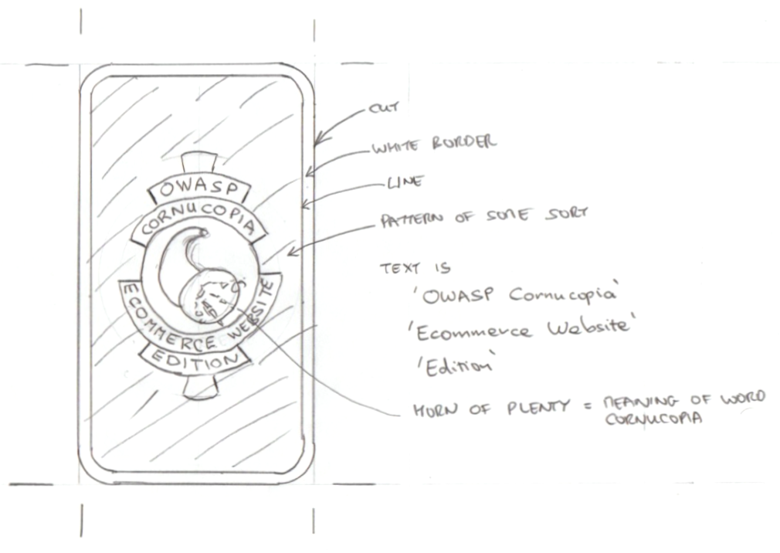
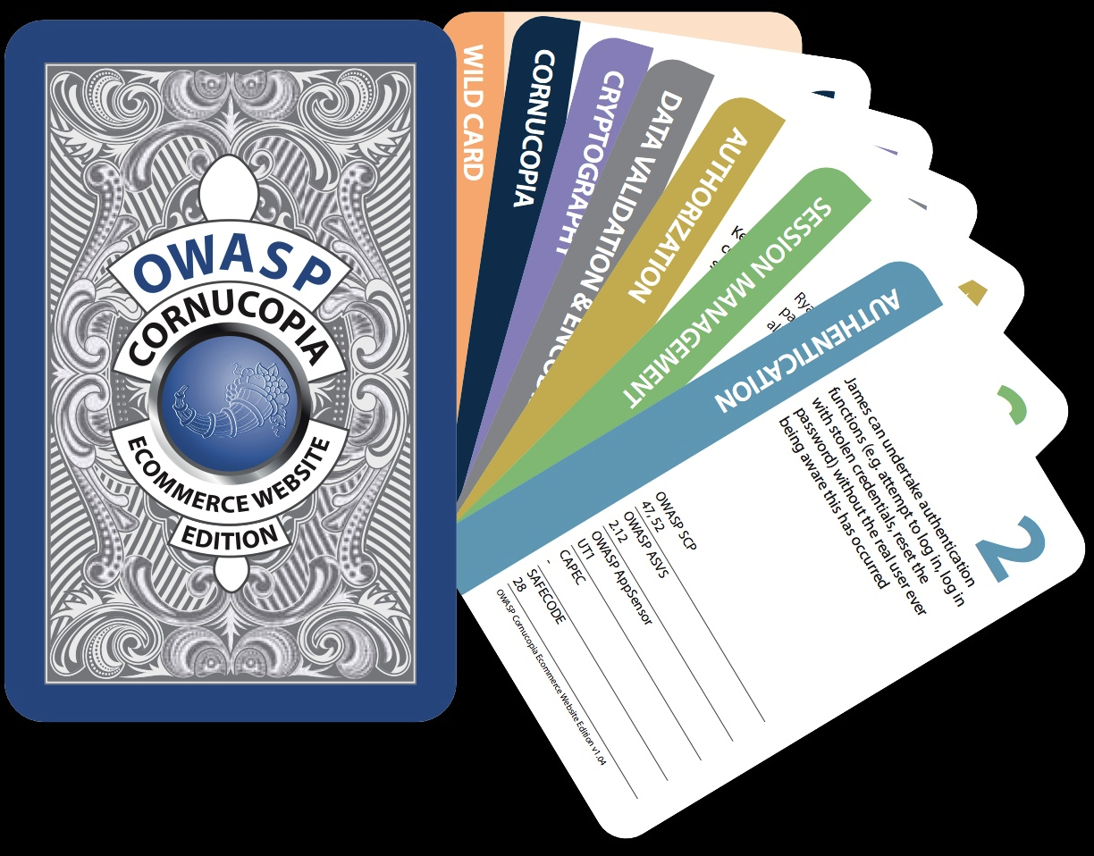
Now with design
?

Slide 40
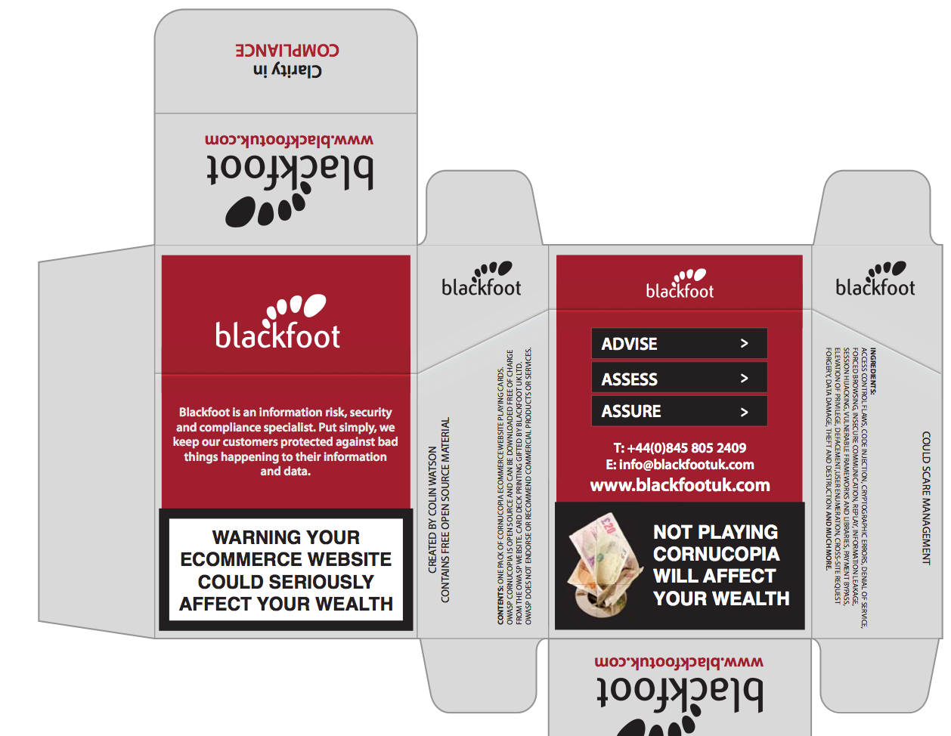
And with a box

Slide 41
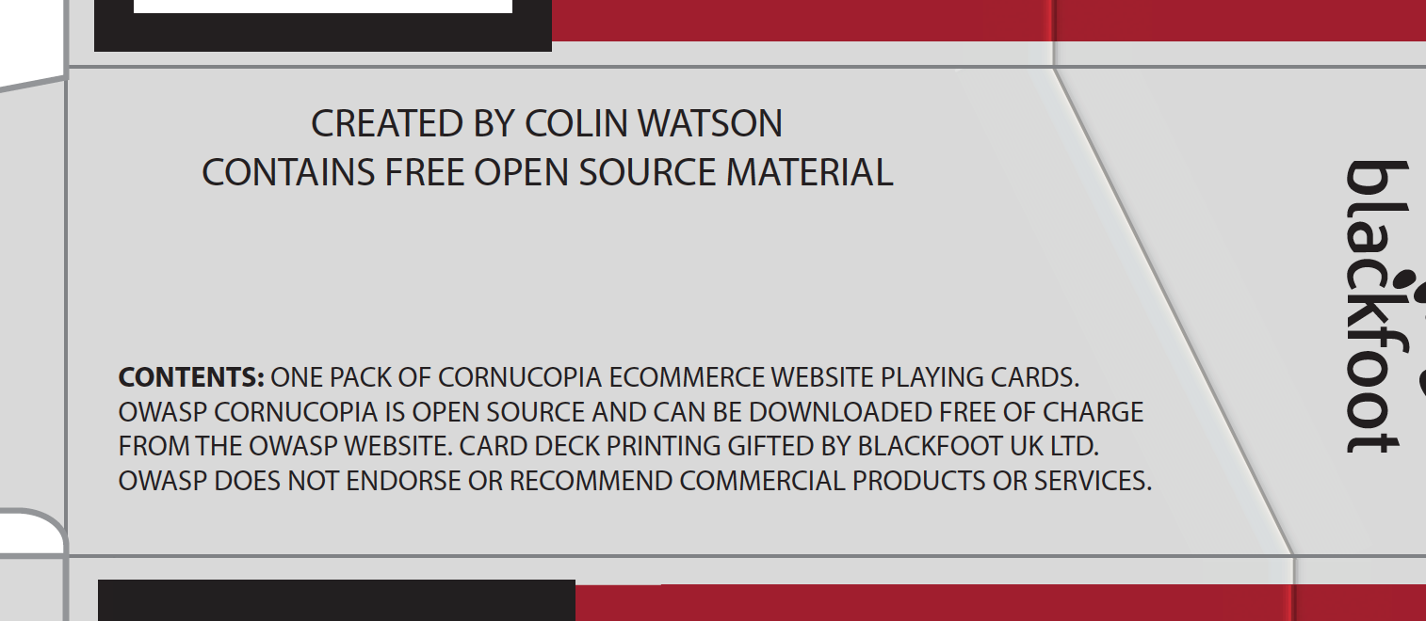
Side 1 - Contents

Slide 42
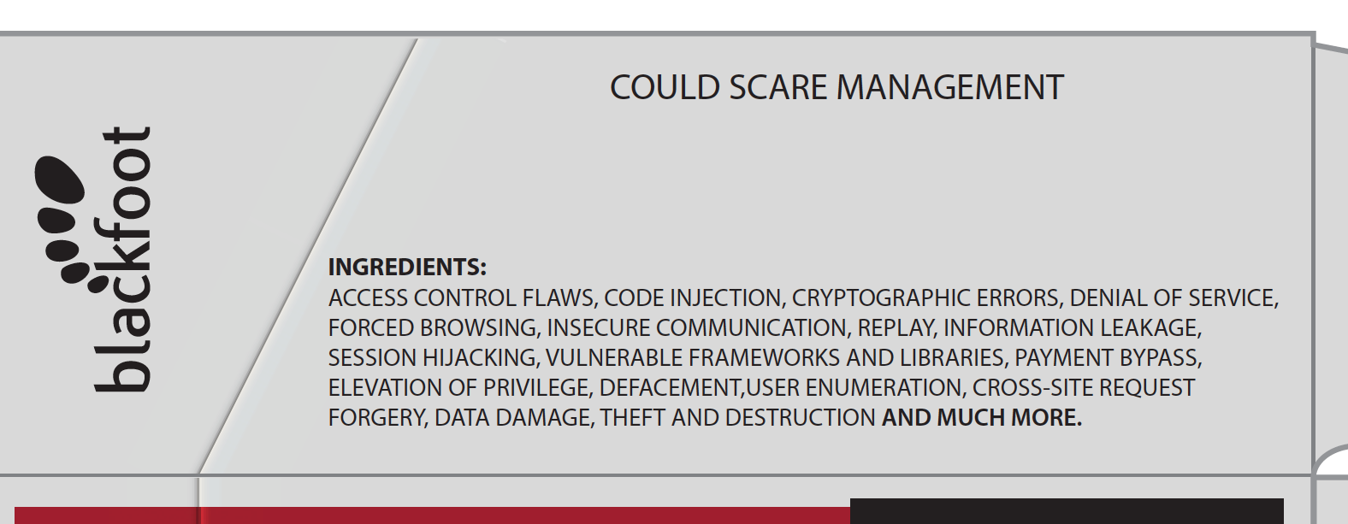
Side 2 - Ingredients

Slide 43
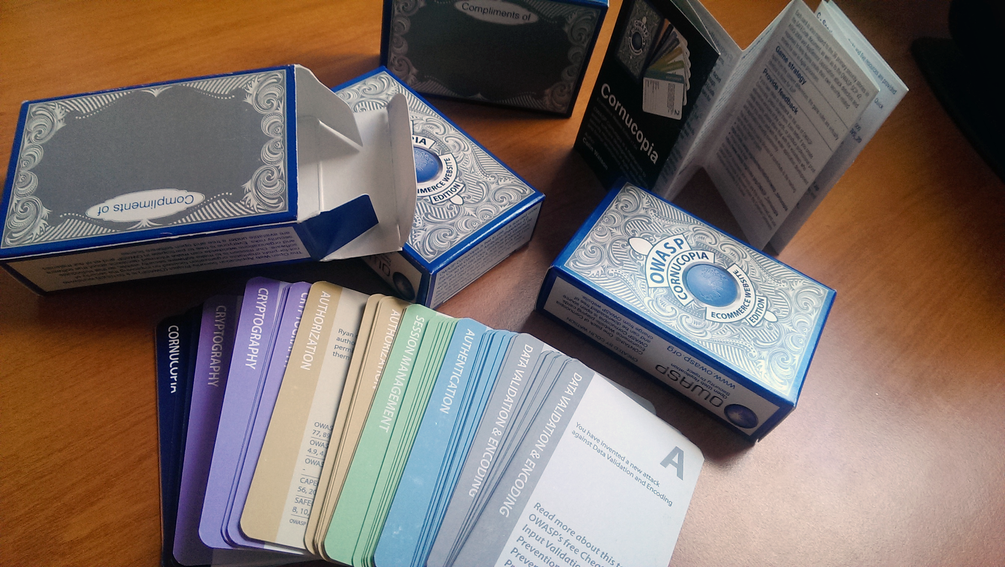
OWASP boxes and leaflets

Slide 44
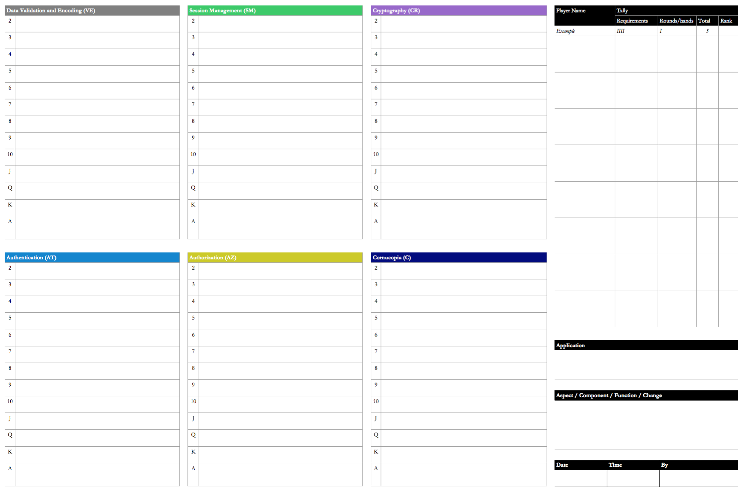
Paper score sheet (bug tracking system is much better)

Slide 45
Updated versions
1.10 (March 2015)
Mappings updated
  OWASP ASVS 2014
Minor text changes
  Descriptions on a few cards to improve readability
List of contributors updated
1.20-EN (June 2016)
Mappings updated
  Mitre CAPEC v2.8 (November 2015)
  OWASP ASVS v3.0.1 (29 June 2016)
Minor text changes
  Descriptions on a small number of cards
  Instructions and FAQs
How to Play video mentioned/linked
Separate score sheet mentioned/linked
Previous embedded score sheet pages deleted
Wiki Deck link added
Correction (identified by Tom Brennan) and addition to text on card 8 Authentication
Co-leader added and list of contributors updated

Slide 46
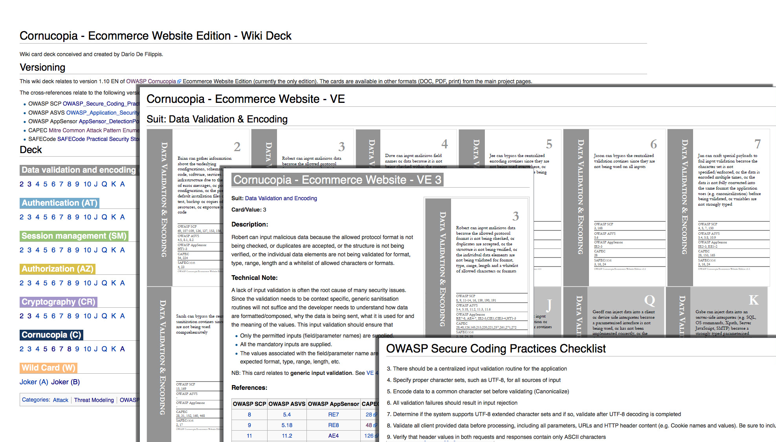
Wiki deck

Slide 47
Break
Pizza
After break
Video demo
Play the game

Slide 48
How to play
Video

Slide 49
Let's play the game
Deck of cards
Players
Target of assessment
Record-keeping sheet
Prizes!
6-8 people per table

Slide 50
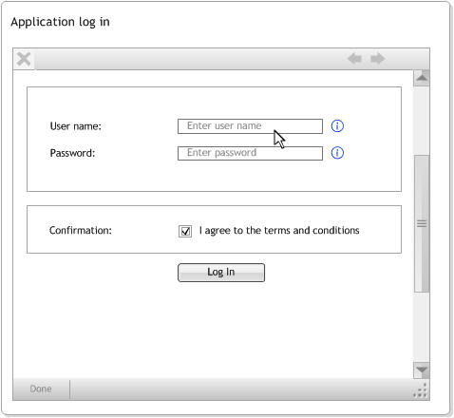
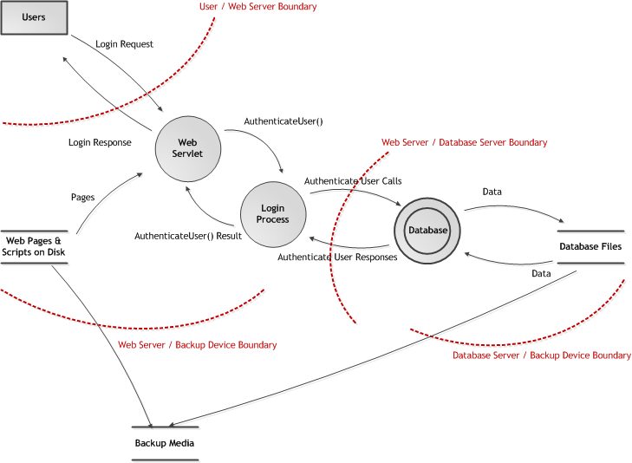
Assessment target

Slide 51
Cornucopia Gamification
Motivations
To develop skills
Winning
Social mechanics
Achievement
Feedback to improve performance
Game mechanics
Turns
Random
Quest
Points
Rewards
Victory condition
Victory points
Victory condition
Victory points
Business outputs
Security requirements (or threat model)
Education/awareness
http://gamification.playgen.com/

Slide 52
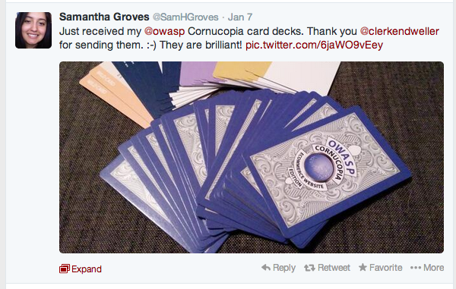
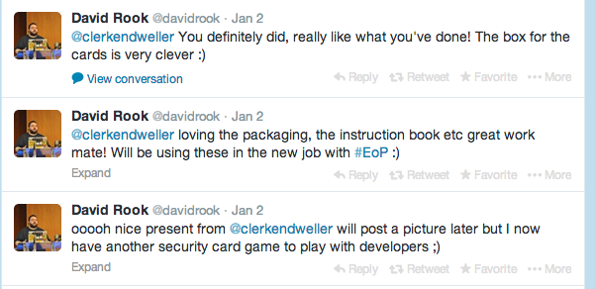
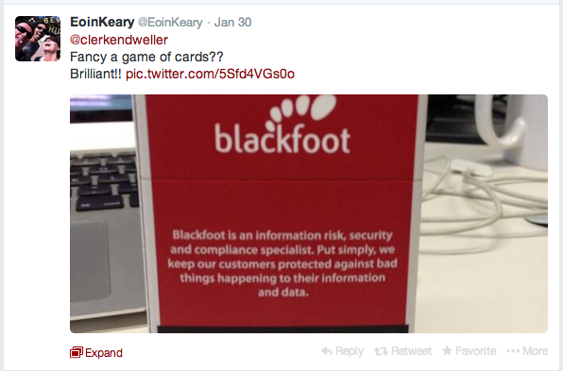
Twitter feedback about printed decks

Slide 53
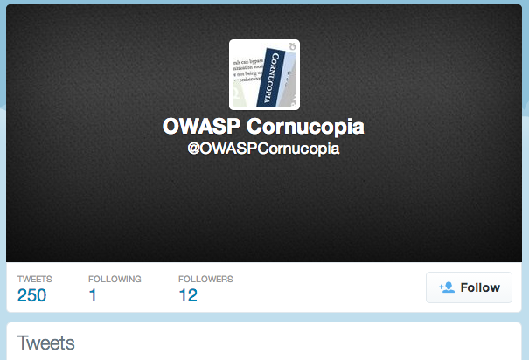
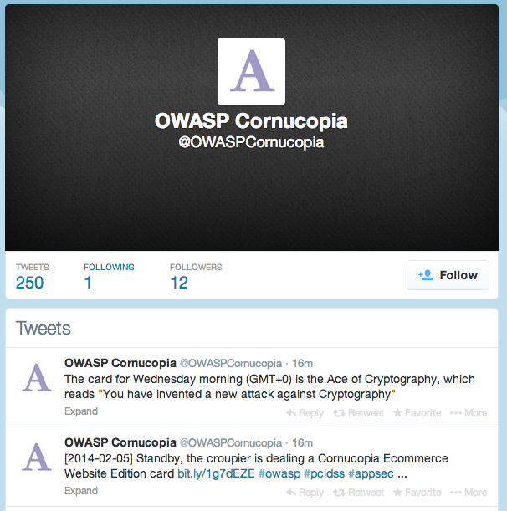
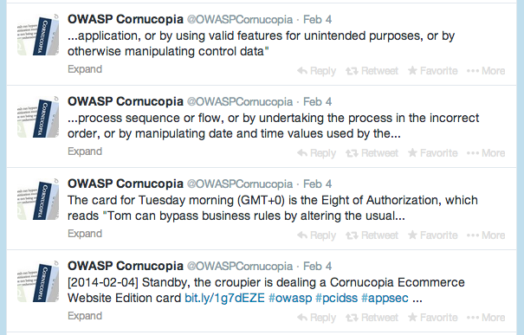
The Cornucopia Croupier

Slide 54
The project
OWASP Cornucopia
Project https://www.owasp.org/index.php/OWASP_Cornucopia
Mailing list https://lists.owasp.org/mailman/listinfo/owasp_cornucopia
Buy card decks
OWASP Portal
Download Cornucopia Ecommece Website Edition v1.20
https://www.owasp.org/index.php/File:OWASP-Cornucopia-Ecommerce_Website.docx
Project leaders
Colin Watson
Darío De Filippis

Slide 55
Stop

