Slide 1
OWASP Threat Dragon
Mike Goodwin
OWASP Newcastle
September 2017

Slide 2
Agenda
Threat modelling overview (optional)
Project goals
Internals
Demo
Where next?

Slide 3
What is threat modelling?
Threat modelling is a process by which potential threats can be identified, enumerated, and prioritized – all from a hypothetical attacker’s point of view. The purpose of threat modelling is to provide defenders with a systematic analysis of the probable attacker’s profile, the most likely attack vectors, and the assets most desired by an attacker.
- Wikipedia

Slide 4
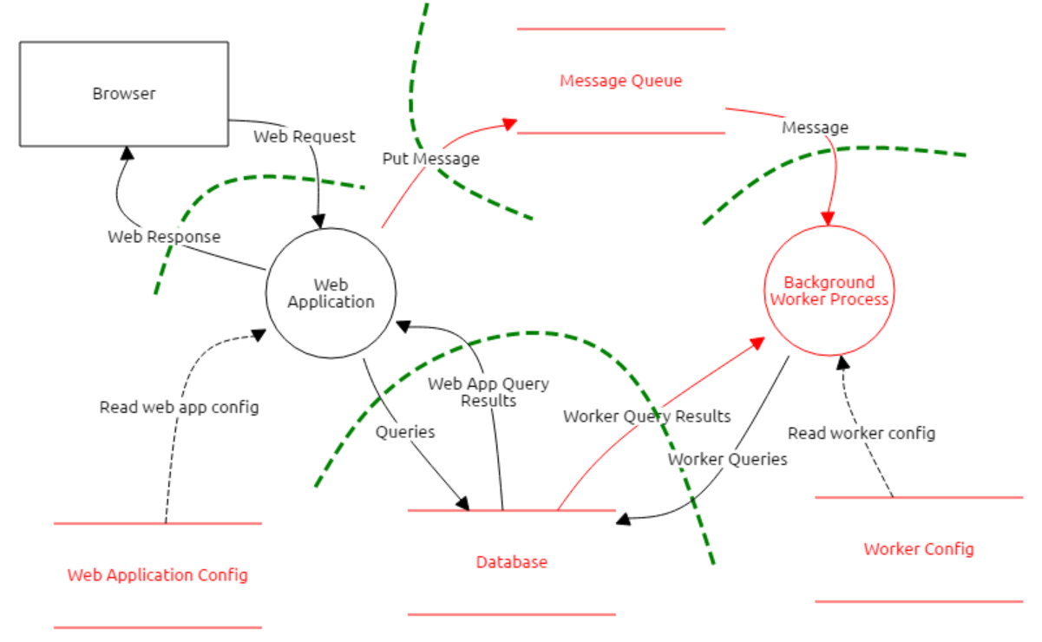
Data flow diagrams

Slide 5
STRIDE
S – spoofing
T – tampering
R – repudiation
I – information disclosure
D – denial of service
E – elevation of privilege

Slide 6
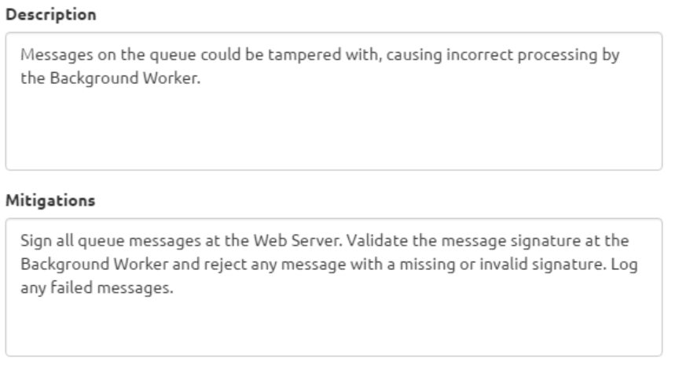

Slide 7
Goals and status
Free, open-source and cross platform
Fun and engaging user experience
Aligned and integrated with developer tools
Powerful threat generation engine
Currently an OWASP Incubator Project
Notes:
Background – have done a lot with the MSFT Threat modelling tool which is OK (recent versions seem to be a lot better). But it’s not cross platform.
There are some paid for tools that I’ve never used.
A lot of stuff is done ad-hoc/with whiteboard/on paper which can work really well, but relies a lot on expertise in the team and is hard to evolve or maintain.

Slide 8


Technology overview
Angular web client shell
Electron app shell
Core Components
Core Components
Node.js Web App
Web application variant
Desktop application variant
Notes:
Core components delivered as an NPM package containing an Angular module

Slide 9
Core vs. shell
Core (85% of the code) | Web app | Desktop app shell
Diagramming | Container | Container
Threat generation | Authentication | Installer and automatic update
Threat model encapsulation | Interaction with GitHub | Interaction with file system
Core plumbing and navigation

Slide 10


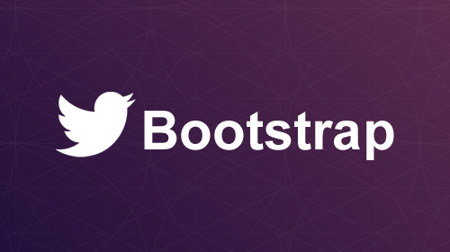
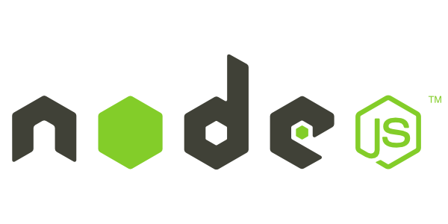



Main libraries/components

Slide 11
Demo

Slide 12
Roadmap: Threat generation
Threat libraries
Based on context of the application (e.g. eCommerce threats)
https://www.owasp.org/index.php/OWASP_Automated_Threats_to_Web_Applications
Based on the context of an element (e.g. elements connected to data flows across trust boundaries)
User defined
Balance between doing too much and not doing enough
(Plumbing) Replace rule engine

Slide 13
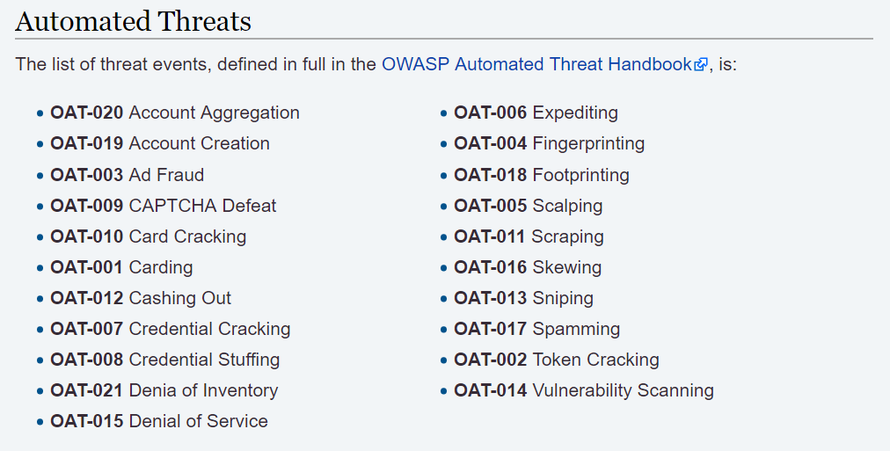

Slide 14
Roadmap: Improve UX and add features
Selecting private/public repos
Undo/redo
Threat model reports*
Diagramming improvements
Capture more information about models/elements (to support threat generation)
Code signing/auto-update for OSX

Slide 15
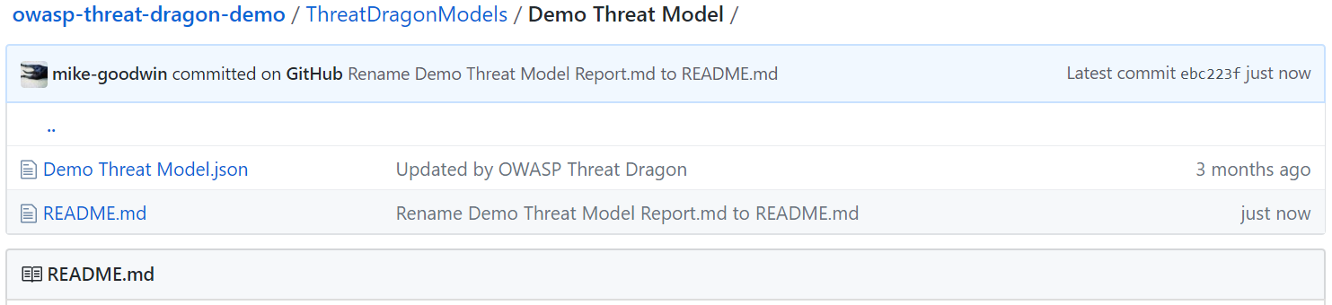
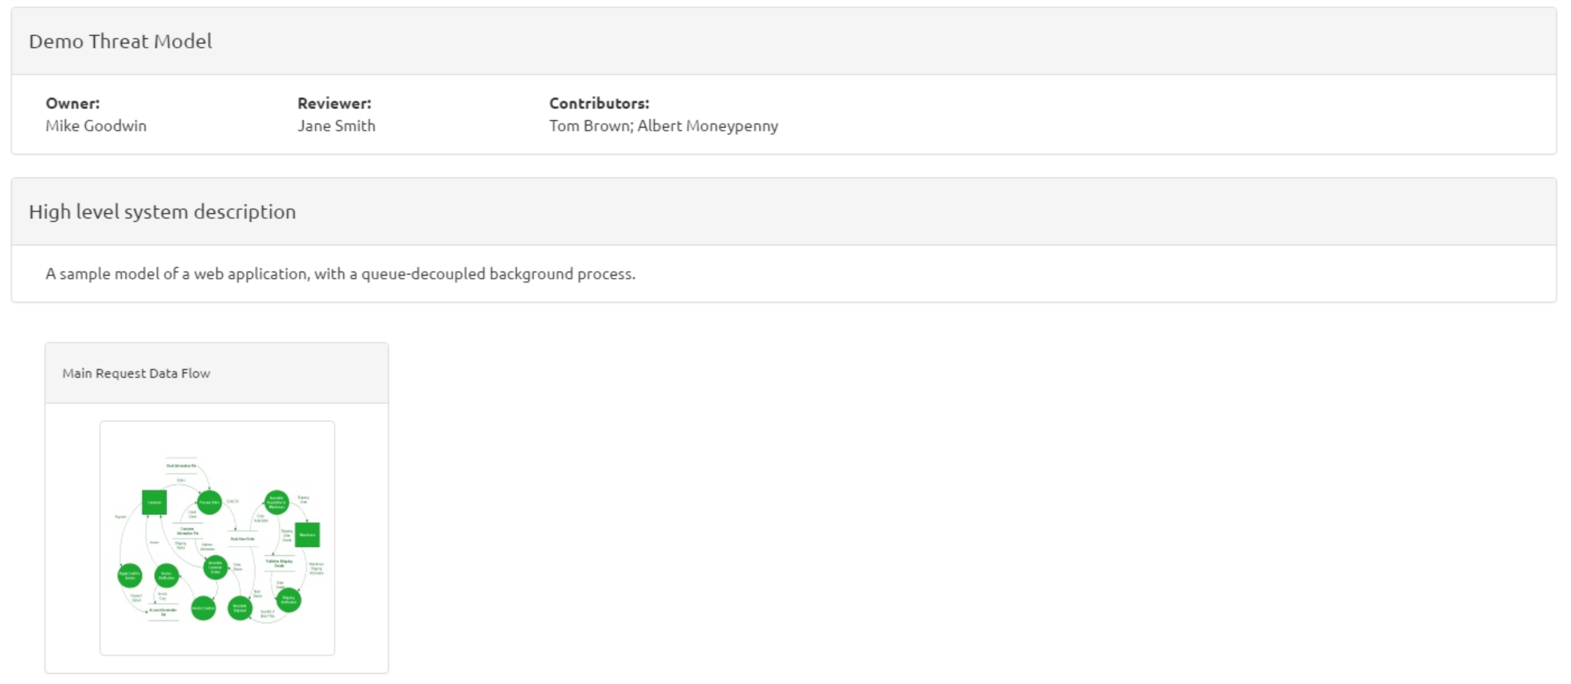

Slide 16
Roadmap: Integration
More source control systems (e.g. BitBucket, GitHub Enterprise)
Integrate threats with GitHub issues (or other ticketing system)
Merging changes from different people
Deeper workflow integrations*

Slide 17
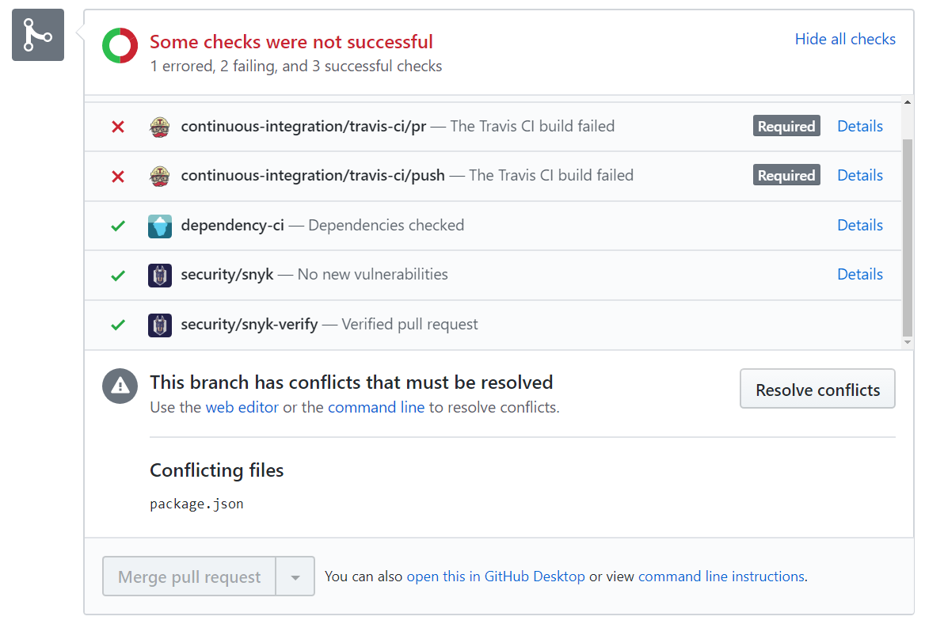

Slide 18



OWASP Threat Dragon – Model has open, high severity threats
OWASP Threat Dragon – Model was reviewed <1 day ago

Slide 19
What does it need most?
Progression to “Labs”
People to try it and give feedback
Contributors/collaborators

Slide 20
Links
GitHub:
https://github.com/mike-goodwin/owasp-threat-dragon
https://github.com/mike-goodwin/owasp-threat-dragon-core
https://github.com/mike-goodwin/owasp-threat-dragon-desktop
Docs:
http://docs.threatdragon.org/
Live demo:
https://threatdragon.org/
OWASP project page:
https://www.owasp.org/index.php/OWASP_Threat_Dragon

Slide 21


Me
@theblacklabguy
mike.Goodwin@owasp.org

Slide 22
Questions

