Slide 1
Leveraging agile to gain better security
An agile developer’s perspective
Erlend Oftedal
Board Member – Norway
Bekk Consulting AS
erlend.oftedal@bekk.no

Slide 2
Who am I?
Erlend Oftedal
Consultant/developer at Bekk Consulting AS in Oslo, Norway
Board member of OWASP Chapter Norway
Member of Honeynet Chapter Norway

Slide 3
Agenda
Agile – What and why?
The agile toolbox
Agile and secure?

Slide 4
Why was agile created?
We are building the wrong solution
  Does not meet requirements
  Requirements change
We are building the solution wrong
  High number of bugs
  Not delivered on time
  Hard to change
Notes:
Requirements change and we cannot accomodate
Solutions are not built to be changeable

Slide 5
Waterfall
System requirements
Software requirements
Analysis
Program design
Coding
Testing
Operations

Slide 6

What are we building?
Notes:
Now the problem with waterfall is that we are making decisions when we have very little information, and there is no way to change those decisions later
We discover problems when we start testing our solution, but then it’s to late – there is to little time left – to fix everything.
We end up with a suboptimal solution

Slide 7
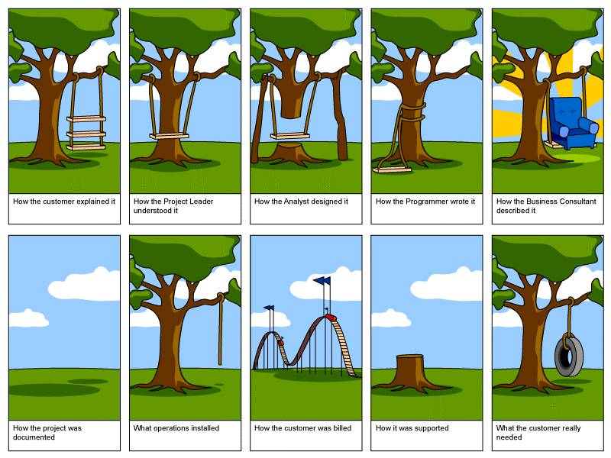
Requirements Specification
Is it accurate?
Will all stakeholders understand it and get the same picture?
Notes:
The problem with the requirements are…
This is very accurately displayed by this drawing
(wait)

Slide 8
Requirements cost
Inaccurate requirements
  ”It doesn’t work – let’s do more”
Effort/time invested
Accuracy

Slide 9
Security requirements
Delivery to production
Effort
Time

Slide 10
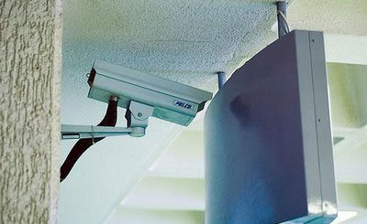
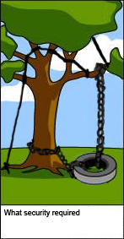
Are we securing the right solution?

Slide 11
So what is agile?
Agile is process – it’s not a process
Agile is culture
Agile is a set of tools and techniques
Summary of agile:
”We reflect after each iteration”

Slide 12
The Agile Manifesto
Individuals and interactions over processes and tools
Working software over comprehensive documentation
Customer collaboration over contract negotiation
Responding to change over following a plan
That is, while there is value in the items on the right, we value the items on the left more
http://agilemanifesto.org/

Slide 13
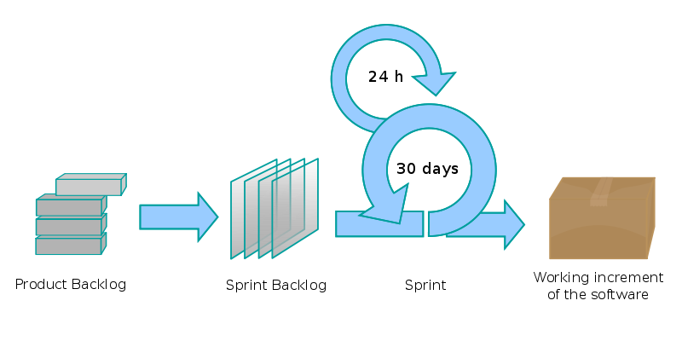
Agile
http://commons.wikimedia.org/wiki/File:Scrum_process.svg

Slide 14
Requirements
Customer collaboration over contract negotiation
Responding to change over following a plan
Co-located customer
  Customer is accessible
  Short feedback loop - decide and verify often
”Plans are nothing – planning is everything” Eisenhower

Slide 15
Agile requirements

Slide 16
Handling risk
Handle risk early
  Proof of concepts
  Starting with the most difficult tasks
Postpone decisions to the latest responsible point in time
  More information → informed decisions
Making risk visible

Slide 17
Definition of done
What does ”90% done” mean?
When is a task done?
  Tests are passing?
  Accepted by customer?
  In production?

Slide 18
Common arguments against Agile
Too little documentation
Focus is only on functionality
Agile is not written in stone
  Let’s change it

Slide 19
Tools from the agile toolbox
Continuous integration
Clean code
Pair programming

Slide 20
Continuous integration and automated tests
Build code on check-in
Run tests on check-in
  Unit tests
  Integration tests
  Acceptance tests
  Web tests

Slide 21
Unit tests
Tests a small unit of code
Does not touch external resources
Very fast to run (milliseconds)
Can serve as specification for a class
Security benefit
  Reduce number of logical bugs
  We can test our security modules
    Are the roles resolved correctly?
    OWASP ESAPI

Slide 22
Integration tests
Test integration between components and can touch external resources
A bit slower to run
Security benefit
  Test how components interact
    Can a person in role X perform task Y?
    Can a person in role Z perform task Y?

Slide 23
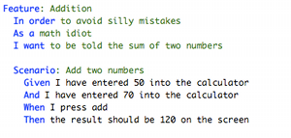
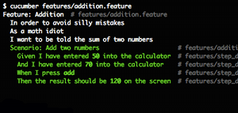
Acceptance tests
High level tests
Runnable specs
  Cucumber/Rspec/Fitnesse etc.
Web tests
  Watir/Selenium etc.
Can be quite slow to run
  Run the slowest every night
Security benefit
  Test the whole stack
  Verify an XSRF protection?
[http://cukes.info]

Slide 24
Clean code
SOLID principles
Keep code DRY
  Don’t Repeat Yourself – No duplication
Testable code
  Dependency Injection
  Test Driven Development
    Write a test
    Implement untill the test passes
    Refactor
    Goto 1
  Behaviour Driven Development

Slide 25
Bug handling
1. Write a test that proves the existense of the bug
2. Fix the code and watch the test pass
→ Automated regression testing
Security benefit
  If we find a bug somewhere, we can make sure it does not reappear

Slide 26
Pair programming
Instant code review
Knowledge sharing
  Reducing risk by not depending on a single person
  Spreading knowledge within the team
Security benefit
  Spread knowledge about potential issues and frameworks
    OWASP Top 10
    OWASP ESAPI

Slide 27
Testing, clean code and security
Well-tested code gives us assurance and confidence in our code base
Well-tested code is easy to change
  We have a safety net
Changeable code allows us to refactor
  Clean code
  Change design – improve the architecture
  Improve the readability

Slide 28
Testing, clean code and security - cont.
Clean readable code is easier to understand
  ”Comments are a failure to express oneself in code” Robert C. Martin (paraphrased)
Understandable code is easier to secure
Security tests give us assurance and confidence in our security controls
  Regression testing
  OWASP ESAPI

Slide 29
Going fast
”The only way to go fast, is to go well”
Robert C. Martin
Don’t hack and skip testing just to finish at the end of an iteration
  Write unit tests
  Fix the code
  Refactor

Slide 30
Definition of done revisited
A task is not done before:
  Security has been evaluated
  Tests for possible security issues are in place
Avoid security sprints if you can

Slide 31
Winning the prioritization race
Create a business case
Use standard well-tested components to lower implementation costs
Do not enter
  XSS, SQL-injection etc. are not user stories!

Slide 32
Agile security enablers
Security controls
Secure coding guidelines
Training
[Dave Wichers – ”Security in agile development” - AppSec NYC 2008]

Slide 33
Secure coding guidelines
Improve as you go
Should be easy to change and easy to access
  Wiki
Implement as code analysis rules where possible and cost effective
  Run as part of local build in IDE
  Run as part of CI

Slide 34
Training
Web security training
  Internal or external
Microworkshops on demand
  5-20 minutes workshop
  Present a problem and a solution with examples from the project’s code base
  Example: ”How to avoid SQL-injection and why it’s dangerous?”
  Can be used to introduce rules in the secure coding guideline

Slide 35
Copying the co-located customer idea
The co-located security professional
Short feedback loop
Improve knowledge sharing
Alternative:
  Protégé or apprentice
Danger:
  Avoid ”that’s the security guy’s responsibility”

Slide 36
Summary
Agile does not focus on security
  the good news is that we can change that
We can hook security onto the process:
  Have security competency in the team
  Establish security as a joint responsibility
  Training and microworkshops
Clean code can help improve security
  Readability, simplification, testability
Focus on getting things done
  Create ”security sprints” or security tasks only if absolutely necessary

Slide 37
Questions?
More information:
  http://www.agileandsecure.com/
  http://www.infoworld.com/d/security-central/how-achieve-more-agile-application-security-425
  http://video.google.com/videoplay?docid=-8287209466278543377&hl=en
My blog: http://erlend.oftedal.no/blog/
Twitter: webtonull

