Slide 1
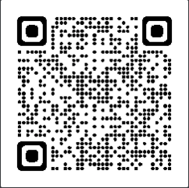
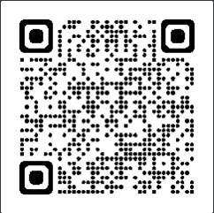
Meeting Starts at 7:05PM
In the meantime, checkout these links
https://granitecity.io
https://owasp.org/www-chapter-sacramento

Slide 2
OWASP Sacramento
June 2023

Slide 3
Agenda
Food & Drinks
Community topics……
Modern Threat Modeling and Cloud Systems

Slide 4

Being at Granite City means you’re part of an engaging, inviting and supportive ecosystem. It means you’re in the company of like-minded and exciting professionals. It means you’ve joined a place to grow your business and be supported in the process.
All memberships include:
High-speed & secure wi-fi
Access to printer/copier/scanner
Invites to exclusive member-only social events and programs
Use of our community kitchen
Locally roasted craft coffee served hot and ready until 3pm
Private Office & what you’ll get:
24/7 Access
Digital Key Access
2 hours of free meeting room space per month (Town Hall or Gallery
Coworking & what you’ll get:
Part-Time Membership – 4 days per month access
Weekdays – 8:30am-5pm Monday – Friday access, digital key entry, 2 hours of free meeting space per month (Gallery)
Full Time – 24/7 access, digital key access, 2 hours of free meeting space per month (Gallery)
Notes:
Please choose an upcoming AppSec Global, and any local regional or chapter events

Slide 5
OWASP Sacramento Chapter
Community stuff
Remember to join us on our July talk to hear Sean Marpo talk about ”Vuln Hunting at Scale”

Slide 6
Threat Modeling – History – Source: Wikipedia
STRIDE methodology
The STRIDE approach to threat modeling was introduced in 1999 at Microsoft, providing a mnemonic for developers to find 'threats to our products'.^{[9]} STRIDE, Patterns and Practices, and Asset/entry point were amongst the threat modeling approaches developed and published by Microsoft. References to "the" Microsoft methodology commonly mean STRIDE and Data Flow Diagrams.
P.A.S.T.A.
The Process for Attack Simulation and Threat Analysis (PASTA) is a seven-step, risk-centric methodology.^{[10]} It provides a seven-step process for aligning business objectives and technical requirements, taking into account compliance issues and business analysis. The intent of the method is to provide a dynamic threat identification, enumeration, and scoring process. Once the threat model is completed, security subject matter experts develop a detailed analysis of the identified threats. Finally, appropriate security controls can be enumerated. This methodology is intended to provide an attacker-centric view of the application and infrastructure from which defenders can develop an asset-centric mitigation strategy.

Slide 7
Threat Modeling – History – Source: Wikipedia
Trike
The focus of the Trike methodology^{[11]} is using threat models as a risk-management tool. Within this framework, threat models are used to satisfy the security auditing process. Threat models are based on a “requirements model.” The requirements model establishes the stakeholder-defined “acceptable” level of risk assigned to each asset class. Analysis of the requirements model yields a threat model from which threats are enumerated and assigned risk values. The completed threat model is used to construct a risk model based on asset, roles, actions, and calculated risk exposure.
VAST
The Visual, Agile and Simple Threat (VAST) methodology,^{[12]} is based on ThreatModeler, a commercial automated threat-modeling platform. VAST requires creating two types of models: application threat models and operational threat models. Application threat models use process-flow diagrams, representing the architectural point of view. Operational threat models are created from an attacker point of view based on DFDs. This approach allows for the integration of VAST into the organization's development and DevOps lifecycles.^{[13]}

Slide 8
Threat Modeling – History – Source: Wikipedia
The Hybrid Threat Modeling Method
Researchers created this method to combine the positive elements of different methodologies.^{[14][15][16]} This methodology combines different methodologies, including SQUARE^{[17]} and the Security Cards^{[18]} and Personae Non Gratae.^{[19]}

Slide 9
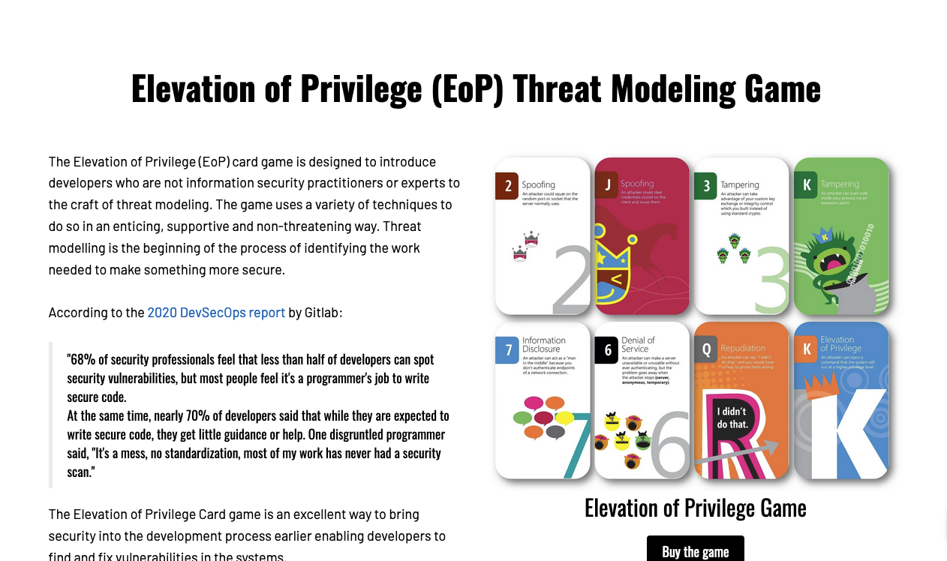
Slight Tangent: Threat Modeling Game
Gather the team
Play the game
Profit

Slide 10
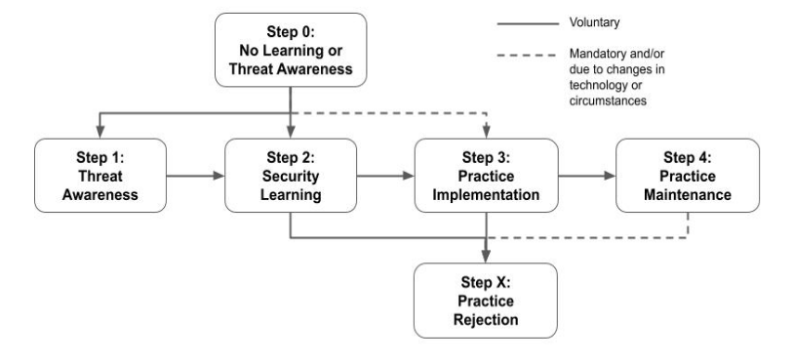
Why is Threat Modeling Important

Slide 11
Threat Modeling Simplified
What are we working on?
What can go wrong?
What are we going to do about it?
Did we do a good job?

Slide 12
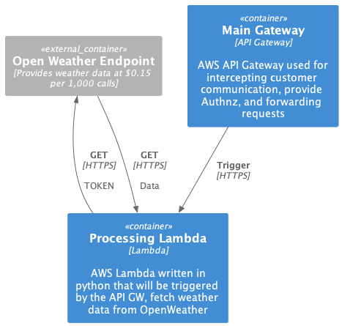
What are we working on?
Let’s assume that we must build a system that returns weather data. This system uses a token to talk to OpenWeather and capture data based on the GEO Location of the caller

Slide 13
Live Demo
Identify Assets
Identify Threats
Identify Controls

Slide 14
OWASP Community
Next Meeting: June 21st from 7PM-9PM (same location)
Call for Presentations: June and July (same location)
If you’d like to present (or know someone else who would) at the OWASP Sacramento Chapter’s upcoming meetings, please email us your topic.
You don’t need to be an expert!
Joubin: joubin.jabbari@owasp.org
Ryan: ryan.kozak@owasp.org

