Slide 1
Meeting Starts at 6:05PM
In the meantime, checkout https://zapcon.io

Slide 2
OWASP Sacramento
February 2022

Slide 3
Agenda
Community Topics
Welcome to 2022!
ZapCon
CI/CD and TeamCity in a nutshell.
PwnCity Walkthrough

Slide 4
Happy 2022!
Looking to have meetings monthly.
Has been the 4th Thursday of every month @ 6pm.
May evaluate different time/day of week if members would like.
Virtual for the next couple, but we’ll evaluate the potential to have them in person.

Slide 5
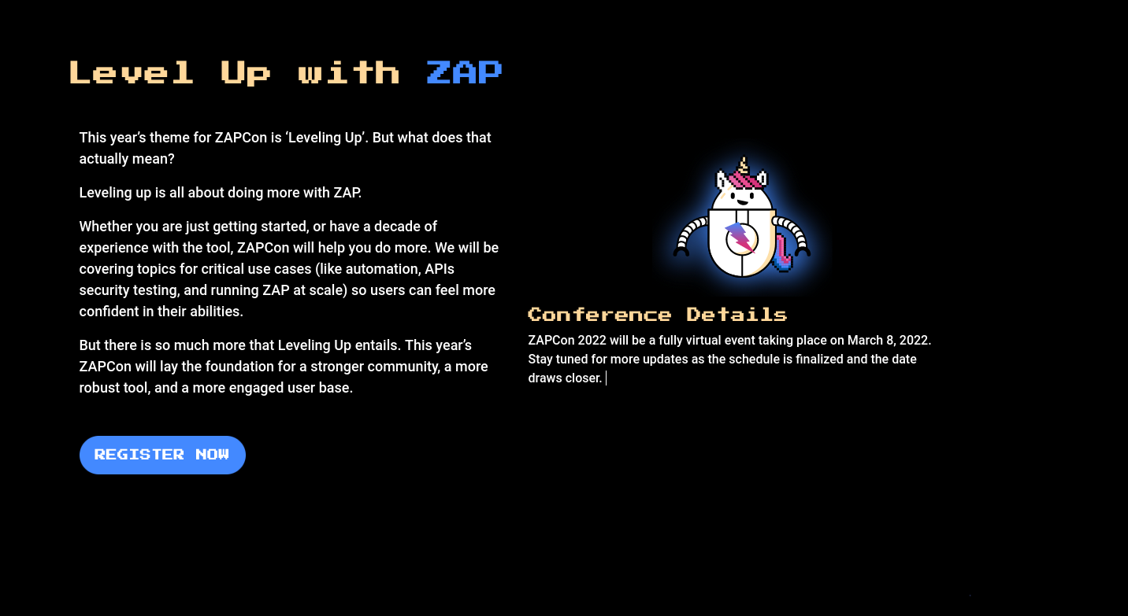

Slide 6
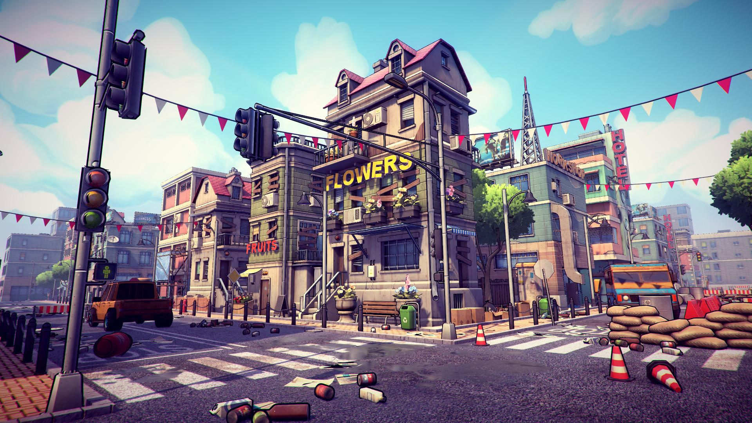
PwnCity

Slide 7
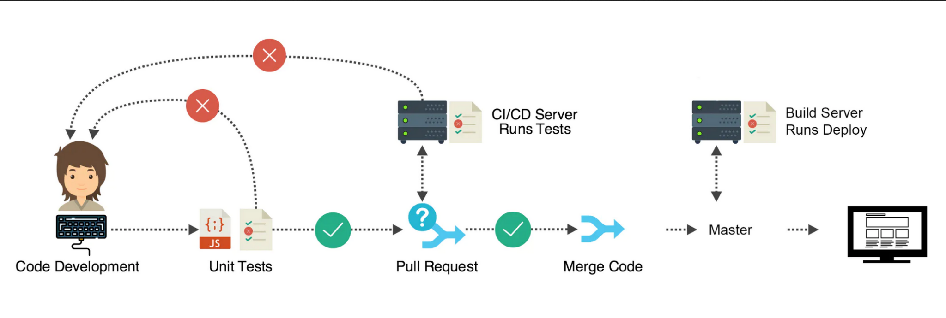
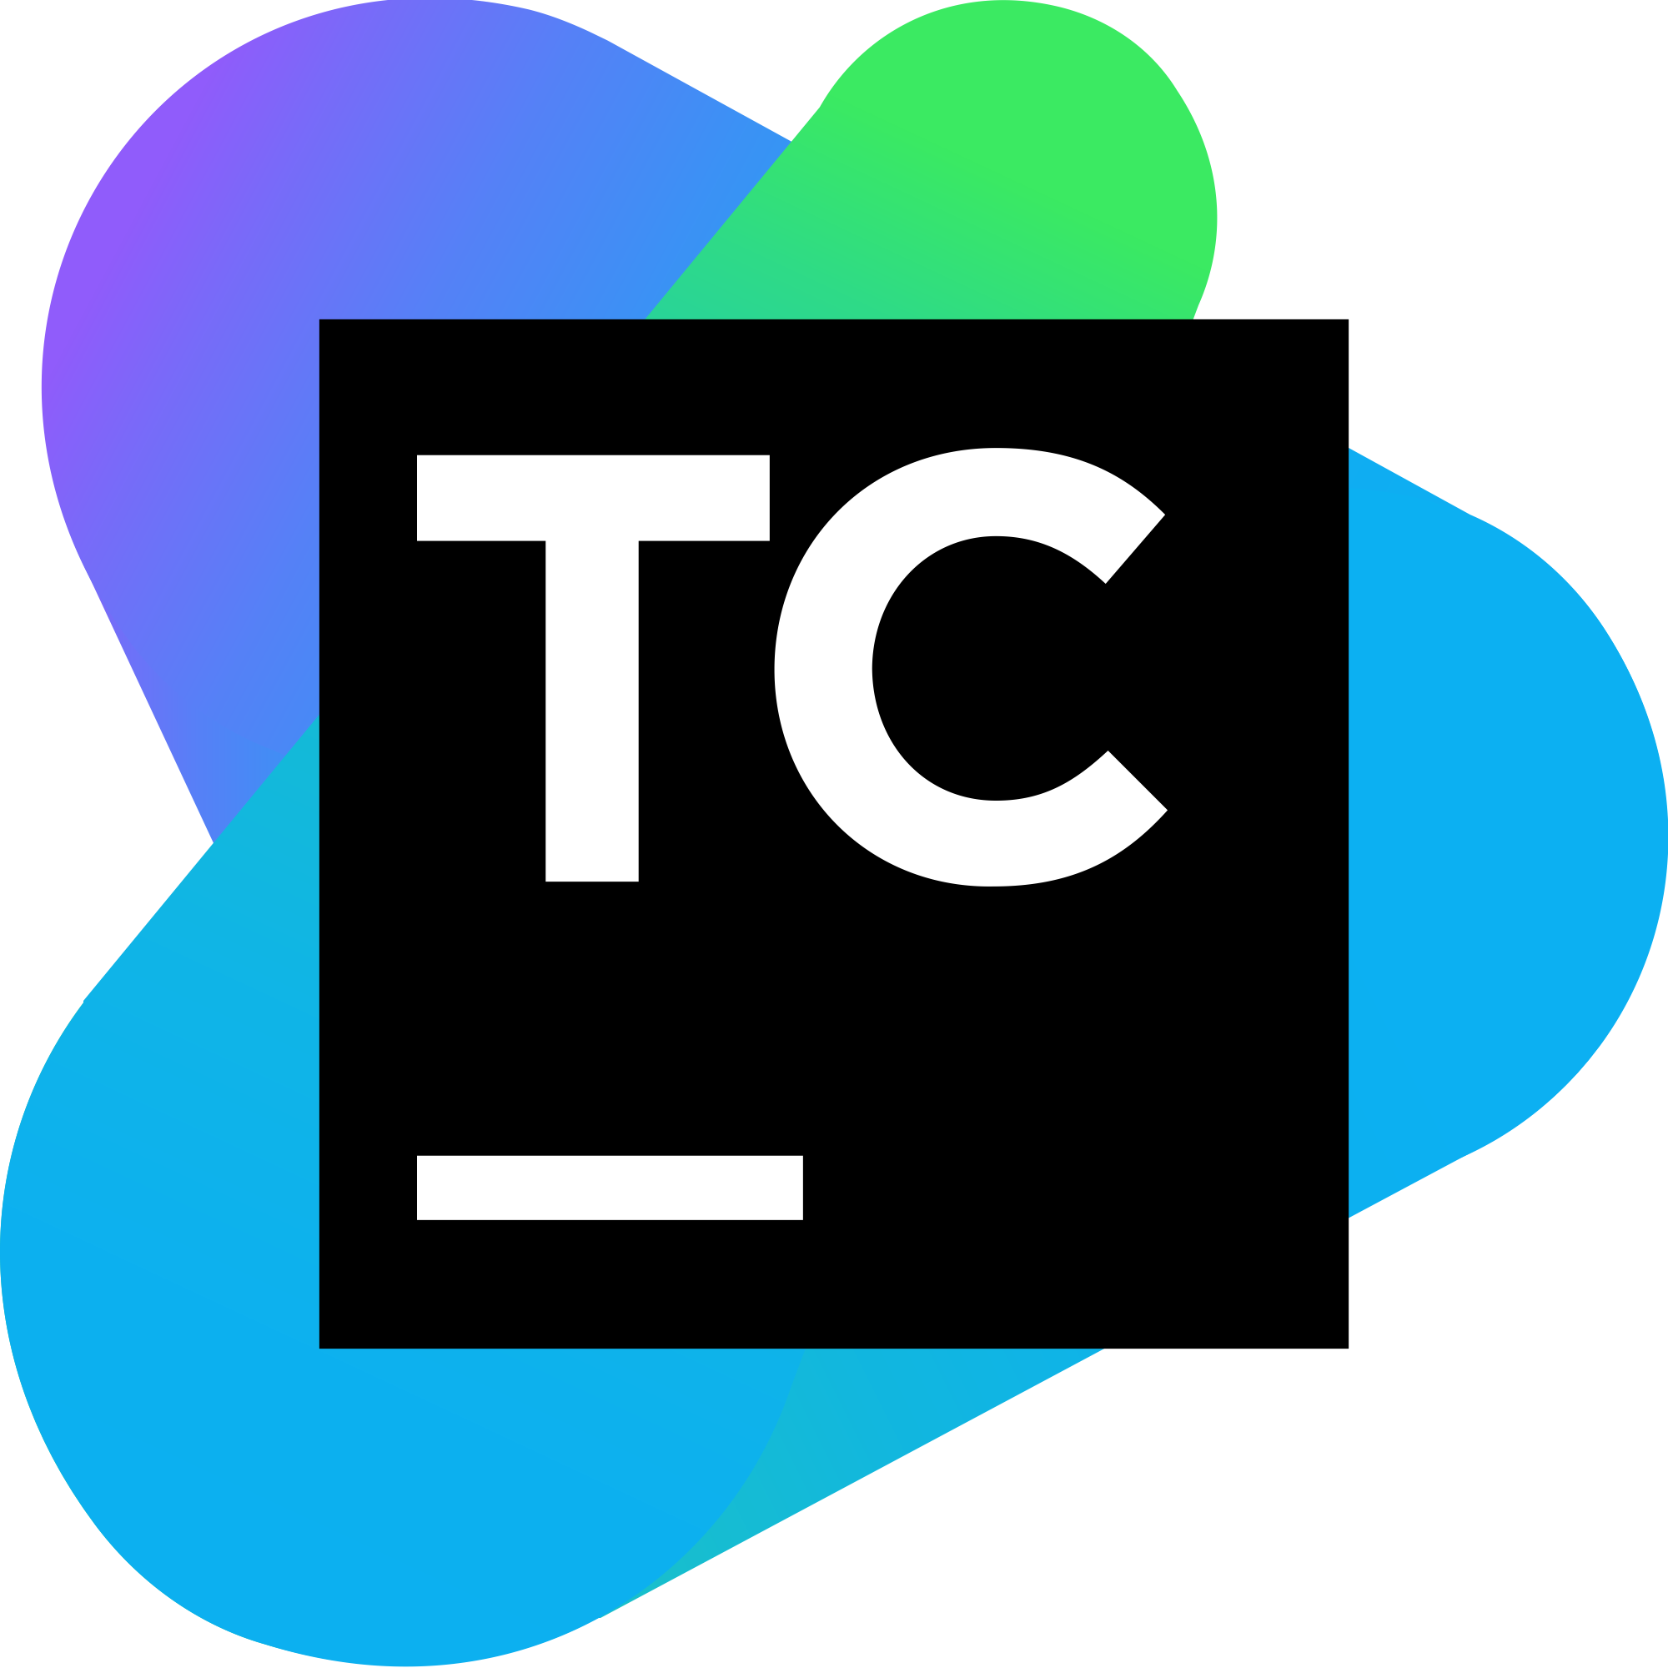


CI/CD
Code changes are made, and automated build-and-test steps are triggered. The code is then delivered automatically as a part of the CD process.
The “CI/CD pipeline” refers to the automation that enables incremental code changes from developers’ desktops to be delivered quickly and reliably to production.
-Synopsys
CI and CD stand for continuous integration & continuous delivery.

Slide 8
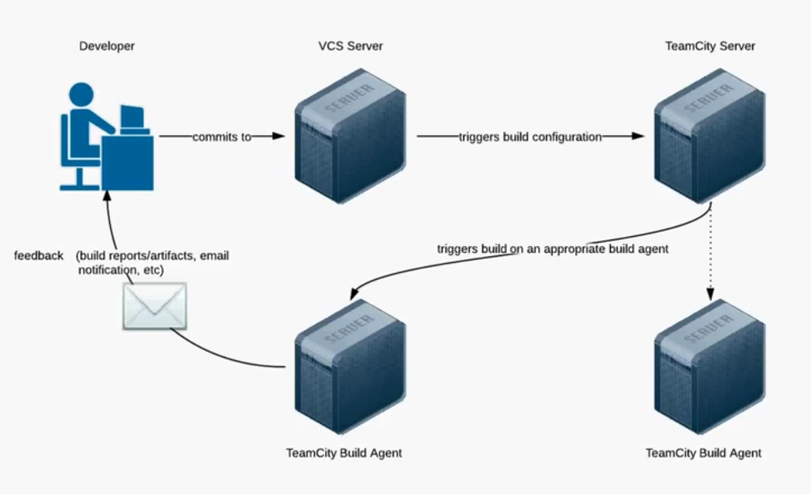
TeamCity
by JetBrains
TeamCity is a general-purpose CI/CD solution that allows the most flexibility for all sorts of workflows and development practices.
-JetBrains
Consists of
Version Control Repo(s)
Build Server(s)
Build Agent(s)

Slide 9
Disclaimer
This presentation neither advocates for or against the use of TeamCity by JetBrains.
TeamCity is the chosen CI/CD tool for this demonstration of an insecurely configured environment.
This presentation does not imply any security shortcomings in TeamCity as a product.

Slide 10
Begin

Slide 11
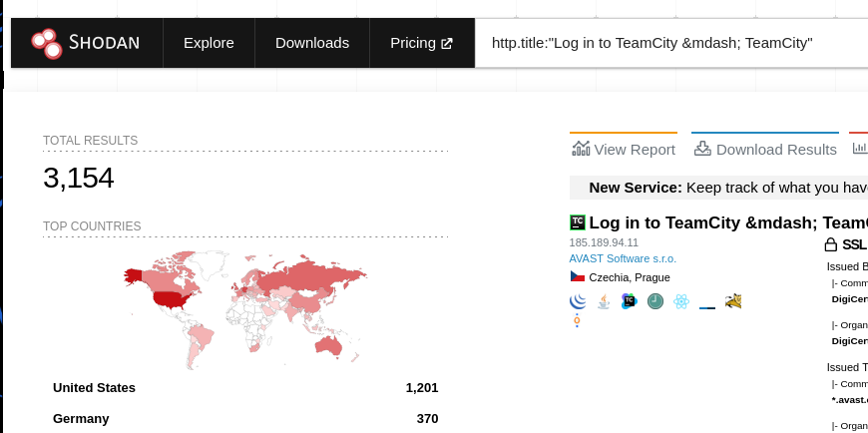
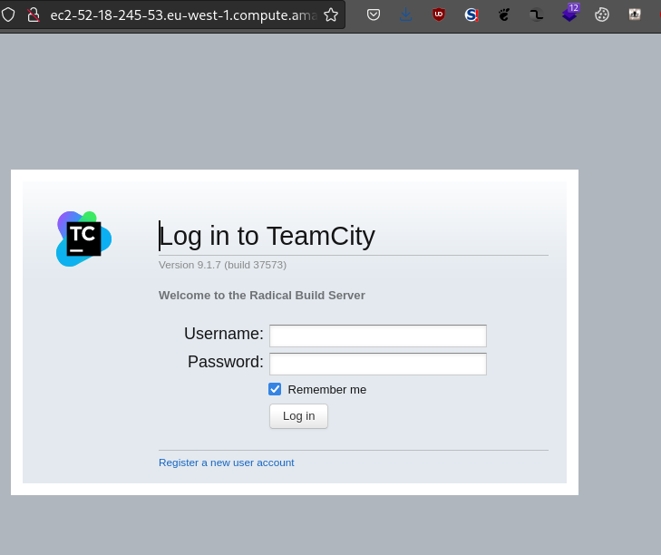
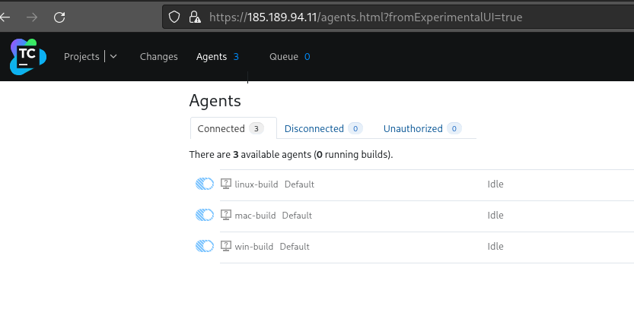
Background
http.title:"Log in to TeamCity &mdash;”
Shodan reveals thousands of exposed TeamCity panels.
Registration and Guest login is enabled in the wild for many.
PwnCity is a compilation of misconfigurations I’ve come across during engagements.
Chains of misconfigurations can and has lead to complete compromise of a network.

Slide 12
Premise
We’ve been asked to evaluate the security posture of a small software development shop.
Objective: Determine if we can gain access to sensitive information.
Our recon has determined that they own the assets behind the public IP address 52.234.0.18

Slide 13
Demo
Duration – 30 min(ish)

Slide 14
Conclusion
These misconfigurations are common because…?
Of ignorance.
Environments are/were built quickly to achieve business goals,so no one ever looked back.
The impact of multiple misconfigurations combined isn’t clear enough to owners.
All of the above.
A hardening guide for admins, is a cheat sheet guide to attackers.
Common security practices are all important for good reason.
TeamCity is an example in this case for any CI/CD tools/server.

Slide 15
References
https://blog.jetbrains.com/teamcity/2021/02/hardening-your-teamcity-server/
https://www.jetbrains.com/help/teamcity/super-user.html
https://github.com/kacperszurek/pentest_teamcity
https://github.com/d0n601/PwnCity/

Slide 16
OWASP Community
Call for Presentations: March and April (likely virtual events)
If you’d like to present (or know someone else who would) at the OWASP Sacramento Chapter’s upcoming meetings, please email us your topic.
You don’t need to be an expert!
Joubin: joubin.jabbari@owasp.org
Ryan: ryan.kozak@owasp.org

