Slide 1
Meeting Starts at 7:05PM
In the meantime, checkout https://granitecity.io

Slide 2
OWASP Sacramento
April 2023

Slide 3
Agenda
Food & Drinks
Intro to the chapter
Desired outcome from the community
Next Months’ Teaser: Modern Phishing with Evilginx2

Slide 4

Being at Granite City means you’re part of an engaging, inviting and supportive ecosystem. It means you’re in the company of like-minded and exciting professionals. It means you’ve joined a place to grow your business and be supported in the process.
All memberships include:
High-speed & secure wi-fi
Access to printer/copier/scanner
Invites to exclusive member-only social events and programs
Use of our community kitchen
Locally roasted craft coffee served hot and ready until 3pm
Private Office & what you’ll get:
24/7 Access
Digital Key Access
2 hours of free meeting room space per month (Town Hall or Gallery
Coworking & what you’ll get:
Part-Time Membership – 4 days per month access
Weekdays – 8:30am-5pm Monday – Friday access, digital key entry, 2 hours of free meeting space per month (Gallery)
Full Time – 24/7 access, digital key access, 2 hours of free meeting space per month (Gallery)
Notes:
Please choose an upcoming AppSec Global, and any local regional or chapter events

Slide 5
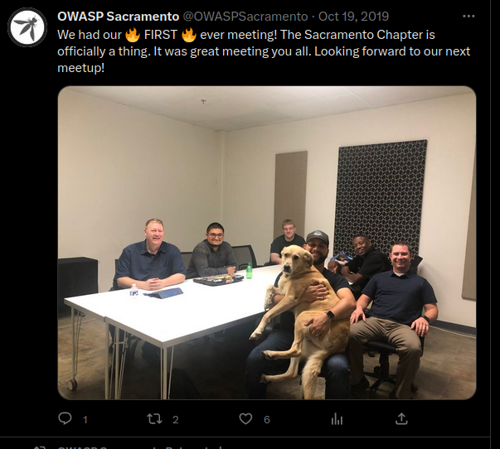
History of the Sacramento Chapter
Chapter Started - 2010?
Chapter with some attendance
Lets discuss, how
Chapter died out and leaders were non-responsive - 2014?
We rebooted the chapter - 2019
We were doing okay… ish
2023: Meetings lined up for
April, May, June, July, August and September
COVID - 2020
Now 🡪 Let’s do better this time

Slide 6
OWASP Sacramento Chapter
Let’s discuss
How can we make this chapter better?
What are our members looking to get out of this group?

Slide 7

Modern Phishing with Evilginx2 (Preview)
evilginx2 is a man-in-the-middle attack framework used for phishing login credentials along with session cookies, which in turn allows to bypass 2-factor authentication protection.
Custom version of nginx HTTP server to provide man-in-the-middle functionality to act as a proxy between a browser and phished website.
Implements its own HTTP and DNS server.
Utilizes LetsEncrypt for TLS certs.
Does contain known signatures for Blue Teams.
FIDO2 will protect you as it’s domain specific.
Operationalizing it takes creativity, speed, and contains many other small nuances (next month).
GitHub Project: https://github.com/kgretzky/evilginx2

Slide 8
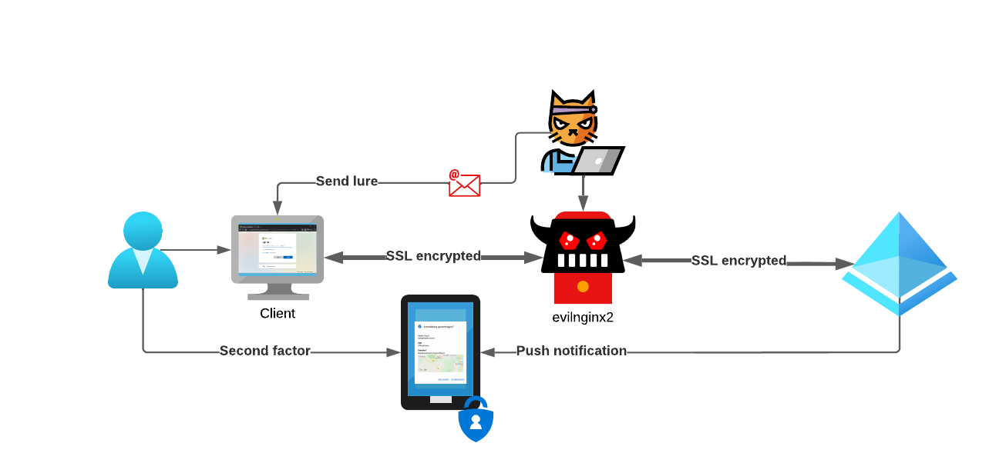
Modern Phishing with Evilginx2 (Preview)
Lures can be….
Placed on creative TLDs.
Emailed to victims directly.
Presented via DNS Spoofing.
QR codes, etc…

Slide 9
Modern Phishing with Evilginx2
Demo (preview?)

Slide 10
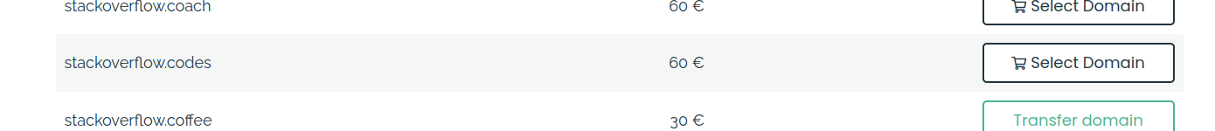
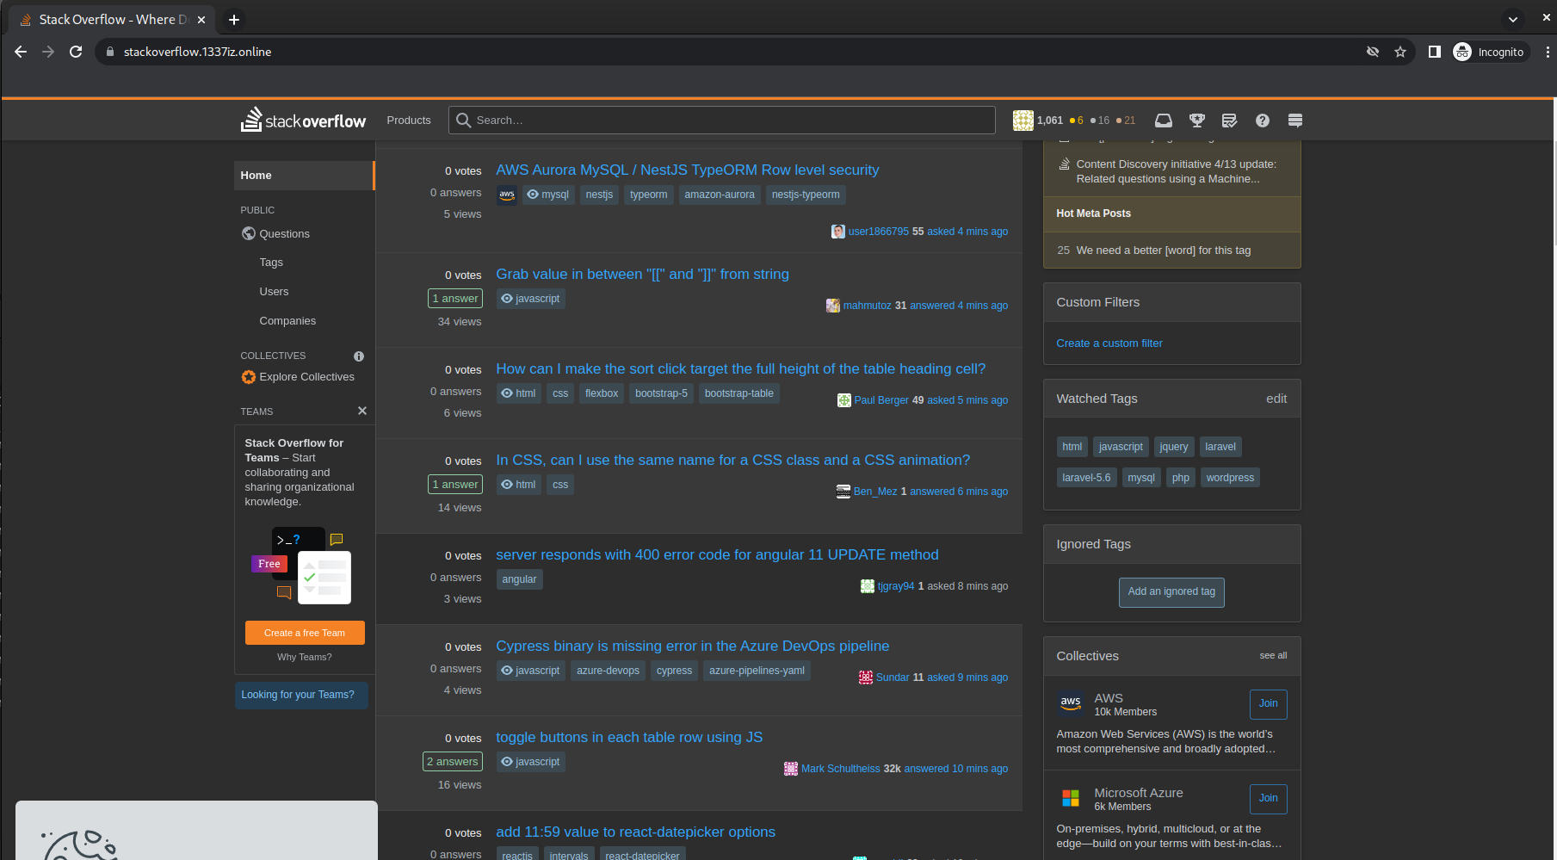
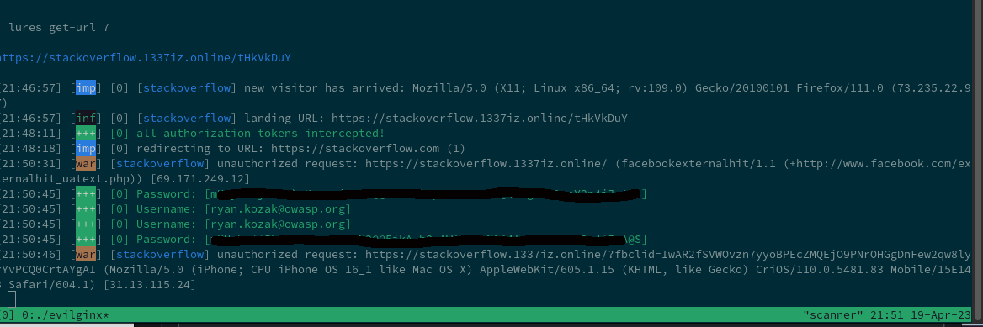
Modern Phishing with Evilginx2 (Preview)
Next month we’ll teach you how to phishlet ;)

Slide 11
OWASP Community
Next Meeting: May 17th from 7PM-9PM (same location)
Call for Presentations: June and July (same location)
If you’d like to present (or know someone else who would) at the OWASP Sacramento Chapter’s upcoming meetings, please email us your topic.
You don’t need to be an expert!
Joubin: joubin.jabbari@owasp.org
Ryan: ryan.kozak@owasp.org

