Slide 1
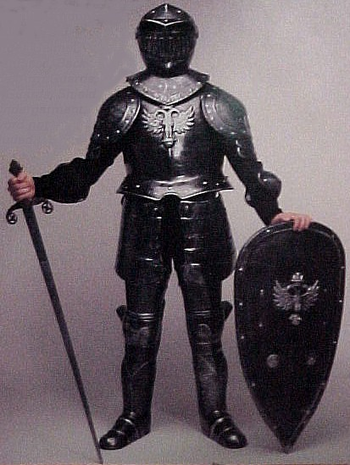
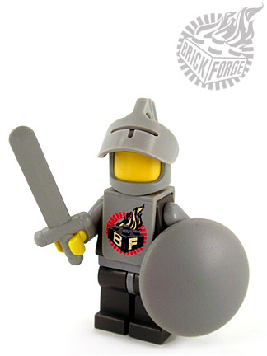
Top 10 Web Security Controls

Slide 2



Jim Manico @manicode
VP Security Architecture, WhiteHat Security
15 years of web-based, database-driven software development and analysis experience
Over 7 years as a provider of secure developer training courses for SANS, Aspect Security and others
OWASP Connections Committee Chair
OWASP Podcast Series Producer/Host
OWASP Cheat-Sheet Series Manager

Slide 3
(1) Query Parameterization (PHP PDO)
$stmt = $dbh->prepare("INSERT INTO REGISTRY (name, value) VALUES (:name, :value)");
$stmt->bindParam(':name', $name);
$stmt->bindParam(':value', $value);

Slide 4
Query Parameterization (.NET)
SqlConnection objConnection = new SqlConnection(_ConnectionString);
objConnection.Open();
SqlCommand objCommand = new SqlCommand(
"SELECT * FROM User WHERE Name = @Name AND Password =
@Password", objConnection);
objCommand.Parameters.Add("@Name", NameTextBox.Text);
objCommand.Parameters.Add("@Password", PasswordTextBox.Text);
SqlDataReader objReader = objCommand.ExecuteReader();
if (objReader.Read()) { ...

Slide 5
Query Parameterization (Java)
double newSalary = request.getParameter("newSalary") ;
int id = request.getParameter("id");
PreparedStatement pstmt = con.prepareStatement("UPDATE EMPLOYEES SET SALARY = ? WHERE ID = ?");
pstmt.setDouble(1, newSalary);
pstmt.setInt(2, id);
Query safeHQLQuery = session.createQuery("from Inventory where productID=:productid");
safeHQLQuery.setParameter("productid", userSuppliedParameter);

Slide 6
Query Parameterization (Ruby)
# Create
Project.create!(:name => 'owasp')
# Read
Project.all(:conditions => "name = ?", name)
Project.all(:conditions => { :name => name })
Project.where("name = :name", :name => name)
# Update
project.update_attributes(:name => 'owasp')
# Delete
Project.delete(:name => 'name')

Slide 7
Query Parameterization (Cold Fusion)
<cfquery name="getFirst" dataSource="cfsnippets">
SELECT * FROM #strDatabasePrefix#_courses WHERE intCourseID =
<cfqueryparam value=#intCourseID# CFSQLType="CF_SQL_INTEGER">
</cfquery>

Slide 8
Query Parameterization (PERL)
my $sql = "INSERT INTO foo (bar, baz) VALUES ( ?, ? )";
my $sth = $dbh->prepare( $sql );
$sth->execute( $bar, $baz );

Slide 9
OWASP Query Parameterization
Cheat Sheet

Slide 10

XSS: Why so Serious?
Session hijacking
Site defacement
Network scanning
Undermining CSRF defenses
Site redirection/phishing
Load of remotely hosted scripts
Data theft
Keystroke logging

Slide 11
Danger: Multiple Contexts
Browsers have multiple contexts that must be considered!
HTML Body
HTML Attributes
<STYLE> Context
<SCRIPT> Context
URL Context

Slide 12
XSS in HTML Attributes
<input type="text" name="comments"
value="UNTRUSTED DATA">
<input type="text" name="comments"
value="hello" onmouseover="/*fire attack*/">
Attackers can add event handlers:
onMouseOver
onLoad
onUnLoad
etc…
Notes:
1 - 12

Slide 13
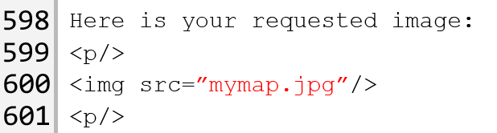
XSS in Source Attribute
User input often winds up in src attribute
Tags such as
<img src="">
<iframe src="">
Example Request:
http://example.com/viewImage?imagename=mymap.jpg
Attackers can use javascript:/*attack*/ in src attributes
Notes:
2/1/12
13
©2007 Ernst & Young Advanced Security Center

Slide 14
URL Parameter Escaping
Escape all non alpha-num characters with the %HH format
<a href="/search?data=UNTRUSTED DATA">
Be careful not to allow untrusted data to drive entire URL’s or URL fragments
This encoding only protects you from XSS at the time of rendering the link
Treat DATA as untrusted after submitted
Notes:
1 - 14

Slide 15
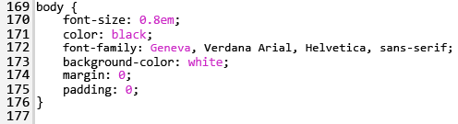
XSS in the Style Tag
Applications sometimes take user data and use it to generate presentation style
Consider this example:
http://example.com/viewDocument?background=white
URL parameter written within style tag
Notes:
15

Slide 16

CSS Pwnage Test Case
<div style="width: <%=UNTRUSTED%>;"> Mouse over </div>
UNTRUSTED = ESAPI.encoder().encodeForCSS("expression(alert(String.fromCharCode (88,88,88)))");
<div style="width: expression\28 alert\28 String\2e fromCharCode\20 \28 88\2c 88\2c 88\29 \29 \29 ;"> Mouse over </div>
Pops in at least IE6 and IE7
lists.owasp.org/pipermail/owasp-esapi/2009-February/000405.html
Notes:
1 - 16

Slide 17
Javascript Context
Escape all non alpha-num characters with the \xHH format
<script>var x='UNTRUSTED DATA';</script>
You're now protected from XSS at the time data is assigned
What happens to x after you assign it?
Notes:
1 - 17

Slide 18
Best Practice: DOM Based XSS Defense
Untrusted data should only be treated as displayable text
JavaScript encode and delimit untrusted data as quoted strings
Use document.createElement("…"), element.setAttribute("…","value"), element.appendChild(…), etc. to build dynamic interfaces
Avoid use of HTML rendering methods
If you do have to use the methods above remember to HTML and then JavaScript encode the untrusted data
Avoid passing untrusted data to eval(), setTimeout() etc.
Don’t eval() JSON to convert it to native JavaScript objects. Instead use JSON.toJSON() and JSON.parse()
Run untrusted scripts in a sandbox (ECMAScript canopy, HTML 5 frame sandbox, etc)
Notes:
Need to expand this section!

Slide 19
(2) XSS Defense by Data Type and Context
Data Type | Context | Defense
String | HTML Body | HTML Entity Encode
String | HTML Attribute | Minimal Attribute Encoding
String | GET Parameter | URL Encoding
String | Untrusted URL | URL Validation, avoid javascript: URL’s, Attribute encoding, safe URL verification
String | CSS | Strict structural validation, CSS Hex encoding, good design
HTML | HTML Body | HTML Validation (JSoup, AntiSamy, HTML Sanitizer)
Any | DOM | DOM XSS Cheat sheet
Untrusted JavaScript | Any | Sandboxing
JSON | Client parse time | JSON.parse() or json2.js
Safe HTML Attributes include: align, alink, alt, bgcolor, border, cellpadding, cellspacing, class, color, cols, colspan, coords, dir, face, height, hspace, ismap, lang, marginheight, marginwidth, multiple, nohref, noresize, noshade, nowrap, ref, rel, rev, rows, rowspan, scrolling, shape, span, summary, tabindex, title, usemap, valign, value, vlink, vspace, width

Slide 20
OWASP Abridged XSS Prevention
Cheat Sheet

Slide 21
Attacks on Access Control
Vertical Access Control Attacks
A standard user accessing administration functionality
"Privilege Escalation"
Horizontal Access Control attacks
Same role, but accessing another user's private data
Business Logic Access Control Attacks
Abuse of workflow

Slide 22
Best Practice: Code to the Permission
if (AC.hasAccess(ARTICLE_EDIT, NUM)) {
//execute activity
}
Code it once, never needs to change again
Implies policy is persisted in some way
Requires more design/work up front to get right

Slide 23
Best Practice: Use a Centralized Access Controller
In Presentation Layer
if (ACL.isAuthorized(VIEW_LOG_PANEL))
{
<h2>Here are the logs</h2>
<%=getLogs();%/>
}
In Controller
try (ACL.assertAuthorized(DELETE_USER))
{
deleteUser();
}

Slide 24
(3) Access Control Positive Patterns
Code to the permission, not the role
Centralize access control logic
Design access control as a filter
Fail securely (deny-by-default)
Apply same core logic to presentation and server-side access control decisions
Server-side trusted data should drive access control
Provide privilege and user grouping for better management
Isolate administrative features and access

Slide 25
OWASP Access Control
Cheat Sheet
(beta, work in progress)

Slide 26
Anatomy of an CSRF Attack
Consider a consumer banking application that contains the following form
<form action="https://bank.com/Transfer.asp" method="POST" id="form1">
<p>Account Num: <input type="text" name="acct" value="13243"/></p>
<p>Transfer Amt: <input type="text" name="amount" value="1000" /></p>
</form>
<script>document.getElementById(‘form1’).submit(); </script>

Slide 27
(4) Cross Site Request Forgery Defenses
Cryptographic Tokens
Primary and most powerful defense. Randomness is your friend.
Request that cause side effects should use (and require) the POST method
Alone, this is not sufficient
Require users to re-authenticate
Amazon.com does this *really* well
Double-cookie submit
Decent defense, but no based on randomness, based on SOP

Slide 28
OWASP CSRF Cheat Sheet
Cheat Sheet

Slide 29
Authentication Dangers
Weak password
Login Brute Force
Username Harvesting
Session Fixation
Weak or Predictable Session
Plaintext or poor password storage
Weak "Forgot Password" feature
Weak "Change Password" feature
Credential or session exposure in transit via network sniffing
Session Hijacking via XSS

Slide 30
(5) Authentication Defenses
2FA/MFA/Passwords as single factor are DEAD
Develop generic failed login messages that do not indicate whether the user-id or password was incorrect
Enforce account lockout after a pre-determined number of failed login attempts
Force re-authentication at critical application boundaries
edit email, edit profile, edit finance info, ship to new address, change password, etc.
Implement server-side enforcement of credential syntax and strength

Slide 31
OWASP Authentication Sheet
Cheat Sheet

Slide 32
(6) Forgot Password Secure Design
Require identity and security questions
Last name, account number, email, DOB
Enforce lockout policy
Ask one or more good security questions
http://www.goodsecurityquestions.com/
Send the user a randomly generated token via out-of-band method
email, SMS or token
Verify code in same web session
Enforce lockout policy
Change password
Enforce password policy

Slide 33
OWASP Forgot Password Sheet
Cheat Sheet

Slide 34
(7) Session Defenses
Ensure secure session ID’s
20+ bytes, cryptographically random
Stored in HTTP Cookies
Cookies: Secure, HTTP Only, limited path
Generate new session ID at login time
To avoid session fixation
Session Timeout
Idle Timeout
Absolute Timeout
Logout Functionality
Notes:
> OUTLINE
>
> 1) Authentication, session management, and access control
> - Pre and post authentication session IDs
> - Session ID (temporary) equivalent to the strongest authentication method
> (point to authentication cheatsheet)
>
> 2) Session ID secure properties
> 2.1) Session ID name fingerprinting
> 2.1) Session ID length
> 2.2) Session ID entropy
> 2.3) Session ID content
> 2.4) Cryptographically strong session id
> 2.5) Recommendations for a secure session management database
>
> 3) Session ID exchange mechanisms
> 3.1) Used vs. accepted session ID exchange mechanisms
>
> 4) Session ID sent via cookies
> 4.1) HTTPonly cookies
> (point to XSS cheatsheet)
> 4.2) Secure cookies
> (point to TLS cheatsheet)
> 4.3) Domain and path cookie attributes
> 4.4) Expire attribute
> 4.5) CSRF implications of cookies
> (point to CSRF cheatsheet)
> 4.6) Cross-Site Tracing (XST) prevention
> 4.7) HTTP response splitting prevention
> 4.8) Cookie META tag prevention ????
>
> 5) Session ID initial verification
> 5.1) Permissive and strict session management
> 5.2) Treat session ID as any other user input
>
> 6) Renew the session ID after any privilege level change
>
> 7) Session expiration (on both client and server)
> 7.1) Automatic session expiration
> 7.1.1) Idle timeout
> 7.1.2) Absolute timeout
> 7.2) Manual session expiration
> 7.2.1) Logout button
> 7.2.2) Javascript logout on window close
> 7.2.3) Features for disabling session cross-tab
>
> 8) Session hijacking detection
> 8.1) Binding the session ID to other user properties
> 8.2) Logging: Monitoring creation, life cycle, and destruction of session IDs
> 8.3) Are multiple simultaneous logons allowed?
> 8.4) Session management WAF protections
>

Slide 35
OWASP Session Management
Cheat Sheet

Slide 36
(8) Clickjacking Defense
Standard Option: X-FRAME-OPTIONS Header
// to prevent all framing of this content response.addHeader( "X-FRAME-OPTIONS", "DENY" );
// to allow framing of this content only by this site response.addHeader( "X-FRAME-OPTIONS", "SAMEORIGIN" );
Frame-breaking Script defense:
<style id="antiClickjack">body{display:none}</style>
<script type="text/javascript">
if (self == top) {
var antiClickjack =
document.getElementByID("antiClickjack");
antiClickjack.parentNode.removeChild(antiClickjack)
} else { top.location = self.location;
}
</script>

Slide 37
OWASP Clickjacking Sheet
Cheat Sheet
Missing, care to help?

Slide 38
(9a) Secure Password Storage
public String hash(String plaintext, String salt, int iterations)
throws EncryptionException {
byte[] bytes = null;
try {
MessageDigest digest = MessageDigest.getInstance(hashAlgorithm);
digest.reset();
digest.update(ESAPI.securityConfiguration().getMasterSalt());
digest.update(salt.getBytes(encoding));
digest.update(plaintext.getBytes(encoding));
// rehash a number of times to help strengthen weak passwords
bytes = digest.digest();
for (int i = 0; i < iterations; i++) {
digest.reset(); bytes = digest.digest(bytes);
}
String encoded = ESAPI.encoder().encodeForBase64(bytes,false);
return encoded;
} catch (Exception ex) {
throw new EncryptionException("Internal error", "Error");
}}

Slide 39
(9b) Password Security Defenses
Disable Browser Autocomplete
<form AUTOCOMPLETE="off">
<input AUTOCOMPLETE="off">
Password and form fields
Input type=password
Additional password security
Do not display passwords in HTML document
Only submit passwords over HTTPS

Slide 40
OWASP Password Storage Sheet
Cheat Sheet
beta, work in progress

Slide 41
(10) Encryption in Transit (TLS)
Authentication credentials and session identifiers must me be encrypted in transit via HTTPS/SSL
Starting when the login form is rendered
Until logout is complete
All other sensitive data should be protected via HTTPS!
https://www.ssllabs.com free online assessment of public facing server HTTPS configuration
https://www.owasp.org/index.php/Transport_Layer_Protection_Cheat_Sheet for HTTPS best practices

Slide 42
OWASP Transport Layer Protection
Cheat Sheet

Slide 43
Thank you!
Questions?
jim.manico@whitehatsec.com
jim@owasp.org

