Slide 1
myBBC Security Council
What it means to YOU!

Slide 2
OWASP London Preface
Background
myBBC is the BBC’s new identity and personalisation platform
We have a Security Council tasked with implementing best practices
This Presentation
Aimed at general devs, testers, managers and product owners
Aims to show
What we do
How it helps enable teams and individuals
How people can engage with and use the new systems we have created

Slide 3
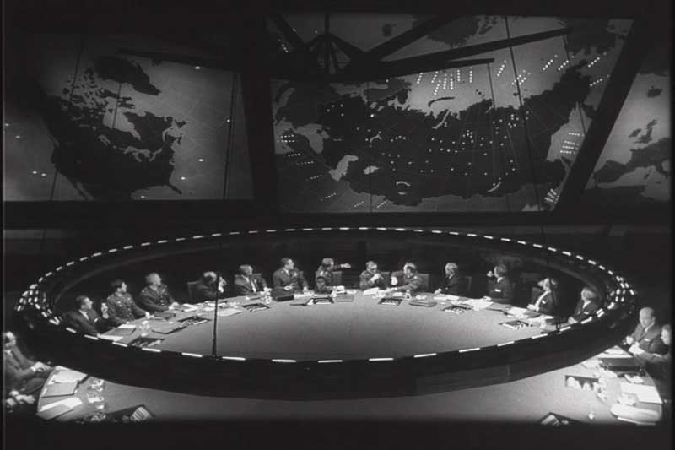
What People Think

Slide 4
Who We Really Are
Security Champions
Developers
Developers in Test
InfoSec
Management
Other Interested Parties

Slide 5
What We Do
Enable Teams
Track Security Issues Across myBBC
Provide the joined up thinking needed for a project this size
Learn New Skills
Create Threat Models and Attack Surface Analyses
Spread Knowledge
Maintain the Security Area

Slide 6
Why We Do It
myBBC HAS To Take Security Seriously
Huge store of sensitive personal data, including children’s data
Under intense scrutiny by the Information Commission and EU.
Fines of up to 4% turnover: £200,000,000!!!
Can be fined for internal failures as well as actual breaches.
There are many projects within myBBC
A problem in one system can spread
Joined up approach, tracking
Add to the infosec skillset of myBBC

Slide 7
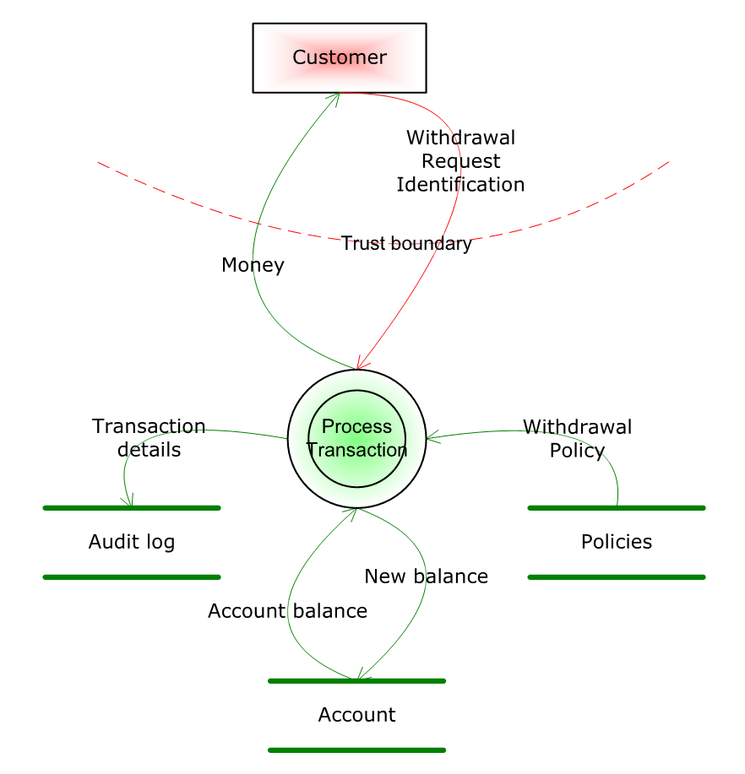
Examples #1 (not myBBC)

Slide 8
Examples #2
Threat Model
Scenarios and risks
Discoverability
Exploitability

Slide 9
The AppSec Project
JIRA Project Separate From myBBC Projects
Tracks application security risks outside of usual workflow, Agile roadmaps etc
Used for escalation, accepting risk, or scheduling of work to fix risk
Separate from the actual ‘Project Level’ tickets to fix security issues

Slide 10
What This Means To You
You Can Raise InfoSec Concerns, And They Will Be Addressed
Cross project concerns are not a problem
Cross team workflow issues not a problem
The appropriate managers will be able to see and respond to your concerns
You Can Gain Some Valuable InfoSec Knowledge And Skills

Slide 11
How To Get Involved
Explore The AppSec Tickets For Your Team
Raise security tickets if there is something you spot or know of. They will be addressed.
Talk To Your Security Champion
See The Threat Model For Your Team.
THIS IS FOR YOU!!!!!!

