Slide 1

Identities Exposed
How Design Flaws in Authentication Solutions May Compromise Your Privacy

Slide 2

About Me
David Johansson
Started working as a security consultant in 2007
Building security solutions (e.g., SAML 2.0 IdP)
Helping others design and build secure software
Based in London since 3 years, working for Cigital (now part of Synopsys)

Slide 3
What if Everyone knows who you are?
Your Privacy

Slide 4
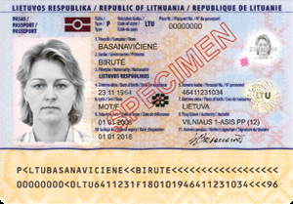
Would you walk around everywhere showing your passport openly?
Your Privacy
In the digital world, it could well happen without you ever knowing…

Slide 5
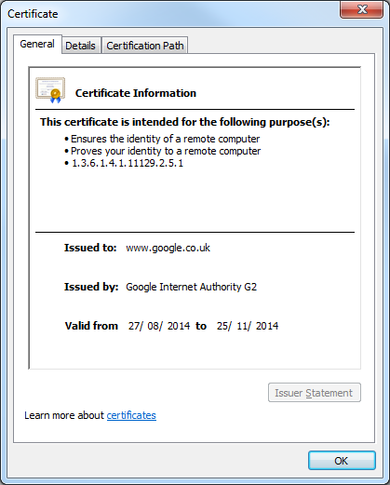
Digital Identities
Name
Issuer
Validity
Also contains:
Serial number
Information binding it to the subject
Forgery protection, etc.

Slide 6
National Electronic ID
In Sweden we have national electronic IDs
Used for online authentication/signing
Government e-services, Online banks, etc.
Contains PII
Full name, Date of birth, Personal identity number (NIN/SSN-equivalent)
Based on client certificates protected by custom software

Slide 7

Please Update Your Software!
In 2013, a letter was sent out to around 500,000 individuals in Sweden
Urged users to update their electronic ID software
Why such a drastic action?
Imagine Microsoft’s “Patch Tuesdays” being delivered by Royal Mail…

Slide 8
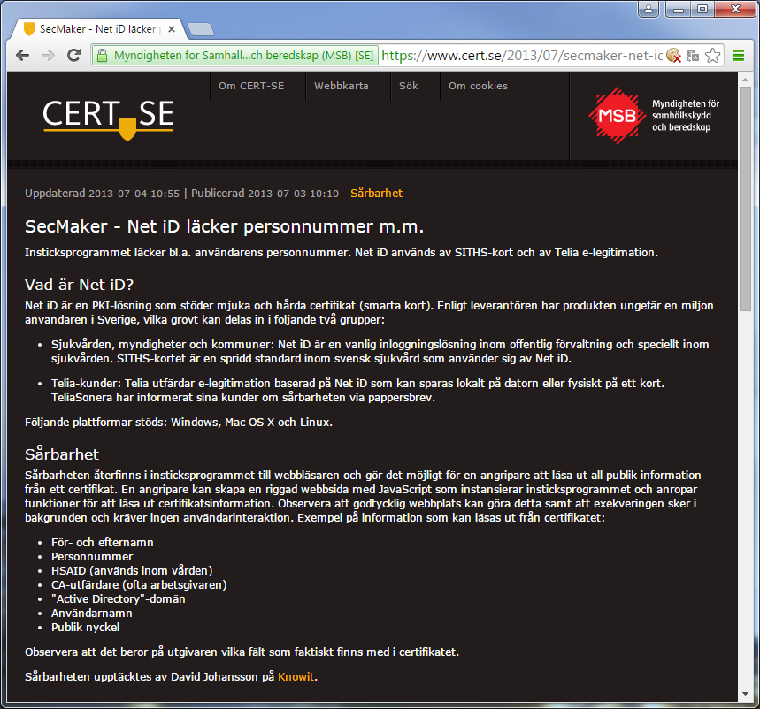
1 Million Identities Exposed
Possible to enumerate certificates by calling plugin through JavaScript
No user interaction needed, no need of previous authentication
Any site could silently identify you – even if you were using proxies, TOR network, etc.
document.iID.EnumProperty('Certificate','0')
Notes:
About 1 million users affected, of which:
~500,000 private individuals (electronic ID)
~400,000 healthcare professionals

Slide 9
The Privacy Problem
Was this just an odd software error?
Or is there a problem with privacy in authentication solutions in general?

Slide 10
Privacy Requirements
Authentication Solutions

Slide 11
Security vs. Privacy
Security is considered an important aspect when designing authentication:
Password policies
Multi-factor authentication
Protect passwords in transit and at rest
Prevent brute-force attacks
Prevent replay attacks, etc.
But does this protect users’ privacy?

Slide 12
[Privacy] User Stories
As a user, I want to know who I communicate with before I authenticate myself so that I avoid revealing my identity to unknown entities.

Slide 13
[Privacy] User Stories
As a user, I want to know when I authenticate so that I only reveal my identity when I intend to do so.

Slide 14
[Privacy] User Stories
As a user, I want to know and control what information I reveal when I authenticate so that I only reveal information about myself that I intend to share with the other party.

Slide 15
[Privacy] User Stories
As a user, I want to know that only the intended recipient can see my identity when I authenticate so that I don’t expose my identity to others listening in on the conversation.

Slide 16
Privacy Requirements
[Privacy] User Story
Privacy Requirement
Know who I communicate with
Know when I authenticate
Know and control what information I reveal
Know that only the intended recipient can see my identity
System authenticates before user
Explicit or implicit approval of authentication
Explicit or implicit approval of which identity data to share
Secure transmission of identity data
Notes:
Translated into privacy requirements:
The system must prove its identity before the end user authenticates. (The order of authentication is important, e.g. the server should authenticate itself before the user and not vice versa.)
The user must be notified when authentication takes place and explicitly or implicitly approve that his/her identity is revealed to the other entity.
The user must be notified about what information is shared during authentication and explicitly or implicitly approve that this information is shared with the other entity.
Identity information must be protected from eavesdroppers during authentication, e.g., be encrypted or only transmitted through an encrypted channel.

Slide 17
SSL/TLS Client Certificate Authentication
Privacy Issues in

Slide 18
SSL/TLS Mutual Authentication
Client and server wants to establish a secure connection
Server may ask for client certificate during SSL/TLS handshake
Are the privacy requirements for clients fulfilled in SSL/TLS?

Slide 19
Demo 1: The Browser Bug
TLS Client Privacy - Round 1: Internet Explorer vs. Chrome

Slide 20
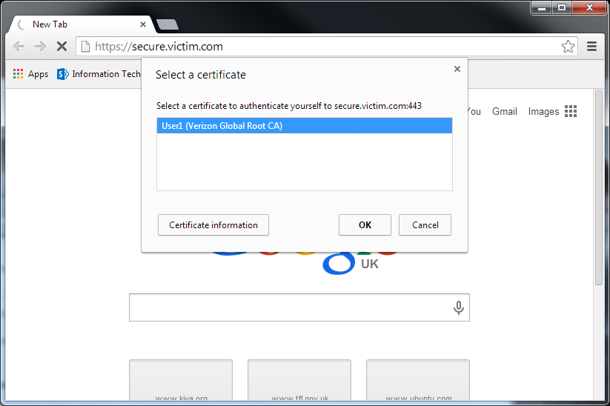
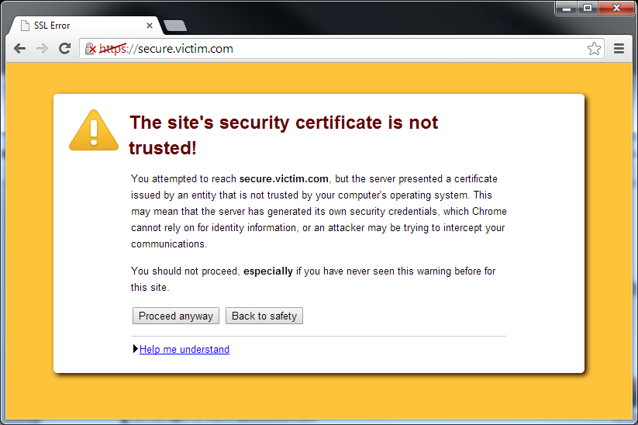
Chrome’s Privacy Error
Client
Spoofed Server
Client Hello
Server Hello Server Certificate Server Key Exchange* Certificate Request Server Hello Done
Forged (invalid) server certificate
No warning in browser
Browser validates certificate and displays warning after handshake completes
Client Certificate Client Key Exchange Certificate Verify ChangeCipherSpec
Client sends certificate to spoofed server
The user is warned of the certificate error, but the identity of the client is already exposed.
Finished
*Server Key Exchange is only sent when more than the server certificate is needed for the key exchange, e.g. ephemeral Diffie-Hellman.
Notes:
Backup slide in case of issues with live demo

Slide 21
Privacy - Round 1: Microsoft IE 1 – 0 Google Chrome
And the winner is…
Wait, not so fast!
Internet Explorer used to do the same…
…and in fact all browsers can be fooled!

Slide 22
SSL/TLS Privacy Flaw
Client
My Spoofed Server
The real www.example.com
Client Hello
Use the real site’s public certificate
Spoofed server identifies itself as the legitimate server
Server Hello Server Certificate Certificate Request Server Hello Done
Pick cipher with static RSA key exchange*, e.g., TLS_RSA_WITH_AES_256_CBC_SHA
Client Certificate Client Key Exchange Certificate Verify ChangeCipherSpec
Client authenticates to spoofed server
The SSL/TLS connection then fails, but the identity of the client is already exposed.
Finished
*Server Key Exchange message is not required for static RSA key exchange - > no explicit validation of server’s private key possession.
Notes:
SSL/TLS only validates server’s possession of the private key for Server Key Exchange messages
For many ciphers, only implicit validation is done (i.e., encryption fails, bad MAC)
Malicious servers can exploit this by choosing an appropriate cipher suite, i.e., one that doesn’t require additional key material, such as TLS_RSA_WITH_AES_256_CBC_SHA

Slide 23
Demo 2: The TLS Privacy Flaw
TLS Client Privacy - Round 2: All Your Identities Are Belong To Us

Slide 24
Active Attacks
This protocol flaw can be exploited in active attacks to expose identities through client certificates
For example, inject hidden iFrame with HTTPS URL in any plain HTTP response
Intercept TLS handshake for HTTPS request and request client certificate
Browser prompts user or may even send client certificate without user’s knowledge

Slide 25

Passive Eavesdropping
Client
Server
Client Hello
Server Hello Server Certificate Server Key Exchange* Certificate Request Server Hello Done
Client Certificate Client Key Exchange Certificate Verify ChangeCipherSpec
Eavesdropping on network communication
Plaintext
Ciphertext
Finished
*Server Key Exchange is only sent when more than the server certificate is needed for the key exchange, e.g. ephemeral Diffie-Hellman.
Notes:
Another privacy issue in SSL/TLS is that client certificates are sent in plaintext during the handshake before the encryption begins. Any passive eavesdropper on a network connection can read identity data from client certificates during TLS connection setup.

Slide 26
SSL/TLS Mutual Authentication
Privacy RequirementS
System authenticates before user
Explicit or implicit approval of authentication
Explicit or implicit approval of which identity data to share
Secure transmission of identity data
Privacy requirements are not fulfilled in SSL/TLS Mutual Authentication.

Slide 27
TLS 1.3 Privacy Improvements
The draft of TLS 1.3 contains several improvements to privacy
Explicit verification of server’s key possession
CertificateVerify: signature over entire handshake
Encrypts communication before sending client certificate
However, TLS 1.3 is still work in progress and will likely take time before widely supported
For now, avoid storing PII in client certificates used with TLS

Slide 28
SAML 2.0 SSO
Passive authentication requests in

Slide 29
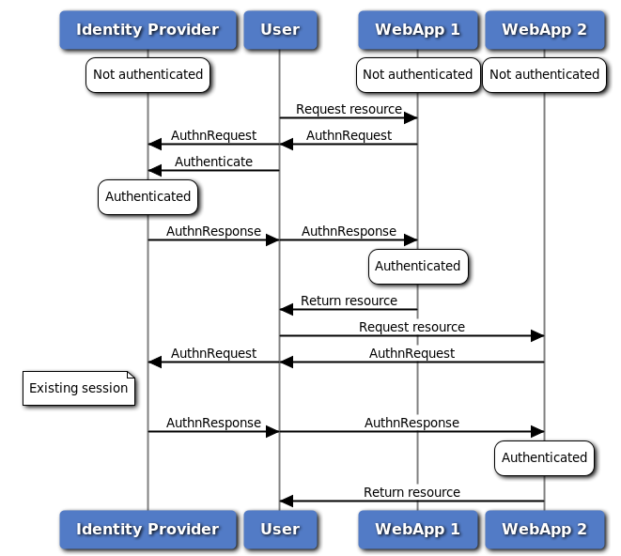
SAML Web Browser SSO

Slide 30

SSO within an Organization
App
App
IdP
App
App
App
We typically have some level of trust for all applications within our organization

Slide 31
SSO across Organizations
IdP
Trust
App
App
Trust
Trust?
App
App
App
App
App

Slide 32
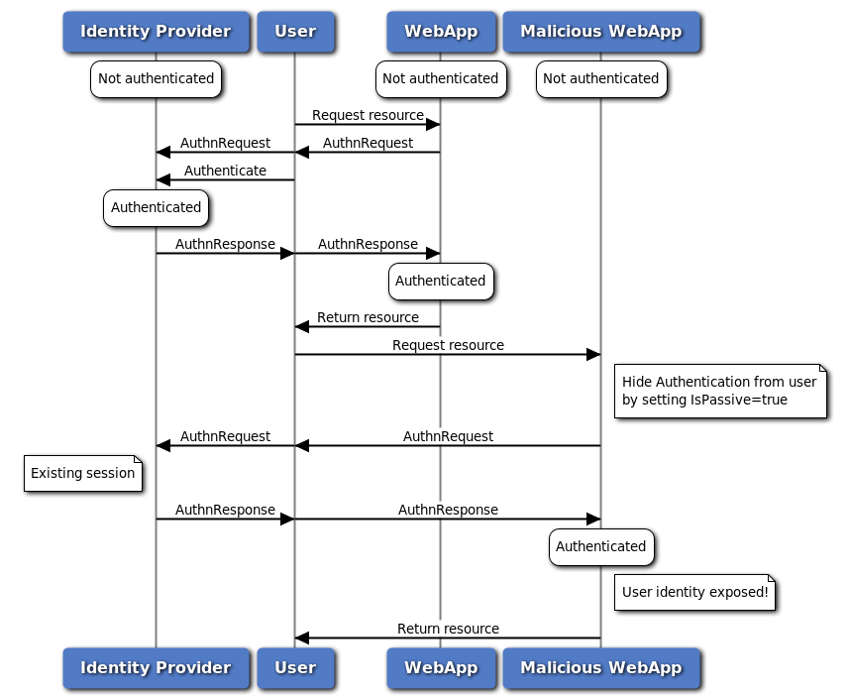
Passive AuthnRequest
Privacy requirement not met
A Boolean value. If "true", the identity provider and the user agent itself MUST NOT visibly take control of the user interface from the requester and interact with the presenter in a noticeable fashion. If a value is not provided, the default is "false".

Slide 33
Conclusions
Users’ privacy often neglected
Secure authentication doesn’t necessarily mean that privacy is protected
Several solutions have privacy flaws
Protect your users’ privacy
Privacy requirements must be considered when designing authentication solutions

Slide 34
Questions?
(Whitepaper on TLS privacy issues to be released soon…)

