Slide 1

InfoSec
Natural Selection
An How-To Guide for Measuring the VALUE of InfoSec Products
www.sectoolmarket.com

Slide 2
InfoSec Products Typical Use Cases
Aspects Requiring Evaluation in InfoSec Products

Slide 3

Products Are Branded In Many Ways:
InfoSec Marketing “Classifications”
Next Generation
Behavior Based
Cutting Edge
Intelligent
Best of Breed
Heuristic
Actionable
Cyber-X

Slide 4


Represent the VALUE as Useful, Easy-to-digest,
Number
What’s In It For You?
Breakers
Defenders
Builders
Stay Out of Trouble! (Lawsuits, Fines, Jail)
Perform Better Tests! (Coverage, Accuracy)
Get Richer Faster! (Spend Less Money & Time)
Catch More Badguys (Efficient Detection)
Better Sleep (Efficient Protection)
Bigger Beer Budget (Spend Less Money)
Less Post-Release Bugs! (Identify More Issues Sooner)
Shorter Lists of Excuses in Incidents (Generate Better Code)

Slide 5
Solution Evaluation Methodology
Aspects Requiring Evaluation in InfoSec Products

Slide 6



Product Evolution Categories Simplified
Relevance
Risk
Does It Work ?
Is It Safe ?
Technology Support
Quality
Potential Hazards
What Can It Do ?
How Well Can It Do It ?
Pricing / Integration / Support

Slide 7
Does It Work ?

Slide 8
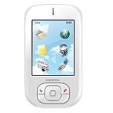
Relevance – Technology Support
Assess & Protect
SQL
Web Server
Protocol
Input
WAF / IDS / IPS
NoSQL
SCANNERS
Output
CMS
SOAP / REST Services
LDAP

Slide 9
Relevance – Technology Support
Web Environments
SQL
Web Server
Protocol
GET, POST, XML, JSON …
Input
WAF / IDS / IPS
NoSQL
SCANNERS
Output
CMS
HTML, LINKS, FORMS, JS / AJAX, XML …
SOAP / REST Services
LDAP

Slide 10
Support for Key Aspects
Support Required For:
- Input Delivery Vectors , Protocol
- Crawling / Parsing Response Content
- Development Language Runtime Environment (v) Support
Support Required For:
- Development Language Syntax Familiarity
- Entry Point Detection (Sinks & Sources)
Support Required For:
- Input Delivery Vectors , Protocol
- Crawling / Parsing Response Content
DAST
Web Application Scanners
SAST
Source Code Analysis
IAST
Interactive Memory Analysis

Slide 11
Technology Support
Support for Testing Modern Technologies

Slide 12



Traditional Input Delivery Vectors
Application-level attacks are usually delivered in the form of inputs.
These inputs can be delivered to the application in many forms, some of the most common include:
URL Addresses (file / dir)
Query String Parameters (GET)
HTTP Body Parameters (POST)
Cookie Parameters
HTTP Headers
Multipart

Slide 13

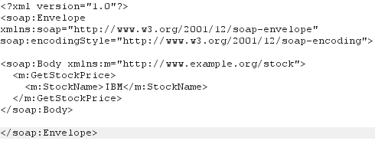
Modern Input Delivery Vectors
In the last couple of years, richer input delivery formats were adopted, requiring products to adapt in order to stay relevant:
JSON, Nested JSON
  Parameters
  Values
XML / SOAP, Nested XML
  Elements
  Attributes
  Tags

Slide 14
Tech-Specific Input Delivery Vectors
Various technologies also make use of their own proprietary input delivery vectors. Common instances include:
GWT
OData
Flash AMF
.Net WCF, Binary WCF
Java Serialized Objects
DWR

Slide 15
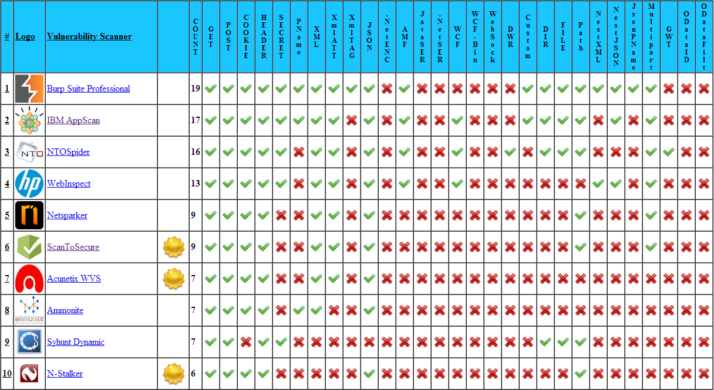

Slide 16
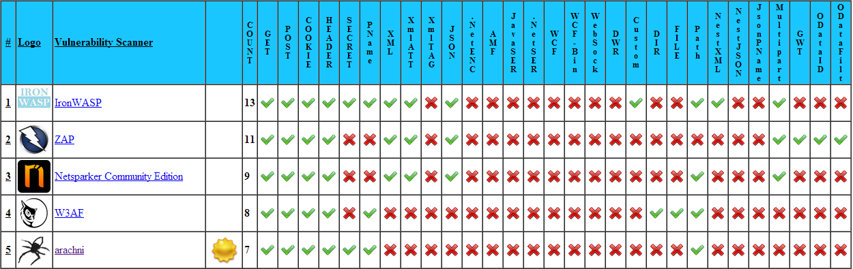

Slide 17
Crawling Efficiency
Support for Crawling Modern Technologies

Slide 18





Crawling Modern Technologies
Form & Link Crawling:
Ajax Crawling
WebSockets Crawling
Angular JS Crawling
Flash Crawling
Applet Crawling

Slide 19
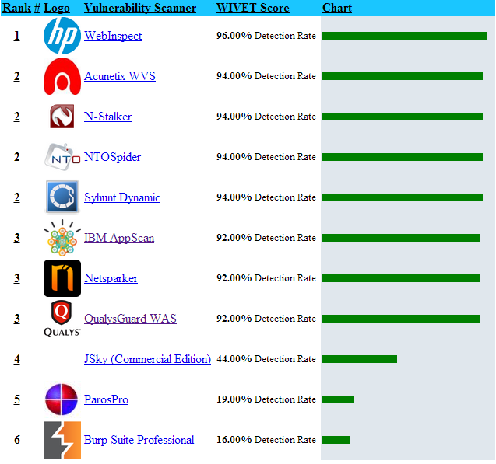
Crawling Engine Efficiency (WIVET)

Slide 20
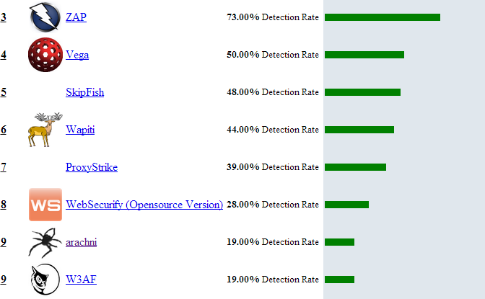
Crawling Engine Efficiency (WIVET)

Slide 21
Is It Safe ?

Slide 22
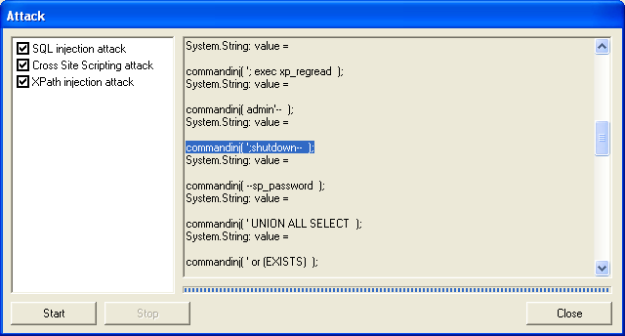
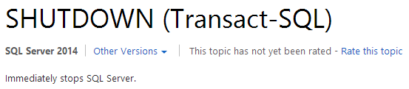
Scan Safety – WS Digger (Foundstone - 2005)

Slide 23
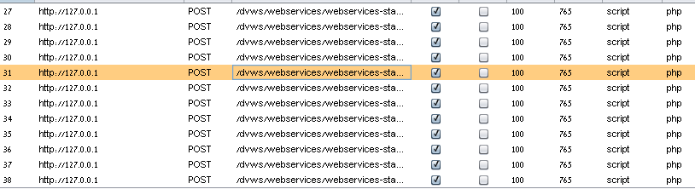
Scan Safety – WS Digger - Practical Joke ?
Traffic Analysis Shows that the SHUTDOWN command is NOT actually sent by WSDigger ☺
  Probably just a Practical Joke on the weary pen-tester (Good One!)
However, WSDigger is sending payloads that may cause a worse outcome

Slide 24
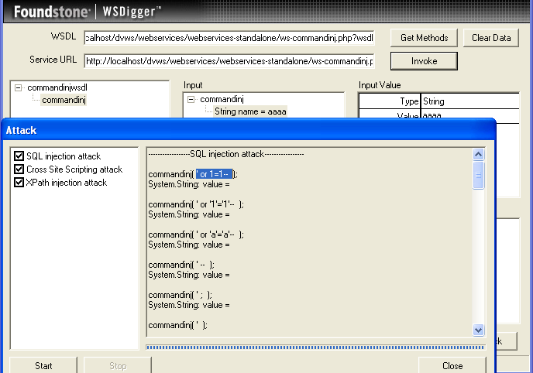
Scan Safety – WS Digger (Foundstone - 2005)

Slide 25
Scan Safety Hazards in Detail
SQL Injection Unsafe Payloads
  SQL Comments (--)
    May cause parser to ignore filtering conditions in DELETE / UPDATE statements
  SQL OR Clauses (OR true=true)
    May cause permissive filtering conditions in DELETE / UPDATE statements
  Exaggerated Time Delay (sleep/wait_for_delay/benchmark + lack of load safety)
    May effectively cause denial of service
  Unsafe Commands (Shutdown, DROP, DELETE, etc)
    May cause data corruption and/or denial of service
DELETE FROM tblComments WHERE cid=11; -- AND userid=55
DELETE FROM tblComments WHERE cid=1 OR 1=1

Slide 26
Attack Payload Safety
Vulnerability Detection Plugin
SQL Injection
Persistent XSS
OS Command Injection
Server Code Injection (ASP 3.0)
Buffer Overflows
Format String Injection
SQL Comments, OR Clauses (DELETE, UPDATE),… | Unsafe
Shared Content Corruption, HTML Comments | Unsafe
File Overrides, Unsafe Commands | Unsafe
Unsafe Commands, OR Clauses, Comments | Unsafe
System Crash, Data Corruption | Unsafe
System Crash, Data Corruption | Unsafe
Etc …

Slide 27

Scan Safety Elements Support
Infrastructure Scan Features
Application Scan Features
Safety Elements
Safe Plugins
Load Control
Request Delay
Response Time Adjustment
Safety Elements
Safe Payloads
Load Control
Request Delay
Response Time Adjustment
URL Restrictions
Protection Product Features
Safety Elements
Security (Self)
Entity Block Policy
Auto-Release Support
Controlled Fall-Down*
Latency / Low Capacity

Slide 28
What Can It Do ?

Slide 29
Module Comparison
Components Included In Each Product Suite

Slide 30







Scan Engine Modules
Module Type
Generic Web Application Scanner
Generic Web Service Scanner
Generic Flash Application Scanner
Manual Interception Proxy
Signature-Based Vulnerability Scanner (CGI Scanner/Web Server Scanner)
Fuzzer
Source Code Analysis
Interactive Application Analysis (IAST)
ZAP
LAPSE+
AppScan

Slide 31

Monitoring Modules
Module Type
Signature-Based Web Application Firewall (Web IDS/IPS)
Positive-Mode Web Application Firewall (Positive Security Model)
Code-Integrated Memory Level IDS/IPS
Heuristic Learning Mode
Application-Level Anti-DDoS Solution
Anti-Scraping Solution
Anti-Automation Solution
ModSecurity
AppSensor

Slide 32











Vulnerability Databases and Classifications
Generic Vulnerability Classifications
  OWASP Attacks & Vulnerabilities
  WASC Threat Classification
  OWASP TOP 10 / Testing Guide
  MITRE CWE & CAPEC
  VulneraPedia, Hakipedia, BH Academy, etc…
Scoring Systems:
  CVSS, CAESARS
Reported Vulnerabilities Databases:
  CVE, NIST NVD, Security Focus BID…

Slide 33
RvR
Relative Vulnerability Rating
RGvRR
- Relative Generic Vulnerability Risk Rating

Slide 34
Content Evaluation for InfoSec Products
RGvRR
- Relative Generic Vulnerability Risk Rating
Unifying Generic Vectors From:
  OWASP Attacks & Vulnerabilities
  OWASP TOP 10 / Testing Guide
  WASC Threat Classification
  MITRE CWE & CAPEC
  VulneraPedia, Hakipedia, BH Academy, etc…
  Vendor Publications, Blogs, Publications, Conferences, Undocumented Well Known Vectors
Simplified Scoring Systems for Product Evaluation, In Comparison to CVSS

Slide 35
RvR Vulnerability Category Diversity

Slide 36
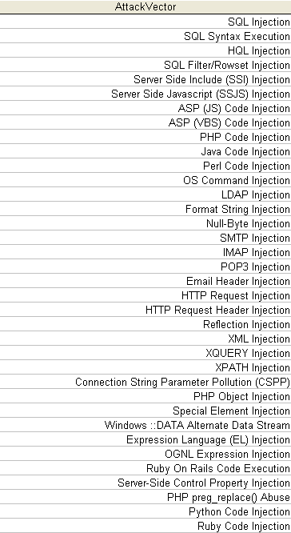
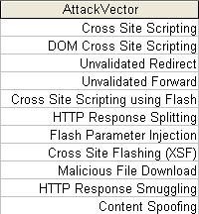
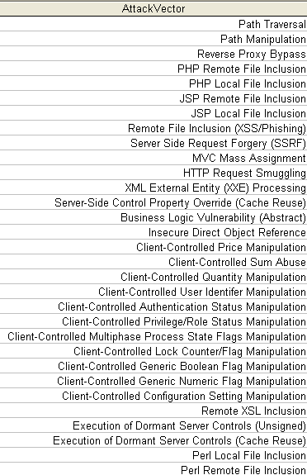
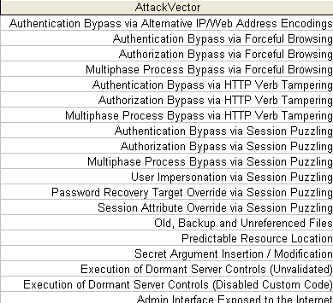
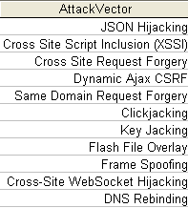
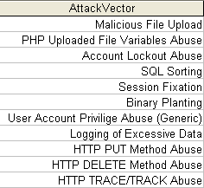
RvR Vulnerability Category Diversity
Injections
Reflections
Manipulations
Forced Access
3rd Party Abuse
Feature Abuse

Slide 37
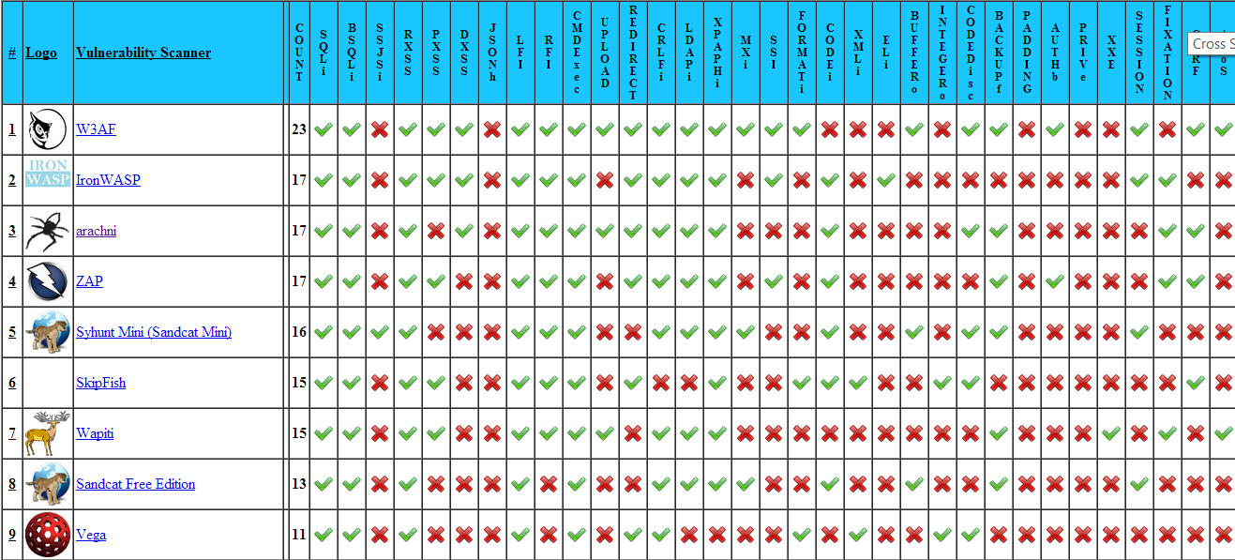
Vulnerability Detection Features

Slide 38


Prominent Vectors Supported
Module Type
Injections
Browser-Related Attacks
Memory Attacks
Context-Specific (Logical) Attacks
Technology Specific
Enumeration
Cryptographic
8+
4+
None
3+
1+ (XML)
2+
1+
6+
5+
None
None
1+ (EL, XML)
1+
1+
12+
8+
2-3+
4+
2+ (XML, Flash)
2+
1+
Burp Suite
Netsparker
AppScan

Slide 39
Newly Published Vectors Supported
Module Type
MVC Mass Assignment
EL-Injection
Heartbleed
JSON Hijacking
.Net Hidden Control Activation
Cross Site Web Socket Hijacking
Padding Oracle
Burp Suite
Netsparker
AppScan

Slide 40
How Well Can It Do It ?

Slide 41



Evaluation Platforms
(Web) Application Vulnerability Assessment (DAST, SAST, IAST)
  WAVSEP (Accuracy)
  WIVET (Crawling, Input Vector Extraction)
  bWAPP (Vulnerability Detection Diversity)
Infrastructure Vulnerability Assessment
  Metasploitable
Web Application Firewall (WAF):
  WTF (Imperva’s WAF Testing Framework),
Intrusion Detection (IDS/IPS):
  Pytbull (Vulnerable Test Cases), RIPE (Buffer Overflows), EVADER (Evasion Techniques)

Slide 42
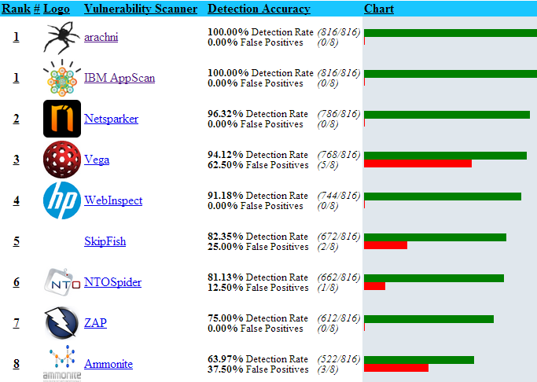

Slide 43


SQL Injection Detection Accuracy
Detection Accuracy
False Positives

Slide 44
Reflected XSS Detection Accuracy
Detection Accuracy
False Positives

Slide 45
Local File Inclusion Detection Accuracy
Detection Accuracy
False Positives

Slide 46
Remote File Inclusion Detection Accuracy
Detection Accuracy
False Positives

Slide 47
Unvalidated Redirect Detection Accuracy
Detection Accuracy
False Positives

Slide 48
Backup/Hidden Files Detection Accuracy
Detection Accuracy
False Positives

Slide 49
User Experience
Performance, Stability, Capacity, Result Consistency, Preq.

Slide 50
Performance
Relative Stability and Capacity
Measuring Performance
  Related Elements
    Plugin Amounts
    Threads
    Memory Allocation
    Technology
    External Factors (bandwidth, server connections, server performance, etc)
  Payload amount per exposure, Payload types
Measuring Performance Per Attack Vector

Slide 51
Summary
Results & Conclusions

Slide 52
Checklist - Evaluating Key Aspects
Test Support For:
1) Protocol (Enc. / Compress.) 4) Attacks Detected
2) Input Delivery Vectors 5) Relevant Signatures
3) Incident Response Methods 6) Evasion Resilience
Test Support For:
1) Protocol (Enc. / Compress.) 4) Crawling / Parsing Content
2) Input Delivery/Entry Vectors 5) Vulnerabilities Supported
3) Authentication Protocol 6) Detection Accuracy
Assess
DAST/SAST/IAST
Protect
WAF/IDS/IPS

Slide 53
Product Evolution Categories Simplified
Supported Technologies
Safety Aspects
What Can It Do ?
How Well Can It Do It ?
Protocol
Payload Safety
Accuracy
RvR
Input Format
URL Exclusions
Consistency
Crawl Method
Load Control
Stability
Authentication
Request Delay
Performance

Slide 54

Questions

