Slide 1
Steering the Battleship to a Secure path
Bringing the product security message to HP Software
Tomer Gershoni, Chief Products Security Officer, HP Software
OWASP Israel Conference, August, 2014

Slide 2
About me
Overall, more than 12 years in the Information Security Domain
5 Years to HP Software
Started with 3 Years as HP Software as a Service (SaaS) Chief Information Security Officer
Before: MOD, Mirs/Motorola, Cellcom

Slide 3

HP Software Security & Trust Office
HP Software Security & Trust Office is the unit in HP Software responsible for Product Security in the last 2 years

Slide 4



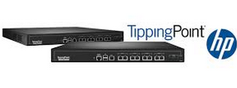
What Are We Not Going To Talk About?
Our Best Of Breed Security Products
Or Our Super Cool IT Operation Management & Application Delivery Management Products
Don’t Worry More No Pictures ☺

Slide 5
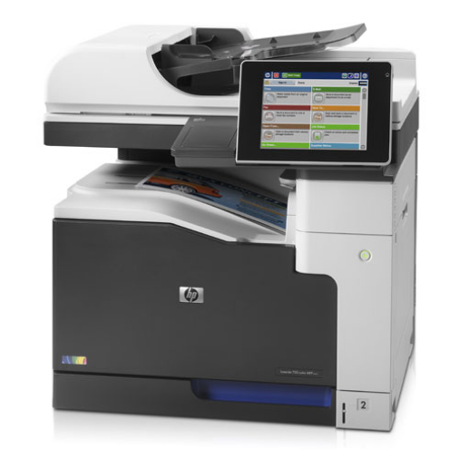
We Are Going To Talk About?
Our new HP LaserJet Enterprise 700 series
If we will have time….

Slide 6
We Are Going To Talk About?
Running a Product/Software Security in Large, Global Enterprise

Slide 7
HP is one of the world’s largest technology companies, delivering innovation in printing, personal computing, software, services, and IT infrastructure.

Slide 8











HP Strategy - Provide Solutions For The New Style of IT
Services
Advise
Transform
Manage
Finance
Printers & Personal Systems
Converged Infrastructure
HP Software
IT
Management
Analytics
Security
Printers
PCs
Tablets
Servers
Storage
Networking
Big Data
Cloud
Mobility
Security

Slide 9
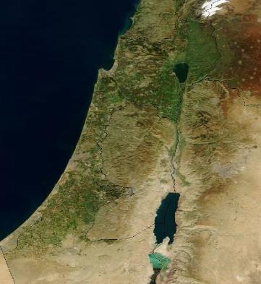

HP in israel: 5 business units, 8 sites:
5,673 employees
HP Labs
Haifa
30 employees
HP Scitex
Caesarea | Natania | Ashkelon
650 employees
HP Israel
Raanana
1,500 employees
HP Software
Yehud
1,243 employees
HP Indigo
Ness Ziona | Kiryat Gat
2,250 employees

Slide 10



HP Software
Driving the New Style of IT
Application Delivery Management
IT Operations Management
HP Security
HP Vertica
HP Autonomy
  Test and deliver packaged, web, cloud & mobile apps
  Application Lifecycle Management
  Agile Manager
  Quality and Performance Testing
  HP Anywhere
  Automate and monitor cloud and infrastructure
  Business Service Management
  Service and Portfolio Management
  Cloud Automation
  A new style of security to disrupt the adversary
  HP TippingPoint
  HP ArcSight
  HP Fortify
  The analytics engine for speed and scale
  HP Vertica Analytics Platform
  Simplify how you manage human information
  Customer Communications Management
  Information Analytics
  Information Management & Governance
  Marketing Optimization
HP HAVEn – Big Data platform

Slide 11
HP Software
#1 or #2
Top 10
50,000+
94%
7,000
with
in all markets
where we compete
Software company
Customers
of Fortune 100
Technologists driving innovation
TSIA rated
Outstanding
Leading products
95%
Customer satisfaction
One of the largest
SaaS providers
In leading markets

Slide 12
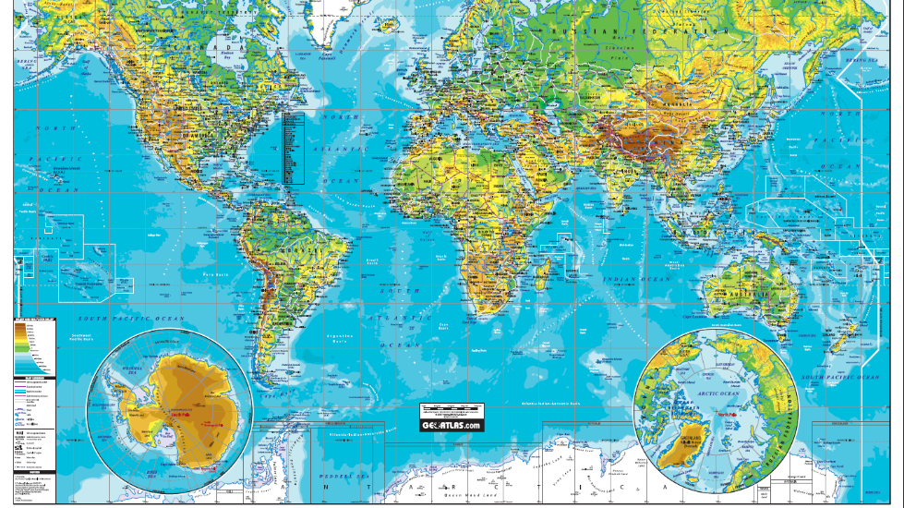

Slide 13
The early days…
2 Years ago…

Slide 14

HP Software Product Security Point Of View

Slide 15
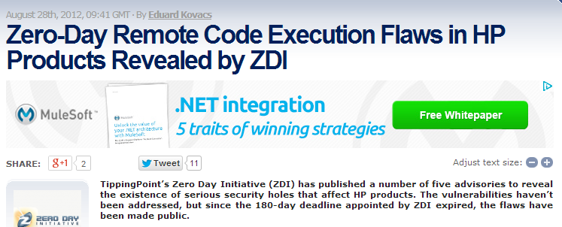
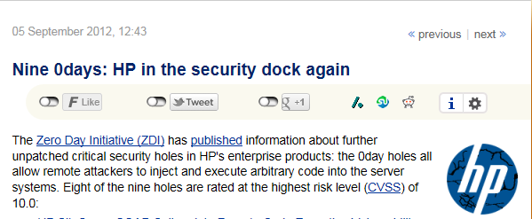
The starting point…
2012

Slide 16
Our Journey Course
Products’ Security market lead
FY13
FY14
FY15
Execution
Diagnosis & Foundation

Slide 17
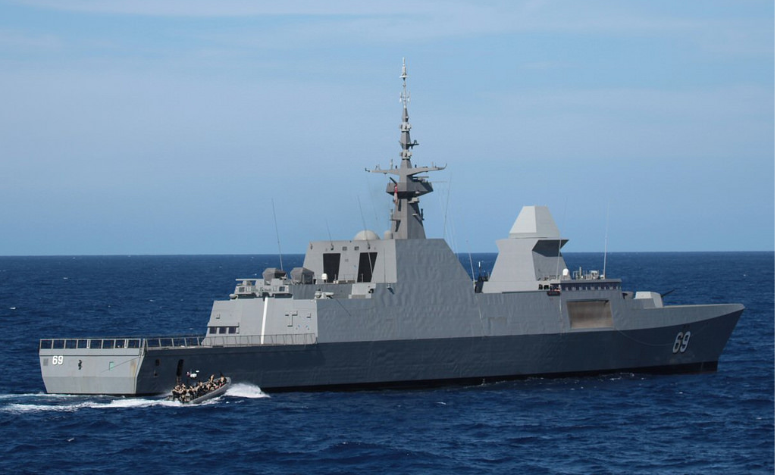

Slide 18
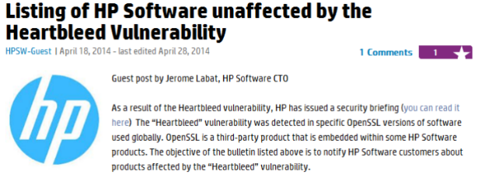
Some Improvement Made (But More is Required)
More than 150 Security bulletin & Customer communications released in 2014

Slide 19
We Are Going To Talk About?
Bottom Up
Employees Commitment and Understanding
Top Down
Gain Management Engagement (and Funding)
Business Alignment

Slide 20
HP Software Security & Trust Office Vision
Position HP Software products Security as a market business differentiator by branding HP Software as market lead in its products security and reduce overall organizational security risk.

Slide 21
Gain Management engagement
Bottom Up
Employees Commitment and Understanding
Top Down
Gain Management Engagement (and Funding)
Business Alignment

Slide 22
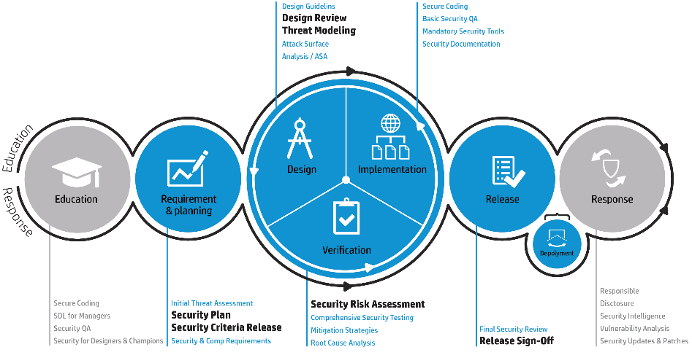
Software Lifecycle
Management Framework

Slide 23
Identify and Share the risks!!
1
2
3
4
5
6
Security & Trust CPSO & Management
Continuous risk identification & analysis
Security lab, security leads
Determine vulnerability score (VS)
Security lead, security risk manager
Finalize mitigation plan
Security & Trust CPSO, GM / SPM /PM
Security risk manager
Security lead, R&D teams, PM's
Define product criticality
Security release sign off
Determine risk profile

Slide 24
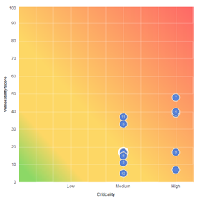




Business Oriented Jargon
Criticality = What will happen if..
Vulnerability Score
Risk Profile
Segment | Criteria | Scale | Weight
Business | Annual Revenue | $200M>= | 30%
 |  | $100<=AR<$200M
 |  | $100M<
 | Business Strategy (P/G/A) | P | 20%
 |  | G
 |  | A
Security | Processed Data Type | S. PII | 25%
 |  | Business/technical
 |  | Non sensitive data
 | Deployment Model | SaaS | 25%
 |  | On Premise with Web Presence Potential
 |  | On Premise Only
 | Breach History | 1> in past year | 10%
 |  | =1
 |  | 0

Slide 25
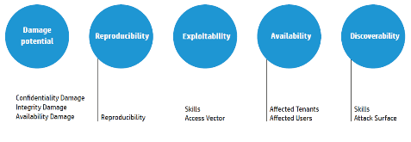
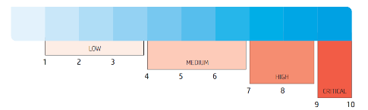
Risk Evaluation Consistency
Formalizing a vulnerability scoring toolbar (VST) for risk evaluation
Vulnerability calculator segments
Risk level determination

Slide 26
What’s The Cost ?
Security development lifecycle – how much will it cost?
Topic | Product Delivery Model (In Days)
 | Major Version |  |  |  |  | Continuous delivery |  |  |  |  | New Product
SLM Activities Total in Days | Dev 44 | Sec champ' 32 | QA/SCOE 33 | PMO 8 | Architects 16 | Dev 20.5 | Sec champ' 44 | QA/SCOE 8.5 | PMO 11.5 | Architects 17.5 | Dev 42 | Sec champ' 40.5 | QA/SCOE 17 | PMO 11 | Architects 24
 | 133 Days |  |  |  |  | 102 Days |  |  |  |  | 134.5 Days
Example
So how much fixing it will cost me?
Product Name & Version | Current Risk Distribution |  | Current VS | Efforts Required to Reduce all High risks | Efforts Required to Reduce all Medium risks | VS Post Resolution
Product A release 5.5 | High 4 | Medium 14 | 23 | 40 days | 147 days | Low
Product B Release 2.1 | High 9 | Medium 2 | 29 | 41 days | 10 days | Low

Slide 27
Management Accountability
Release Sign Off
  A release sign off process was established, requesting the relevant stake holder approval based on risk profile found
0-2 years products
2+ years products
Criticality 1<=Criticality<=3 | Vulnerability score 1<=VS<=100
 |  | High VS>30 | Medium 10<VS<30 | Low VS<10
 | High <=2 | GM | GM | VP PM
 | Medium 1.5<=x<2 | GM | GM | SPM
 | Low <1.5 | VP PM | SPM | SPM
Criticality 1<=Criticality<=3 | Vulnerability score 1<=VS<=100
 |  | High VS=>30 | Medium 10<=VS<30 | Low VS<10
 | High <=2 | GM | GM | VP PM
 | Medium 1.5<=x<2 | GM | VP PM | SPM
 | Low <1.5 | VP PM | SPM | SPM

Slide 28
PU “A” Product Security Plan – Risk Reduction Status
PU | Product & Version | Previous QBR |  | Current Status |  |  |  |  |  |  | Commitment Objective | Next QBR
 |  | Last QBR VS | Agreed VS Objective | Critical | High | Medium | Low | Total product | VS | Risk Profile | Met objective? | Objective for release and future release | Date
 |  |  |  |  |  |  |  | # Of Risks | Status | Status
A | Tinky Winky v.1 | 17 | 14 | 0 | 2 | 14 | 1 | 17 | 17 | GM | NA | 14 | 09/24/14
 | Dipsy v.2.5 | 10 | 8 | 0 | 2 | 5 | 6 | 13 | 10 | GM | NA | 8 | 09/24/14
 | Laa-Laa v. 3.5 | 29 | 23 | 0 | 5 | 3 | 2 | 10 | 18 | GM | √ | 16 | 12/24/14
 | Po 11.24 | 1 | 1 | 0 | 0 | 0 | 6 | 6 | 1 | PM | √ | 1 | 12/24/14
 | Noo-Noo v.9.33 | 22 | 18 | 0 | 4 | 3 | 0 | 7 | 14 | VP PM | √ | 12 | 12/24/14
 | Sun v.11.24 | 29 | 23 | 0 | 7 | 11 | 2 | 20 | 29 | PM | NA | 23 | 09/24/14
High Criticality
Medium Criticality
Low criticality

Slide 29
Employees Commitment
Bottom Up
Employees Commitment and Understanding
Top Down
Gain Management Engagement (and Funding)
Business Alignment

Slide 30

Building Security from Grounds Up
Develop & run a global Security experience program
Building a Security Training Center
Security Trainings
‘Secure Our Software’
WW security awareness events
Starting point

Slide 31
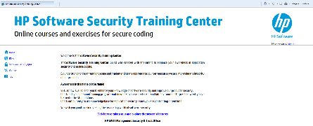
Security Experience - Execution
Java secure coding
Application Security for QA
JS / HTML5 / Angular secure coding
.Net secure coding
Mobile secure coding / Phone gap
.Net Client server secure coding
Security for managers (2014)
Technical security awareness (2014)
Global security training program
Building a Security Training Center
Security Trainings
Java secure coding
.Net secure coding
Application Security for QA
JS / HTML5 / Angular secure coding
8 Courses
1,421 employees
Trained Globally
.Net Client server secure coding
Mobile secure coding / Phone gap
Cloud security course
Security for managers (2014)

Slide 32
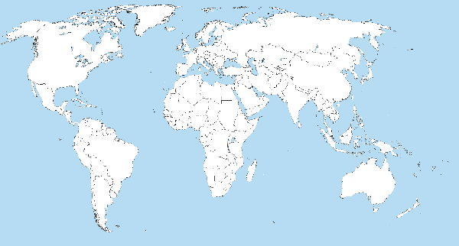

Security Experience - Execution
SOS 2014 | Secure Our Software | Worldwide Event
More than
1000 employees attended
Sunnyvale, US
150 employees participated
Yehud, IL
300 employees participated
Shanghai, China
250 employees participated
Bangalore, India
300 employees participated

Slide 33


Slide 34
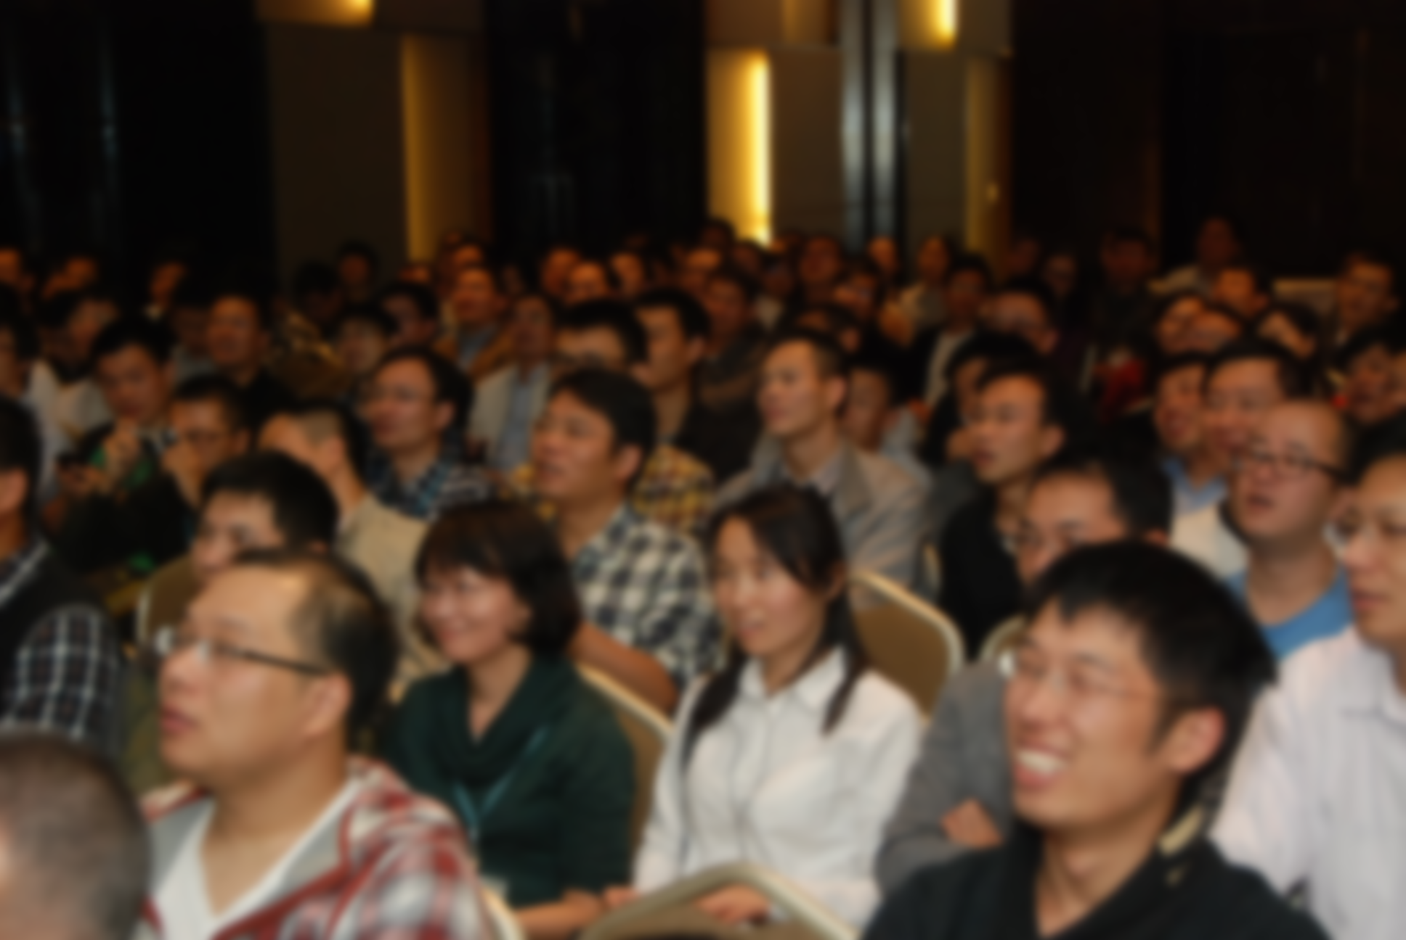

Slide 35

Current Status
Current status
2014 goal

Slide 36
We Are Going To Talk About?
Bottom Up
Employees Commitment and Understanding
Top Down
Gain Management Engagement (and Funding)
Business Alignment

Slide 37
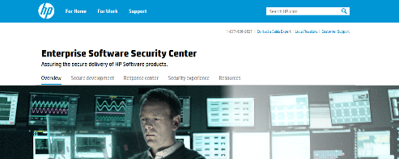
Business Enablement – Tools To Help You
Customer Websites
Customer website
Security Assurance Letters
Security White Papers

Slide 38
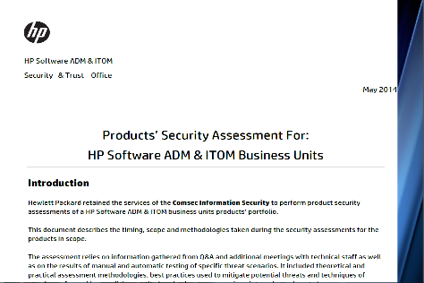
Business Enablement – Tools To Help You
Customer Websites
3rd party assurance letter
Security Assurance Letters
Security White Papers

Slide 39
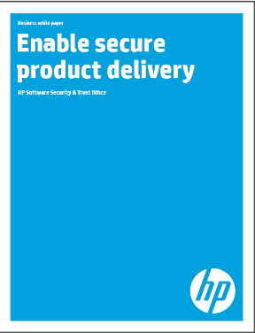
Business Enablement – Tools To Help You
Customer Websites
Security white paper
Security Assurance Letters
Security White Papers

Slide 40
HP Software Response Center

Slide 41
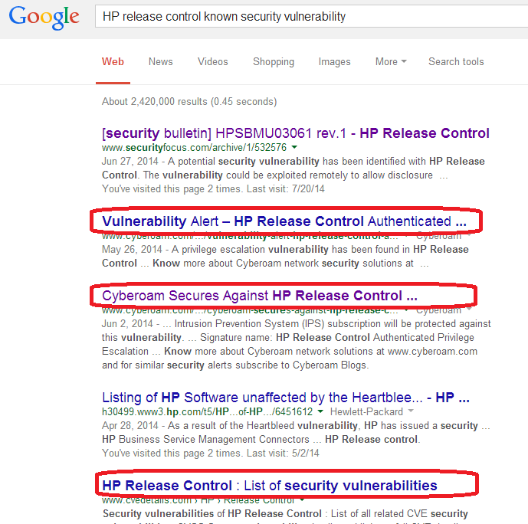
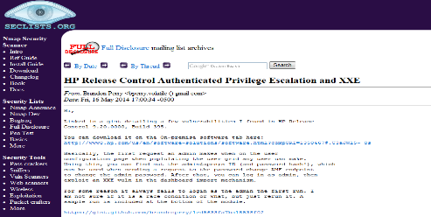
Incident Response – Is It Really Important?

Slide 42
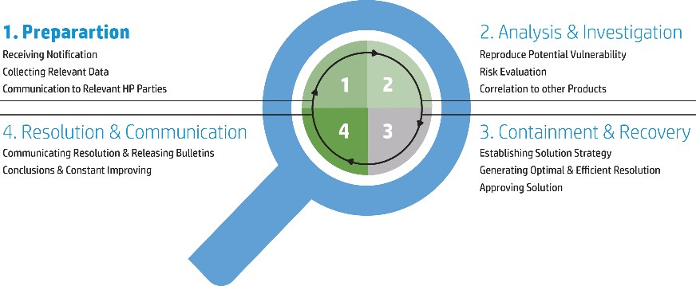
Building an Incident Response Center
Central point of contact for all reported security issues
Risk Management | Secure Development Life Cycle | Security Experience (Education) | Response Center | Business Enablement | ITOM security status

Slide 43

Did It Do Any Good?
HP Software was one of the first software vendors to release a formal public response

Slide 44
Summary

Slide 45
To summarize – the Key Success Factors in a products security program
Risk Assessments and Transparency
Talk the business language:
    What’s the impact?
    What’s the investment that the business needs to put to remediate the risk?
    Work together with the business to find the best cost efficient solutions
  Timely response – Customers and deals are not waiting for you
  Think out of the box
  Act with multidisciplinary approach – don’t throw empty phrases

Slide 46

When It Comes To Security
You Must Connect the dots and LEAD!!!

Slide 47

Corporate
Field
Sales
R&D
Management
Support

Slide 48
What’s next?
Upcoming challenges or trends (or at least wishful thinking)
Certifiable product security standard (Not ISO 27034)
Mobile Security
Products Privacy
Big data changes everything
DEVOPS, DEVOPS, DEVOPS…

Slide 49
Follow up
HP Software Security & Trust Office Website
http://www8.hp.com/us/en/software-solutions/enterprise-software-security-center/index.html
We’re Hiring – send your CV to:
jobs2@hp.com

Slide 50
Thank You
Q&A

