Slide 1
CSRF Basics
Ofer Shezaf,
CTO, Breach Security
ofers@breach.com

Slide 2

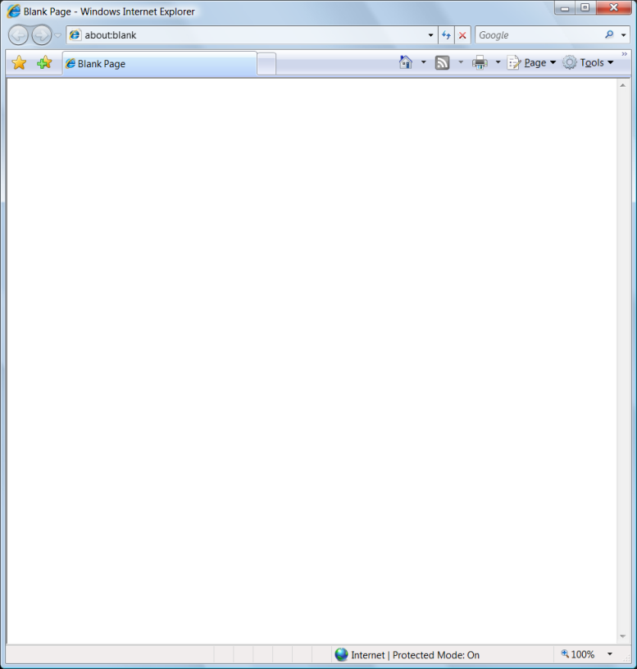
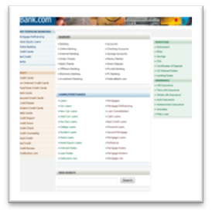


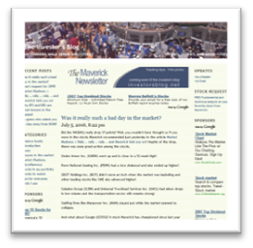

Same Origin Policy
Part of the sandbox which forms the basic Web security.
A “browser window” can access only the site from which it was fetched, sandboxing two applications one for the other.
bank.com
XHR
TAG
XHR
TAG
JS
blog.net
document, cookies

Slide 3
Attacks Against Same Origin Policy
Malware – a malicious software is installed on the victim’s computer:
  Full control of the victim’s computer.
  No vulnerability necessary.
Browser Bug – victim’s browser (or related software) is unpatched:
  Level of cross domain risk depends on the specific bug.
  In many cases allows full control of victim’s computer.
  Heavily used by Malware.
XSS - Exploiting a server side vulnerability to run scripts in server’s context on victim’s browser.
  Effectively breaks same origin policy for vulnerable site (and others that might trust it).
  Easy to mitigate if input is normally simple (i.e. no tags in input).
CSRF - ???

Slide 4

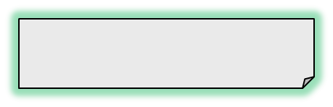

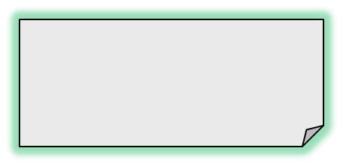

What is Cross Site Request Forgery (CSRF)?
Sending requests to other applications is not controlled by same origin policy. Only receiving results!
This allows an attacker to perform actions within the victim’s authenticated session.
Go to Transfer Assets
https://bank.com/fn?param=1
Select Fund and Amount
https://bank.com/fn?param=1
Submit Transaction
(Credentials included!)
https://bank.com/fn?param=1
JSESSIONID=AC934234…

Slide 5
How Does CSRF Work?
Tags
  <img src=“https://bank.com/fn?param=1”>
  <iframe src=“https://bank.com/fn?param=1”>
  <script src=“https://bank.com/fn?param=1”>
Autoposting Forms
  <body onload="document.forms[0].submit()">
  <form method="POST" action=“https://bank.com/fn”>
  <input type="hidden" name="sp" value="8109"/>
  </form>
XmlHttpRequest

Slide 6
What Can Attackers Do with CSRF?
Anything an authenticated user can do
  Click links
  Fill out and submit forms
  Follow all the steps of a wizard interface
No restriction from same origin policy, except…
  Attackers cannot read responses from other origins
Severe impact on accountability
  Log entries reflect the actions a victim was tricked into executing

Slide 7
Partial solutions
Only accept POST
  Blocks simple link-based attacks (IMG, frames, etc.)
  But hidden POST requests can be created with frames, scripts, etc…
Referer checking
  Some users prohibit referers, so you can’t just require referer headers
  Attacker can:
    Use Flash to forge the referer.
    Techniques to selectively create HTTP request without referers exist.
  Makes attacks harder and can be a supporting mechanism. Might be valuable in controlled environments.
Requiring multi-step transactions
  CSRF attack can perform each step in order.
  Still makes the attack much more complex.

Slide 8

Re-authentication - Better, but less useful…
Re-authenticating for crucial action
  Must be atomic, i.e. performed together with the critical actions.
  A burden for users.
  Overuse of passwords tend to make them weaker:
    People choose simpler passwords, or write them down for the duration of the session.
Captcha
  A better alternative to
  re-authentication
  from the usability stand-point.
  Many implementations known to be breakable.
  Still needs to be atomic

Slide 9
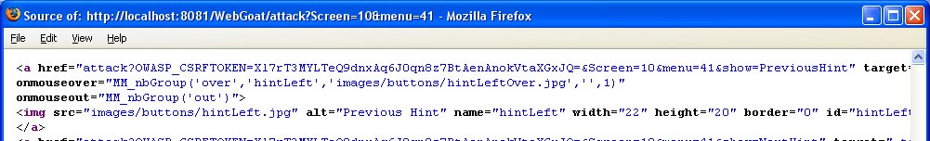
Tokens - Best, but…
Adding a token or a signature to linkable elements to ensure proper flow:
  Cryptographically strong referrer.
Requires a lot of tuning:
  Must be consistent from point of authentication.
  Deep linking, bookmarks must be taken into account.
Many reference implementation, but not standard in frameworks yet:
  OWASP CRSFguard: http://www.owasp.org/index.php/CSRFGuard
  PHP CSRFGuard: http://www.owasp.org/index.php/PHP_CSRF_Guard
  JSCK: http://www.thespanner.co.uk/2007/10/19/jsck/

Slide 10
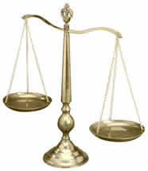
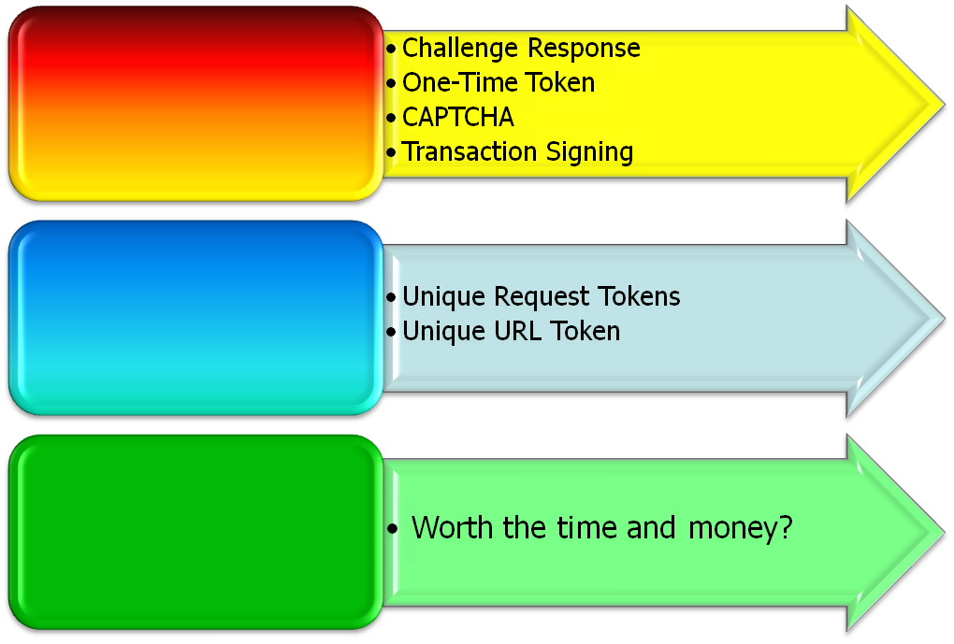



Enterprise CSRF Mitigation Strategy
Balance Between Security, Usability, and Cost
Notes:
How do organizations with various development groups consisting of ‘cowboy’ developers mitigate this problem throughout? Ans: It’s a balance act that requires a well defined strategy
Some solutions are bullet-proof in theory but greatly hinder the usability of the application
Some solutions are strong, but fail in certain scenarios
Our Strategy:
Gather information on all development groups: what technologies, what applications?
Use this opportunity to raise awareness of the issue
Assess the risk associated with each of the applications in each development group and PRIORITIZE WHAT APPS AND BUSINESS FUNCTIONS NEED TO BE PROTECTED
Implement a ‘visible but transparent’ solution that can be incorporated into each development group. Things to consider…
Does the technology utilized by the dev group facilitate the ‘drop, configure, deploy’ approach ? (i.e. J2EE, .NET)
Are there actual code changes to the applications that must take place?
How much time, effort, and money needs to be spent to implement this solution?
How are we affecting the usability of our application?
Plan time for testing! Some application code changes will be significant!
Go over graph: ‘Mission Critical vs. Everyday vs. Lunch Menu’

Slide 11

  Thanks to Eric Sheridan, who’s presentation at OWASP San Jose 2007 is the base for this one: http://www.owasp.org/images/c/c9/CSRF_DangerDetectionDefenses.ppt
  Also see:
  http://www.owasp.org/index.php/Cross-Site_Request_Forgery
  http://www.cgisecurity.com/articles/csrf-faq.shtml
Notes:
Main Point
Any remaining questions that we haven’t addressed yet?
Teaching Points
If you have any questions about application security, please don’t hesitate to call me or send an email. I’d be happy to help you work it out.
Examples, Demonstrations, Stories, Notes

