Slide 1

Warning Ahead: Security Storms are Brewing in Your JavaScript
Maty Siman

Slide 2

About Me
Maty Siman
Founder and CTO of Checkmarx – Static Application Security Testing (AKA – Source Code Analysis)

Slide 3

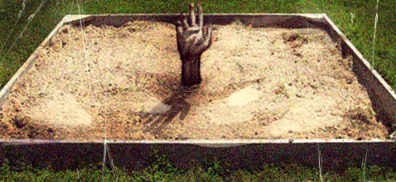
Agenda
Same old XSS becomes a monster
Broken sandbox
Client side JS
“I know where you were last summer”

Slide 4
New Tricks, Old Dog
We will see how a single XSSed page can be used to take screenshots of other non-XSSed page.

Slide 5
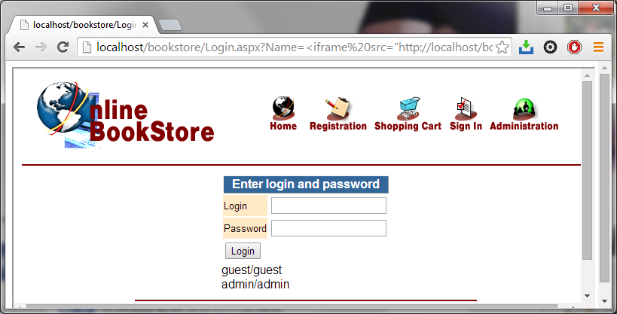
Technique
  Step A – use XSS to embed self
    http://server/page.aspx?xss=<iframe src=“http://server/page.aspx”>
Iframe border
(left visible for demo purposes)
    http://localhost/bookstore/Login.aspx?Name=<iframe src="http://localhost/bookstore/login.aspx" width="100%" height="100%“>

Slide 6
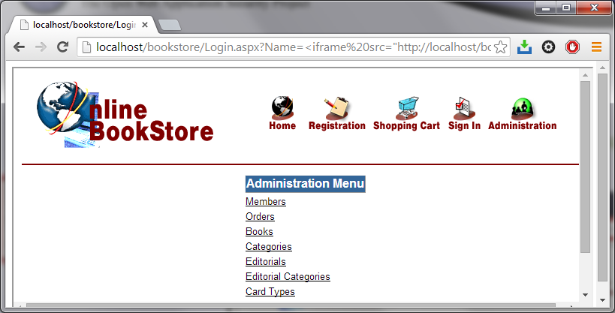
Technique
  Step B – the outer page remains the same while the user browses inside the inner frame.
  The outer page’s scripts can access the inner’s data
Iframe border
(left visible for demo purposes)
The user went to the admin page, but the URL is still the XSS’ed login page

Slide 7
Technique
  Step C – HTML5 introduced the concept of Canvas … … which can be used to take screenshots
What is Canvas? (w3schools)
The HTML5 <canvas> element is used to draw graphics, on the fly, via scripting (usually JavaScript).
Html2canvas (html2canvas.hertzen.com)
This script allows you to take "screenshots" of webpages or parts of it, directly on the users browser. The screenshot is based on the DOM and as such may not be 100% accurate to the real representation as it does not make an actual screenshot, but builds the screenshot based on the information available on the page.

Slide 8
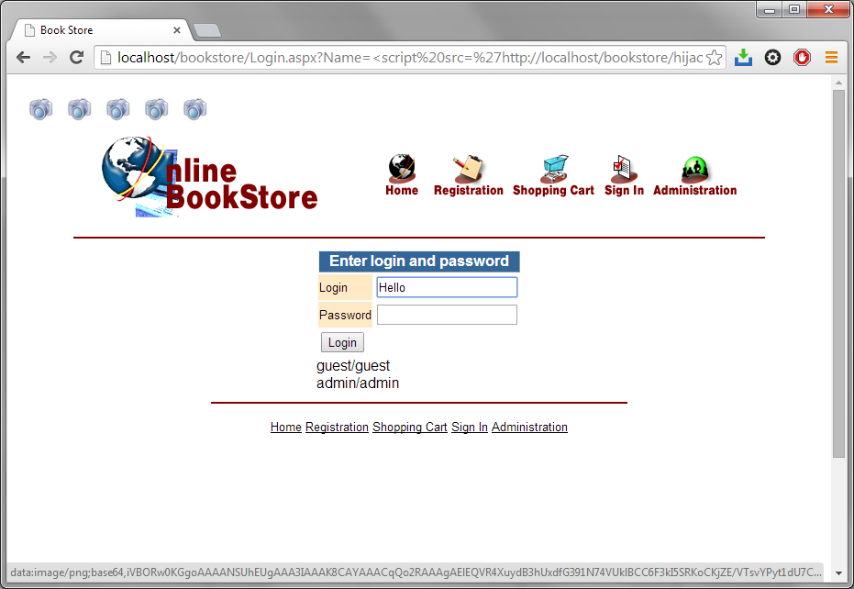
XSS that takes base64 screenshots
    http://localhost/bookstore/Login.aspx?Name=<script src='http://localhost/bookstore/hijackpage.js'></script>

Slide 9
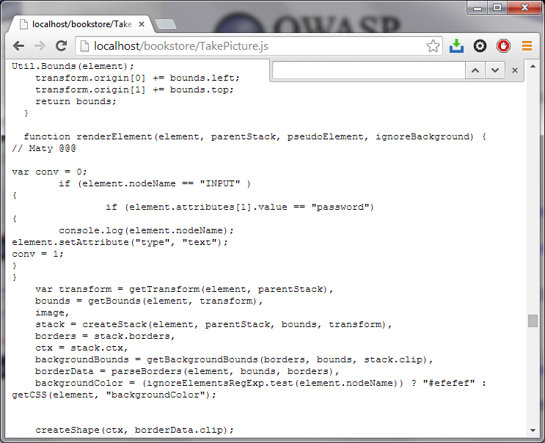
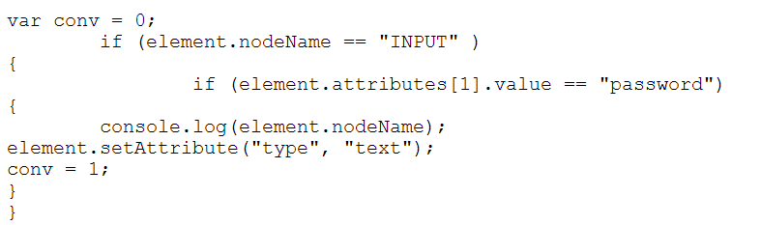
Technique
  Step D – Since Html2canvas is open-sourced which builds screenshots based on DOM information, we can modify it a bit – to
  reveal passwords

Slide 10
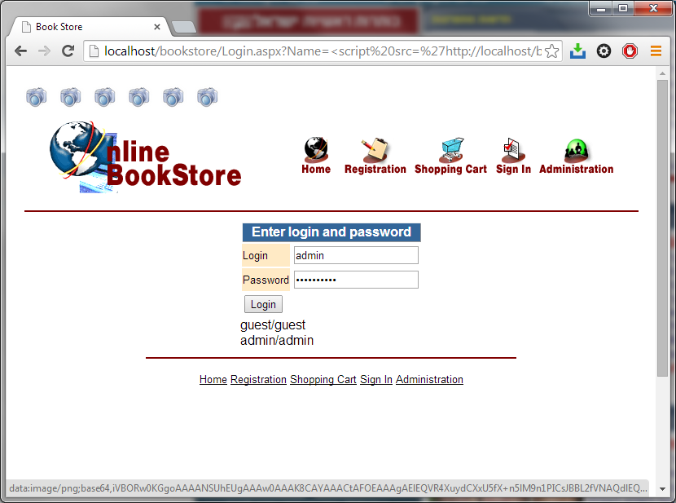
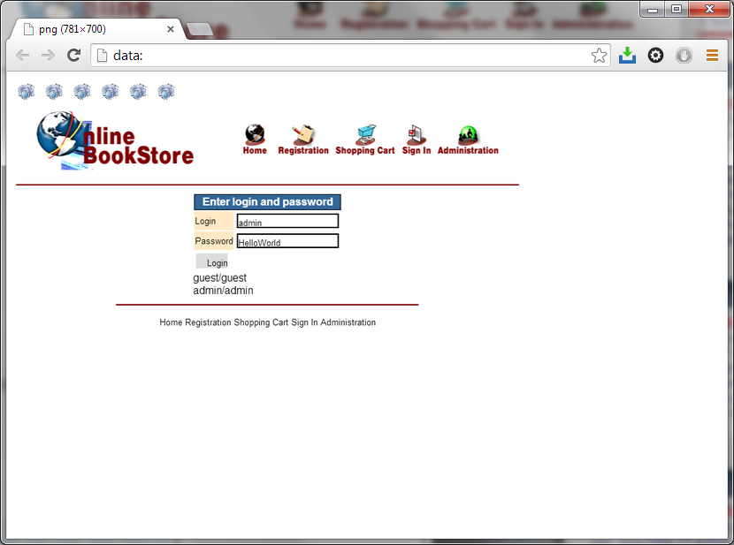

Slide 11





New Tricks, Old Dog
Now we will see how an XSS can be used as an agent to map the structure of a network behind a firewall
Super-charged XSS
  Advanced port scanning (WebSockets)
    http://www.andlabs.org/tools/jsrecon.html

Slide 12
Same Origin Policy
main page
http://www.cnn.com/main
“Change background to green”
Iframe / same origin
http://www.cnn.com/story1

Slide 13
Same Origin Policy
main page
http://www.cnn.com/main
“Change background to green”
Iframe / different origin
http://www.fox.com

Slide 14
Same Origin Policy
main page
http://www.hacker.com
“Fill in the acct_to and sum fields, and then btn_click that OK button “
Iframe / different origin
http://www.bank.com
Transfer
Money
Acct_to
Sum
OK

Slide 15
SOP
Same Origin Policy
permits scripts running on pages originating from the same site based on combination of scheme, hostname and port number.

Slide 16
Markets
Recently, companies started offering markets of extensions for their cloud offerings, like Salesforce.com, Microsoft 365, etc…
This means the javascript is written by a 3rd party but hosted and delivered from the very same server as the main page
So SOP doesn’t play well

Slide 17
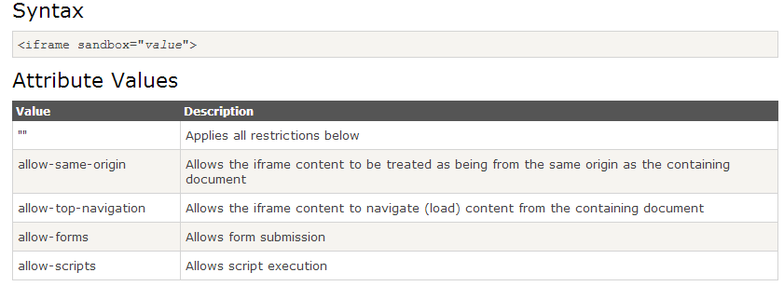
Sandbox – pitfalls?

Slide 18
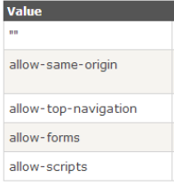
Same Origin Policy
main page
http://www.server.com
Iframe / same origin
<script> alert(1) </script>
http://www.server.com/iframe
1
Click

Slide 19
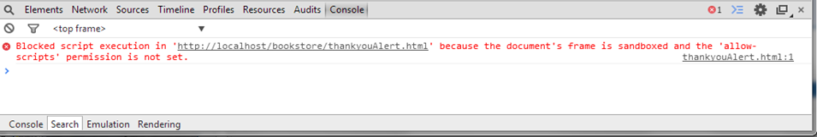
Same Origin Policy
main page
http://www.server.com
Sandboxed Iframe
Default permissions
Same Origin
<script> alert(1) </script>
http://www.server.com/iframe
Click

Slide 20
Same Origin Policy
main page
http://www.server.com
Sandboxed Iframe
Allowing Scripts and SOP
Same Origin
<script> alert(1) </script>
http://www.server.com/iframe
1
Click

Slide 21
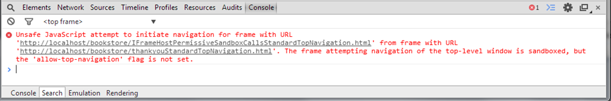
Same Origin Policy
main page
http://www.server.com
Sandboxed Iframe
Allowing Scripts and SOP
Same Origin
<script> top.navigate(…) </script>
http://www.server.com/iframe
Click

Slide 22
Same Origin Policy
main page
http://www.server.com
http://www.hacker.com
Sandboxed Iframe
Allowing Scripts and SOP
Same Origin
<script> top.find(myself)
addPermission(myself, top_nav)
Refresh()
navigate(…) </script>
http://www.server.com/iframe
Click

Slide 23
Source | Demo | Action | Permission
Host Embedded | Click | Alert | IFrame
Host Embedded | Click | Alert | IFrame + Full SB
Host Embedded | Click | Alert | Iframe + SB allowing Scripts and SameOrigin
Host Embedded | Click | Top Navigation | Iframe + SB allowing Scripts and SameOrigin
Host Embedded | Click | “Tricky” top navigation | Iframe + SB allowing Scripts and SameOrigin

Slide 24
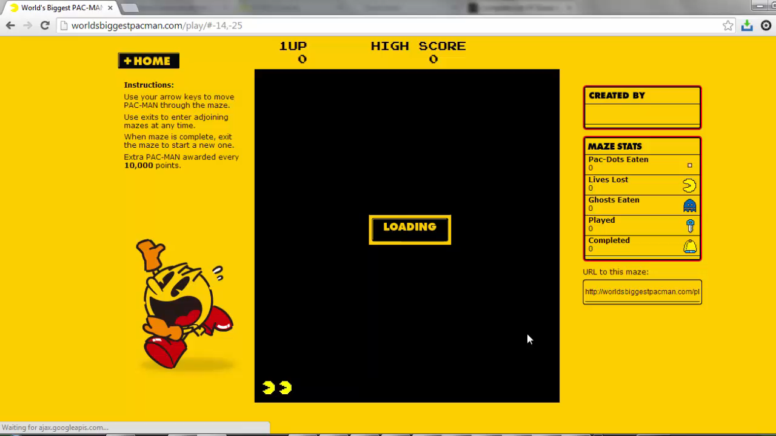

Slide 25
New Tricks, New Dogs
Demo
http://localhost/bookstore/k2.html

