Slide 1

Anti Samy picking a fight with xss
Arshan Dabirsiaghi, OWASP Peasant
Senior Application Security Engineer, Aspect Security
arshan.dabirsiaghi@aspectsecurity.com
(301) 604 - 4882

Slide 2
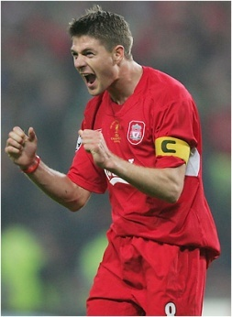
who am i?
Name Arshan Dabirsiaghi (gesundheit)
Trade Security hobbyist & developer
Job Senior Application Security Engineer with Aspect Security
Side Job Liverpool fan (go gerrard!)
Political Affiliation Plutocrat
Quote “poor people are crazy; i’m eccentric”

Slide 3
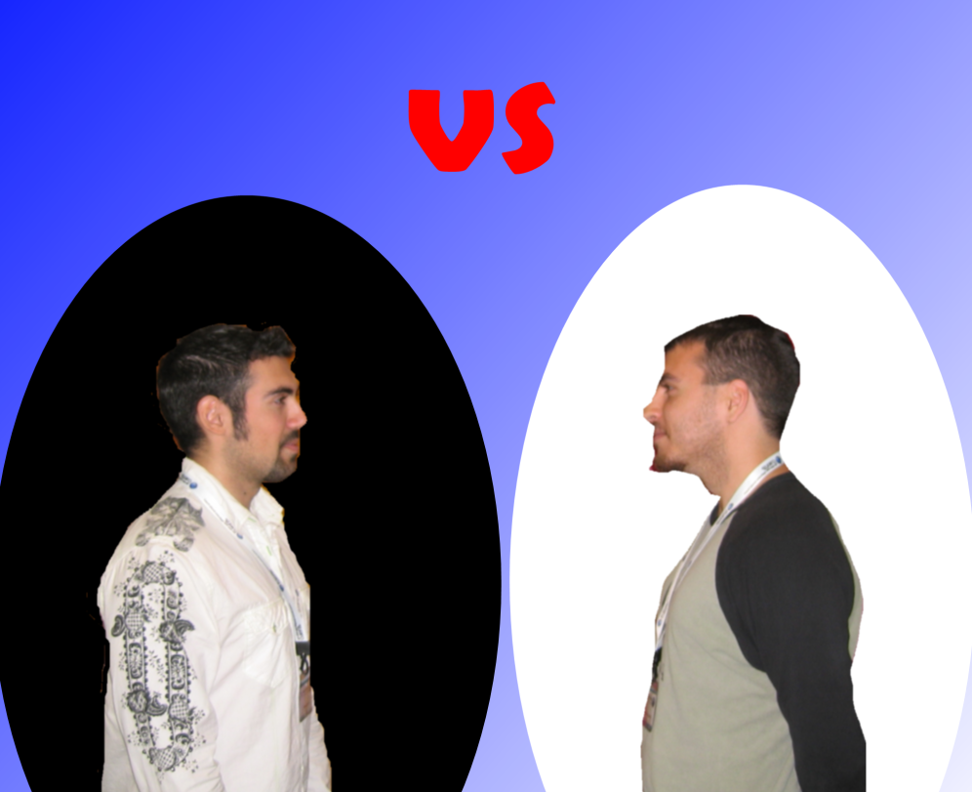
samy vs arshan
aka good vs evil,
sammy hagar vs david lee roth
ryu vs ken
…an old age old battle

Slide 4
Arshan
samy
Taller, better looking
Persian (exotic)
More chest hair
Lots of friends
Can divide by zero
Criminal record
Iranian (call DHS)
A lot of notoriety and street cred
Can’t get friends the old fashioned way, has to hack them

Slide 5
talk agenda – socratic stylez
what is stored/persistent xss?
  we’ll figure out the problem
who is samy?
  we’ll see a real world example of problem
why are you wasting my time? its nice out
  i’ll explain how i can help solve the problem
how can you prove it?
  demo + metrics

Slide 6
reflected xss – the trogdor analogy
attacker crafts a URL that submits JS to the application and sends that URL it to eleventy billion (11x10^{mc2}) peasants
one peasant clicks on the link and their browser sends the JS to the application
the web app reflects the input (containing JS) to the browser and the JS gets exec’d
xss has now burninated the victim
Notes:
This is not meant to be a primer on XSS
Reflected is the more common, less dangerous type of vulnerability
Requires proactive user
One of the reasons why I told my grandmother not to click on links, but now she’s dead (why didn’t she listen?)

Slide 7


reflected xss - illustrated
email/googleTalk/irc/etc.
*deAthL0rd420*
jen.innocent@good.com
Hey Jen, click on this link - itsa soooo good!!!?!
http://www.good.com/logon.jsp?uid=“><script>alert(‘xss’)</script>

Slide 8

reflected xss - illustrated
HTTP/HTTPS
www.good.com
jen.innocent@good.com
GET /logon.jsp?uid=“><script>alert(‘xss’)</script> HTTP/1.1
User-Agent: Lynx
Cookie: Session_Cookie: F24EX98H3L3GAW1;

Slide 9
reflected xss - illustrated
HTTP/HTTPS
www.good.com
jen.innocent@good.com
<html>
<body><form action=“logon.jsp”>
Logon Name: <input name=“uid”
value=“”><script>alert(‘xss’)</script>”>
…
</form></body>
</html>

Slide 10
stored xss – the arsenic in the well
attacker submits sticky (persisted) input to the app (e.g., blog comment/user profile)
i mention the input contains JS? whoops
later, some random peasant comes along and views the profile or blog comment
application displays comment/profile to user browser and JS inside it gets exec’d instead of displayed on browser
hours later, a seagull dnky punches an angry pirate to death (totally unrelated)

Slide 11
stored xss - illustrated
HTTP/HTTPS
*deAthL0rd420*
www.good.com
POST /setMyProfile.jsp HTTP/1.1
User-Agent: Lynx
Cookie: Session_Cookie: F24EX98H3L3GAW1;
profile=<script>alert(‘hi’)</script>
Notes:
As you can see he’s using lynx
Because he’s the freaking man

Slide 12
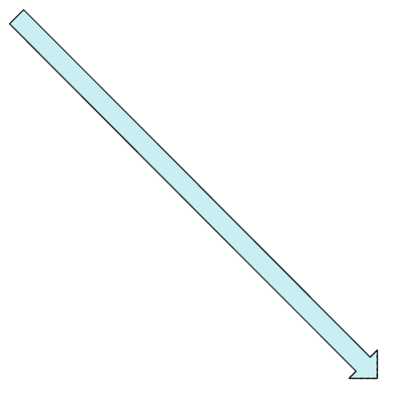

stored xss - illustrated
HTTP/HTTPS
www.good.com
1st person to view
attacker’s profile
<html>
<body>
…
<div id=“profile”>This user’s profile:
<script>alert(‘hi’)</script>
2nd person to view
attacker’s profile
Notes:
Victim comes along – “what kind of ass has a name of “death lord 420? I gotta see his picture”

Slide 13
the story of samy
weren’t you here an hour ago?
well, you blew it
… ok, i’ll tell

Slide 14

the story of samy (part 2 of 3)
myspace™ is one giant advertisement banner that has a hidden social networking site inside of it (like an easter egg)
you setup a profile, pics, etc. for other people to see
samy wanted an xss worm in his
own profile that made the reader
his friend and new source of worm

Slide 15
the story of samy (part 3 of 3)
myspace did well not to let any JS through
samy used ‘java\nscript’ since ‘javascript’ was filtered out, String.fromCharCode(34) to generate a double quote, etc.
10 hours – 560 friends, 13 hours – 6400, 18 hours – 1,000,000, 19 hours – entire site is down

Slide 16
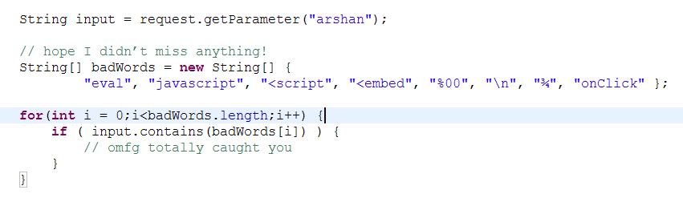
what did myspace do wrong?
they used a word blacklist
negative security models are error prone
unknown attacks / fragmenting / encoding can usually bypass (sometimes trivially)

Slide 17
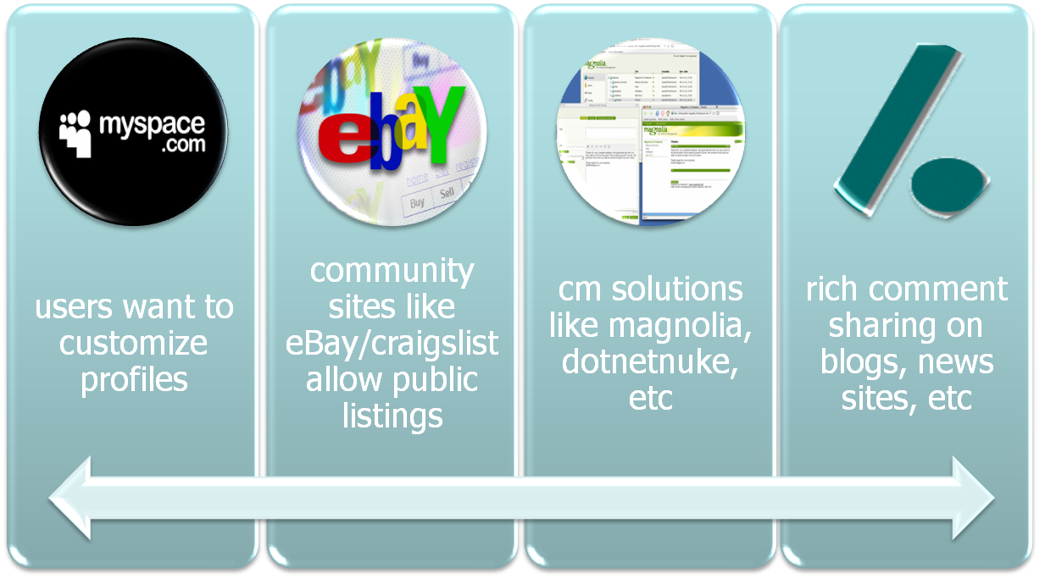
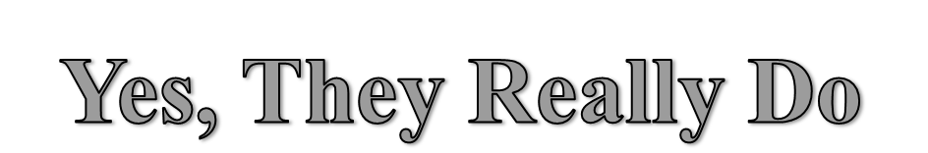
do sites really need html from users?
Notes:
Lots of reasons why you’d need to accept html from users
eBay, MySpace, craigs list, blogs, etc.
Not too much to ask... Allowing user more options makes the experience richer

Slide 18
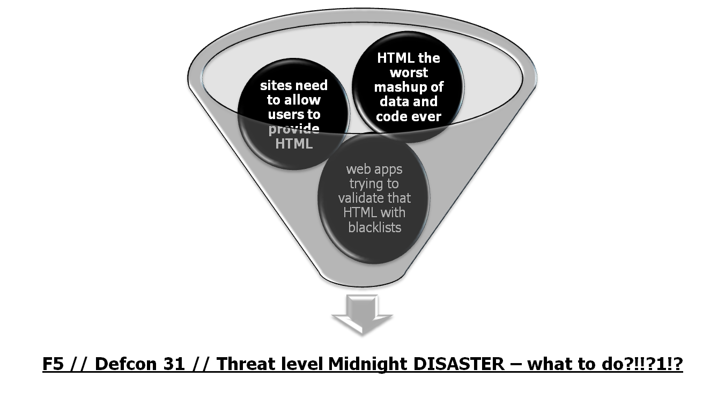
this is a bad situation…

Slide 19

an HTML validation tool and API
funded by an OWASP Spring of Code grant
uses a positive security model
takes dirty HTML/CSS that could contain xss and spits out a safe version of that input while retaining all formatting code
(applause)

Slide 20
goals for anti-samy
provide high assurance
  provide 99% (or close enough) protection against xss
  browser wars, new w3c directives, etc. cause rules to change
be portable
  works with terribly broken html
  easy-to-use API or tool
  use single XML policy file with default settings providing high assurance
  absorbable by validator implementations in different languages
be able to provide friendly feedback, able to just “make it work”
  users may copy html/js from a site they like
  not all JavaScript is xss, user intention may not be malicious
  help user to tune html/js to work with requirements
use it to meet girls
  this goal is not going so well
  do you know anyone?
Notes:
Cross site scripting is so prevalent… do we really need to move in this direction?
Yes – take the offensive
What we’re doing now is ok – awareness is definitely growing, but developers still largely unaware
User agents working towards limiting damage of XSS
Simple server-side plugin to kill the whole issue

Slide 21

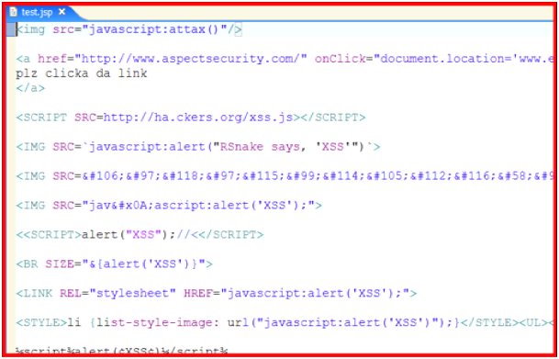

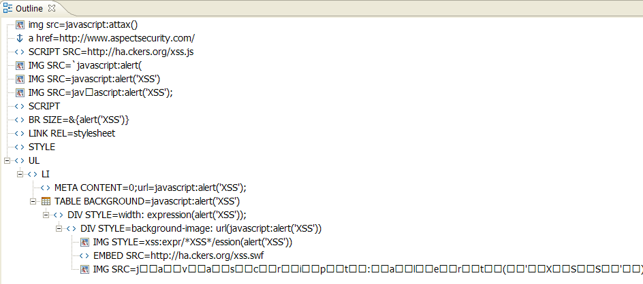
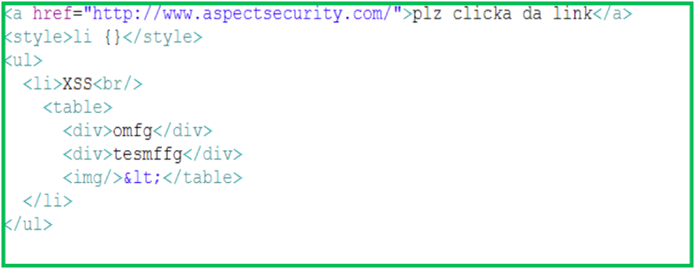
anti samy seen from outer space
dirty html gets run through nekoHTML for structural sanitization (and legal validation)
Notes:
we use neko mostly because its fun to say and it lets us produce a document fragment rather than a full html doc
can’t have nested anchor tags
can’t have a lot of tags in the <head> section

Slide 22
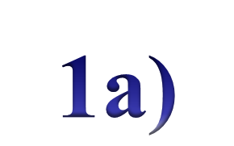
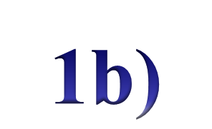
neko validation
body
<body>
<div id=“foo”>
<img src=“javascript:xss()”>
</div>
<b><u>
<p style=“expression(…)”>
samy is my hero</p>
</u></b>
\0<<script src=“hax.js”>
</script>
div
b
(text)
script
id=foo
&#000;&lt;
src=hax.js
img
u
src=javascript:xss()
p
style=expression(…)
(text)
samy is my hero
- DOM object
- fragmenting attacks gone
html now sanitized

Slide 23
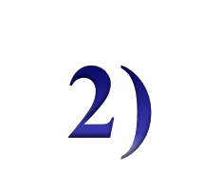

anti samy seen from outer space
Step through DOM tree and validate each node according to
the policy file… filter / remove
nodes / content
or attributes as
needed

Slide 24
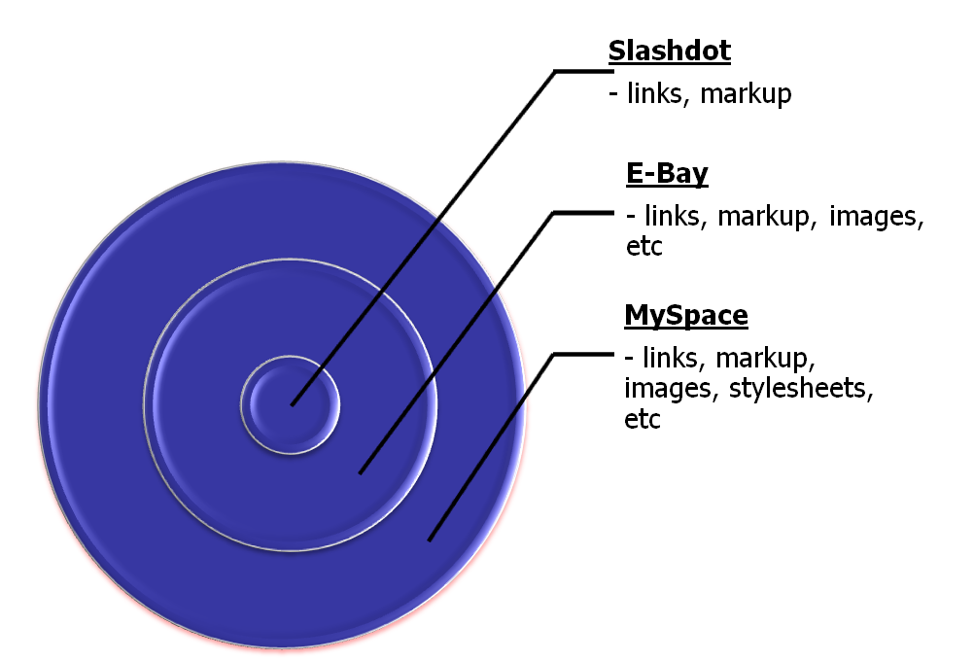

antisamy.xml – customize to your site’s policy

Slide 25
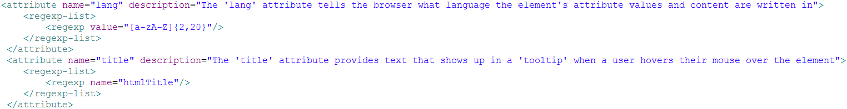
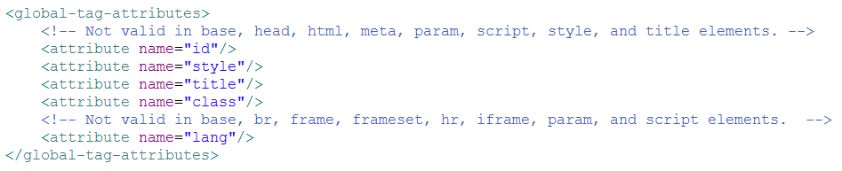
common stores in antisamy.xml
Common Regular Expressions (write once then use anywhere by name)
Common Tag Attributes (define attribute once then use in many tags)
Global Tag Attributes (define implicit attributes for all tags)

Slide 26

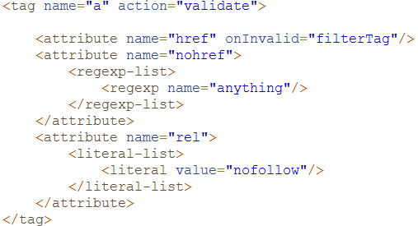
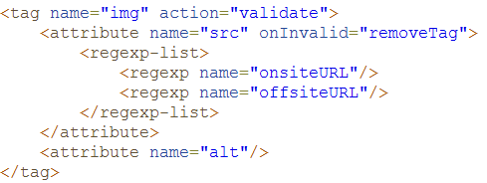
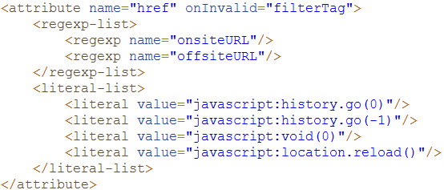

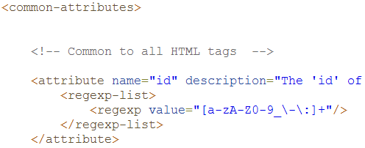
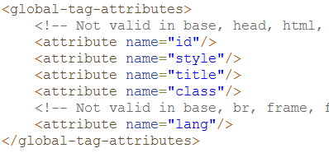
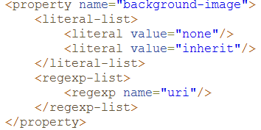
validation step-through (this slide is bananas)
head
antisamy.xml
div
b
i
(text)
id=foo
&#000;&lt;
img
meta
src=bar.jpg
content=0;url=javascript:attax()
p
http-equiv=refresh
style=expression(…)
a
href=javascript:attax()
li
style=background-image:
url(‘javascript:attax()’)
script
(text)
src=http://evil.com/hax.js
samy is my hero
Tag Not Found!

Slide 27
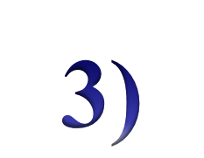
anti samy seen from outer space
Return as string or
DOM object

Slide 28
CleanResults object
getCleanHTML() - String
getCleanXMLDocumentFragment()- DOM
getScanTime() – double
getErrorMessages() – String[]

Slide 29
how do i get started?
figure out policy on what tags and attributes to allow for your site
customize one of the default antisamy.xml files
add 5-10 lines of code to your app
done! congratulate self with guilt free visit to singles.net (look for tom stracener’s alternative profile)

Slide 30
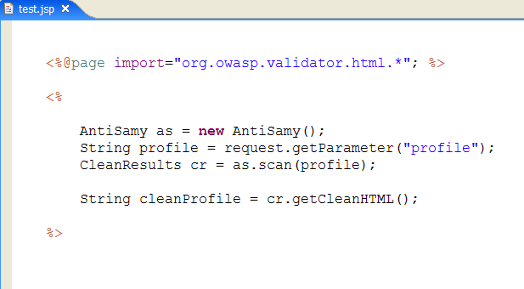
using antisamy api is really hard

Slide 31
project goals
work to create a peer reviewed, time tested solution for validating html
destroy the idea that letting users provide their own html is too dangerous
enable the next gen of user generated content sites
samy is a threat to western society
Notes:
Change the way web apps think about defending against xss
They always screw it up anyway – at least 5 times I’ve seen “string.indexOf(“<script”)

Slide 32
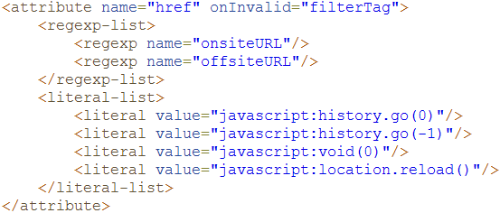
what about CSRF?
simple – go through antisamy.xml and remove the ability to have offsite resources
changing common attributes make this real easy
hosting csrf attacks is an accepted risk for many

Slide 33
known vulns?
us-ascii (any modulated charset – anybody check the other charsets?) utf-7 (if it even works anymore) – ANY time the browser is on a different planet than the input
I’ve asked pretty much everyone I met to look for bad regexps in it and tom stracener (m4m singles.net) found one bypass during the conference [but still gave it very high praise]
i need help locking down the regular expressions – plz help test we are a community!

Slide 34
change the world – for the better
Why should ebay, google, myspace be the only people able to have this functionality?
this is my pdp slide

Slide 35
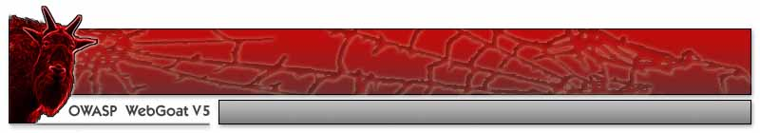

demo time

Slide 36
demo time (0 of 3 – few javascript tests)
everything on rsnake’s cheat sheet
side note: really useful wasc project (enumerating javascript entry points)
Solution: already defended against in default policy files

Slide 37
demo time (1 of 3 –absolute div overlay)
create a div in our profile that overlays the entire page (or a subsection)
extremely effective phishing vector
  SSL certificate is valid
  look and feel matches expectations
Solution: insert a stylesheet rule in the policy file to prevent access to any position value except those we want
Notes:
and remove none from valid values of display property

Slide 38
demo time (2 of 3 – div hijacking)
redefine an existing div “above” our profile
most stylesheets defined at the beginning of the page in <head> or “at the top”
Solution: blacklist the IDs and selector names you want to prevent the user from being able to modify

Slide 39
demo time (3 of 3 – all your base are belong to us)
insert a <base> tag to hijack internal resources
used to define a base for all relative URLs on the page
isn’t used a whole lot as it doesn’t work within javascript & some other issues
Solution: remove <base> tag from policy file

Slide 40
Thanks to:
jason li for helping out with coding and brainstorming css attacks
jeff williams: useful feedback and general awesomeness
owasp for the grant
all you guys for listening
samy for being a hero

Slide 41
¿questions?

