Slide 1

OWASP AntiSamy Project
Jason Li
Senior Application Security Engineer
jason.li@aspectsecurity.com

Slide 2
Who are you people?
Jason Li is a ballroom dancing, 10-pin bowling maniac
  Application Security Engineer @ Aspect Security
  OWASP AntiSamy Contributor
Arshan Dabirsiaghi is a soccer playing, video game rock star
  Director of R&D @ Aspect Security
  OWASP AntiSamy Creator and Project Lead
Together, they fight crime.

Slide 3
Talk Outline
What is OWASP AntiSamy?
Why did you make it?
How does it work?
When is it going to do more?
Let’s see it!

Slide 4
What is OWASP AntiSamy?
An HTML validation tool and API
Currently a Beta Status Project. Started as an OWASP Spring of Code 2007
Uses a positive security model
Takes HTML/CSS from unknown sources and returns a cleaned version that retains all formatting

Slide 5
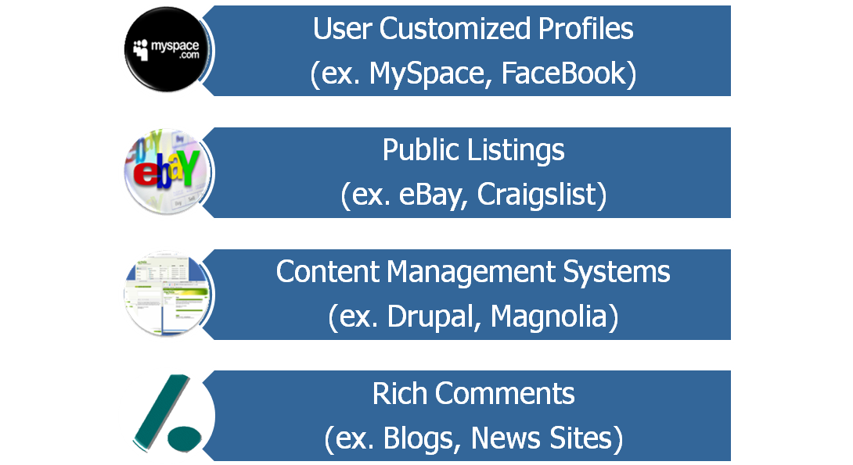
Why did you make it?
Websites need user created content:
User generated content can contain XSS attacks

Slide 6
What is XSS?
General Problem:
  Site takes input that is included in HTML sent to user
  Attacker crafts malicious script as the input
  Victim has malicious script run in browser
  Game Over.
Two types of XSS:
  Reflected XSS – attacker tricks victims into clicking a link containing a malicious attack
  Stored XSS – attacker stores an attack that victims later stumble upon

Slide 7


Reflected XSS - Illustrated
Email / Instant Message
attacker@evil.com
innocent@victim.com
Check out this cool link!!!
http://www.example.com/search?<script>alert(‘bang!’)</script>

Slide 8

Reflected XSS - Illustrated
HTTP / HTTPS
HTTP / HTTPS
innocent@victim.com
www.example.com
<html>
…
You searched for: <script>alert(‘bang!’)</script>
…
</html>
GET /search?<script>alert(‘bang!’)</script> 2.0P/1.1
User-Agent: InterOperFireFari/4.04
Cookie: SESSION_COOKIE: QXJzaGFuIGlzIG15IGhlcm8=;

Slide 9

Stored XSS - Illustrated
HTTP / HTTPS
HTTP / HTTPS
www.example.com
innocent@victim.com
attacker@evil.com
HTTP / HTTPS
<html>
…
Headline News (Waffles, BE):
…
attacker@evil.com Says:
<script>alert(‘bang!’)</script>
…
</html>
POST /comment?<script>alert(‘bang!’)</script> 2.0P/1.1
User-Agent: InterOperFireFari/4.04
Cookie: SESSION_COOKIE: QXJzaGFuIGlzIG15IGhlcm8=;
sacrificial@lamb.com

Slide 10
But That’ll Never Happen to Me!
GMail has cookies stolen via XSS in Google Spreadsheets (April 2008)
U.S. Presidential Candidate Barrack Obama has supporters redirected to Hillary Clinton’s site via XSS (April 2008)
MySpace profiles hijacked via Samy Worm (October 2005)

Slide 11
The Samy Worm
MySpace is a popular social networking website
Users create custom profiles
  Includes use of HTML
  JavaScript, quotes, and other potentially dangerous characters stripped out by MySpace filters
Link profiles with “friends” (mutually authorized)

Slide 12
The Samy Worm (continued)
Samy wanted to make friends
Used his profile to store an XSS attack
  Circumvents JavaScript stripping with:
  “java\nscript”
  Generates quotes using:
  String.fromCharCode(34)

Slide 13
The Samy Worm (continued)
Anyone viewing Samy’s profile:
  Made Samy their “friend” (actually, their “hero”)
  Had their profile changed to store and perpetuate the attack
10 hours – 560 friends, 13 hours – 6400, 18 hours – 1,000,000, 19 hours – site is down

Slide 14
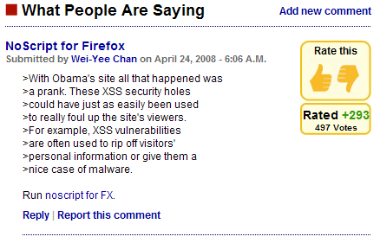
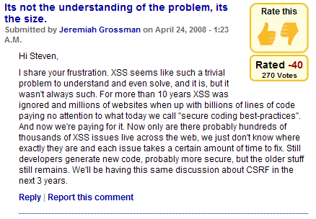
Isn’t It the User’s Problem?
Source: http://blogs.computerworld.com/can_we_please_stop_cross_site_scripting_attacks

Slide 15
What If I…
Just strip out <script> tags (i.e. blacklist)!
  Requires constant update
  Provides low assurance (ex. Samy Worm)
Use a JavaScript editor! (ex. TinyMCE or FCKEditor)
  Client side validation easily circumvented
  Requires matching server side validation
Use another markup language (ex. BBCode)
  Lose richness of HTML
  Flawed parsers can allow same attacks

Slide 16
What If I…
Encode text and decode selected tags
  Good for small set of formatting tags (ex. em, strong)
  For rich HTML, must enumerate all desired tags
  Loss of attributes, including style attributes which are a primary source of formatting
Use XSL Transformations
  Flexible implementation – wide variety of parsers
  Does not provide corrective feedback to user
  Difficult to parse style formatting

Slide 17
So What Makes AntiSamy Better?
High Level of Assurance
  Settings are safe by default
  Unaffected by new standards/tags
Usability
  Easy to use API
  Custom policy provides flexibility for desired behavior
  Validation engine provides feedback to users
  Works with broken HTML and CSS

Slide 18
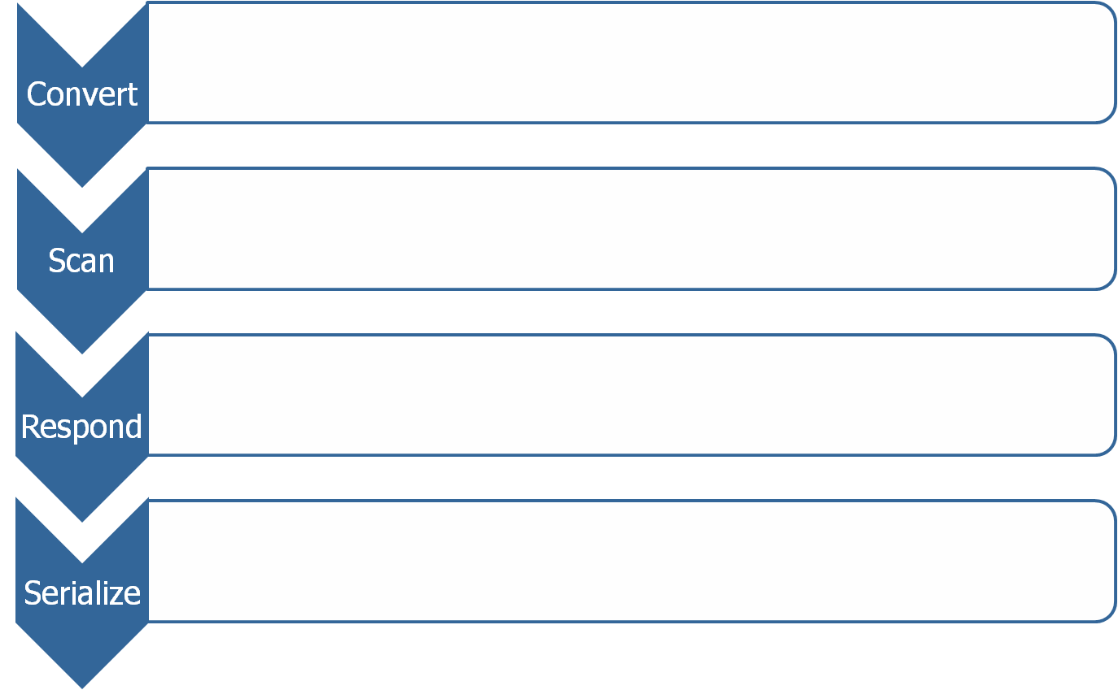
How does it work? (cont)
Scan each node against policy file
Policy file defines corresponding response for each tag
Serialize output as HTML or XHTML
Notes:
Filter promotes content but erases tag
Validate validates the tag against policy file
Truncate strips all attributes and child tags
Remove deletes the entire node

Slide 19

How does it work? (cont)
Parse CSS using SAC (Simple API for CSS)
SAC is event-driven (a la SAX)
Validate selector and id names against policy
Validate property values against policy
Remove failed properties and selectors
Canonicalize style output
Import and optionally embed referenced style sheets
Repeat validation process for imported stylesheets

Slide 20
How does it work? (cont)
<body>
<p>
This is <b onclick=“alert(bang!)”>so</b> cool!!
<img src=“http://example.com/logo.jpg”>
<script src=“http://evil.com/attack.js”>
</body>
Clean via Neko
body
p
img
src=“…”
script
src=“…”
(text)
b
onclick=“…”
(text)

Slide 21
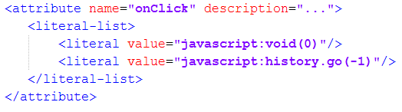
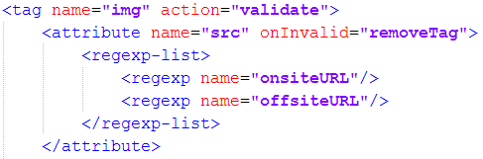
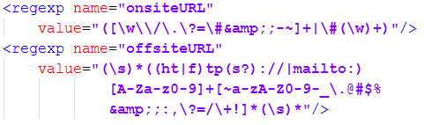


How does it work? (cont)
body
p
img
src=“…”
script
src=“…”
(text)
b
onclick=“…”
antisamy-policy.xml
(text)

Slide 22
How does it work? (cont)
Clean Result:
Error Messages:
  The onclick attribute of the b tag has been removed for security reasons. This removal should not affect the display of the HTML submitted.
  The script tag has been removed for security reasons.
<body>
<p>
This is <b>so</b> cool!!
<img src="http://example.com/logo.jpg"/>
</p>
</body>

Slide 23
How do I use it?
AntiSamy class:
  scan(taintedHtml[, policy]) – CleanResults
CleanResults class:
  getCleanHTML() – String
  getCleanXMLDocumentFragment() – DocumentFragment
  getScanTime() – double
  getErrorMessages() – ArrayList<String>

Slide 24
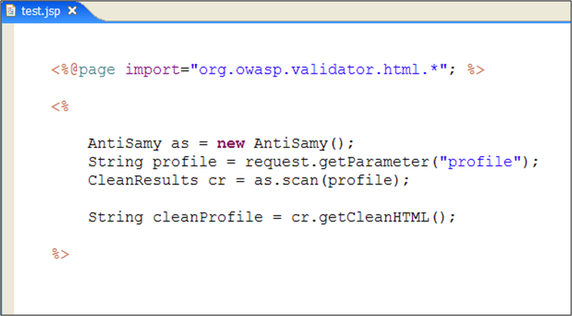
How do I use it? (cont)

Slide 25
That’s nice, but I don’t want…
Policy allows customization based on site policy
Policy file consists of:
  Directives
  Common Regular Expressions
  Common Attributes
  Global Tag Attributes
  Tag Rules
  CSS Rules

Slide 26
That’s nice, but I don’t want…
I don’t want users to:
  Have offsite images
  Use HTML <form> tags
I don’t want to do any work
  Standard policy file is safe by default
  Multiple policy files for typical use cases available (eBay, MySpace, Slashdot, anything goes)

Slide 27
OK, I’m sold – where do I get it?
Project Homepage:
http://www.owasp.org/index.php/Category:OWASP_AntiSamy_Project
Source Code:
http://code.google.com/p/owaspantisamy/
Over 3,000 downloads of AntiSamy resources since project was released

Slide 28
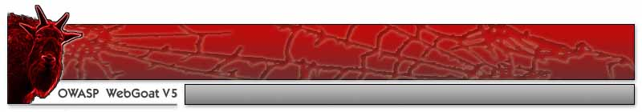

Demo Time

Slide 29
Demo Time (JavaScript tests)
Standard XSS Attacks
RSnake’s cheat sheet
Solution: Already defended against in default policy files

Slide 30
Demo Time – Absolute Div Overlay
Create a div in our profile that overlays the entire page (or a subsection)
Extremely effective phishing vector
  SSL certificate is valid
  Look and feel matches expectations
Solution: Add a stylesheet rule in the policy file to whitelist allowed position values

Slide 31
Demo Time – Div Hijacking
Redefine an existing div “above” our profile
Most stylesheets defined at the beginning of the page in <head> or “at the top”
Solution: Blacklist the IDs and selector names used by site to prevent the user from modifying them

Slide 32
Demo Time – Base Hijacking
Insert a <base> tag to hijack internal resources
Used to define a base for all relative URLs on the page
Isn’t used a whole lot as it doesn’t work within javascript & some other issues
Solution: remove <base> tag from policy file

Slide 33
When is it going to do more? (cont)
Version 1.1.1 released April 17, 2008
  Java 1.4 compatible
  HTML entities recognized using (X)HTMLSerializer
  Added XHTML support
  Input/Output encoding can now be specified
  Policy files internationalized
Incorporated into OWASP ESAPI project

Slide 34
When is it going to do more?
Support For Other languages:
  .NET version in development as part of OWASP Summer of Code 2008
  PHP version is ongoing in coordination with Zend
  ColdFusion support through native Java interface
Future Features:
  Internationalization of error messages
  Full CSS2 support

Slide 35
Thanks
Arshan Dabirsiaghi for bringing me into the project
Jeff Williams, Gareth Heyes, Michael Coates, Joel Worral, Raziel Alvarez for helping improve AntiSamy
OWASP for its continued support of the project

Slide 36

Questions?

