Slide 1
Validating Rich User Content:
Using OWASP AntiSamy
Jason Li
jason.li@owasp.org
AppSec India Conference
August 20th, 2008

Slide 2
Talk Overview
Why do we need rich content?
What strategies exist for validating rich content?
What is OWASP AntiSamy?
How does it work?
Demo
Project Status

Slide 3
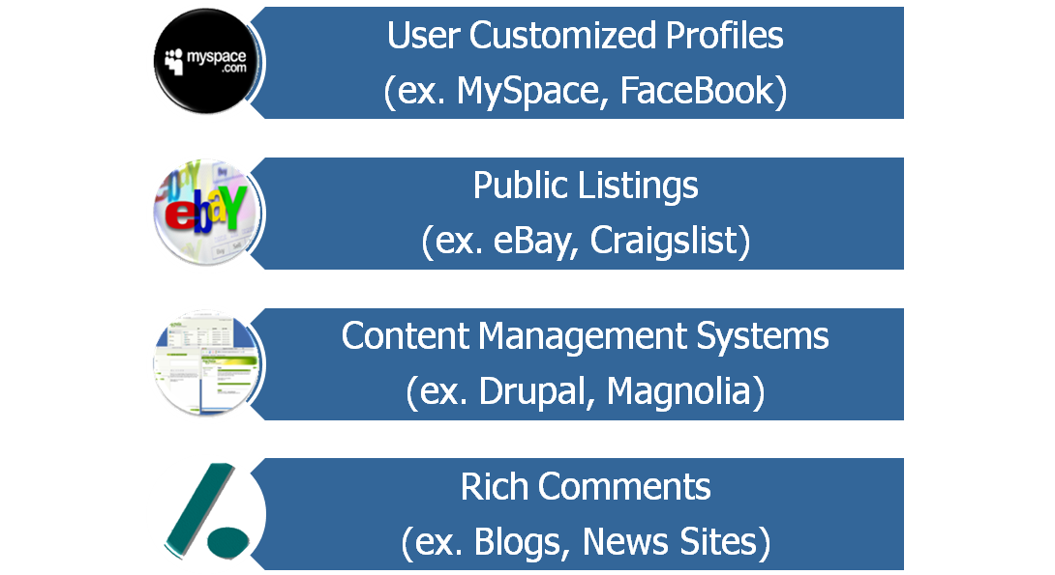
Why Do We Need Rich Content?
Websites need user created content:
User generated content can contain XSS attacks

Slide 4
What is XSS?
General Problem:
  Site takes input that is included in HTML sent to user
  Attacker crafts malicious script as the input
  Victim has malicious script run in browser
  Game Over.
Two main types of XSS:
  Reflected XSS – attacker tricks victims into clicking a link containing a malicious attack
  Stored XSS – attacker stores an attack that victims later stumble upon

Slide 5


Reflected XSS - Illustrated
Email / Instant Message
attacker@evil.com
innocent@victim.com
Check out this cool link!!!
http://www.example.com/search?<script>alert(‘bang!’)</script>

Slide 6

Reflected XSS - Illustrated
HTTP / HTTPS
HTTP / HTTPS
innocent@victim.com
www.example.com
<html>
…
You searched for: <script>alert(‘bang!’)</script>
…
</html>
GET /search?<script>alert(‘bang!’)</script> 2.0P/1.1
User-Agent: InterOperFireFari/4.04
Cookie: SESSION_COOKIE: QXJzaGFuIGlzIG15IGhlcm8=;

Slide 7

Stored XSS - Illustrated
HTTP / HTTPS
HTTP / HTTPS
www.example.com
innocent@victim.com
attacker@evil.com
HTTP / HTTPS
<html>
…
Headline News (Waffles, BE):
…
attacker@evil.com Says:
<script>alert(‘bang!’)</script>
…
</html>
POST /comment?<script>alert(‘bang!’)</script> 2.0P/1.1
User-Agent: InterOperFireFari/4.04
Cookie: SESSION_COOKIE: QXJzaGFuIGlzIG15IGhlcm8=;
sacrificial@lamb.com

Slide 8
But That’ll Never Happen to Me!
GMail has cookies stolen via XSS in Google Spreadsheets (April 2008)
U.S. Presidential Candidate Barrack Obama has supporters redirected to Hillary Clinton’s site via XSS (April 2008)
MySpace profiles hijacked via Samy Worm (October 2005)

Slide 9
The Samy Worm
MySpace is a popular social networking website
Link with “friends” (mutually authorized)
Users create custom profiles
  Includes use of HTML
  JavaScript, quotes, and other potentially dangerous characters stripped out by MySpace filters

Slide 10
The Samy Worm (continued)
Samy wanted to make friends
Used his profile to store an XSS attack
  Circumvents JavaScript stripping with:
  “java\nscript”
  Generates quotes using:
  String.fromCharCode(34)

Slide 11
The Samy Worm (continued)
Anyone viewing Samy’s profile:
  Made Samy their “friend” (actually, their “hero”)
  Had their profile changed to store and perpetuate the attack
10 hours – 560 friends, 13 hours – 6400, 18 hours – 1,000,000, 19 hours – site is down
Notes:
Arshan’s Next Generation XSS talk @ 16:30

Slide 12
Strategies That Don’t Work
Use HTML Encoding!
  Convert < and > to &lt; and &gt;
  Encoding removes tags and formatting
Just strip out <script> tags (i.e. blacklist)!
  Requires constant update
  Provides low assurance (ex. Samy Worm)
Use a JavaScript editor (ex. TinyMCE or FCKEditor)!
  Client side validation easily circumvented
  Requires matching server side validation

Slide 13
Strategies That Do Work
Use Another Markup Language
Encode Text and Decode Selected Tags
Use XSD For Validation
Use OWASP AntiSamy

Slide 14
Use Another Markup Language
Examples include BBCode and WikiText
Create an alternate set of markup tags:
  [b]bold text[/b]
  [i]italic text[/i]
  [url=http://owasp.org]Links[/url]
Markup parser converts this to:
  <strong>bold text</strong>
  <em>italic text</em>
  <a href="http://owasp.org">Links</a>

Slide 15
Use Another Markup Language (cont)
Advantages:
  Effectively a whitelist of “allowed” formatting tags
  Several existing markup languages already available
Disadvantages:
  Not as rich as HTML
  Forces users to learn yet another markup language

Slide 16
Encode Text and Decode Selected Tags
Suggested by Chris Shiflett (http://shiflett.org/blog/2007/mar/allowing-html-and-preventing-xss)
HTML Encode all input
For a pre-defined set of tags, run decoding
  Ex: allow <em> and <strong> tags by decoding &lt;em&gt; and &lt;strong&gt;
This <strong>text</strong> has &lt;script&gt;alert() &lt;/script&gt; <em>tags</em>!
This &lt;strong&gt;text&lt;/strong&gt;
has &lt;script&gt;alert()&lt;/script&gt;
&lt;em&gt;tags&lt;/em&gt;!
This <strong>text</strong>
has <script>alert()</script>
<em>tags</em>!

Slide 17
Encode Text and Decode Selected Tags (cont)
Advantages:
  Ensures all output is encoded
  Whitelist specification of allowed tags
Disadvantages:
  Difficult to properly decode attributes
  Must enumerate all desired tags

Slide 18
Use XSD For Validation
Suggested by Petko Petkov (a.k.a. pdp)
(http://www.gnucitizen.org/blog/bulletproof-rich-content-filters/)
Convert to HTML to XML
Create an XSD defining allowed HTML elements
Verify XML against XSD

Slide 19
Use XSD For Validation (cont)
Advantages:
  Flexible implementation (wide variety of parsers)
  Whitelist specification of allowed tags
  Allows conditionally nested tags
Disadvantages:
  No feedback provided to user
  Must create XSD for all HTML elements

Slide 20
Use OWASP AntiSamy
What is OWASP AntiSamy?
  An HTML/CSS validation tool and API
  Provides safe default whitelist of HTML/CSS
  Provides user-friendly error messages
  Started as an OWASP Spring of Code 2007
  Currently a Beta Status Project
Project lead by Arshan Dabirsiaghi
Core Developers:
  Jason Li (CSS)
  Jerry Hoff (.NET)

Slide 21
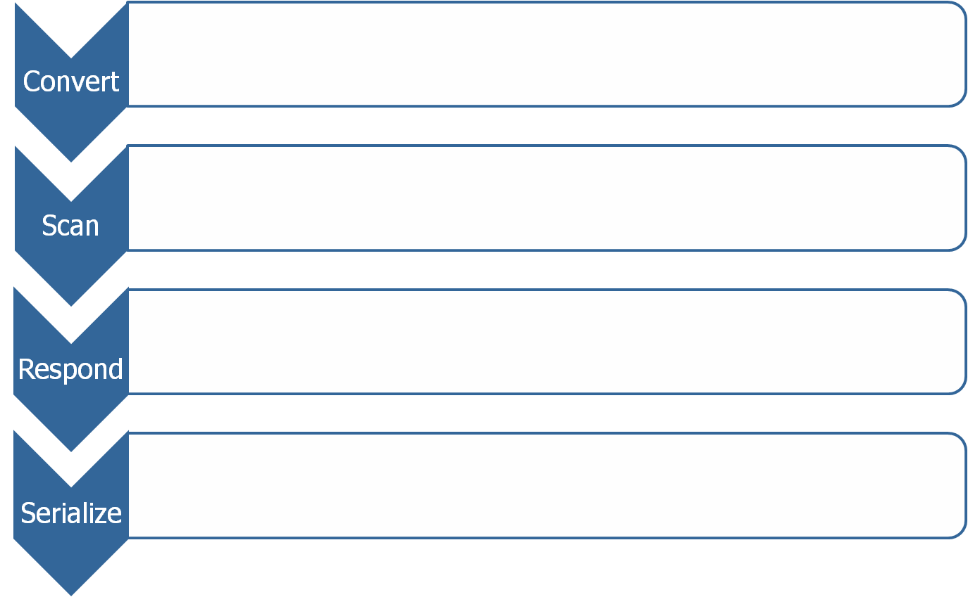
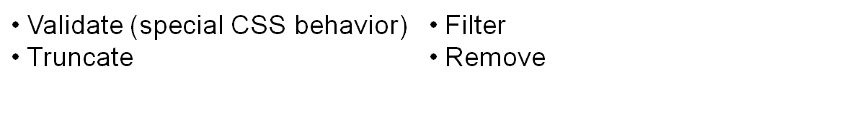
How Does It Work? (cont)
Scan each node against policy file
Policy file defines corresponding response for each tag
Serialize output as HTML or XHTML
Notes:
Filter promotes content but erases tag
Validate validates the tag against policy file
Truncate strips all attributes and child tags
Remove deletes the entire node

Slide 22

How Does It Work? (cont)
Parse CSS using SAC (Simple API for CSS)
SAC is event-driven (a la SAX)
Validate selector and id names against policy
Validate property values against policy
Remove failed properties and selectors
Canonicalize style output
Import and optionally embed referenced style sheets
Repeat validation process for imported stylesheets

Slide 23
How Does It Work? (cont)
<body>
<p>
This is <b onclick=“alert(bang!)”>so</b> cool!!
<img src=“http://example.com/logo.jpg”>
<script src=“http://evil.com/attack.js”>
</body>
Clean via Neko
body
p
img
src=“…”
script
src=“…”
(text)
b
onclick=“…”
(text)

Slide 24
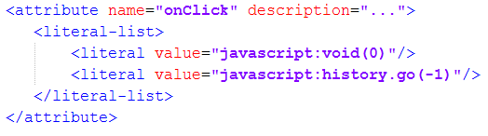
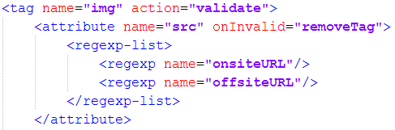
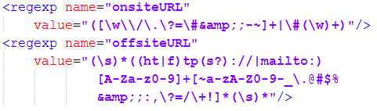


How Does It Work? (cont)
body
p
img
src=“…”
script
src=“…”
(text)
b
onclick=“…”
antisamy-policy.xml
(text)

Slide 25
How Does It Work? (cont)
Clean Result:
Error Messages:
  The onclick attribute of the b tag has been removed for security reasons. This removal should not affect the display of the HTML submitted.
  The script tag has been removed for security reasons.
<body>
<p>
This is <b>so</b> cool!!
<img src="http://example.com/logo.jpg"/>
</p>
</body>

Slide 26
How Do I Use It?
AntiSamy class:
  scan(taintedHtml[, policy]) – CleanResults
CleanResults class:
  getCleanHTML() – String
  getCleanXMLDocumentFragment() – DocumentFragment
  getScanTime() – double
  getErrorMessages() – ArrayList<String>

Slide 27
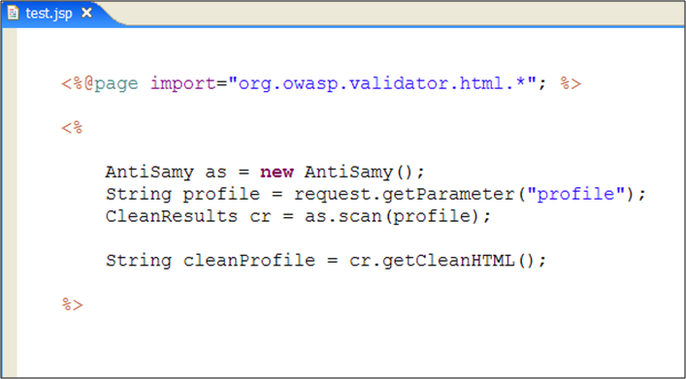
How Do I Use It? (cont)

Slide 28
That’s Nice, But...
Policy allows customization based on site policy
Policy file consists of:
  Directives
  Common Regular Expressions
  Common Attributes
  Global Tag Attributes
  Tag Rules
  CSS Rules

Slide 29
That’s Nice, But...
I don’t want users to:
  Have offsite images
  Use HTML <form> tags
I don’t want to do any work
  Standard policy file is safe by default
  Multiple policy files for typical use cases available (eBay, MySpace, Slashdot, anything goes)

Slide 30
Where Do I Get It?
Project Homepage:
http://www.owasp.org/index.php/Category:OWASP_AntiSamy_Project
Source Code:
http://code.google.com/p/owaspantisamy/
Thousands of downloads of AntiSamy libraries
Used at several Fortune 500 companies

Slide 31
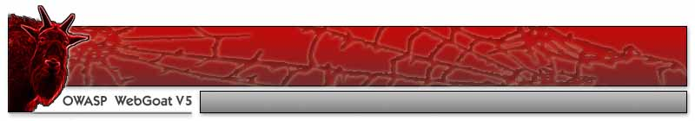


OWASP AntiSamy Demo

Slide 32
JavaScript Demos
Standard XSS Attacks
RSnake’s cheat sheet
Solution: Already defended against in default policy files

Slide 33
Absolute Div Overlay Demo
Create a div in our profile that overlays the entire page (or a subsection)
Extremely effective phishing vector
  SSL certificate is valid
  Look and feel matches expectations
Solution: Add a stylesheet rule in the policy file to whitelist allowed position values

Slide 34
Div Clobbering Demo
Redefine an existing div “above” our profile
Most stylesheets defined at the beginning of the page in <head> or “at the top”
Solution: Blacklist the IDs and selector names used by site to prevent the user from modifying them

Slide 35
Base Hijacking Demo
Insert a <base> tag to hijack internal resources
Used to define a base for all relative URLs on the page
Solution: remove <base> tag from policy file

Slide 36
Current Project Status
Version 1.2 released April 17, 2008
  Java 1.4 compatible
  HTML entities recognized using (X)HTMLSerializer
  Added XHTML support
  Input/Output encoding can now be specified
  Policy files internationalized
  Internationalized error messages for English, Italian, Portuguese, Russian and Chinese
Incorporated into OWASP ESAPI project

Slide 37
Future Roadmap
Support For Other languages:
  .NET version in development as part of OWASP Summer of Code 2008
  ColdFusion support through native Java interface
Features Under Development:
  More internationalization of error messages
  Full CSS2 support

Slide 38
Thanks
Dhruv Soi and Puneet Mehta for inviting me to speak
Arshan Dabirsiaghi for starting the project
Jeff Williams, Gareth Heyes, Michael Coates, Joel Worral, Raziel Alvarez for helping improve AntiSamy
OWASP for its continued support of the project

Slide 39

Questions?

