Slide 1

Security Qualitative Metrics for Open Web Application Security Project Compliance
Ferda Özdemir Sönmez
ferdaozdemir@gmail.com

Slide 2
Agenda
Introduction
Background
OWASP
Proposed Solution
Environment & Methodology Description
Feature Groups
Sample Features from Each Group
Discussion & Concluding Remarks

Slide 3
Introduction
Focus → Large-scale enterprise web application development process
Web App Risk Calculation → In general, non-OWASP based methods
Attack Surface calculation (number of functions, number of entry level functions, number of calls…) is commonly used for risk determination
Our Basis→ Compliance to Open Web Application Security Project (OWASP)
What We Search for →Repeatable features
Overall Target→Reduce vulnerability level of the enterprise web applications starting from the project initiation

Slide 4
Background
Problems
Large scale enterprise software often collect, transfer, and store critical data that should be handled safely.
Web based architecture has been the mainstream design structure for large scale web applications.
This type of software commonly integrates with numerous number of internal or external software and hardware.
Web applications become more vulnerable as they grow in size or as they become more sophisticated, or complex.
High number of human and system interfaces,
High complexity of business requirements,
High change rate in business requirements,
High number and types of users,
Use of third party tools and libraries
The types and sophistication level of the attacks to the web applications increase each year.
What Is the Solution →Find ways :
to develop more secure applications and
to test application security level throughly and correctly with ease

Slide 5
Background
General Purpose Common Practices
Making proper design decisions
Using best practice documents
Selection of proper tools and technologies
Proper environment setup
Having expert developers
..
..
Security Focused Common Practices
Having security experts as a part of the development team
Using white-box security analysis as a part of the continuous development and integration process
Using black-box vulnerability scanners frequently in different phases of development
Making manual static code analysis at some periods
Using automatic compliance checking tools
Obeying (selected) security standards
…
..

Slide 6
Background
Problems in Practice
Web applications are prone to change and new development requests come very often.
Sometimes developing web application is seen as a simple task.
Both of the above reasons often result with unplanned and/or unmethodological approaches in web development process.
Lack of expertise causes problems.
Developers and designers may not have enough security knowledge.
Each team does not include dedicated security experts.
Design and implementation of business requirements takes more time or may take priority.
Security often becomes an issue in the latest part of the design phase or even in the implementation phase.
Automatic (tool based) vulnerability scan results and compliance analyses reports
may lack some of the security issues which are difficult to detect automatically,
do not clearly point out project specific problems, or
do not provide enough details to fix the problem.
Manual static code analyses provides more information,
However, it takes more time and effort.

Slide 7
OWASP
Online group which produces standards, articles, tools, forum information related to web application security.
This information is used by developers, security researchers, and software architects.
OWASP categorizes the subprojects under
three categories,
code projects,
documentation projects, and
tool projects.

Slide 8
OWASP
OWASP Application Verification Standard Project (OWASP ASVS)
OWASP ASVS is commonly used for
web application security evaluation
security requirements determination
OWASP Application Security Verification Standard 3.0 is used
OWASP ASVS 4.0 is released in March 2019

Slide 9
OWASP
architecture design and threat modeling,
authentication verification requirements,
session management verification requirements,
access control verification requirement,
malicious input handling verification requirements,
output encoding/escaping,
cryptography at rest,
error handling and logging,
data protection,
communications,
HTTP security configuration,
security configuration verification requirements,
malicious controls,
internal security verification requirement,
business logic,
file and resources,
mobile,
web services,
configuration.
182 security requirements grouped under the following 19 topics:

Slide 10


Proposed Solution
OWASP provides security requirements but does not provide a way to associate project security features to these requirements directly.
Find repeatable features in enterprise software development
Store and classify these features for reusability
Associate each OWASP requirement to one or more security feature to fulfill all the OWASP requirements.
Determine OWASP Compliance
Level
Better security related decisions
Qualitative metrics which can be assessed through non-numerical reporting

Slide 11
Proposed Solution
Categorized Findings
Qualitative Metric
Directive
Feature
When you evaluate security level
When you describe security properties of the web application
When you design/develop etc.

Slide 12
Environment & Methodology Description

Slide 13
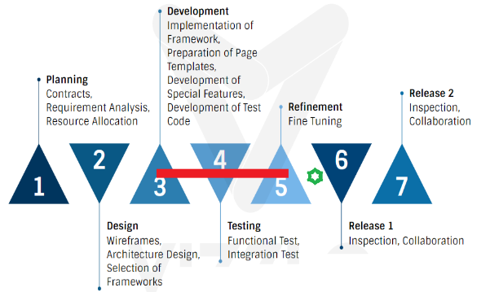
Environment & Methodology Description

Slide 14
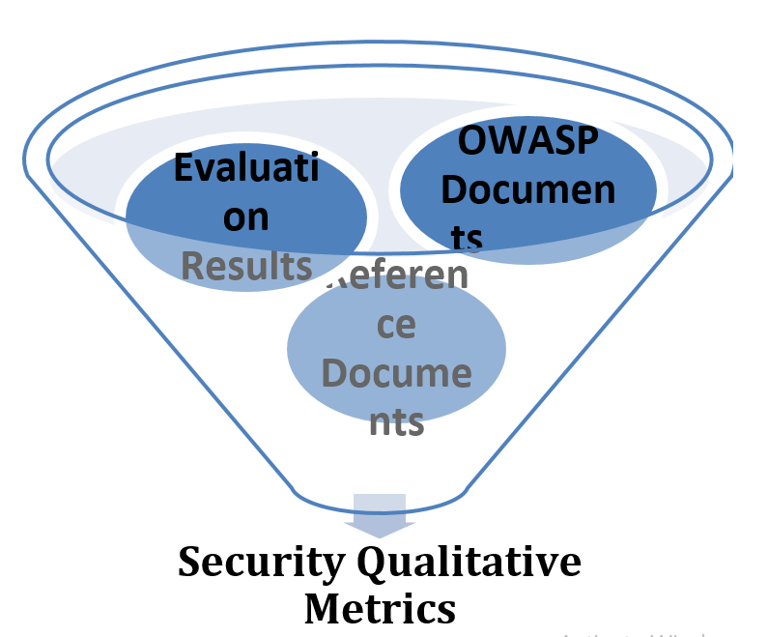
Environment & Methodology Description
Detailed Review of Code and Configuration Files
Interviews with project leads and architects
Summary
Merge
Eliminate redundant items
Group
230 metrics associated to 182 security requirements grouped under 19 topics

Slide 15
Feature Groups
A- Highlights of Application Architecture, Design, and Implementation,
B- Highlights of Technologies,
C- Highlights of Environment,
D- Highlights of Code Generation,
E- Highlights of Development Methodologies, and
F- Highlights of Business Logic.

Slide 16
Sample Features- Group A Highlights of Application Architecture, Design, and Implementation
Having no application asset (e.g. JavaScript and style sheet files) relying on the Internet
Checking incoming content type for Rest services
Using sandbox for multiple applications sharing a single server
Logging both access control successes and failures
Having proper log out functions which terminates all user sessions

Slide 17
Sample Features- Group B Highlights of Technologies
Being skeptical to newly emerged technologies, libraries, third party tools
Using Spring Security for centralized security controls
Annotating web services schema format (e.g. JSON)
Using ASLR technologies on mobile devices
Using Spring-MVC to help clearance of client code from secret codes and business logic.
Avoiding Java Native lib
Using of URLRewritingFilter to filter URL rewrites

Slide 18
Sample Features- Group C Highlights of Environment
Using network segregation
Using firewall rules
Disabling Directory Browsing on web server
Do not storing SVN/Git files on web server
Using static code analysis tools such as SonarQube
Protecting log files against unauthorized access
Checking TLS version for each browser type before production
Removing forward secrecy ciphers from web server configuration files

Slide 19
Sample Features- Group D Highlights of Code Generation
Having automatic code generation without business logic in client
Producing a uniform code to eliminate the risk of RFI (Remote File Inclusion)
Having a uniform front end code to minimize the # of hidden fields, cookies, and ajax
Using parentheses in automatic code generation whenever possible

Slide 20
Sample Features- Group E Highlights of Development Methodologies
Documenting high level architecture
Documenting all functions, libraries, and dependencies for better identification of assets
Deciding data to be destroyed as a part of a retention policy
Leaving selection of certification authority (CA) to the customer
Inspecting code manually before production, to clean sensitive information log
Creating a project package structure document

Slide 21
Sample Features- Group F Highlights of Business Logic
Checking transactions related to monetary values
Checking transactions with date entries
Checking transactions related to external users
Checking transactions involving contractual information
Checking transactions for sequential events
Interrupting transactions which are related to disruption of the business
Giving file download responsibility to users from mobile devices or restricting download from mobile devices

Slide 22
Discussion and Concluding Remarks
Primary Question: How to use this comprehensive list?
1-Decide which parts of OWASP requirements apply to their specific situation
2-Check how much their technologies overlap the suggested arrangement
3-Elicitate the list according the results of 1 and 2
4-Use the final list as a set of directives, a check list, or as a set of metrics
Our Recommendation

Slide 23
Discussion and Concluding Remarks
Having this categorized security qualitative metrics
would be beneficial from the initial phases of application development including analysis, design, implementation, and test,
would allow knowing the security status of the project
would allow making detailed OWASP compliance analysis, and
would help making better decisions related to technology, environment, design, and implementation by various project stakeholders.

Slide 24
Discussion and Concluding Remarks
Limitations
Targeting a specific arrangement of technologies.
The proposed findings are better compatible with the specified technology arrangement.
The study provides application and technology independent information as much as possible.
On most cases vendor or product specific offers are given as examples.
One Inherent Limitation
Even all the 230 listed findings which correspond to all 182 OWASP security requirements apply to any selected project, there may still be risk.
Due to the nature of some requirements, the proposed items may sometimes help to diminish risk, or partially cover a specific vulnerability but may not eliminate the risk totally.

Slide 25
Discussion and Concluding Remarks
Future Study
The provided security qualitative metrics might be categorized in different ways.
An alternative categorization of these metrics may target user roles, such project manager, architect, or developer.
Another categorization alternative may point out different phases of the web application development life cycle.
This study can be extended with new information
with new version of OWASP ASVS.
by examining various other technology compositions.
This study can be offered as a OWASP project itself .

Slide 26
Thank You ☺
Any Questions?

