Slide 1

Enter the Threat Dragon
OWASP Threat Dragon workshop
Walk through of this threat modeling tool
Showcase a simple threat model
Run through of a modeling session
No prior experience necessary

Slide 2

Sponsored by ForgeRock
Digital Identity for Consumers and Workforce

Slide 3
Introduction
OWASP Threat Dragon project and documentation
Project leaders
Jon Gadsden
Leo Reading
Mike Goodwin – author & founder
Cupcake, making threat modeling less threatening

Slide 4
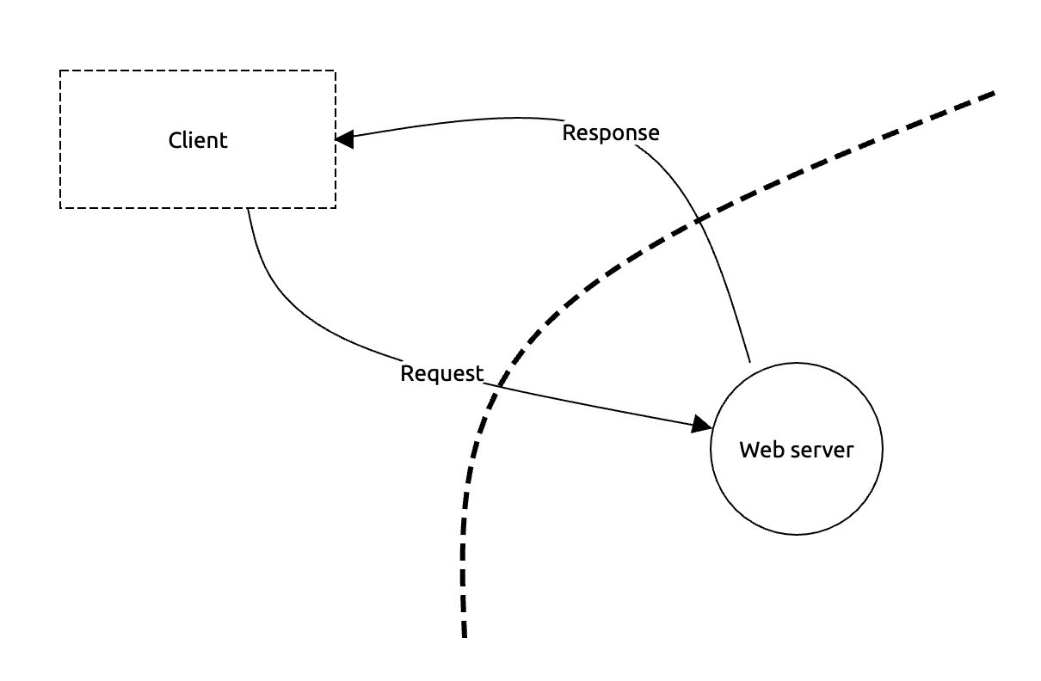
Introduction
What to expect
Installing
Creating projects
Creating diagrams
Adding threats
Putting it all together
How it works in practice
Call for help

Slide 5
Introduction
How this workshop should work:
6 sections
  Talk for no more than 15 minutes
  Do the practical
  A short discussion to allow catch-up
Ask any question at any time

Slide 6
Context
Threat modeling as part of a Secure Development Lifecycle
Security & crypto requirements
Threat modeling bitesize #1
Secure coding
Third Party Software
Static application security-testing
Threat modeling bitesize #2
Dynamic application security-testing

Slide 7
Context
Required by various standards bodies
Mitigation for OWASP A04:2021 - Insecure Design
Incremental – make it bitesize
Collaborative involving the whole team
Refer to the OWASP Threat Modeling project

Slide 8
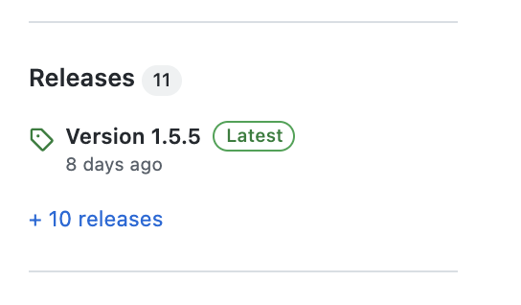
Installing
Desktop version
  Linux AppImage, Snap, deb and rpm
  MacOS Apple Disk Image
  Windows NSIS installer
Web Application version
  Docker container
  From source

Slide 9
Installing
Desktop for MacOS or Windows
Download from github site
.dmg MacOS Apple Disk Image (also .zip)
.exe Windows NSIS installer

Slide 10
Installing
Desktop for Linux systems
Snap from the snapcraft site
Download from github site:
  AppImage
  .deb or .rpm installers

Slide 11
Installing
As a web application #1
  Either container using dockerhub image
  Or direct from source
Storage on github only (for now)
Requires environment variables

Slide 12
Installing
As a web application #2
Environment variables – consider using .env
  GITHUB_CLIENT_ID
  GITHUB_CLIENT_SECRET
  NODE_ENV
  SESSION_STORE
  SESSION_SIGNING_KEY
  SESSION_ENCRYPTION_KEYS

Slide 13
Practical #1
Install the desktop version:
Either Linux
Or Windows
Or MacOS
Alternatively the web application can be used

Slide 14
Discussion
Of course there are alternatives
Microsoft Threat Modeling Tool
Text based threat modeling: eg OWASP pytm
Whiteboards are widely used

Slide 15
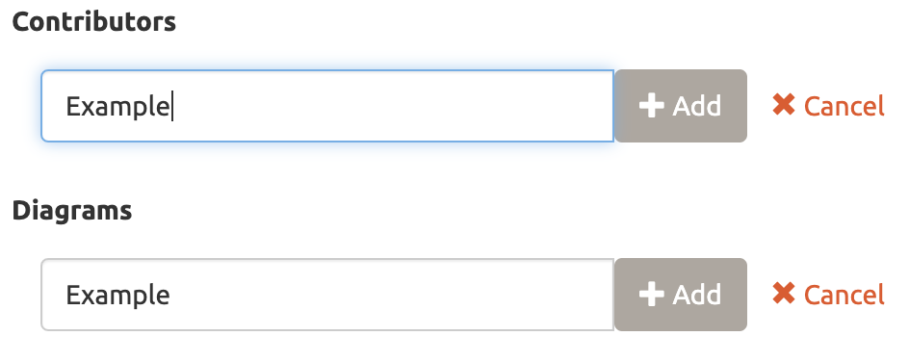
New Model
Contextual information
Title - the threat model title cannot be empty.
Owner – there is only one owner, can be a team
Reviewer – there is only one reviewer, can be a team
High level system description
Contributor(s) – remember the ‘Add’ button
Diagram(s) – remember the ‘Add’ button
Diagrams are not (yet) hierarchical

Slide 16
Practical #2
Create a new model and add :
Title
Owner and Reviewer
High level system description
Add multiple Contributors
Diagram + duplicate diagram
Cheat: download ‘step 1’ from docs.threatdragon.org/downloads/

Slide 17
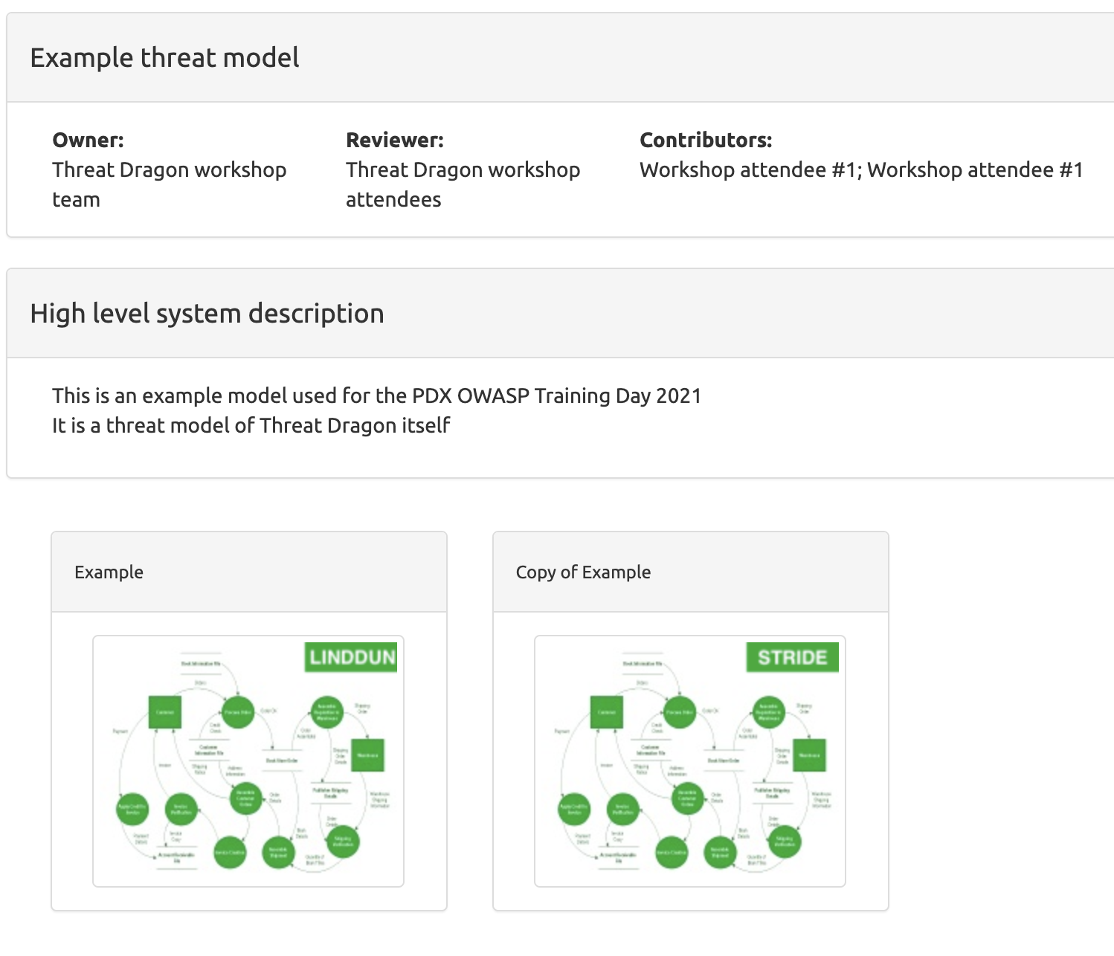
Practical #2

Slide 18
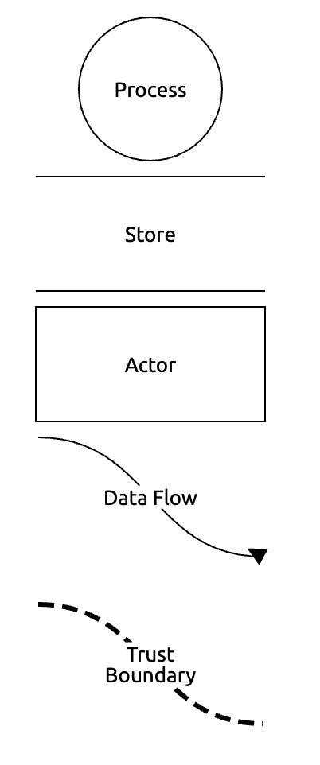
Diagrams
Threat, not system, perspective
Process
Store
Actor
Data flow
Trust boundary

Slide 19
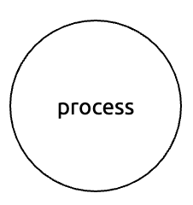
Process
Usually a component under our control
Name
Description
Out of scope? Reasoning
Context properties
Privilege level

Slide 20
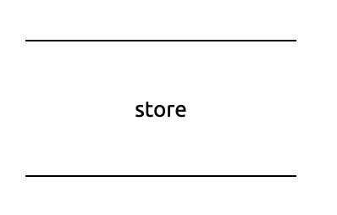
Store
Data at rest, almost always within the system but can be external
The usual Name, Description, Out of scope? & Reasoning
Context properties
Is a log?
Stores credentials?
Is encrypted?
Is signed?
This could be regarded as an asset

Slide 21
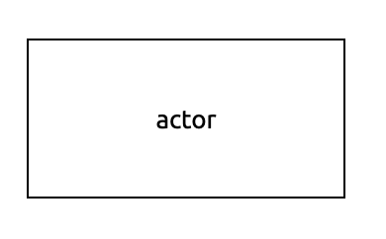
Actor
Commonly a component outside of our system
The usual Name, Description, Out of scope? & Reasoning
Properties
Provides authentication?

Slide 22
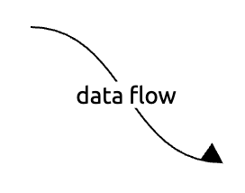
Data Flow
Data in transit, often cross trust boundaries
The usual Name, Description, Out of scope? & Reasoning
Properties
Protocol
Is encrypted?
Is over a public network?
Two ways to create data flow

Slide 23
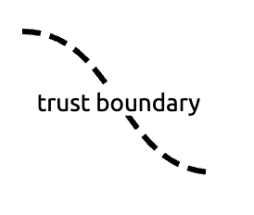
Trust Boundary
Name is optional in this case
No other properties
It is not a box (yet)
The most important of the elements

Slide 24
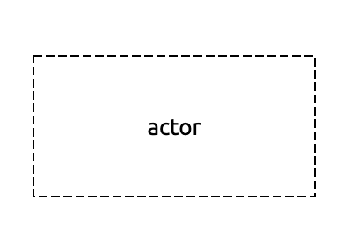
Scope
Scope for diagram components
Components can be declared out of scope
Useful for focussing on important components
Boundaries never out of scope
Try and give a reasoning
Helps incremental

Slide 25
Practical #3
Add elements to the new diagram
Processes, Stores, Actors, Trust boundaries
Add data flows
Add data flows using components
Delete some diagram elements
Take some elements in and out of scope
Cheat: download ‘step 2’ from docs.threatdragon.org/downloads/

Slide 26
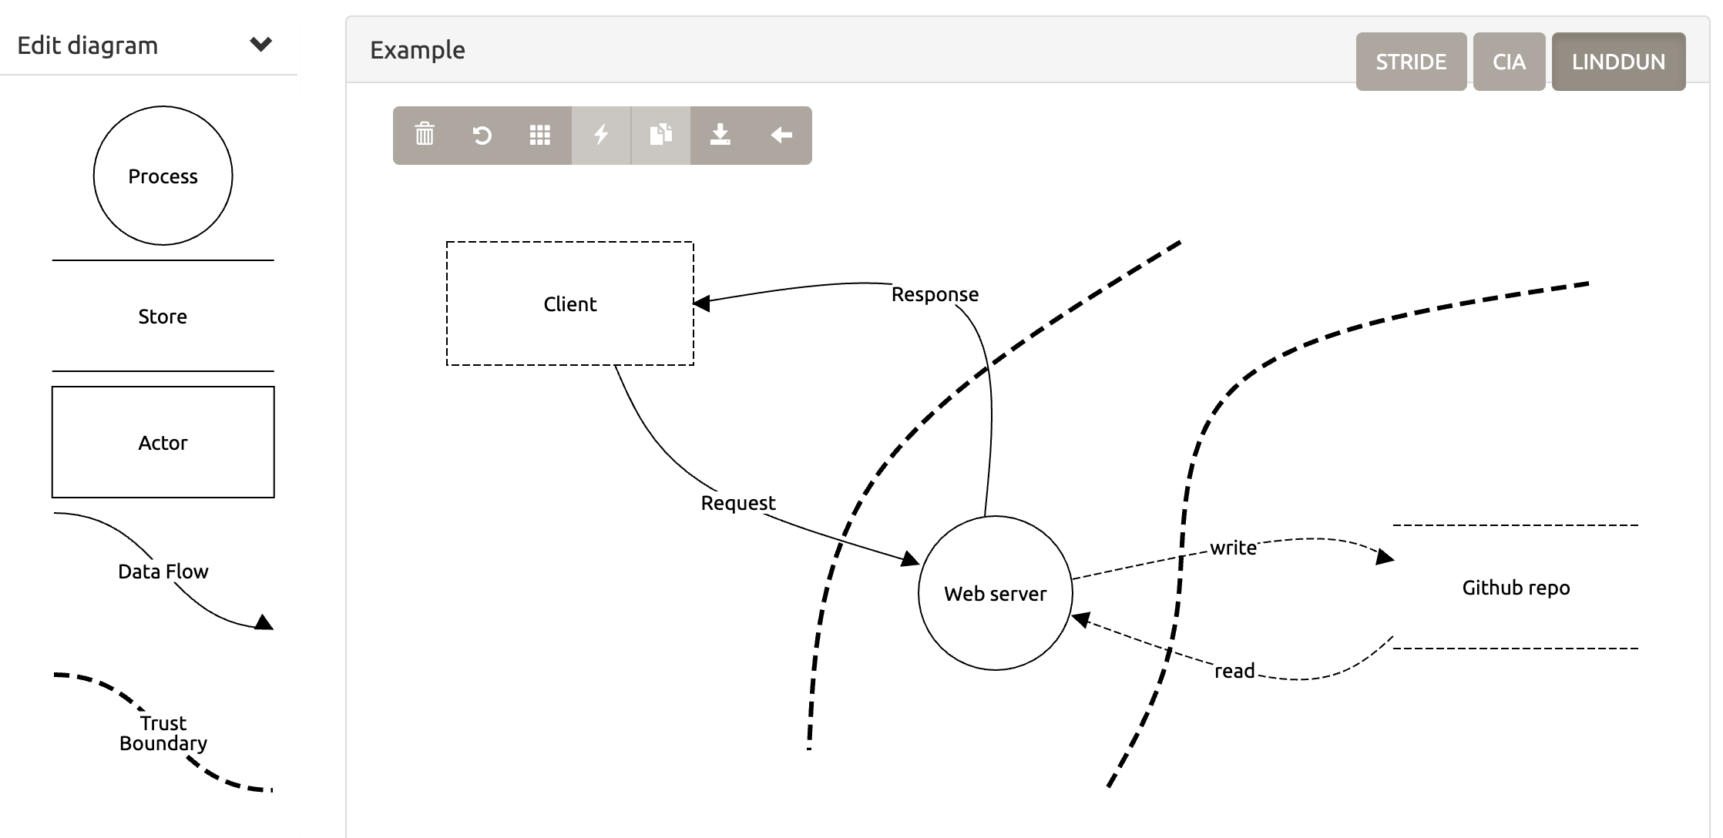
Practical #3

Slide 27
Discussion
It is not a system diagram
It is a threat model using a different perspective
More like requirements “what can go wrong”?
It comes before design and implementation

Slide 28
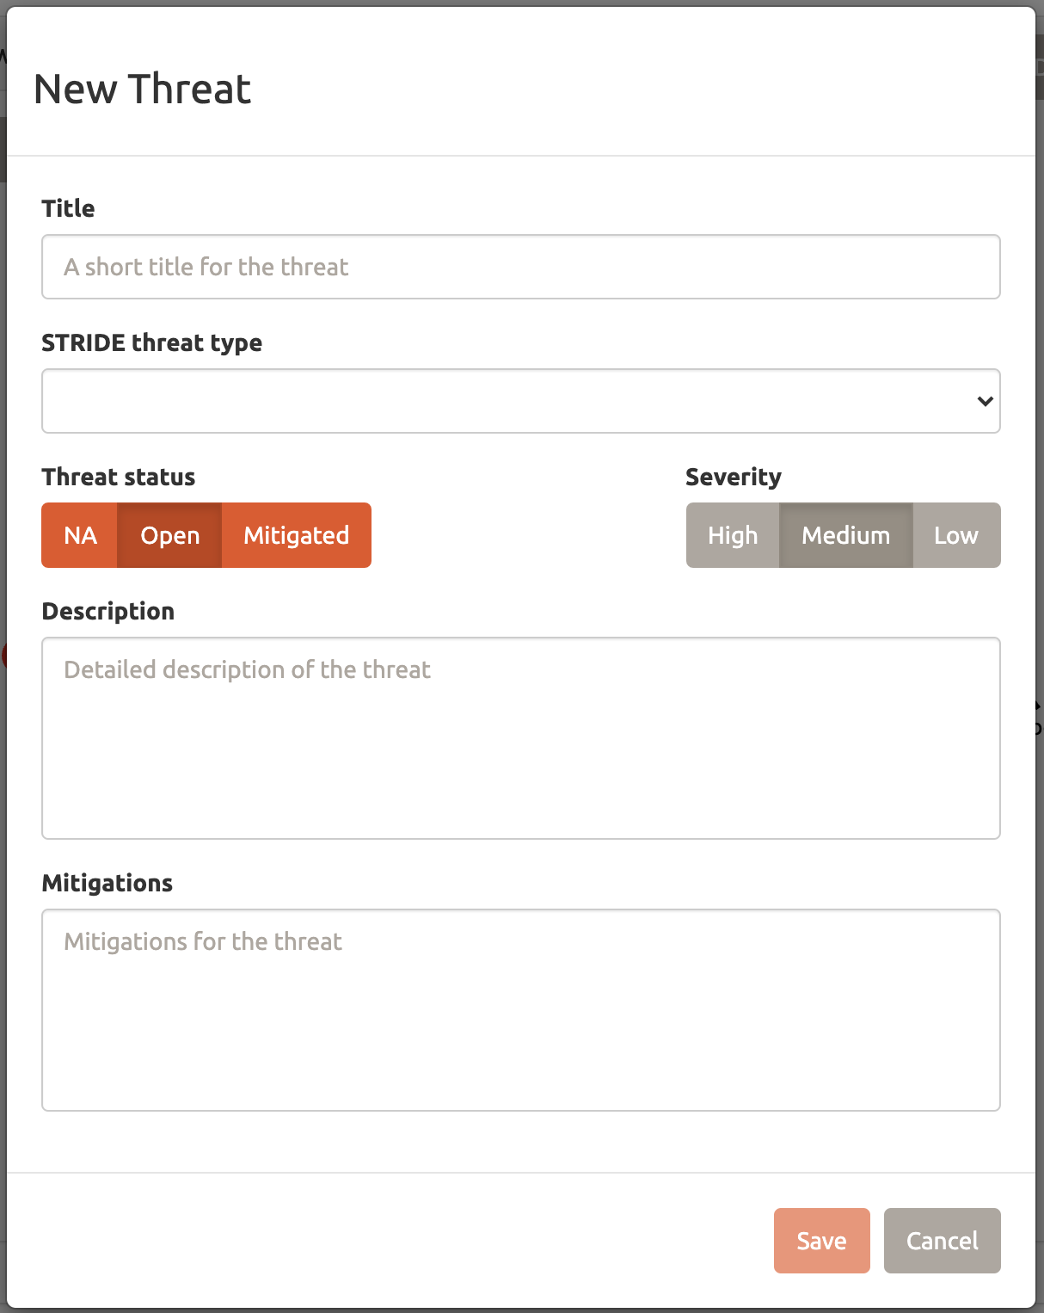
Threats
The reason for the threat model
STRIDE / CIA / LINDDUN
You can mix and match
Status: NA / Open / Mitigated
Priority: Low / Medium / High
Description of threat
Mitigation or even prevention

Slide 29
Threat Engine
STRIDE per Element
 | Spoofing | Tampering | Repudiation | Information disclosure | Denial of service | Elevation of privileges
Process | X | X | X | X | X | X
Store |  | X | X | X | X
Actor | X |  | X
Data flow |  | X |  | X | X

Slide 30
Threat Engine
LINDDUN per Element
 | Linkability | Identifiability | Non-repudiation | Detectability | Disclosure of information | Unawareness | Non-compliance
Process | X | X | X | X | X |  | X
Store | X | X | X | X | X |  | X
Actor | X | X |  |  |  | X
Data flow | X | X | X | X | X |  | X

Slide 31
Threat Engine
CIA
Confidentiality
Integrity
Availability
For all elements

Slide 32
Threat Engine
Threats by Context
Uses the properties of the diagram components
Very incomplete, area of future work
So far only one threat suggestion:
If public data flow & not encrypted
Suggest data flow is encrypted

Slide 33
Practical #4
Add threats to the diagram
Choose LINDDUN or CIA or STRIDE
Add a specific threat
Add threats per element
Choose a different categorisation, mix and match
Try the threat by context
Cheat: download ‘step 3’ from docs.threatdragon.org/downloads/

Slide 34
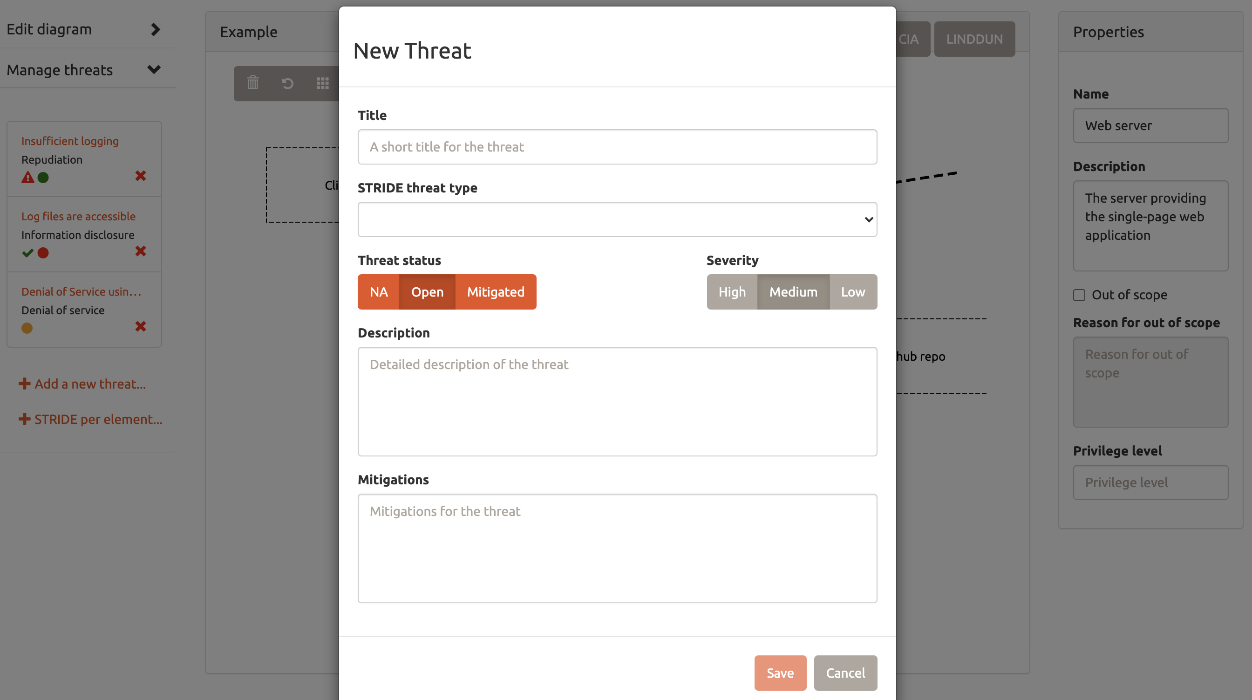
Practical #4

Slide 35
Discussion
Save it, prove it, update it
Output as PDF
Hardcopy output
Threat model as code

Slide 36
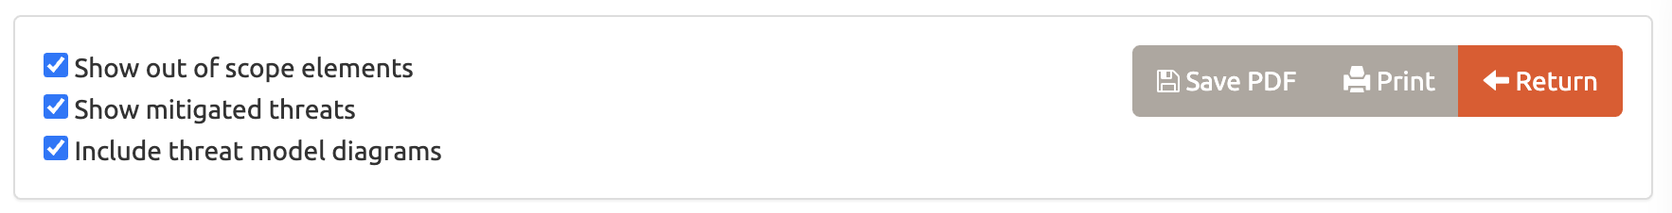
Reporting
Select your threats:
Show out of scope elements
Show mitigated threats
Include threat model diagrams
Landscape / Portrait (but not yet)

Slide 37
Practical #5
Putting it all together – model Threat Dragon itself
Client
Server
Backend
Boundary
Reports
Cheat: download ‘step 4’ from docs.threatdragon.org/downloads/

Slide 38
Discussion
The 4 Questions
What are we working on?
What can go wrong?
What are we going to do about it?
Did we do a good job?

Slide 39
In Practice
Incremental – make it bitesize
Collaborative involving the whole team
As valuable as you make it
Threat Model as code
Revisit the model
No Security Heroes

Slide 40
Practical #6
Feature requirements: Cupcake’s Status
Request: GET threatdragon.org/status
Response: one of Awesome/Good/Fair/Asleep
Set status: PUT threatdragon.org/super-secret-api
Default status: Awesome

Slide 41
Call for Help
Ask any question on the github project space
Always looking for suggestions
Always looking for help as well
Thankyou for joining, any last questions?

