Slide 1
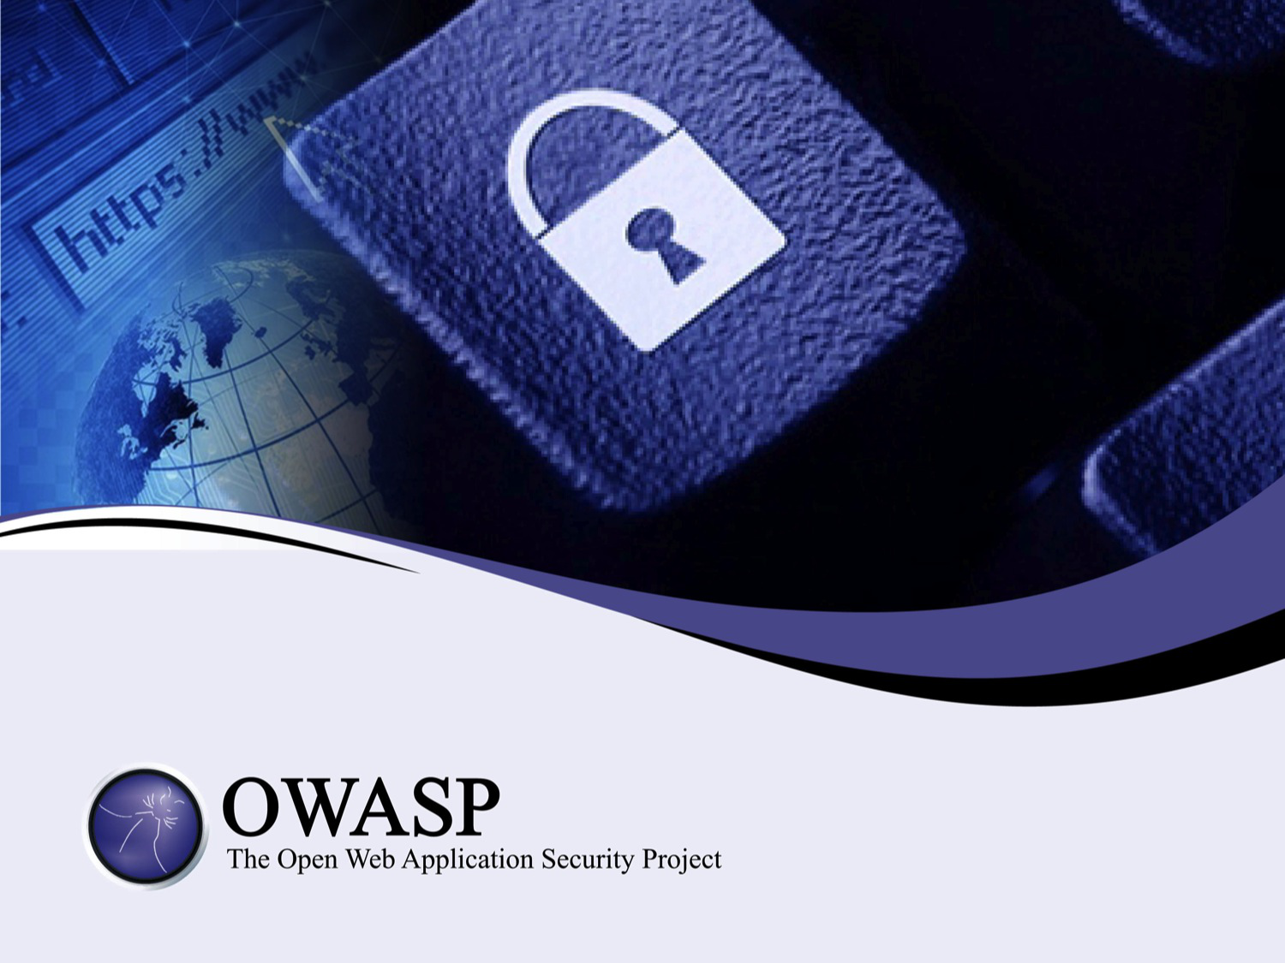

Slide 2
An Introduction to Threat Modeling
as part of a secure software development lifecycle

Slide 3
About Me
Jon Gadsden
Embedded software engineer and security advocate
… product security and secure development lifecycle activities. In his spare time he likes to help organise security conferences and contribute to open source projects - the latest being the OWASP Threat Dragon modeling tool.

Slide 4
What will be covered
Components of a threat model
Why we have them
It is not a system diagram
Tools
Something is better than nothing
Clangers and practicalities
Cup Cake!

Slide 5
Who models threats?
It can be diagrammatic
It can be a spreadsheet
It can be descriptive
… so, who already uses threat modeling?
Notes:
Show of hands

Slide 6
Who enjoys threat modeling?
… and who thinks it is 'a good thing'?
If not, then you are in good company
If so, then you are also in good company
Notes:
Show of hands
Exercise in futility

Slide 7

What is a threat model?
Essentially a data flow diagram
Protected assets
Attack vectors
Attack surfaces
… that lists possible threats
Notes:
Show of hands

Slide 8
Recap on vulnerability, asset, threat
Vulnerability
an exploitable weakness in a system or its design
Asset
anything that is valuable to an organization
Threat
potential danger to an asset
Vector
method to realise an exploit
Trust boundary
change in level of trust for information or execution

Slide 9





Actors, Processes and Trust Boundaries
Threat Model components
Actor
Process
Storage
Data flow
Trust boundary

Slide 10
Why model threats
What is the point of threat models?
Security designed in from the start
Determines the threat surface
Starting point of penetration / vulnerability testing
But hard to justify: often no 1:1 benefit

Slide 11
It is not a system diagram
It is not a system diagram
Homunculus
Keep it simple
It is not a system diagram

Slide 12
Iterative
Diagram
Identify threats
Apply Controls
Test!

Slide 13
STRIDE / DREAD
Originates from Microsoft SDL
Spoofing
Tampering
Repudiation
Information disclosure
Denial of service
Elevation of privilages
Damage
Reproducibility
Exploitability
Affected users
-Discoverability

Slide 14
CWE
Common Weakness Enumeration
Community-developed list of software weakness types
Hosted by Mitre (not for profit, federally funded)
cwe.mitre.org

Slide 15
CAPEC
Common Attack Pattern Enumeration and Classification
Community resource for identifying and understanding attacks
Also hosted by Mitre
capec.mitre.org

Slide 16
OWASP
OWASP top ten threats
OWASP top ten remediations
OWASP threat modeling cheat sheet(s)

Slide 17
OWASP Top Ten (2013 Edition)
A1: Injection
A2: Broken Authentication and Session Management
A3: Cross-Site Scripting (XSS)
A4: Insecure Direct Object References
A5: Security Misconfiguration
A6: Sensitive Data Exposure
A7: Missing Function Level Access Control
A8: Cross Site Request Forgery (CSRF)
A9: Using Known Vulnerable Components
A10: Unvalidated Redirects and Forwards
Notes:
A9 is the only new item in the top 10 for 2013.

Slide 18
OWASP Top Ten Controls
C1 Verify for security often and early
C2 Parameterize Queries
C3 Encode Data Before Use
C4 Validate all Inputs
C5 Establish Authentication and Identity Controls
C6 Implement Appropriate Access Controls
C7 Protect Data
C8 Implement Logging And Intrusion Detection
C9 Leverage Security Frameworks and Libraries
C10 Error and Exception Handling

Slide 19
OWASP cheat sheets
OWASP threat modeling cheat sheet(s)
DRAFT CHEAT SHEET - WORK IN PROGRESS
Introduction
The objective of this cheat sheet is to provide guidance to developers, reviewers, designers and architects on conducting successful threat modeling. The main goal of threat modeling is to understand the controls needed for a software system. This is a complex endeavor that will involve investigations into:
The trust boundaries to and within the solution that we build
The actors that interact within and outside of the trust boundaries
etc

Slide 20
Tools, diagrams and spreadsheets
Microsoft Threat Modeling Tool (TMT)
Propietary tools (eg cisco Threat Builder)
OWASP Threat Dragon
Mozilla Sea Sponge
SEI OCTAVE
Trike

Slide 21
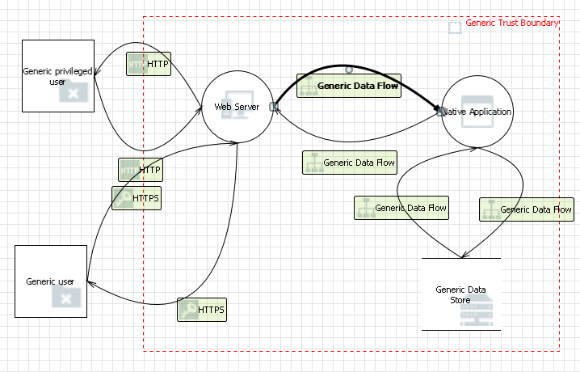
Microsoft Threat Model Tool
33 possible threats automatically identified

Slide 22
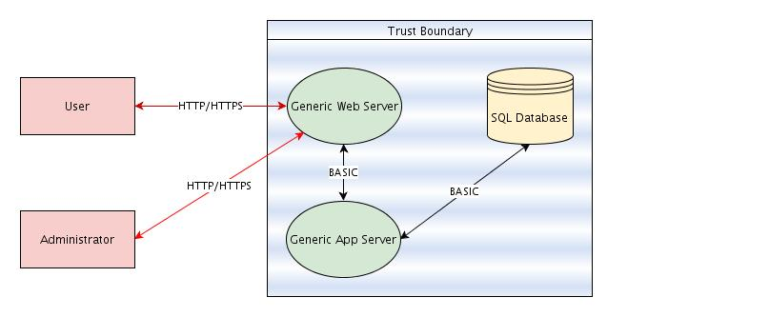
Cisco Threat Builder
50 possible threats automatically identified

Slide 23
OWASP Threat Dragon
0 threats identified (needs work)

Slide 24
Feeling overwhelmed
Simplest models 30 to 50 possible threats
Practical models around 450 possible threats
Not unusual to see upwards of 750
That is a lot of defect requests ...

Slide 25
Guage risk
Any not applicable?
Any already mitigated?
Remediation already in place?
Risk acceptable?
Prioritise the rest

Slide 26
Something is better than nothing
The days of 'the whip' are very last century
More tact and carrot
Think hard before modeling existing systems
Incremental threat modeling

Slide 27
Threat models can save some clangers
Thinking of storing that private key in the binary image? Better threat model it first …
Opening up that ftp port for upload? Better threat model it first …
Tempted to use that serial port? … probably better to threat model it first.

Slide 28
Some threats can never be modeled
Government agencies
Service provider
Back doors
Wet ware (the human)

Slide 29
Exercise in futility
So, is this an exercise in futility ?
You can say 'yes' if you want
Notes:
Show of hands

Slide 30

Demonstration of Threat Dragon
Welcome! (0.1.26)
Free, open source threat modeling tool
OWASP incubator project
Web application
Desktop application for local use
Mike Goodwin

Slide 31
Cupcake's call for contributors
Contribute
Have a github account?
Node.js
Angular
Electron
MongoDB (well, not yet)

Slide 32
Questions (and answers)
Questions?
(and maybe some answers)

