Slide 1

Top 10 Privacy Risks in Web Applications
Method, results and some countermeasures
29 May 2015
Florian Stahl (Project Leader)
Sponsored by

Slide 2
Agenda
Situation
Top 10 Privacy Risks Project
Background
Goal
Method
Results
Countermeasures
Summary

Slide 3
Situation
Secret services undermine privacy without justification and real control
Privacy laws
NSA & Co.
Global Use
Techno-logy
Real Life
Laws do not address real-life privacy risks anymore
Safe Harbor not trusted by EU anymore
Globalization requires global privacy standards
Technical solutions do not provide sufficient privacy and transparency

Slide 4
Forget about laws ;-)
… we want REAL PRIVACY in web applications
Currently many web applications contain privacy risks
Anyway, they are compliant to privacy and data protection laws because
They are hosted in countries with poor privacy laws
Main focus on compliance, not on real-life risks for personal information
No existing guidelines or statistical data about privacy risks in web applications
Foundation of the OWASP Top 10 Privacy Risks Project in early 2014
Nearly 100 privacy and security experts participated

Slide 5
Project Goal
Identify the most important technical and organizational privacy risks for web applications
Independent from local laws based on OECD Privacy Principles
Focus on real-life risks for
User (data subject)
Provider (data owner)
Help developers, business architects and legal to reach a common understanding of web application privacy
Provide transparency about privacy risks
Not in scope: Self-protection for users

Slide 6
OWASP in a nutshell
Open Web Application Security Project
Community dedicated for web application security
Open source and non-profit organization
Creates freely-available articles, methodologies, documentation, tools, and technologies
Known for its Top 10 Security risk list (established standard) and other projects
Provides platform for the Top 10 Privacy Risks project

Slide 7
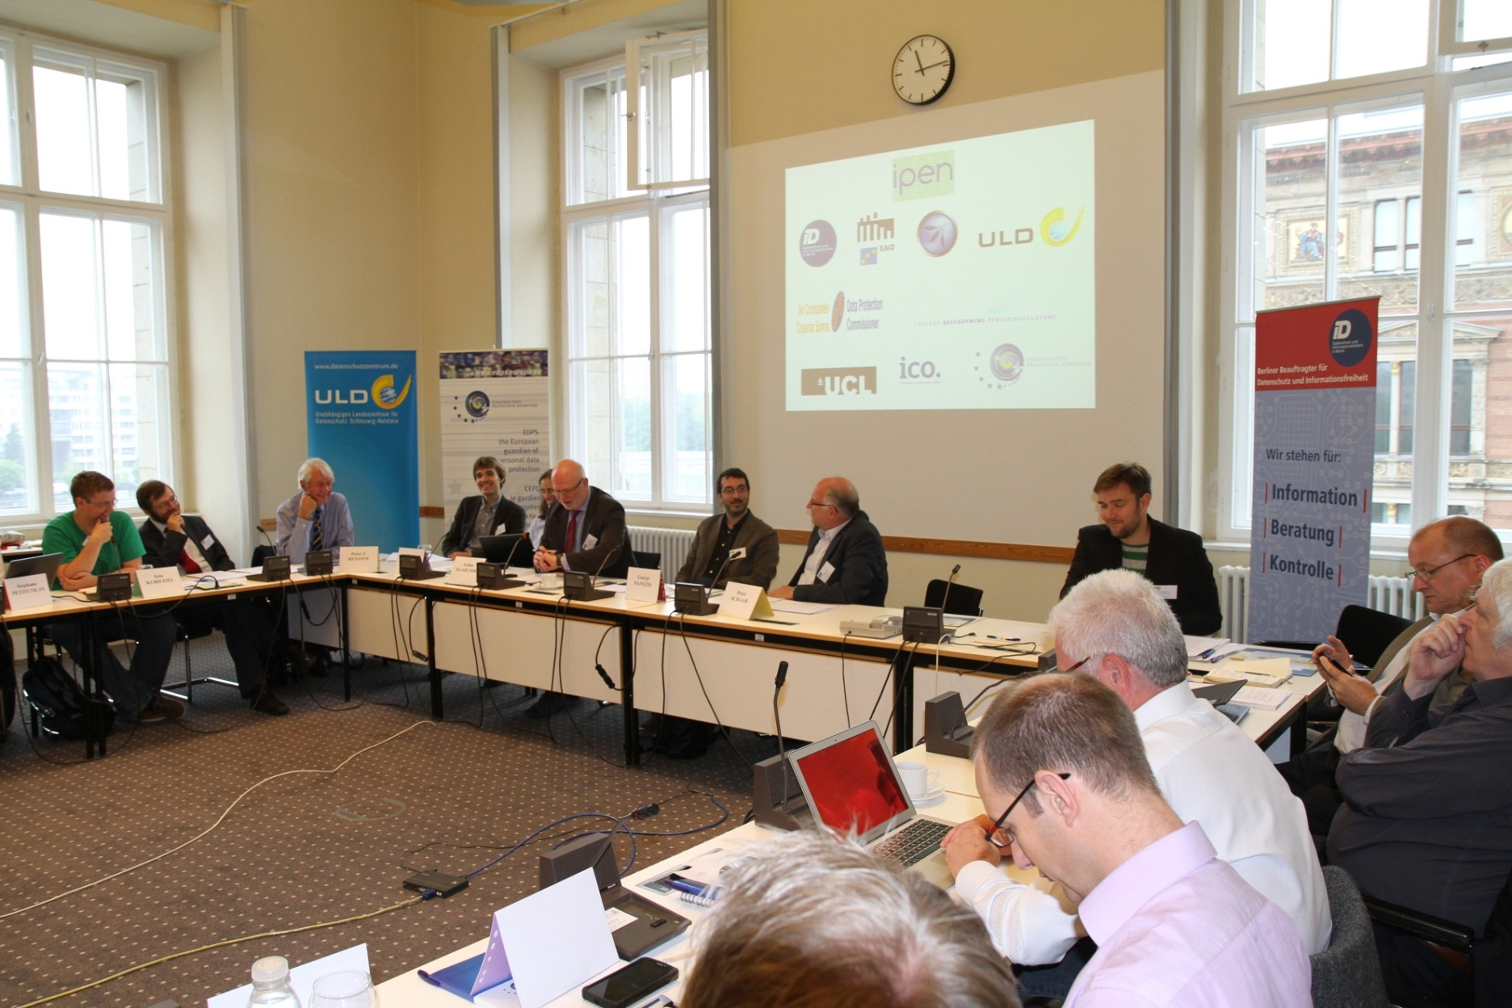
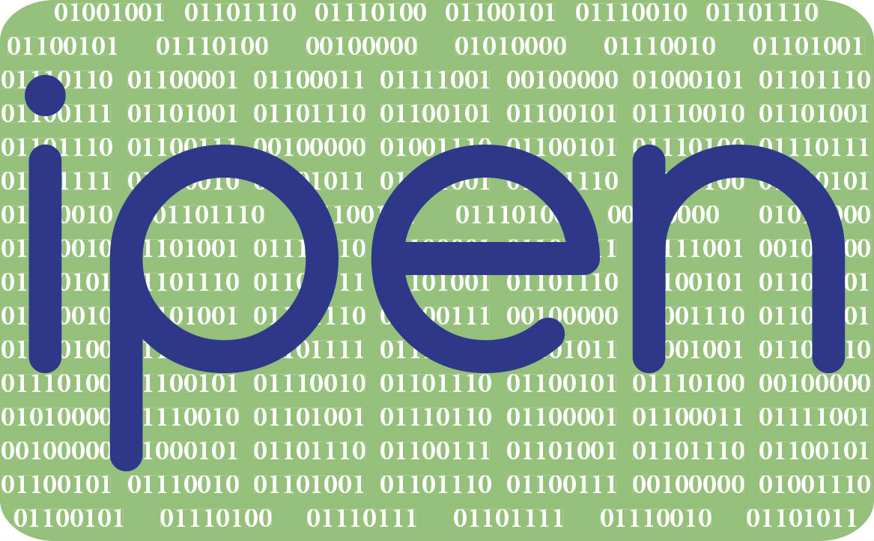
Member of IPEN
Internet Privacy Engineering Network
Founded in 2014 by EU Data Protection Supervisor's Head of Policy
Goal to bring together privacy experts with developers

Slide 8
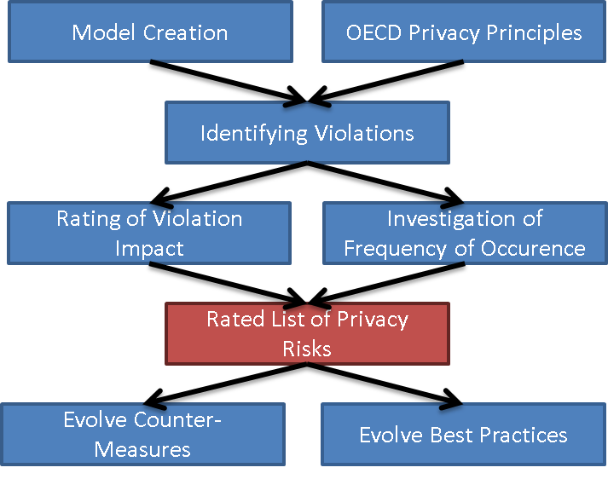
Project Method (1/3)
Sponsored by

Slide 9
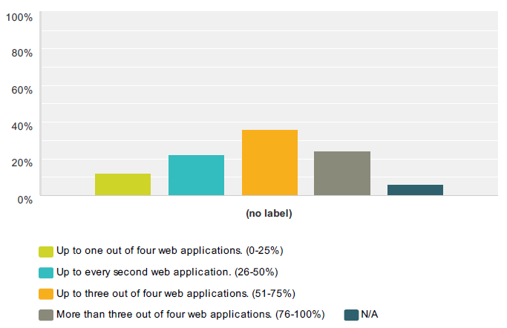
Project Method (2/3)
Survey to evaluate frequency of occurence
63 privacy and security experts participated
Rated 20 privacy violations for their frequency in web sites
Example: Sharing of data with third party (average 1.8)
0
1
2
3

Slide 10
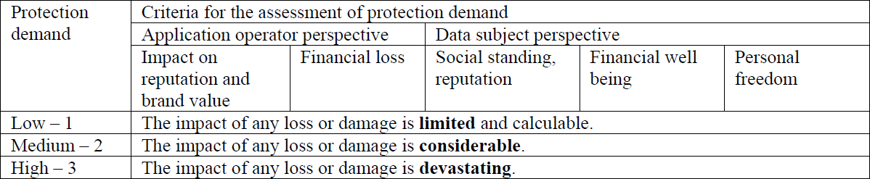
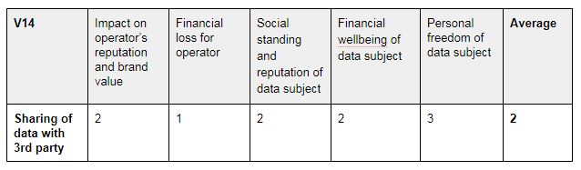
Project Method (3/3)
Impact rating
Example

Slide 11
Results: Top 10 Privacy Risks
P1 Web Application Vulnerabilities
P2 Operator-sided Data Leakage
P3 Insufficient Data Breach Response
P4 Insufficient Deletion of personal data
P5 Non-transparent Policies, Terms and Conditions
P6 Collection of data not required for the primary purpose
P7 Sharing of data with third party
P8 Outdated personal data
P9 Missing or Insufficient Session Expiration
P10 Insecure Data Transfer

Slide 12
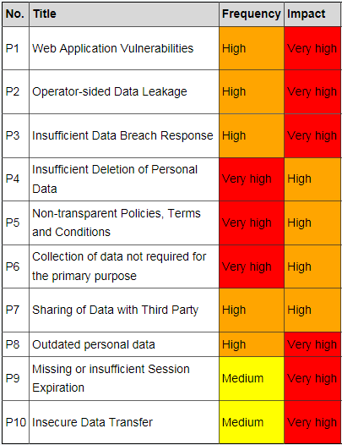
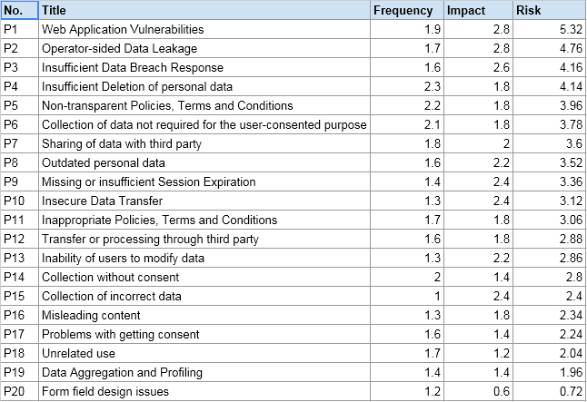
Results in detail

Slide 13
P2: Operator-sided Data Leakage
Internal procedures or staff are often a reason for data leakage
Poor access management
Lack of awareness
Unnecessary copies of personal data
Weak anonymization of personal data:
For publishing or using inside the company: e.g. “We are using anonymized data for marketing purposes.”
Anonymization can go wrong: e.g. AOL search data leak
Location data, browsing behavior or device configuration can be used to identify people

Slide 14
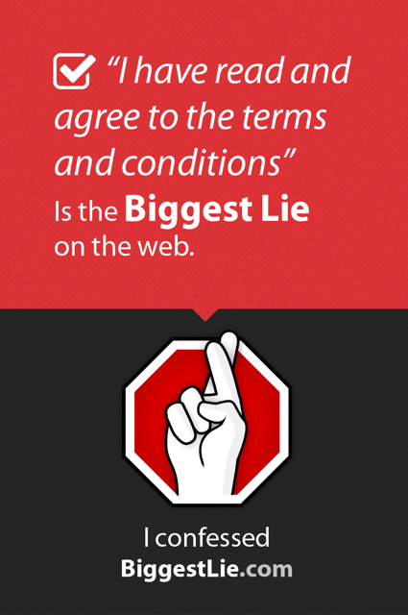
P5: Non-transparent Policies, Terms & Conditions
Privacy Policies, Terms & Conditions are not up-to-date, inaccurate, incomplete or hard to find
Data processing is not explained sufficiently
Conditions are too long and users do not read them

Slide 15
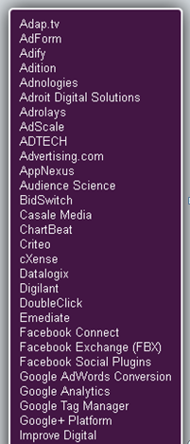
P7: Sharing of Data with 3rd Party
Third Parties:
Advertisers
Subcontractors
Video integration
Maps
Social networks
Problems:
Data is transferred or sold to third parties without user’s knowledge and consent
Complete loss of control
Picture source: Ghostery

Slide 16
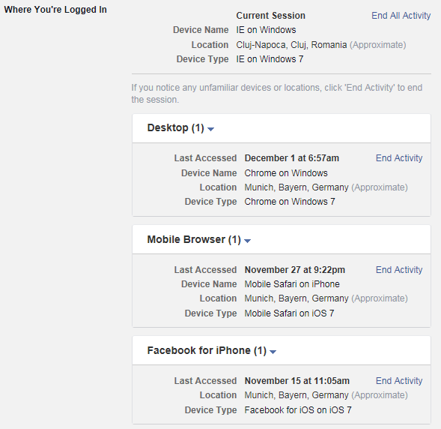
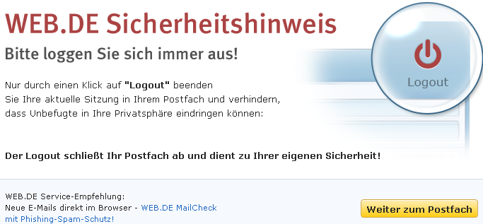
P9: Missing or Insufficient Session Expiration
Automatic session timeout and a highly visible logout button is security state-of-the-art, not for:
Google
Facebook
Amazon
Picture sources: facebook.com, web.de

Slide 17
Countermeasures (1/4)
Raise Awareness among:
Product / Application Designers (business)
They decide about functionality that affects privacy
Developers / IT
Sometimes have the choice to implement privacy friendly applications
Data Protection / Legal
Personal information is mainly processed in IT systems
IT has to be considered when implementing privacy programs
Questions:
How many of you have a legal background?
How many of you consider web applications in their privacy programs?

Slide 18
Countermeasures (2/4)
Implement processes
That consider privacy in all development stages from requirements analysis to implementation (preventive)
To audit privacy measures in web applications (detective)
Ask simple questions
Did you consider privacy when designing the application?
Did you address the OWASP Top 10 Privacy Risks?
How are privacy incidents handled?
How is data deleted?
How do you avoid vulnerabilities in the application?
…

Slide 19
Countermeasures (3/4)
Technology examples
Avoid Data Leakage
Restrictive Access Management
Awareness campaigns
Strong anonymization techniques
Data Leakage Prevention (DLP) solutions
Improve session timeout
Configure to automatically logout after X hours / days
Obvious logout button
Educate users

Slide 20

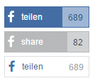
Countermeasures (4/4)
Technology examples
Ideas for better transparency in terms & conditions
Text analyzer: readability-score.com
HTTPA: http with accountability developed by MIT
Share data with third party on click only
Youtube embedded video: Enhanced privacy mode
Facebook buttons: heise Shariff
Picture source: heise.de

Slide 21
Summary
Currently there are many privacy risks in web applications
Compliance-based approach does not cover all of them
Lack of awareness regarding real-life privacy risks
OWASP Top 10 Privacy Risks project created to address this issue and educate developers and lawyers
The project identifies technical and organizational risks independent from local laws
Try to consider these risks when implementing or auditing web applications and apply countermeasures!

Slide 22
Further information
OWASP Top 10 Privacy Risks Project: https://www.owasp.org/index.php/OWASP_Top_10_Privacy_Risks_Project
→ Feel free to contribute
Internet Privacy Engineering Network (IPEN): https://secure.edps.europa.eu/EDPSWEB/edps/EDPS/IPEN
Project sponsor: http://www.msg-systems.com
Sponsored by

