Slide 1
OWASP Testing Guide V3
Matteo Meucci
OWASP Testing Guide Lead

Slide 2
Agenda
Welcome to the OWASP Testing Guide v3!
Objectives
Roadmap to v3
What’s new?
Next step

Slide 3



Who am I?
OWASP
  OWASP-Italy Chair
  OWASP Testing Guide Lead
Work
  CEO @ Minded Security
  Application Security Consulting
  7+ years on Information Security
  focusing on Application Security

Slide 4
Welcome to the OWASP Testing Guide v3!
July 14, 2004
"OWASP Web Application Penetration Checklist", Version 1.0
December 25, 2006
"OWASP Testing Guide", Version 2.0
November, 2008
"OWASP Testing Guide", Version 3.0
http://www.owasp.org/index.php/Category:OWASP_Testing_Project

Slide 5
Objectives
Improve, update, complete v2
Create a complete new project focused on Web Application Penetration Testing
Create a reference for application testing
Describe the OWASP Testing methodology

Slide 6

Testing Guide Project Roadmap
26th April 2008: start the new project
    OWASP Leaders brainstorming
    Call for participation → 21 authors (-18!)
    Index brainstorming
    Discuss the article content
20th May 2008 →New draft Index
1st June 2008 → Let's start writing!
27th August 2008 → started the reviewing phase → 4 Reviewers (-16!)
October 2008 → Review all the Guide
End of November 2008 →Published the Guide! (347pages +80!)

Slide 7
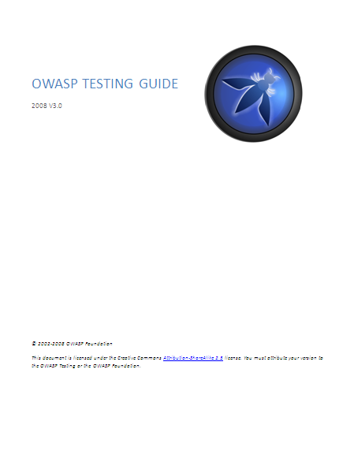
Testing Guide v3: Index
1. Frontispiece
2. Introduction
3. The OWASP Testing Framework
4. Web Application Penetration Testing
5. Writing Reports: value the real risk
Appendix A: Testing Tools
Appendix B: Suggested Reading
Appendix C: Fuzz Vectors
Appendix D: Encoded Injection
Notes:
Testing Guide v2 RC1: Index
1. Frontispiece
2. Introduction
3. The OWASP Testing Framework
4. Web Application Penetration Testing
5. Writing Reports: value the real risk
Appendix A: Testing Tools
Appendix B: Suggested Reading
Appendix C: Fuzz Vectors

Slide 8
What’s new?
V2→ 8 sub-categories (for a total amount of 48 controls)
V3 →10 sub-categories (for a total amount of 66 controls)
36 new articles!
Information Gathering
Business Logic Testing
Authentication Testing
Session Management Testing
Data Validation Testing
Denial of Service Testing
Web Services Testing
Ajax Testing
Information Gathering
Config. Management Testing
Business Logic Testing
Authentication Testing
Authorization Testing
Session Management Testing
Data Validation Testing
Denial of Service Testing
Web Services Testing
Ajax Testing
Encoded Appendix
Notes:
The Guide Contents
A series of articles on the most common web application security problems
Some process information, but not much…
The world desperately needs a body of knowledge on application security. One important piece of this body of knowledge is about application security testing.

Slide 9
Testing paragraph template
Brief Summary
Describe in "natural language" what we want to test. The target of this section is non-technical people (e.g.: client executive)
Description of the Issue
Short Description of the Issue: Topic and Explanation
Black Box testing and example
  How to test for vulnerabilities:
  Result Expected:
  ...
Gray Box testing and example
  How to test for vulnerabilities:
  Result Expected:
  ...
References
  Whitepapers
  Tools

Slide 10
Some new articles
4.1.1 Testing Checklist
4.2.3 Identify application entry points
4.3.3 Infrastructure Configuration
Management Testing
4.5.1 Credentials transport over an
encrypted channel
4.5.2 Testing for user enumeration
4.5.8 Testing for CAPTCHA
4.5.9 Testing Multiple Factors Authentication
4.6.1 Testing for path traversal
4.6.2 Testing for bypassing authorization schema
4.6.3 Testing for Privilege Escalation
4.7.1 Testing for Session Management Schema
4.7.2 Testing for Cookies attributes
4.8.1 Testing for Reflected Cross Site Scripting
4.8.2 Testing for Stored Cross Site Scripting
4.8.3 Testing for DOM based Cross Site Scripting
4.8.4 Testing for Cross Site Flashing
4.8.5.4 MS Access Testing
4.8.5.5 Testing PostgreSQL (from OWASP BSP)
4.9.1 Testing for SQL Wildcard Attacks
4.10.1 WS Information Gathering
4.10.2 Testing WSDL
Checklist PDF

Slide 11


Status and Future Steps
Discuss how to integrate the Develop, Code Review, Testing and ASDR Guide
Improve Client Side Security
Let’s talk at the WORKING SESSION!
Building Guide
Code Review Guide
Testing Guide
Application Security Desk Reference (ASDR)

Slide 12
Obrigado!
V3 Authors
Anurag Agarwwal Daniele Bellucci Arian Coronel Stefano Di Paola Giorgio Fedon Adan Goodman Christian Heinrich | Kevin Horvath Gianrico Ingrosso Roberto Suggi Liverani Alex Kuza Pavol Luptak Ferruh Mavituna Marco Mella | Matteo Meucci Marco Morana Antonio Parata Cecil Su Harish Skanda Sureddy Mark Roxberry Andrew Van der Stock
V3 Reviewers
Marco Cova | Kevin Fuller | Nam Nguyen

Slide 13
Questions?
http://www.owasp.org
http://www.owasp.org/index.php/OWASP_Testing_Project
matteo.meucci@owasp.org

