Slide 1
Tackling Big Data with Hadoop and Graphical Open Source Integration
Michaël Hirt
Data Integration Product Manager

Slide 2
Agenda
What is Big Data ?
Talend’s Goal
What’s next ? Big Data Quality and Big Data management
Talend Open Studio for Big Data in action

Slide 3
What is Big Data?

Slide 4





What Is BIG Data?
2,300 tweets per second (June 2011)
"Big data" is information of extreme size, diversity, complexity and need for rapid processing.
50 gigabytes of data
per person on Earth
50,000,000,000 300 exabytes total
200 billion intelligent devices 200,000,000,000
Ted Friedman - Information Infrastructure and Big Data Projects Key Initiative Overview - July 2011
2015
275 exabytes of data flowing over the Internet each day 275,000,000,000,000,000,000
2020

Slide 5
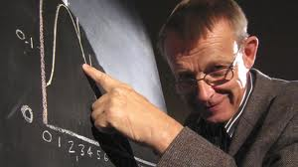
How to define Big data is….
Hans Rosling – uses big data to analyze world health trends
Key Takeaway #1
volume, variety, velocity
Notes:
Hans Rosling (né le 27 juillet 19481 à Uppsala, Suède) est un médecin, théoricien, statisticien et conférencier suédois. Il enseigne la Santé Internationale à l'Institut Karolinska2 . Il est également le co-fondateur et le président de la Fondation Gapminder, qui a développé le logiciel Trendalyzer.
Rosling a fondé la Fondation Gapminder avec son fils Ola Rosling et sa belle-fille Anna Rosling Rönnlund. Gapminder a développé le logiciel Trendalyzer qui permet de convertir les statistiques internationales en graphiques animés et interactifs. Ses conférences utilisant Gapminder pour visualiser le développement mondial ont été couronnées par de nombreuses récompenses7. Les animations interactives sont disponibles gratuitement sur le site de la Fondation.
En mars 2007, Google a acquis les droits du Trendalyzer dans l'intention de mettre à la disposition du public les données mondiales. Ces données sont disponibles gratuitement depuis 2008 pour le grand public sous le titre de Public Data Explorer8.

Slide 6
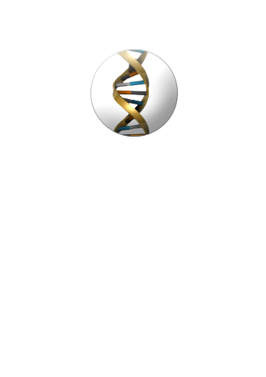

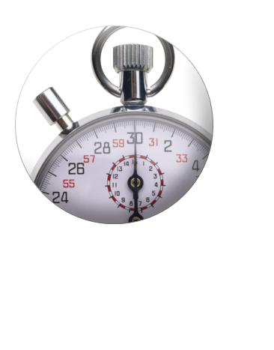
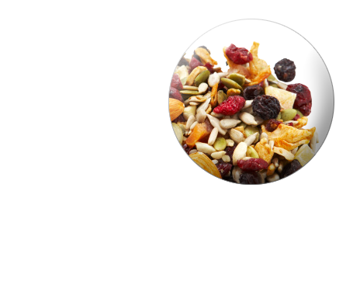
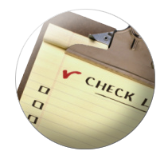
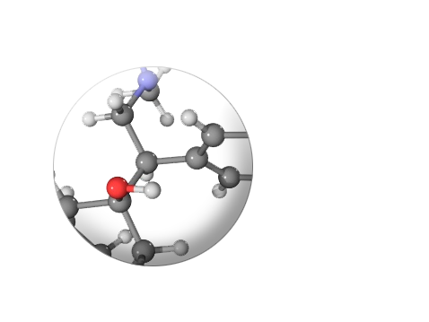
The 6 Dimensions of BIG Data
Primary challenges
Volume
Velocity
Variety
Complexity
And also
Validation
Lineage
Notes:
Volume : “Large” data set. Gigabytes, Terabytes, Petabytes, Exabytes
Velocity : real-time (CDC / Event based trigerring, WS: right time), batch… ETL with Parallelization /ELT/ FS / Hadoop
Variety : Databases including NoSQL, Files, XML, unstructured, on premise or Cloud/ SaaS applications
Complexity: none (replication), heavy, DQ: tMatchGroupHadoop
Validation: Trustworthy, Consistent, Fresh :Reconcillation, Deduplication. Bad Quality is like a virus. In the space of BigData, contamination will be huge and very hard to recover good quality. => DQFirewall.
Lineage: UP, Impact Analysis / DataLineage

Slide 7
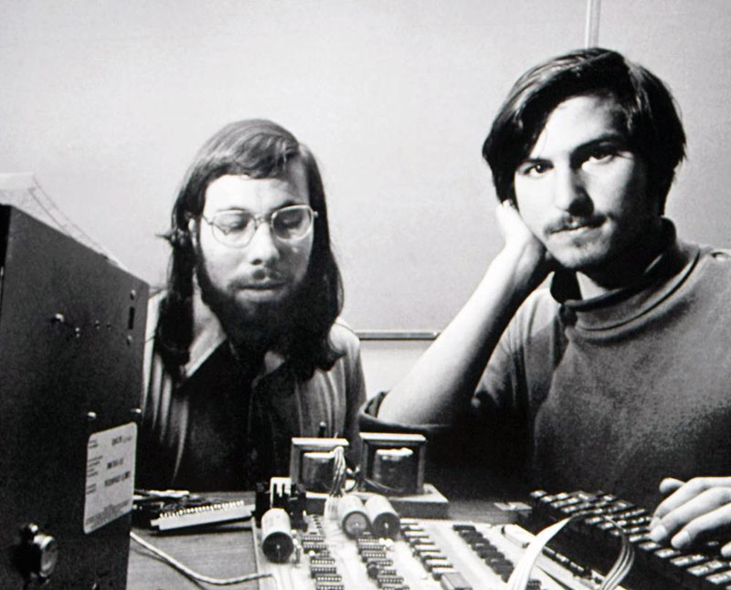
Key Takeaway #2
Forces us to think differently

Slide 8



Traditional Data Flows
CRM
ETL
Data Quality
Traditional Data Warehouse
ERP
Normalized Data
Finance
Scheduled–daily or weekly, sometimes more frequently.
Volumes rarely exceed terabytes
Business Analyst
Business User
Warehouse Administrator
Executives

Slide 9
The new world of big data
Social Networking
Big Data
CRM
ERP
Finance

Slide 10
The new world of big data
Social Networking
Big Data
CRM
Mobile Devices
ERP
Finance

Slide 11
The new world of big data
Social Networking
Big Data
CRM
Mobile Devices
ERP
Transactions
Finance
Network Devices
Sensors

Slide 12
Data driven business
data
enables
governance
information
supports
decisions
drives
Information provides value to the business
If you can't rely on your information then the result can be missed opportunities, or higher costs.
Your business
Matthew West and Julian Fowler (1999). Developing High Quality Data Models. The European Process Industries STEP Technical Liaison Executive (EPISTLE).

Slide 13
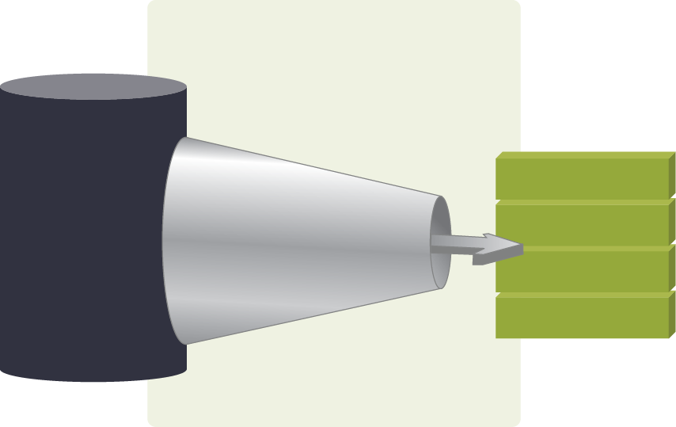
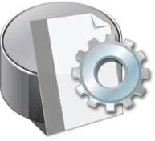


BIG Data Management
Big Data Production
Big Data Management
RDBMS
Analytical DB
NoSQL DB
ERP/CRM
SaaS
Social Media
Web Analytics
Log Files
RFID
Call Data Records
Sensors
Machine-Generated
Big Data
Integration
Big Data
Quality
Big Data Consumption
Mining
Analytics
Storage
Processing
Filtering
Search
Enrichment
Turn Big Data into actionable information

Slide 14
BIG data driven business
BIG data
enables
governance
BIG
information
supports
BIG
decisions
drives
Information provides value to the business
If you can't rely on your information then the result can be missed opportunities, or higher costs.
BIG business
Matthew West and Julian Fowler (1999). Developing High Quality Data Models. The European Process Industries STEP Technical Liaison Executive (EPISTLE).
Notes:
This is a classic diagram that maps how business and data are related. Nothing is new. This never changes. In fact in becomes even more important today.

Slide 15
Our goal

Slide 16
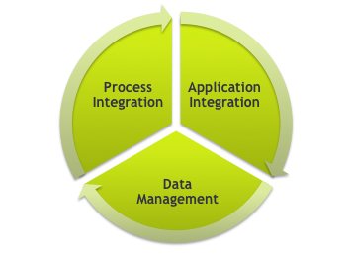












Talend – The Market Leading Unified Integration Platform
Talend Enterprise
Data Quality
Data Integration
MDM
ESB
BPM
Commercial license
Subscription model
Talend Unified Platform
Studio
Repository
Deployment
Execution
Monitoring
Open source license
Free of charge
Optional support
Talend Open Studio for
Data Quality
Data Integration
MDM
ESB
Recognized as the open source leader in each of its market category by all industry analysts
Notes:
We accomplish this innovation by offering two editions of our products.
The Talend Open Studio, at the bottom of this diagram, is a set of free open source products for Data Quality, Data Integration, Master Data Management, Enterprise Service Bus and Business Process Management.
And when you are ready to deploy, you can purchase a Talend Enterprise commercial license, which includes the features found in world-class integration solutions such as extreme scalability, high availability and 24x7 mission-critical support – all backed by a large services and partner ecosystem.
Unlike competitors “non-integrated” integration products, Talend’s uniqueness is in the unification of our products – they are built from the same unified platform, maximizing your productivity and providing greater software reuse and repeatability. An analogy would be the user experience you see with the integration of the iPod, iPad and iPhone.
As shown in this picture, our products leverage the same studio, repository, and deployment, execution and monitoring tools to maximize your productivity.
As modular products, you can buy what you need when you need it, or easily combine them to solve more comprehensive integration problems.

Slide 17
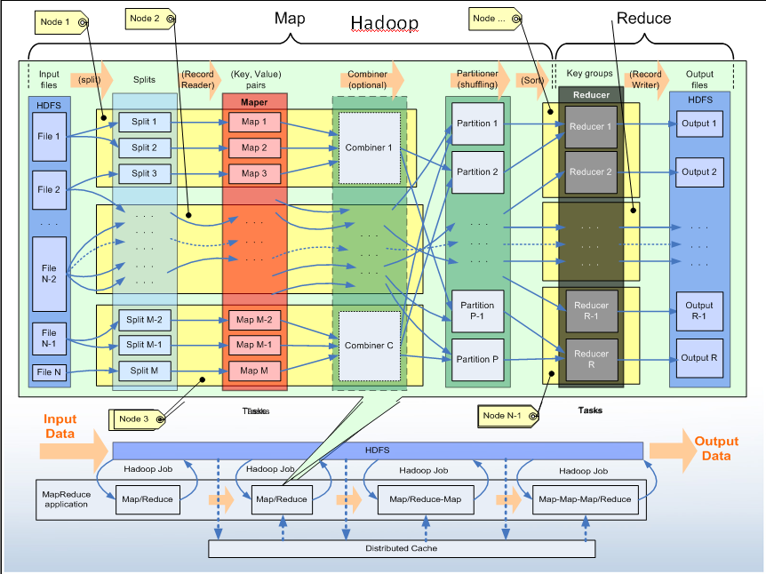
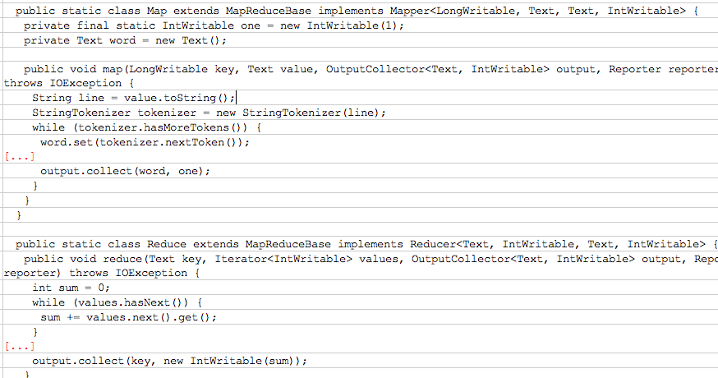
Trying to get from this…
Notes:
For instance, this is a SIMPLE drawing of how the map reduce features work. This is abstract and does not reflect the complexity of code. Still pretty complex.

Slide 18

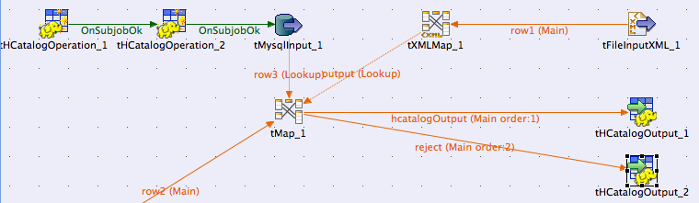


to this…
Why Talend…
ONLY Talend generates code that is executed within map reduce. This open approach removes the limitation of a proprietary “engine” to provide a truly unique and powerful set of tools for big data.
Notes:
Big data has an OPERATION DI challenge. This is the core of what talend was built on and part of our DNA. We simplify the process of implementation to speed projects and increase adoption.
Note: I am trying to get a recording that can be embedded in the slide that will build a HDFS load as you speak. It is so simple that it was completed in the time it took for me to present this slide!

Slide 19
“Big Data for the Masses”

Slide 20
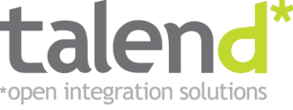








Goal: Democratize Big Data
Talend Open Studio for Big Data
“Big Data for the Masses”
Improves efficiency of big data job design with graphic interface
Abstracts and generates code
Run transforms inside Hadoop
Native support for HDFS, Pig, HBase, Sqoop and Hive
Apache License 2.0
Embedded in Hortonworks Data Platform
Certifed with Cloudera, MapR and Grenplum
…an open source ecosystem
Pig
Notes:
Finally, the entire big data world has been built as an open source ecosystem.
This all makes sense… talend is the open source leader.
To this end we will introduce the first compelte set of tools that will democratize big data. Talend Open Studio for Big Data

Slide 21
Big Data – How about Data Quality?

Slide 22

How is big data integration being used?
Use Cases
Recommendation Engine
Sentiment Analysis
Risk Modeling
Fraud Detection
Marketing Campaign Analysis
Customer Churn Analysis
Social Graph Analysis
Customer Experience Analytics
Network Monitoring
Research And Development
BUT: to what level is DQ required for your use case?

Slide 23
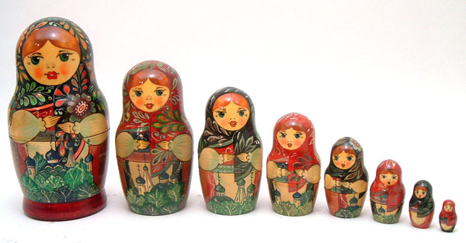
Poor Data Quality + Big Data = Big Problems
Poor Data Quality * Big Data = Big Problems^2
In big data…
poor data quality can be magnified at huge scale
Key Takeaway #3
Notes:
However, with big data comes significant challenges. For example, poor data quality can be magnified at huge scale. Consider a small company with 100 customers. Assume they had a bad address for three customers and sent a mailer out to their list. Three mailers would be returned and they would have wasted about 5 dollars or so. Now imagine the world of big data where this number of customers expands across business lines and companies and partners to millions. The costs are big.
Even more interesting is the ability to not only use the data but to analyze. Across your customer base, how could you monitor and analyze every interaction they ever had with you (social media, web, stores, etc). This is large amounts of data. A small problem with the data can lead to very LARGE issues with analysis, invalidating the entire reason for big data.
Data quality is KEY for big data – it is a core tenant of our strategy.

Slide 24
Two methods for inserting data quality into a big data job
Pipelining: as part of the load process
Load the cluster then implement and execute a data quality map reduce job

Slide 25
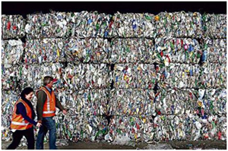
Extract – Transform - Load
E-T-L

Slide 26

Extract – Improve/Cleanse - Load
DQ
E- -L

Slide 27
Pipelining: data quality with big data
CRM
DQ
Big Data
ERP
DQ
Finance
Social Networking
Use traditional data quality tools
No new programming, no PHDs
Once and done
Mobile Devices

Slide 28
Big data alternative: Load and improve within the cluster
CRM
Big Data
DQ
ERP
DQ
Finance
Social Networking
Load first, improve later
Really complex to build, limited tools
Constant on, increments
Insane performance
Mobile Devices

Slide 29
Let us show you…
Notes:
demo

Slide 30
What’s next for Talend Big Data?

Slide 31
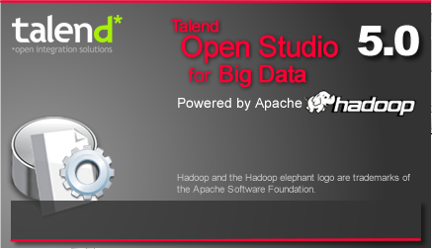


Talend Open Studio for Big Data
4.0: HDFS
4.1: Hive & Sqoop
4.2: Pig
5.0: Hbase
5.1:HCatalog & Oozie
Notes:
HortonWorks => spioff de Y!, plus gros contributeur sur Hadoop
TOS4BD embeded dans toutes les distributions Jira
4.0 GA=Avril 2010 (plus de 2 ans)

Slide 32

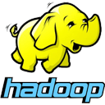

data
big
2012
now
Q4
2013
Talend Open Studio for Big Data
Packaged within Hortonworks Data Platform
…Eclipse tools for HIVE, HDFS, PIG, SCOOP
…supports Oozie, Hcatalog, Kerberos
Free to download and use under the Apache license
…democratizing big data through intuitive tools

Slide 33
Questions / Thanks for attending
mhirt_at_talend.com

