Slide 1
Software development does NOT stop at the last commit
Kris Buytaert
Open World Forum 2013, Paris
@krisbuytaert

Slide 2
Kris Buytaert
I used to be a Dev,
Then Became an Op
Chief Trolling Officer and Open Source Consultant @inuits.eu
Everything is an effing DNS Problem
Building Clouds since before the bookstore
Some books, some papers, some blogs
Evangelizing devops

Slide 3
What's this devops thing anyhow ?

Slide 4
World , 200X-2009
Patrick Debois, Gildas Le Nadan, Andrew Clay Shafer, Kris Buytaert, Jezz Humble, Lindsay Holmwood, John Willis, Chris Read, Julian Simpson, Luke Kanies, John Allspaw and lots of others ..
Gent , October 2009
Mountain View , June 2010
Hamburg , October 2010
Boston, March 2011
Mountain View, June 2011
Bangalore, Melbourne,
Goteborg , October 2011
....
Almost 20 events held in 2013.

Slide 5
devops, a definition:

Slide 6
Adopt the new philosophy. We are in a new economic age. Western management must awaken to the challenge, must learn their responsibilities, and take on leadership for change.
Cease dependence on inspection to achieve quality. Eliminate the need for massive inspection by building quality into the product in the first place.
Improve constantly and forever the system of production and service, to improve quality and productivity, and thus constantly decrease costs.
Institute training on the job.
Institute leadership The aim of supervision should be to help people and machines and gadgets do a better job.
Drive out fear, so that everyone may work effectively for the company.
Break down barriers between departments. People in research, design, sales, and production must work as a team, in order to foresee problems of production and usage that may be encountered with the product or service.
Eliminate slogans, exhortations, and targets for the work force asking for zero defects and new levels of productivity. Such exhortations only create adversarial relationships, as the bulk of the causes of low quality and low productivity belong to the system and thus lie beyond the power of the work force.
                Eliminate management by objective. Eliminate management by numbers and numerical goals. Instead substitute with leadership.
                Remove barriers that rob the hourly worker of his right to pride of workmanship. The responsibility of supervisors must be changed from sheer numbers to quality.
                Remove barriers that rob people in management and in engineering of their right to pride of workmanship.
Institute a vigorous program of education and self-improvement.
Put everybody in the company to work to accomplish the transformation. The transformation is everybody's job.

Slide 7
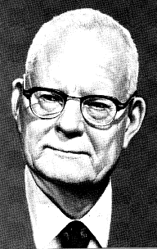
William Edwards Deming
1986, Out of the Crisis.
http://en.wikipedia.org/wiki/W._Edwards_Deming

Slide 8
Devops is a cultural and professional movement
Adam Jacob, Opscode

Slide 9
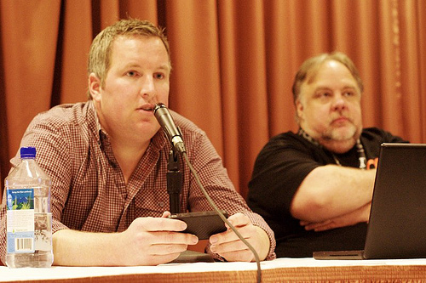
C(L)AMS
Culture
(Lean)
Automation
Measurement
Sharing
Damon Edwards and John Willis
Gene Kim

Slide 10
Whats in it for you ?
Faster time to market
  Features go live in hours vs years
In a more safe
Reliable fashion
  Fully automated
More happy {customers,developers,managers,investors}

Slide 11
A typical dev shop
The PM:
  “Put this Code Live, here's a tarball” NOW!
  Marketing Campain is launched
  We need this yesterday
  It's going on national radio at 5

Slide 12
An oldschool ops shop
What dependencies ?
No machines available ?
What database ?
Security ?
High Availability ?
Scalability ?
My computer can't install this ?

Slide 13
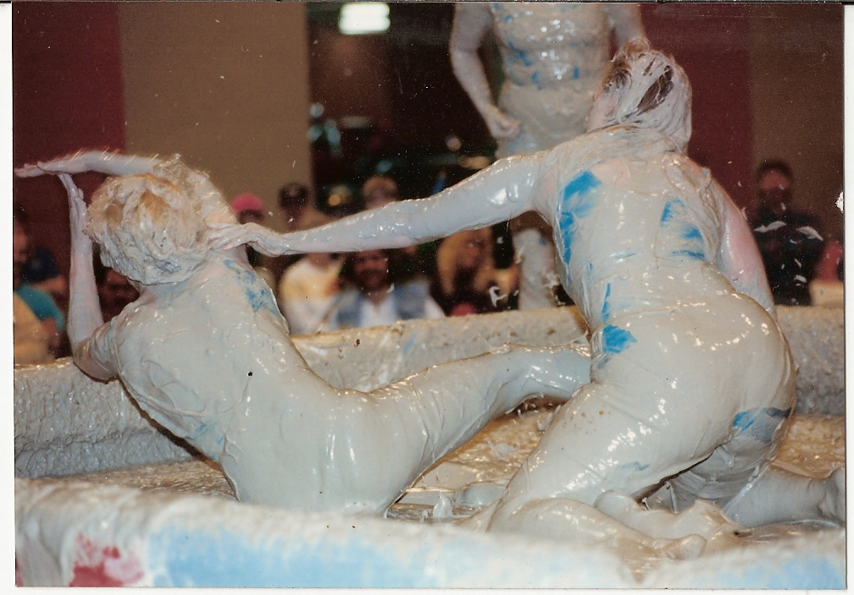
Devs vs Ops

Slide 14
Culture,
automation,
Measturement,
sharing

Slide 15
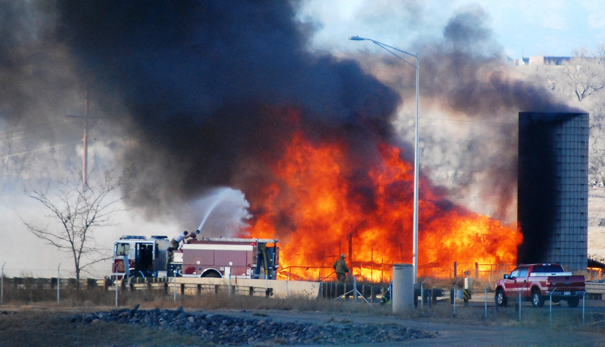
Burn the Silos

Slide 16
Crossfunctional Team
Project team with skills from all over
  Development
  Continuous Integration
  Testing
  Infrastructure (HA/ Scale/ Performance)
    Deployment
    Measurement
Seat them together !
Goal = Help the business

Slide 17

One Team = One Goal !

Slide 18

Enable Communication

Slide 19
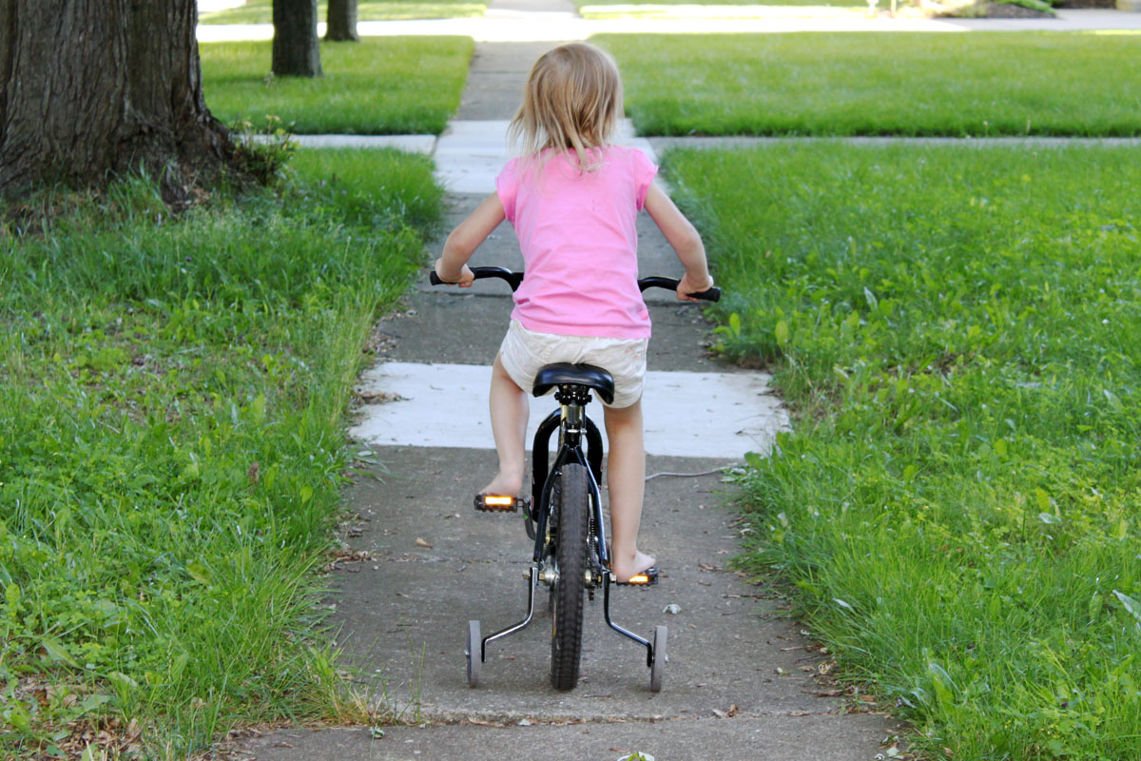
Build Trust
Experiment
  Dev
  Test
Prod
Automate all the things
Measure success
Measure Failure

Slide 20
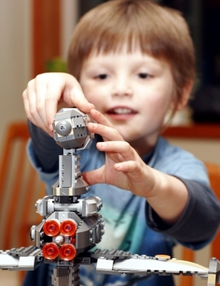
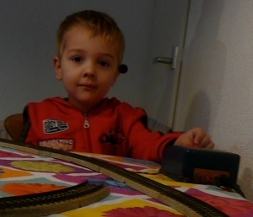
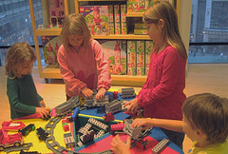
Lets Play Together
Devs
Ops
Getting Along

Slide 21
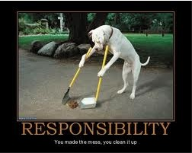

Slide 22
Agile ?
Agile vs Agile
Scrum vs Kanban
Definition of Done
  Done means tested
  Done means in production
  Done means monitored and in production

Slide 23
A software project is not done until
your last enduser is in his grave !
Kris Buytaert, DOD Amsterdam 2013

Slide 24
Culture,
Automation,
Measurement,
Sharing

Slide 25
Automate all the things
Build
  reproducable builds are undiscussable
Test
  testing reduces risk
  automate deployments of your test infra
Deploy
  Infrastructure as Code
  100% automation
  Can you rebuild your infrastructure ?

Slide 26
Continuous Integration
Builds
Nightly Builds
Builds with tests
Nightly Builds with tests
Frequent integration
Continuous Integration

Slide 27
Test Automation
Unit tests
Regression tests
Selenium
Cucumber
TDD
BDD

Slide 28
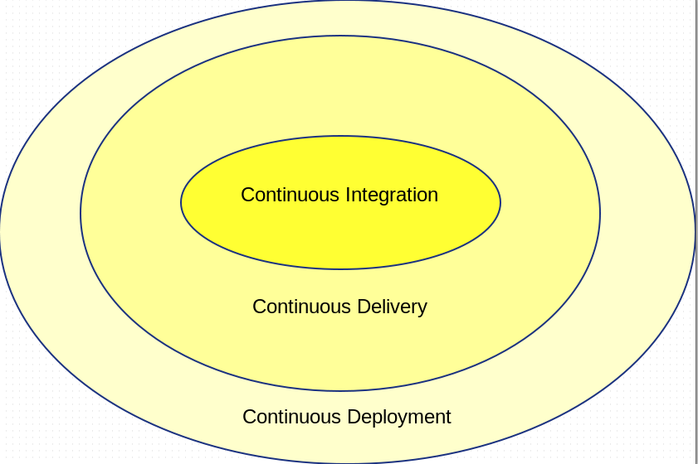

Slide 29
devops (<)> continuous delilvery

Slide 30
" Our job as engineers (and ops, dev-ops, QA, support, everyone in the company actually) is to enable the business goals. We strongly feel that in order to do that you must have the ability to deploy code quickly and safely. Even if the business goals are to deploy strongly QA’d code once a month at 3am (it’s not for us, we push all the time), having a reliable and easy deployment should be non-negotiable."
Etsy Blog upon releasing Deployinator
http://codeascraft.etsy.com/2010/05/20/quantum-of-deployment/

Slide 31
Infrastructure as Code
Treat configuration automation as code
Development best practices
    Model your infrastructure
    Version your cookbooks / manifests
    Test your cookbooks/ manifests
    Dev/ test /uat / prod for your infra
Model your infrastructure
A working service = automated ( Application Code + Infrastructure Code + Security + Monitoring )
Think Puppet, Chef, Cfengine, ...
IAC -ne scripting

Slide 32
Orchestration
On what servers is XYZ running ?
Restart apache on all servers with fact X
Configure DB
  then configure web
  then restart app
Over different hosts , automated
Mcollective, Rundeck, Ansible ...

Slide 33
Culture,
Automation,
Measurement :
measure all the things
Sharing

Slide 34


Slide 35
Self Service Metrics
Being able to add new metrics
Build your own dashboards
Look at metrics / logs on all platforms
Learn from the Logfiles
Learn from the platform

Slide 36
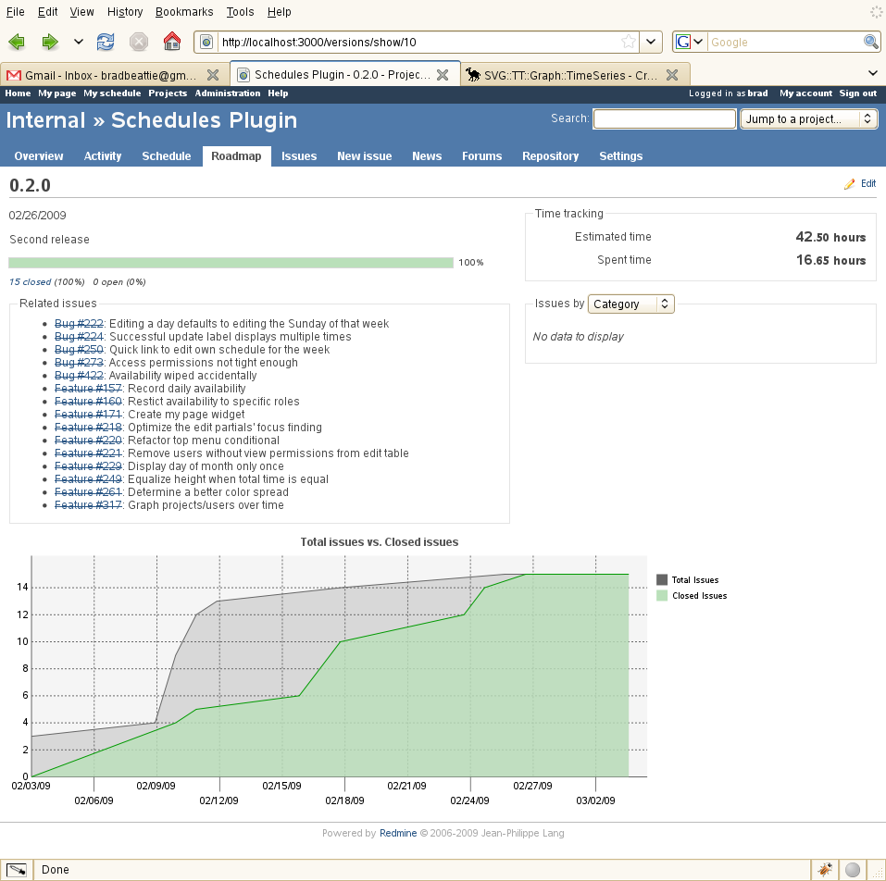
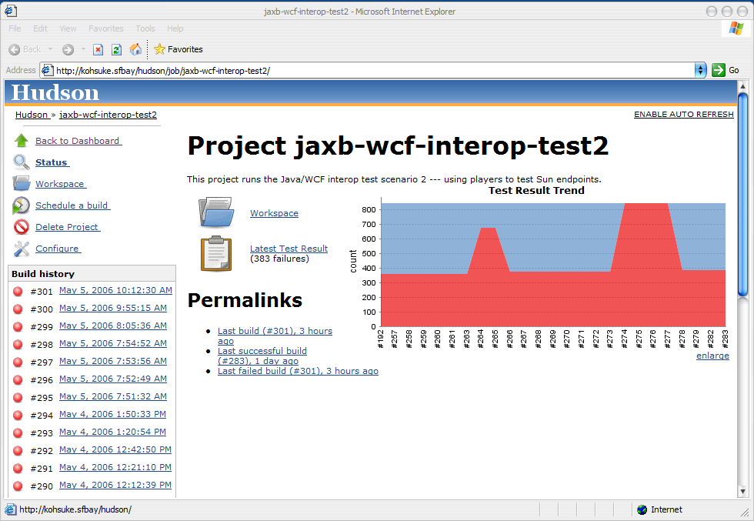
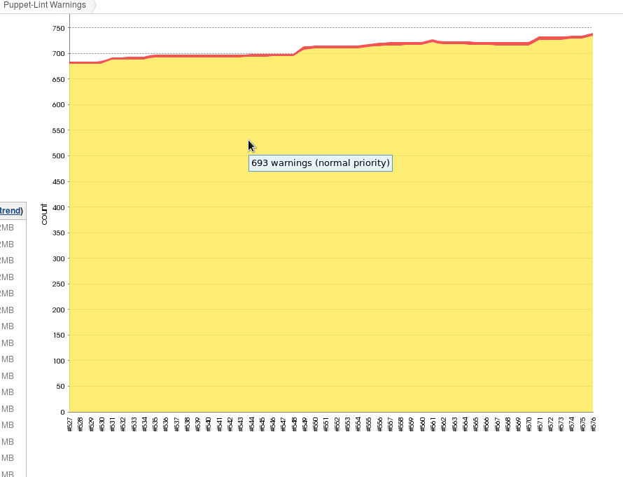
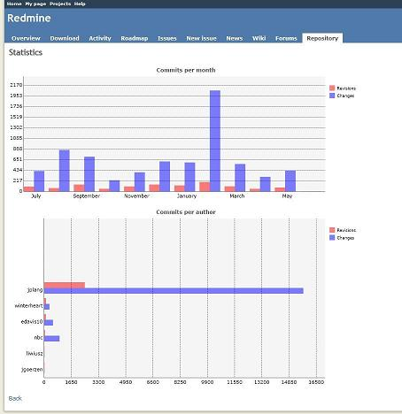
During development

Slide 37
And runtime
Operating System
disk
Cpu
Memory
Application
#users
#feature usage
response time
MiddleWare
Transactions
Queue length
Api calls
(Aborted) Connections

Slide 38
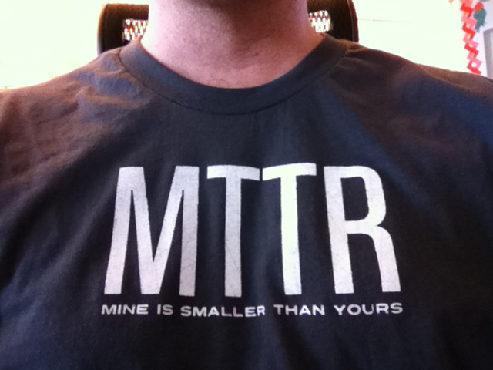

Slide 39
Math 101
f(x)
f'(x)
f''(x)
... statistics 101
Machine Learning

Slide 40
Culture,
Automation,
Measurement,
Sharing

Slide 41
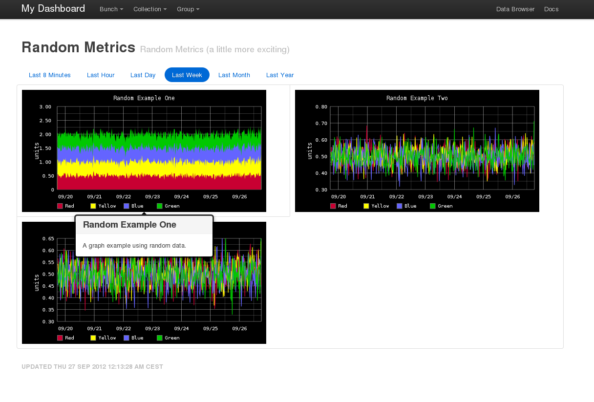
Dashboards

Slide 42
Visualize Business Metrics
$revenue
#sales
signups
conversions
Api calls
Application use

Slide 43
Sharing
Open Source
Talk about Experiences
Publish the code
No proprietary software was used in these slides
Don't get Locked In !

Slide 44
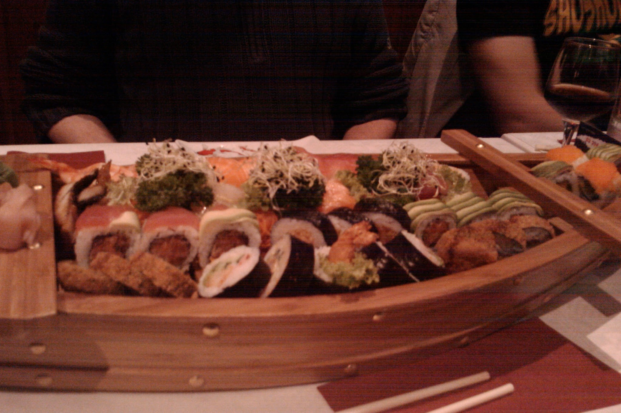
Food

Slide 45

It's not about the tools

Slide 46
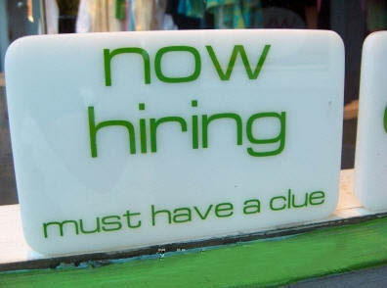
Contact
Kris Buytaert Kris.Buytaert@inuits.be
Further Reading
@krisbuytaert
http://www.krisbuytaert.be/blog/
http://www.inuits.be/
Inuits
Duboistraat 50
2060 Antwerpen
Belgium
891.514.231
+32 475 961221

