Slide 1



JIO and WebViewers: interoperability for Javascript and Web Applications
Ludovic Dubost
CEO XWiki SAS
Viktor Horvath
Alixen
October 4th 2013

Slide 2
Agenda
About the Speakers
Why Interoperability
JIO: accessing Web Applications from Javascript applications
WebViewers: building cross-applications Javascript viewers and editors for content types
Question and Answers

Slide 3
About the Speakers

Slide 4
Ludovic Dubost, XWiki SAS
LGPL Open Source Software
Improving Information organization and sharing in companies
Recognized project with more than 1 Million downloads
8 participations to the Google Summer of code
Tens of thousand XWiki installed
Creator of XWiki in 2004
15 years of Web Development
French company, 30 employes
Services and Solutions based on XWiki
1,6M revenue
Independent company owned by employees
Participating to research projects, including RESILIENCE

Slide 5
Viktor Horvath, Alixen
R&D engineer at Alixen since 2008
Alixen: Free software development,
maintenance,
infrastructures,
consulting
Founded in 2002, merged with Systemis in 2012
Mioga2: Collaborative Extranet
Biblio-PAM: remote access to library resources
Alixen participates in the Resilience project:
J-IO, RenderJS

Slide 6



Resilience
collaborative research project (FUI12)
11 labs and small / mid-size companies
Resilient Computing
"decentralised cloud"
SlapOS, J-IO, RenderJS, OfficeJS
Members: Alcatel, Alixen, Alterway, le CEA, l'INRIA, Institut Télécom Université Paris 13, Mopho, Nexedi, Wallix et XWiki

Slide 7
Why Interoperability ?

Slide 8
Why Interoperability ?
We can make Web Applications
communicate with each other
We can reduce the effort needed for
Open Source projects to support more features

Slide 9
JIO
http://j-io.org

Slide 10
Why JIO ? - Some years ago :
Web servers, databases are expensive
Server-side applications
Apache web server

Slide 11
Why JIO ? - Now :
Web servers, databases are expensive
much cheaper
Server-side applications
Client-side
Apache web server
or asynchronous web and application servers
many more users per server
...data storage cost remains!

Slide 12
Separate web application and its data
localStorage
database
Mioga2
XWiki
Split
Replicate Revision
Encryption
J-IO storage

Slide 13
Characteristics
{
"_id": "my_document",
"title": "New Title",
"_attachments": {
"its_attachment": {
"length": 3,
"digest": "md5-e0089e[...]",
"content_type": "text/plain"
}
}
}
document-oriented storage
files as attachments
similar to NoSQL / JSON storages
enrich a basic storage:
indexes, revisions

Slide 14
Storage Connector: API methods
post / put / putAttachment
get / getAttachment
remove / removeAttachment
allDocs (complex queries)

Slide 15
Connection example
var local_jio = jIO.newJio({
type: 'local',
username: 'viktor',
application: 'test' });
local_jio.put({
_id: '123',
title: 'My Document',
setting: 'important_data'
}, function(err, response) { console.log(response); });
Object { ok=true, id="123"}
local_jio.get({ _id: '123' },
function(err, doc) { console.log(doc.setting); })
important_data

Slide 16
Complex Queries
local_jio.allDocs({
query: 'setting: "important_data"'
}, function(err, response) { console.log(response); });
Object { total_rows=1, rows=
[ Object { id="123", key="123", value={...}} ] }
local_jio.allDocs({
query: '(title:"% Document")
AND (setting: "important_data")',
limit: [0, 100],
sort_on: [['last_modified', 'descending']],
select_list: ['title'],
wildcard_character: '%'
}, function(err, response) { console.log(response); });

Slide 17
What is Mioga2 ?
Collaborative Extranet for 14 years
Project and mission management
within and across organisational borders
workgroups, document sharing, applications
GPLv2 download: http://www.alixen.org

Slide 18
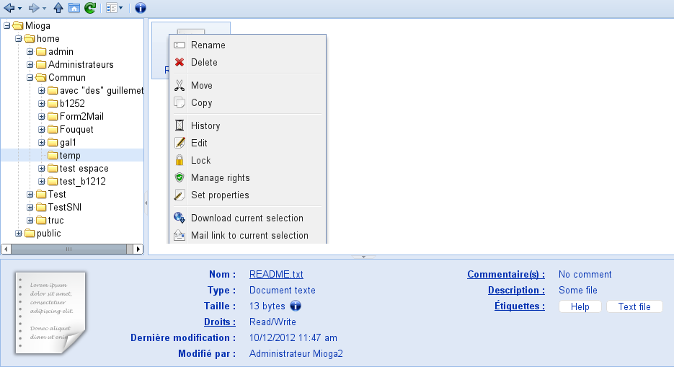
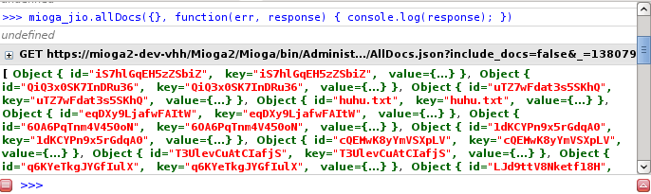
Mioga2 as a JIO Storage Connector
Workgroups have WebDAV spaces
WebDAV - JIO / filesystem - documents

Slide 19
When should you use JIO ?
enable the user to control his data
ease your burden
unify your data access
custom user interface
...towards democratic, truly Free web apps

Slide 20
Web Viewers

Slide 21
WebViewers: the Problem
Many web applications store files (pdf, office, graphs, etc..)
We need ways to view/edit these files in your browser
JavaScript viewers and editors exist but they are complex to integrate

Slide 22
WebViewers: Objectives
One viewer/editor for all Web Applications
One viewer/editor macro for all viewers
Automatic selection of viewer based on content-type
JavaScript only viewers (backend technology agnostic)

Slide 23
WebViewers: How does it work in a Web Application
Viewers are distributed as zip files
A module to install viewers
A way to activate the viewer
  Macro to use in content
  View/Edit button next to a file
A way to read/write the file content in JavaScript

Slide 24
WebViewers: technologies used
RenderJs: gadget technology
JIO: api to read/write files (optional)
Require.js

Slide 25
WebViewers: demo on XWiki, Wordpress
Install a viewer in XWiki
Attach a file in XWiki
Use a macro to view/edit the file in XWiki
Show viewers in Wordpress

Slide 26
WebViewers: support level
Web Applications
  Available: XWiki view/edit, Wordpress view
  Coming: ERP5, Mioga2, Drupal, MediaWiki, ?
Web Viewers
  Available: text, pdf, jquery sheet
  Coming: SVG Edit, Realtime editor, ?

Slide 27
WebViewers: future
Reaching out to Web Applications developers for native support
Reaching out to Viewer/Editor developers for native support
http://www.webviewers.org

Slide 28
Questions ?

Slide 29
Ludovic Dubost: ludovic@xwiki.com, @ldubost
Viktor Horvath info@alixen.fr

