Slide 1

Scalable Machine Learning for Spark
Sam Bessalah - @samklr

Slide 2
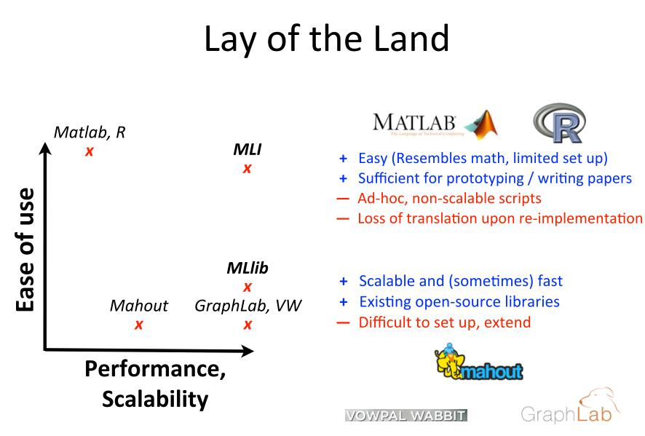

Slide 3
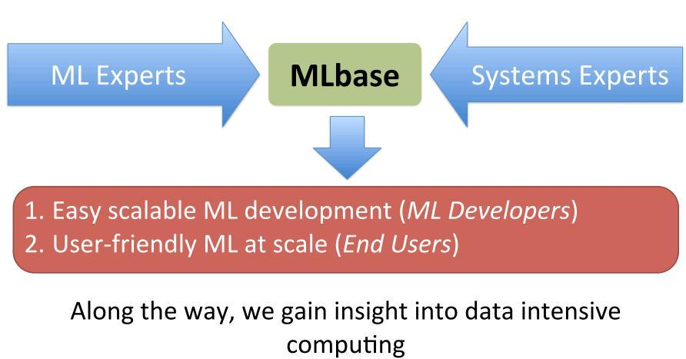

Slide 4
MATLAB Example
- Matlab has an integrated environment for ML development.
Data access and processing abstractions
Leverages and extends the Lapack functionalities
But doesn’t scale to distributed environments.
Matlab Interface
Lapack
Single Node

Slide 5
Spark : In memory, fast cluster computing system suited for
iterative computations like Machine learning algortihms.
MATLAB
MLBASE
Matlab Interface
Lapack
Single Node
SPARK

Slide 6
Spark : In memory, fast cluster computing system
MLLib : Low level ML algorithms implemented as Spark’s standard ML library
MATLAB
MLBASE
Matlab Interface
Lapack
MLlib
Single Node
SPARK

Slide 7
Spark : In memory, fast cluster computing system
MLLib : Low level ML algorithms in SPARK.
MLI : API / Platform for feature extraction, data pre processing and algorithm consumption. Aims to be platform independent.
MATLAB
MLBASE
Matlab Interface
MLI
Lapack
MLlib
Single Node
SPARK

Slide 8
MLBASE
Spark : In memory, fast cluster computing system
MLlib : Low level ML algorithms in Spark.
MLI : API / Platform for feature extraction, data pre processing and algorithm consumption. Aims to be platform independent.
ML Optimizer : automates model selection, by solving a search problem over features extractors
ML Optimizer
MLI
MLlib
SPARK

Slide 9
MLlib
Contains core algorithms implemented using Spark programming model for cluster computing : RDD
So far contains algorithms for :
- Regression : Ridge, Lasso
- Classification : Support Vector Machine, Logistic Regression,
- RecSys : Matrix Factorisation with ALS
- Clustering : K means
- Optimisation : Stochastic Gradient Descent
More being contributed ….

Slide 10
MLI : ML developer API
Aims to shield ML developers from runtimes implementation.
Provides high level abstractions and operators to build models in a distributed environment, along with data processing tools.
Linear Algebra : MLMatrix, MLRow, MLVector …
- Linear algebra on local partitions
- Sparse and Dense matrix support
Table Computations : MLTable
- Similar to R/Pandas(Python) DataFrame or NumPy Array
- Flexibility when loading /processing data
- Common interface for feature extraction

Slide 11
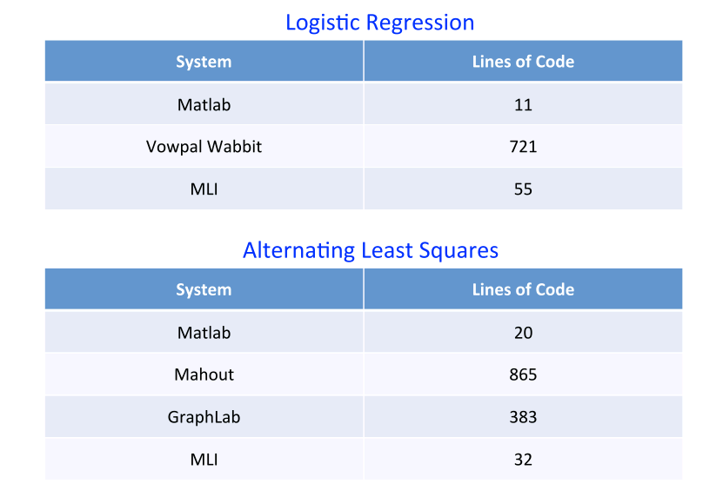
Number of lines of Code

Slide 12
MLI
Functionalities :
-Regression : Linear Regression (Ridge, Lasso)
-Classification : Logistic Regression, Support Vector Machines, Decision
Trees, Naive Bayes
-Collaborative Filtering : Alternating Least Squares, DFC
-Clustering : K-means, DP-Means
-Feature Extraction : PCA, N-grams, feature normalizer, Vectorizers
-Optimization : Parallel Gradient, Local SGD, L-BFGS
-Model evaluation : Cross validation, Evaluation metrics

Slide 13
ML Optimizer
Aimed at non ML developers
Specify ML tasks declaratively
Have the system do all the heavy lifting using MLI and MLLib.
var X = load (‘’local_file ’’, 2 to 10)
var Y = load (‘’text_file’’, 1)
var (fn-model, summary) = doClassify(X, y)
Not available yet, currently under development .

Slide 14
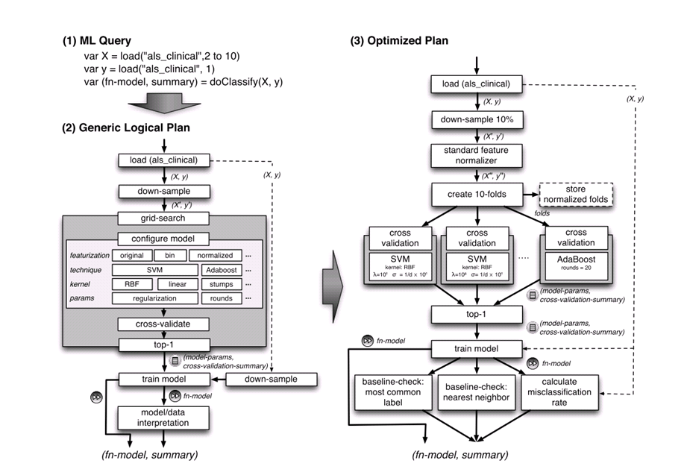

Slide 15
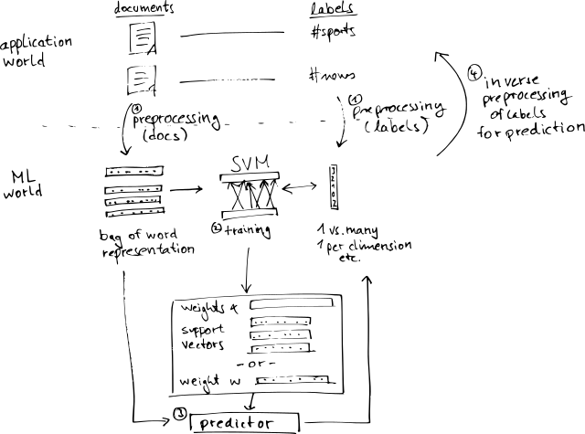
Example Worklow : Document Classification

Slide 16
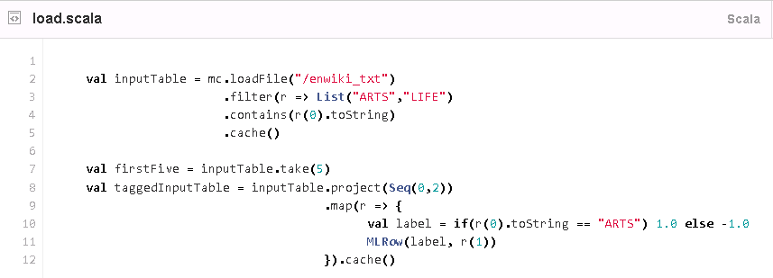
Typical data analysis workflow
Load Raw Data
Spark /MLI

Slide 17
Typical data analysis workflow
Load Data
Spark /MLI
Spark / MLI
Data Exploration / Feature Extraction

Slide 18
Typical data analysis workflow
Load Raw Data
Spark /MLI
Spark / MLI
Data Exploration / Features Extraction
Learn

Slide 19
Typical data analysis workflow
Load Raw Data
Spark /MLI
Spark / MLI
Data Exploration / Features Extraction
Learn
Evaluate Model

Slide 20
Typical data analysis workflow
Spark /MLI
Load Raw Data
Spark / MLI
Data Exploration / Features Extraction
Learn
Evaluate Model
Deploy
Test / Feature Eng.
Application

Slide 21
Typical data analysis workflow
Load Raw Data
Spark /MLI
MLI
Data Exploration / Features Extraction
MLI / MLlib
Learning
MLI
Evaluation
Deployment
Scala / Java App

Slide 22
Current status
MLlib is avilable in Spark from the release 0.8
https://github.com/apache/incubator-spark/tree/master/mllib
MLI is developed separately
http://github.com/amplab/MLI
ML Optimizer, is an active research project in common with the AmpLab Berkeley, VmWAre, and Brown University, first release planned for winter.
Looking for contributors , very welcoming community ☺
http://spark.incubator.apache.org

