Slide 1

Need wifi? If possible use Eduroam
Else let us know for a personal login

Slide 2
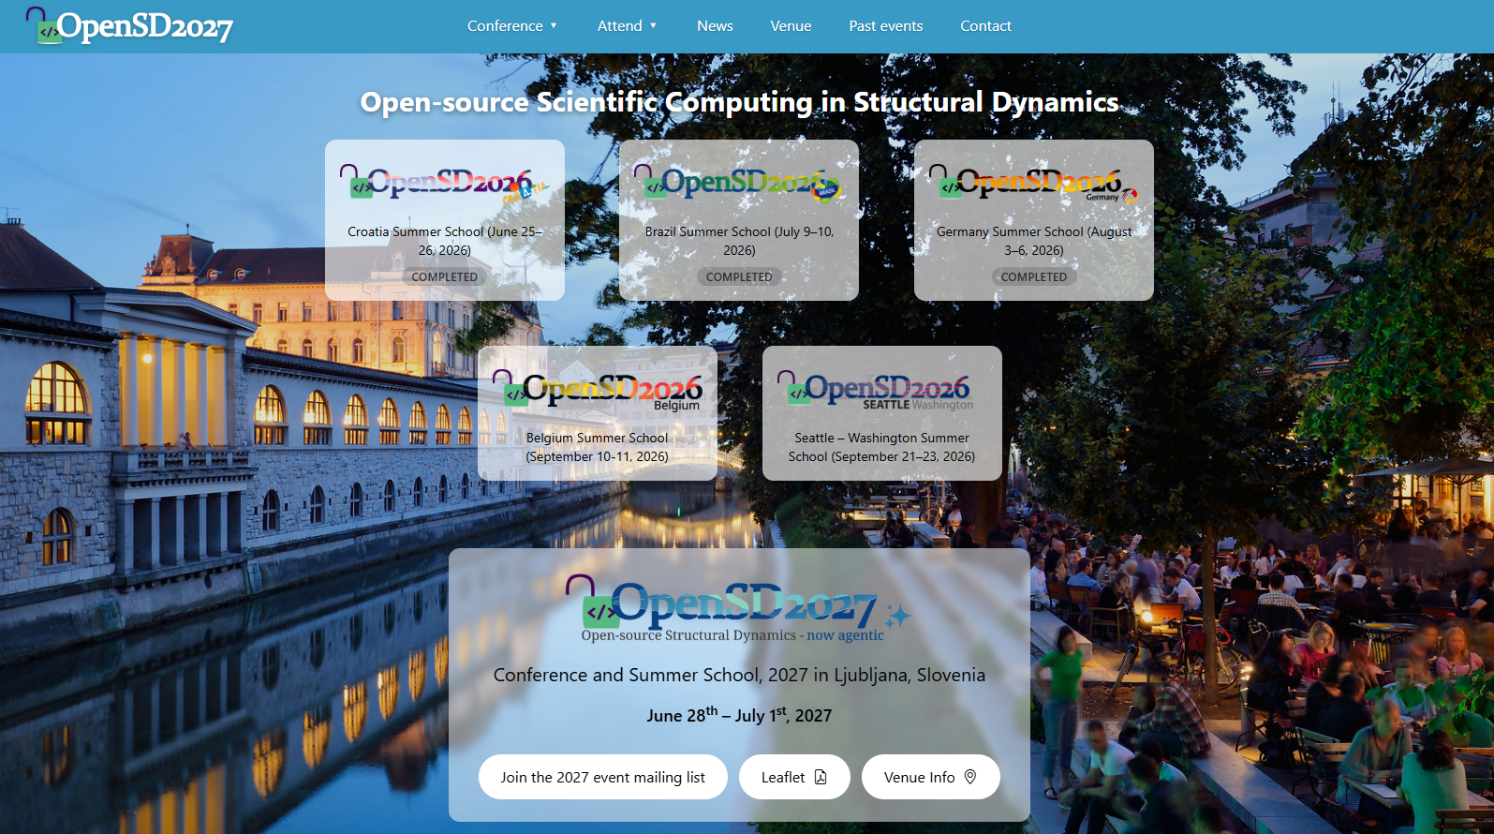
OpenSD : From Ljubljana to the world

Slide 3
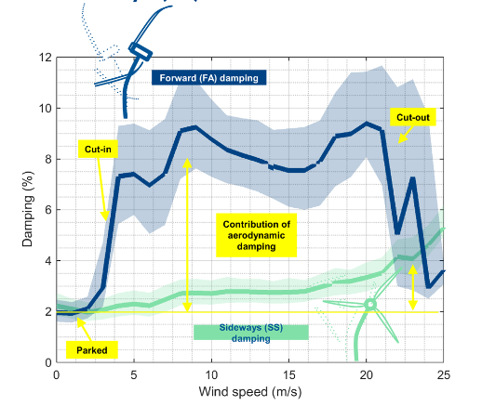
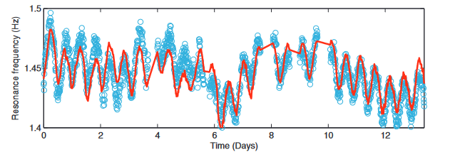
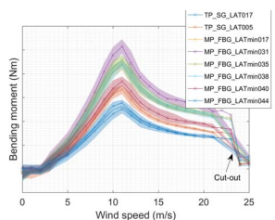
Context
Structural health monitoring of offshore wind turbines
We are a part of the AVRG group, previously led by Prof. P. Guillaume, with a focus on Experimental and Operational Modal Analysis (pLSCF, LMS polyMAX)
OWI-lab @ VUB has been monitoring the structural health of (offshore) wind turbines since 2011
Development of our in-house data acquisition software (NI)
Long term damping estimates in situ (OMA)
Long term resonance frequency monitoring (OMA)
Inclination / Environmental / Bolt monitoring
Load monitoring (FBGs, Resitive SGs)
Fatigue life monitoring
Today (together with the spinoff 24SEA) we have instrumented 100+ wind turbines in the world

Slide 4
Why we go for open Source?

Slide 5



Context
Our history in code
-2011-
DYNAwind
Signal processing
Configuration handling
Data handling
Data storage
Automated OMA
Fatigue processing
…
-2018-
(py)DYNAwind.git
Signal processing
Configuration file handling
Data handling
Database (Postgres)
Automated OMA
Fatigue processing
…
Lessons learned:
Strong integration ☺☺☺
To share code is to share everything ☹ ☹ ☹
Hard to maintain
Hard to test properly
No modularity, e.g. to cope with different project scopes

Slide 6
Context
Our history in code
-2011-
DYNAwind
Signal processing
Configuration handling
Data handling
Data storage
Automated OMA
Fatigue processing
…
-2018-
(py)DYNAwind.git
Signal processing
Configuration file handling
Data handling
Database (Postgres)
Automated OMA
Fatigue processing
…
-2020-
DYNAwind: a Framework
Lessons learned:
Modularity achieved ☺
Easier to maintain ☺
Tier based sharing 😐
Open access difficult especially for top tier packages, due to internal depencies ☹
BUT internal dependencies allow for very efficient workflows (monolithic architecture)
dw_FATIGUE
Fatigue processing
dw_MPE
Automated OMA
dw_DATABASE
Database
dw_SIGNAL
Signal processing
Configuration file handling
Data handling

Slide 7

Context
Our history in code
-2011-
DYNAwind
Signal processing
Configuration handling
Data handling
Data storage
Automated OMA
Fatigue processing
…
-2018-
(py)DYNAwind.git
Signal processing
Configuration file handling
Data handling
Database (Postgres)
Automated OMA
Fatigue processing
…
-2020-
DYNAwind: a Framework
dw_FATIGUE
pyFatigue
Fatigue processing
dw_MPE
Automated OMA
Lessons learned:
No more internal dependencies ☺☺☺
Much Easier to maintain ☺☺☺ : Separation of concerns
Open access possible ☺
Monolith’s strengths maintained ☺
dw_DATABASE
Database
dw_SIGNAL
Signal processing
Configuration file handling
Data handling

Slide 8
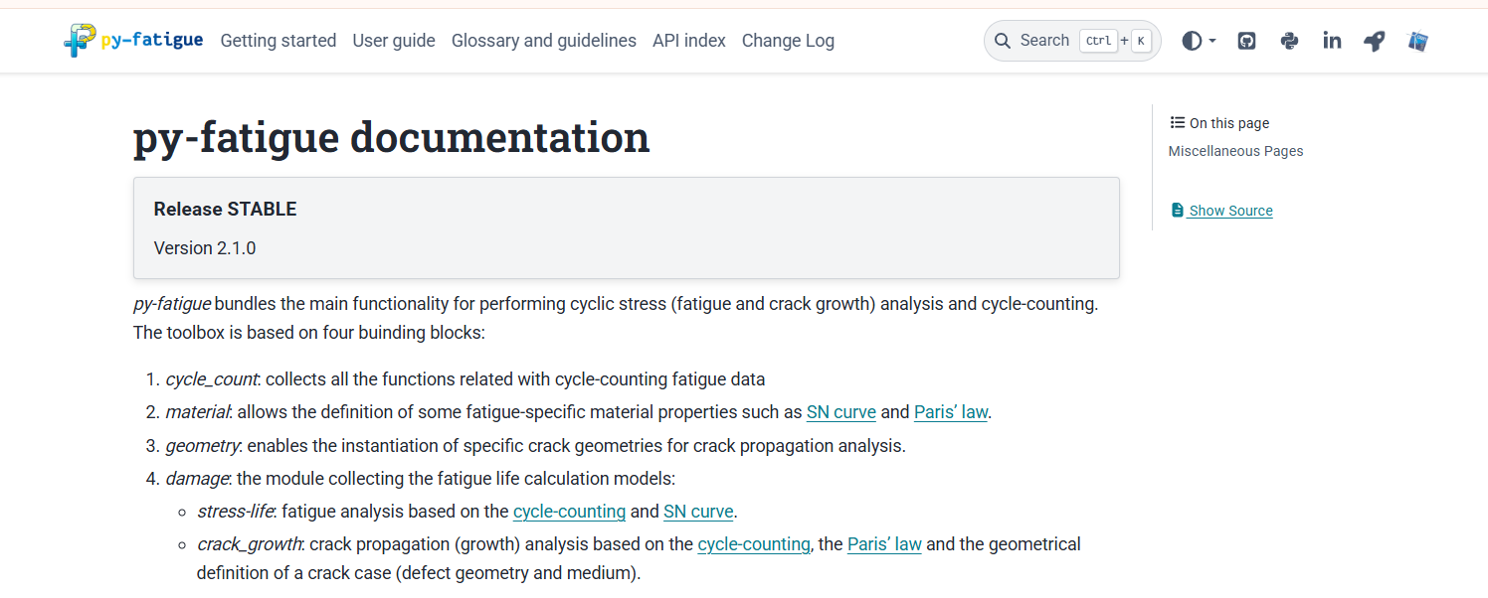

Slide 9
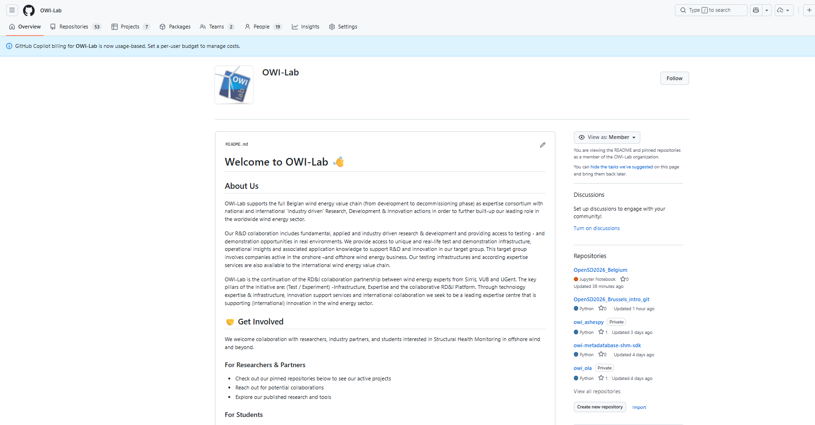
https://github.com/OWI-Lab

Slide 10
Who are you?
A quick roundtable
Who are you?
What is your professional situation?
Why did you want to participate in this workshop?

Slide 11
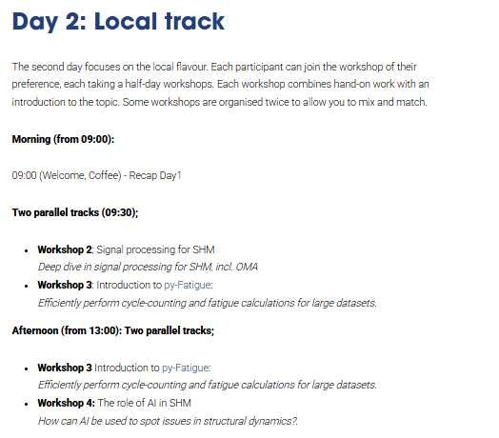
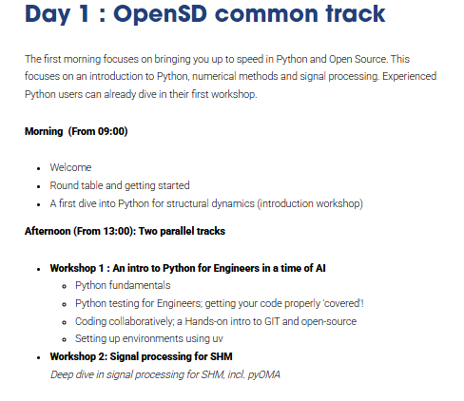
Agenda
Too much? We know it is a lot, all slides and notebooks are available online after the workshop!
📸 Group picture over lunch!

Slide 12
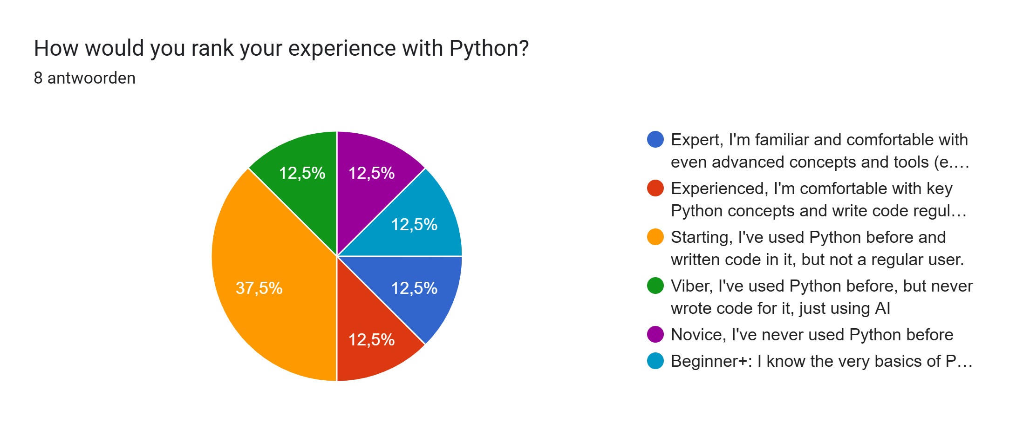
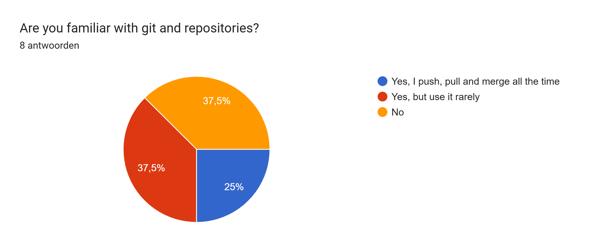
Day 1: Idea
We cater to both starters and more experienced developers;
In the morning we have a small introduction session, to get everyone started
Trivial? Then you are an experienced user, consider it a warm-up. You can decide for your yourself whether or not you would like to join the intro track.
Learning a lot? We recommend you stay in the introduction track. You’ll need a bit more background to keep track
Those skipping the introduction track can join all three ‘local’ workshops!

Slide 13
Day 1 : Afternoon
Workshop 1 : An intro to Python for Engineers in a time of AI
Python fundamentals
Python testing for Engineers; getting your code properly 'covered'!
Coding collaboratively; a Hands-on intro to GIT and open-source
Setting up environments using uv
Workshop 2: Signal processing for SHM Deep dive in signal processing for SHM, incl. pyOMA
End of day around 16:30 – 17:00

Slide 14
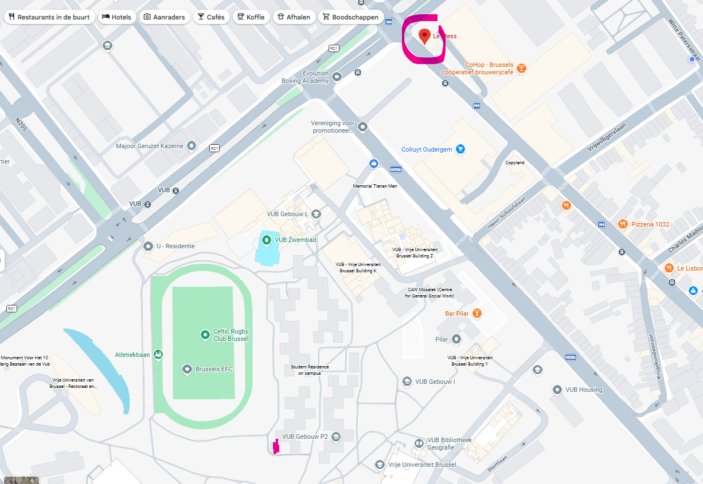

Conference dinner at leMess
For those who have registered; we meet in front of LeMess at 18:25

Slide 15
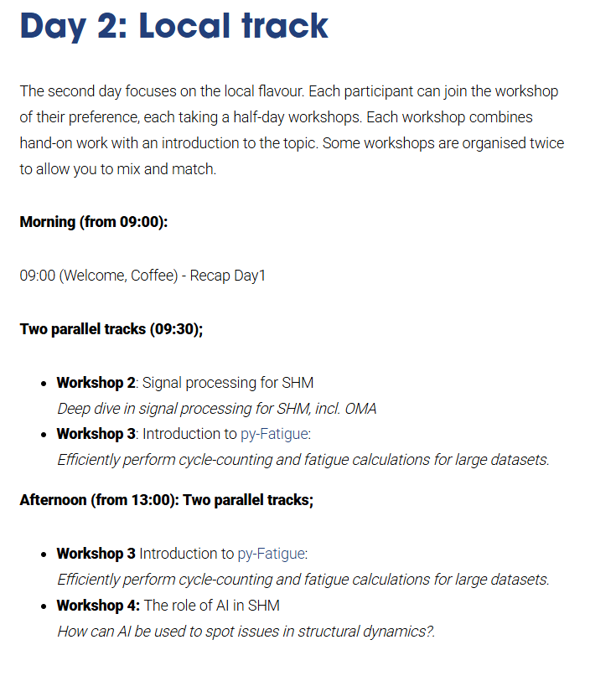
End of day around 16:30 – 17:00

Slide 16
Need wifi? If possible use Eduroam
Else let us know for a personal login

