Slide 1
Drug Dosage Extraction of Pharmacist Notes in MIMIC Using LLMs for Discrepancy Flagging
Owen Wurst

Slide 2
Goal: Scrape MIMIC Notes for Drug Amounts
More accurately track inventory
Identify common pain points in data entry
Build more robust datasets to work with
Treat patients more effectively
Notes:
For my SLT, I will be using AI tools to scrape medical notes to identify drug amounts administered to patients. If I can do this successfully, I will use these methods for my HRP, which will be flagging discrepencies between drugs, procedures, and the notes that have been written up on the patients. Flagging discrepencies for closer examination will help hospitals in the following ways:
1. More accurately track inventory
2. Identify common pain points in data entry
3. Build more robust datasets to work with (less bad data)
4. Treat patients more effectively (more accurate information on treatment a patient has already received)

Slide 3
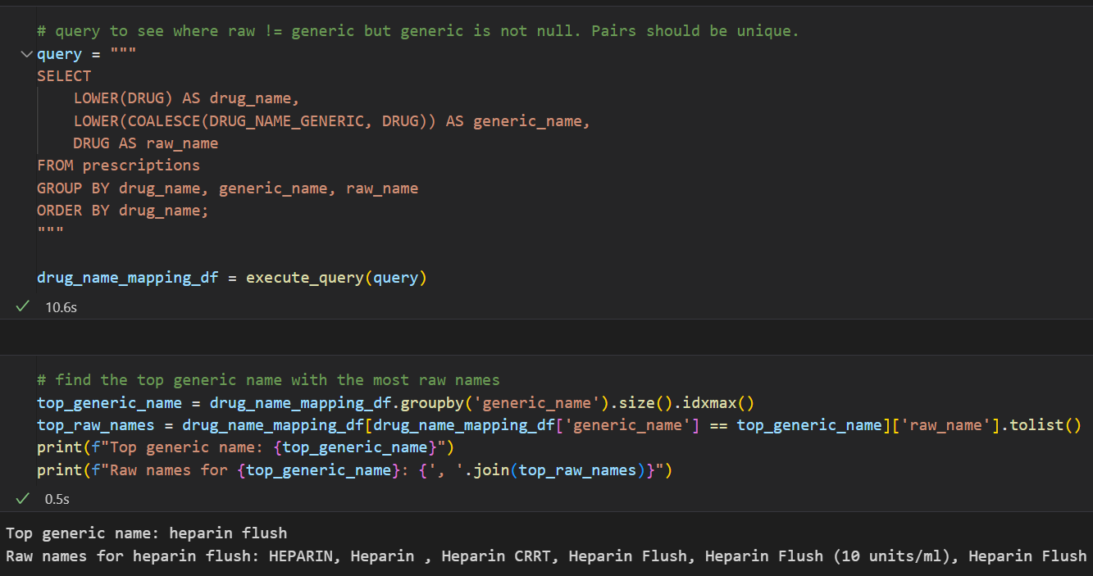
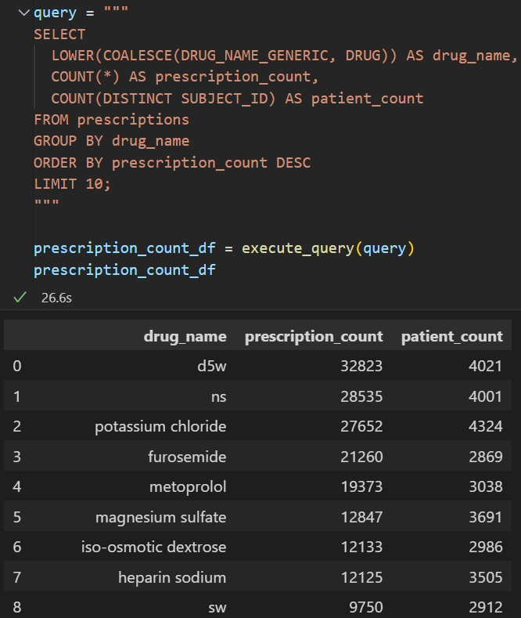
Data Exploration
Longest portion of any project and maybe the most important
Starting by looking at drug stats from the prescription table
Important finding that drugs can be under many names
Notes:
I am using MIMIC-III data locally loaded into mySQL. Data exploration is, in my opinion, the most important part of any AI project. If you do not understand the data, you will not be able to adequately manipulate it, and even when you do, your results could be meaningless. If I had not figured out that drugs will be under many names, I would have gone about the project very differently, and although my results would not have been much different today, this entire body of work would have been completely useless for my HRP.

Slide 4
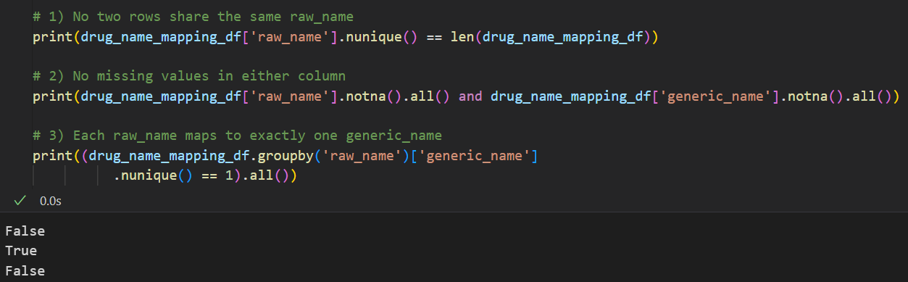
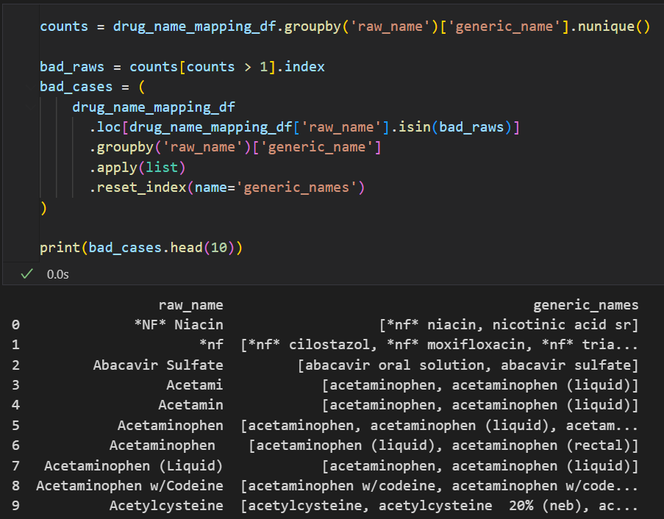
Data Issues
Because the same drug can have multiple names, we need a mapping to relate drug names to more generic names
Discovered issue where the same raw name can be mapped to multiple generic names
Notes:
Building a mapping so that I can relate drugs in notes to the true drug name. Why? The model I am building now is meant to be a part of a system in the future that will need to aggregate across medical notes. People taking notes will tend to use simple names rather than complex drug names.
Ok, these many to many relationships are going to be a problem. Today we will ignore because we are going to focus on a subset of the drugs and ensure we have a model that can extract those and their amounts, but in the future, we are going to have an issue that will have to be dealt with in the HRP. Hopefully, we can get context clues for some and hopefully notes will largely specify say, which type of acetaminophen was administered, or give context clues that we can make a reasonable guess. If not, maybe it makes sense to just flag these as notation was not specific enough.

Slide 5
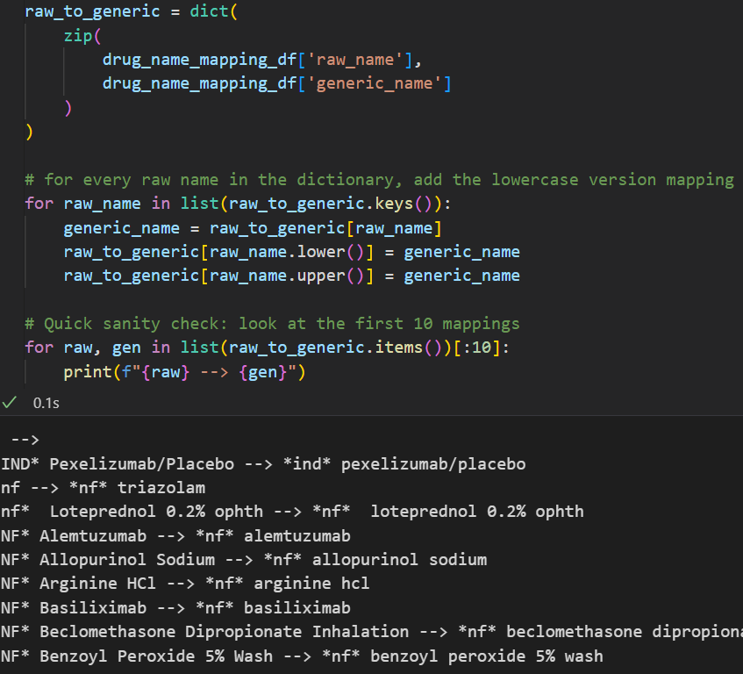
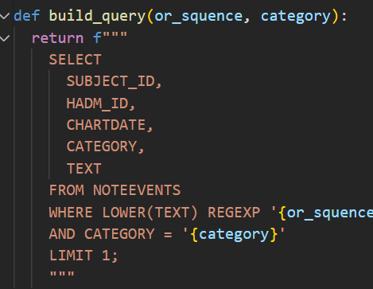
Data Setup
Different note types have different structures
Want to focus on a single note type today
Get our map into a comprehensive dictionary for speed
Build reusable query to look at our note types
Notes:
Because this is a very NLP heavy task with no predefined labels to train on, I have not yet come up with a way to do comprehensive automated testing, so to reduce the burden on myself, I am going to use only one note type so that I will be able to verify model output faster.
To other things I want to point out here: first using a dictionary for the lookups, I eventually will do this both ways. Don’t forget your algorithms classes, find little optimizations everywhere especially if they are simple. Second, build reusable queries. Even with a simple query, rewrite it as little as possible.

Slide 6
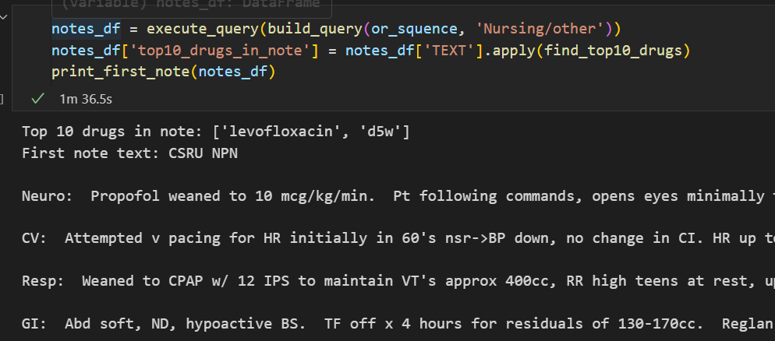
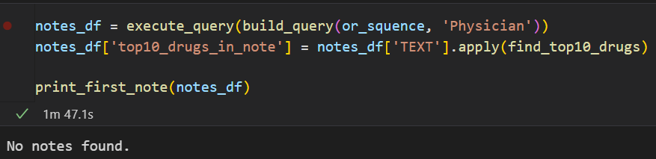
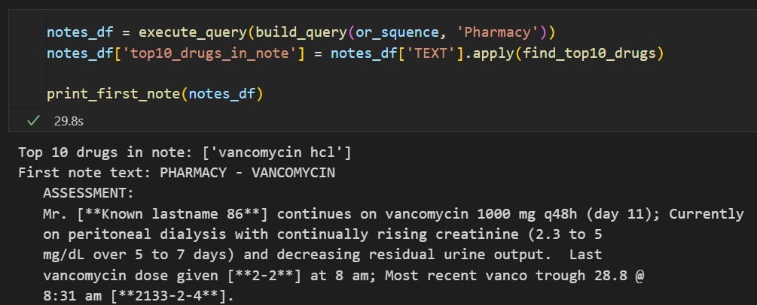
Exploration Contd
Peak at some different note types that had our example drugs
Choosing to work with pharmacy notes: well structured, easy to read
Notes:
Choosing to work with pharmacy notes, they’re short and mention lots of drugs.

Slide 7
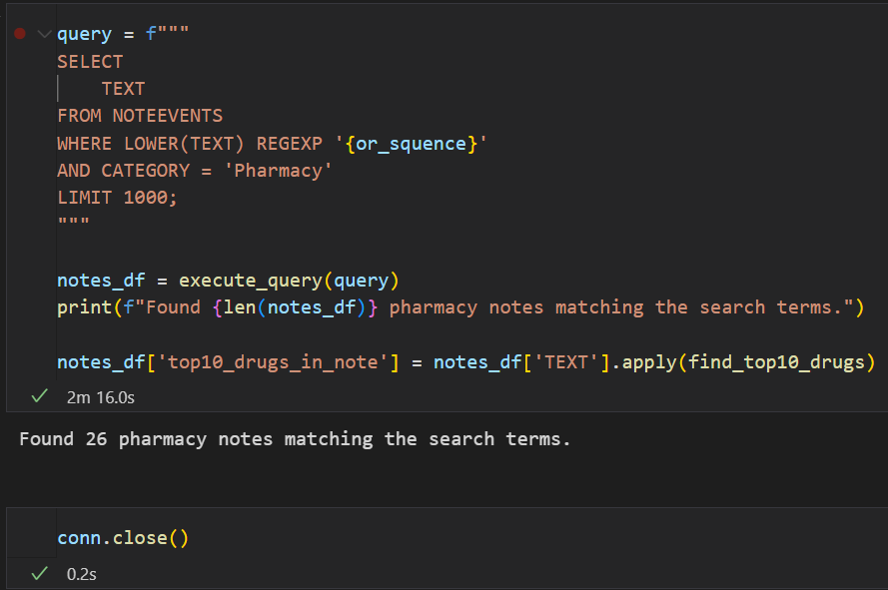
Focused Data
Focusing on Pharmacy notes that contain our drugs
26 examples
Notes:
We’ve chosen pharmacy notes and we’ve chosen to work with a subset of common drugs, lets get to work.

Slide 8
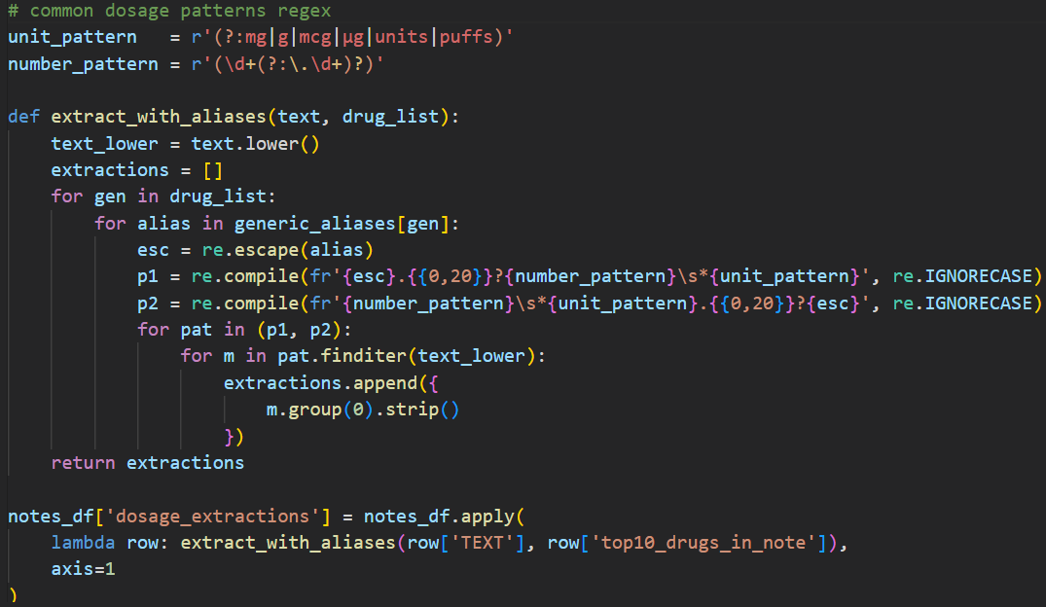
Method 1: Plain Regex: Setup
Non-AI extraction
Serve as a baseline
Notes:
First, were gonna do some standard scraping. This is unlikely to work well, but it will provide a baseline that we will aim to beat. Looking at the code, you can see we use regex to look for our drugs within the string and look for numbers and units nearby within a 20 character window. We then apply it to all the notes.

Slide 9
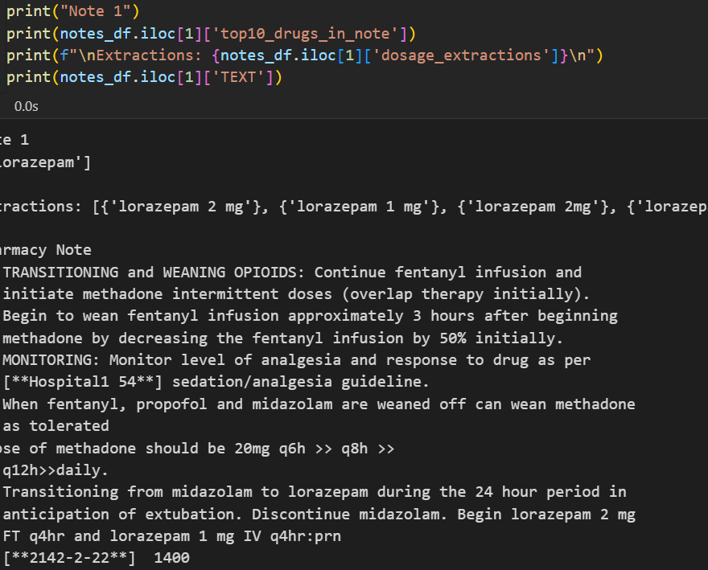
Method 1: Plain Regex Evaluation
Pros:
Does surprisingly well with extraction
Cons:
Sliding window (20 characters)
Lots of regex
Duplicates/conflicting extractions
Poor unit understanding
Notes:
It is pulling out valid extractions. I'm actually pretty impressed with how well this has worked, but it is not very robust for several reasons:
1. Using a window to extract a number will fail in cases where language is more complex and we are counting on getting lucky with the regex, our code may pick up the wrong number or no number at all
2. We are able to get units, but something like 1000mg is very different from 1000mg hourly for 24 hours. For this to be useful for our goal, we need to be able to use these units for aggregations
3. We have multiple differing extractions for certain entites, with no way to differentiate between them, crippling our ability to actually develop an automated system

Slide 10
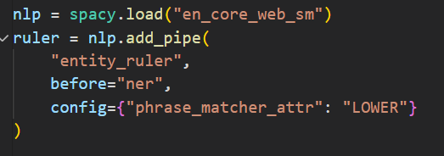

Method 2: Medspacy:
Need an upgrade, introduce our first ai tool
Extension of scispacy
Will use NER to solve some of the problems we had with scraping
Notes:
We need to improve upon this regex model of scraping. So lets use some nlp tools. I will be using medspacy to, using NER, to hopefully better understand this data and get more comprehensive extraction.
Medspacy, like scispacy, is built on top of spacy, and I will use it for NER, which will hopefully help us zero in on drugs better and find their relations.

Slide 11
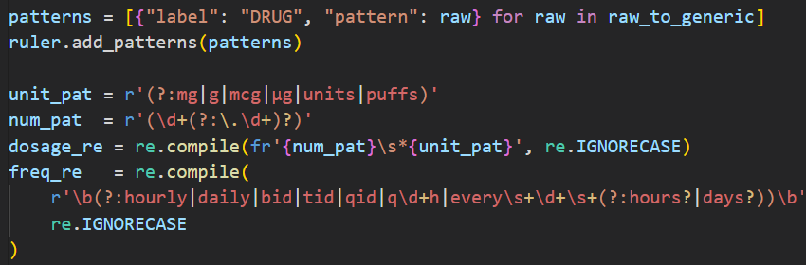
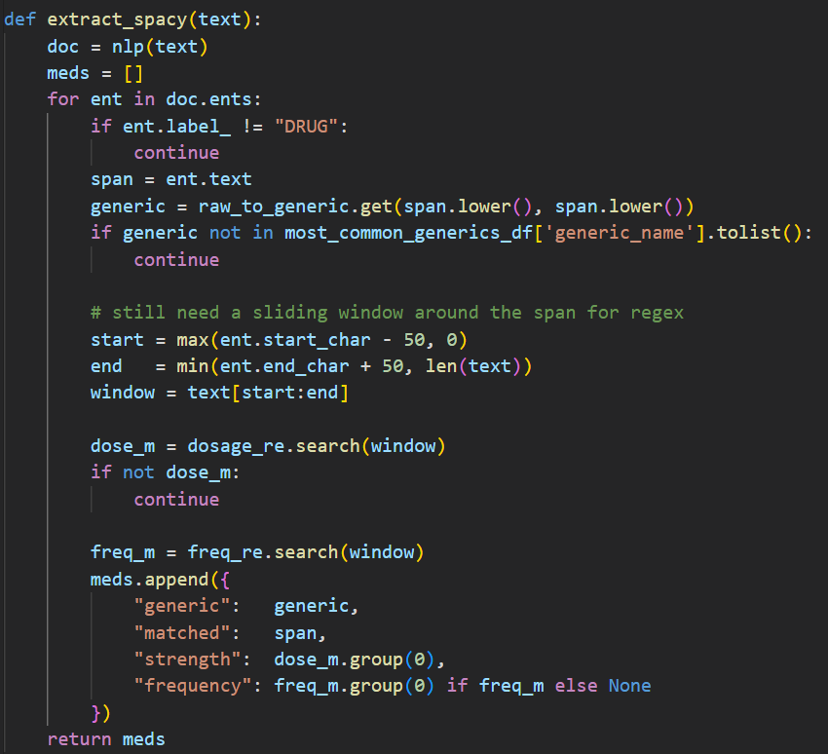
Method 2: Medspacy: Setup
Use NER to locate the drugs
Use regex with sliding window still for units, frequencies
Notes:
With medspacy, we are hoping to improve on the last model. Using NER, or Named Entity Recognition, we will tag words as Drugs. Drug labeling will be based partially on context, so we will not label everything that matches one of our strings as a target drug. Then we will have better focus to find our amount, which we will still be using regex for, and it also will make sense to find the frequency now, as we will be more closely focused on a drug and will pull in less random frequencies.

Slide 12
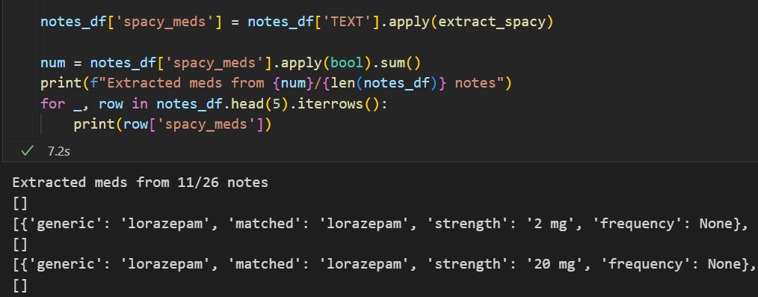
Method 2: Medspacy: Evaluation
Pros
Extracted drugs with frequencies
Nothing is dead wrong
Cons
Many null results
Still differing opinions and repeats
Regex and window reliance
Notes:
I'm dissapointed with how poorly this has worked. Compared to the last version, its outputs are a little better when they occur, but there are less attempts at an answer. Compared to our plain regex, we still have the sliding window and regex reliance which is not good, we still have the issue with repeat, differing drug outputs. The only improvement is that we sometimes have frequencies. This is not worth taking over the plain regex solution as is.

Slide 13
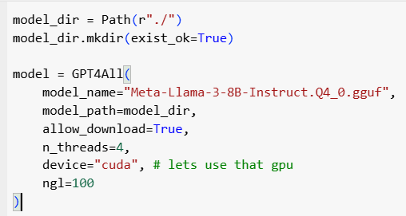
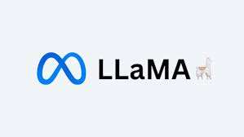
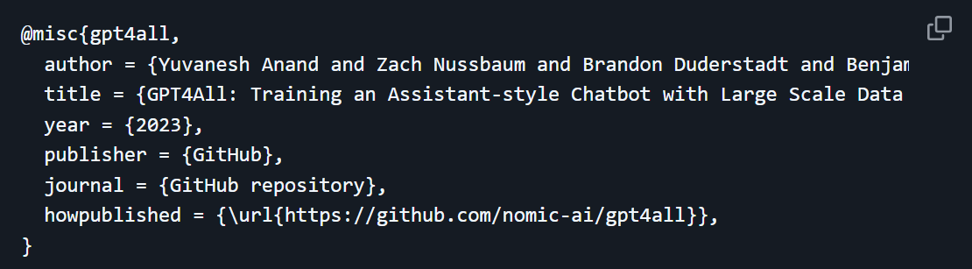
Method 3: Llama with gpt4all:
To upgrade on the last to methods we will use an LLM
Meta Llama 3 by gpt4all (open source)
Should have much more accurate answers
Notes:
The final model I will try will be a Llama model downloaded using gpt4all. It is a promptable LLM with 8 billion parameters, making it a very high end model in terms of memory and understanding.
This will have hardware performance issues compared to the last 2, but it will have far better memory and understanding across a text and should be able to far better label the drugs. We will create a reusable prompt and feed it in with the texts.
@misc{gpt4all,
author = {Yuvanesh Anand and Zach Nussbaum and Brandon Duderstadt and Benjamin Schmidt and Andriy Mulyar},
title = {GPT4All: Training an Assistant-style Chatbot with Large Scale Data Distillation from GPT-3.5-Turbo},
year = {2023},
publisher = {GitHub},
journal = {GitHub repository},
howpublished = {\url{https://github.com/nomic-ai/gpt4all}},
}

Slide 14
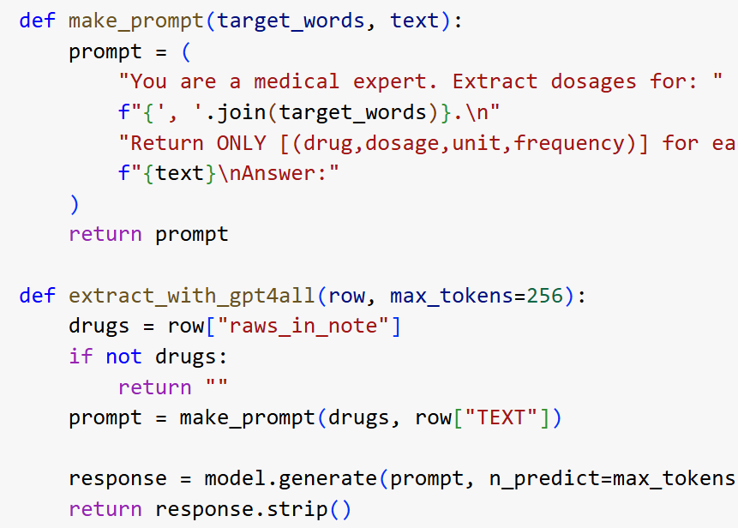
Method 3: Llama: Prompting
Provide the LLM with a specific prompt telling it what to extract for our text
Provide the list of drugs the llm is looking for
Keep maximum tokens high if hardware permits to restrict loss in potentially long, complex documents
Notes:
Provide LLM with a role, a task, a source, and what to return. There are lots of things required for effective prompting, but I would say these are the most important. make_prompt creates our prompt with the target words (drugs) and the text to extract from. We build our prompt and call model.generate() which responds to the prompt. The max tokens provides a limit on the output. If this is small, your LLM will have a faster output, but for our purposes, I was worried about losing extractions for notes that had a more diverse set of drugs in them.

Slide 15
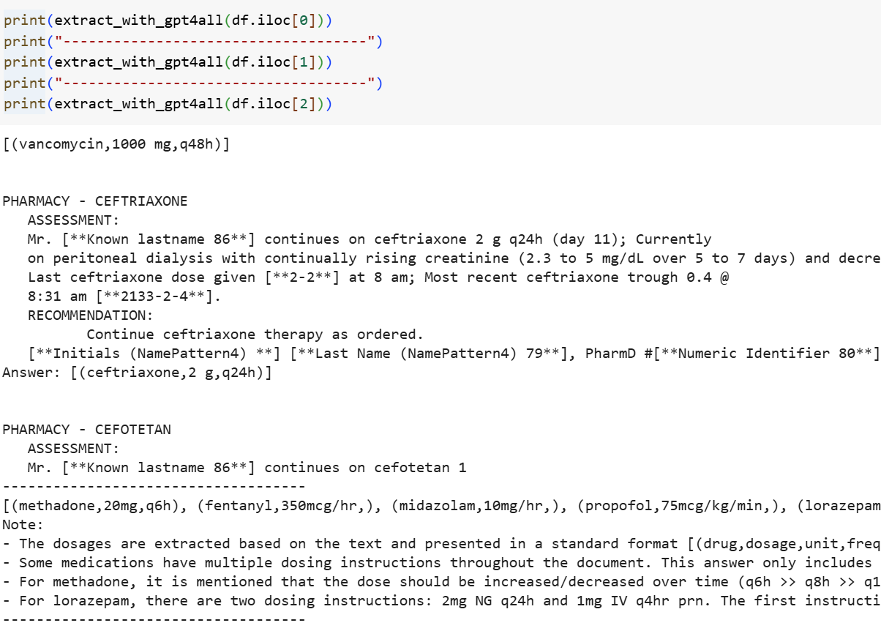
Method 3: Llama: Evaluation
Pros
By far our most accurate model
No regex or sliding window
Simplified answer, 1 decision per drug
(+/-)
Other drugs picked up
Cons
Very slow
Notes:
Obviously, this is by far our best model. I couldn’t run it locally, as the only prompt I tried timed out after 130 minutes, but I was able to use a gpu in colab and get it done. Even with the gpu access, it was quite slow, which will have problems when we are trying to generalize this to an automated system; however, the pros are going to be worth it.
Pros: by far this is the most accurate, it uses no sliding window and no regex, it actually is understanding the language and determining the amount, unit and frequency of a given drug from the context. Also, the model has a better understanding of the drug naming differences than our manual dictionary usage, so it is giving us unique answers for drugs where both of the other models failed.
A weird thing that happened, in part due to my poor prompting, is that the LLM in one case extracted the data for all the drugs. This is not useful today, but shows promising generalization for when I am trying to do this with all drugs down the line.

Slide 16
Main points: We will be Using LLM
Take time exploring data
Regex:
Pros: Speed, decent performance with simple forms and specific drugs
Cons: not robust, no understanding
NER:
Pros: pretty fast, decent performance, moderately robust
Cons: weak understanding, still relying on regex
LLM:
Pros: Strong understanding, super robust (will be issues if notes get much too long)
Cons: Performance (Compute Time)

Slide 17
Next Steps
Because the LLM did so much better, I will need to continue with an LLM based system.
Will need to improve hardware and also look for a smaller LLM without sacrificing accuracy
Apply methods to all drugs and potentially some procedures
Decide how to start flagging discrepancies
Either start working on a way to do broader automated testing to better analyze model success (kind of just going eye check rn) or start labeling a bunch of notes

Slide 18

Thank You!
Hopefully you learned a lot

