Slide 1
Understanding the Entity disambiguation module in PubTatorCentral
2019.06

Slide 2
Entity Disambiguation: problem and solutions
Existing issue
The same entity can be annotated as more than one bioconcept types (mutations/species/genes/chemicals/diseases).
Example
CO₂ can represent:
- the chemical ‘carbon dioxide’ (MESH: D002245)
- the gene ‘complement C2’ (EntrezGene:717)
Solutions
PubTator:
Priority ordering: mutation > species > gene > chemical > disease. (Based on the precision of each concept).
- Accuracy：55.7%
PubTatorCentral:
Identify the disambiguating entities -> identify the match-most type in human-curated database via CNN
- Accuracy：85.2%
Notes:
PubTator central: automated concept annotation for biomedical full text articles

Slide 3
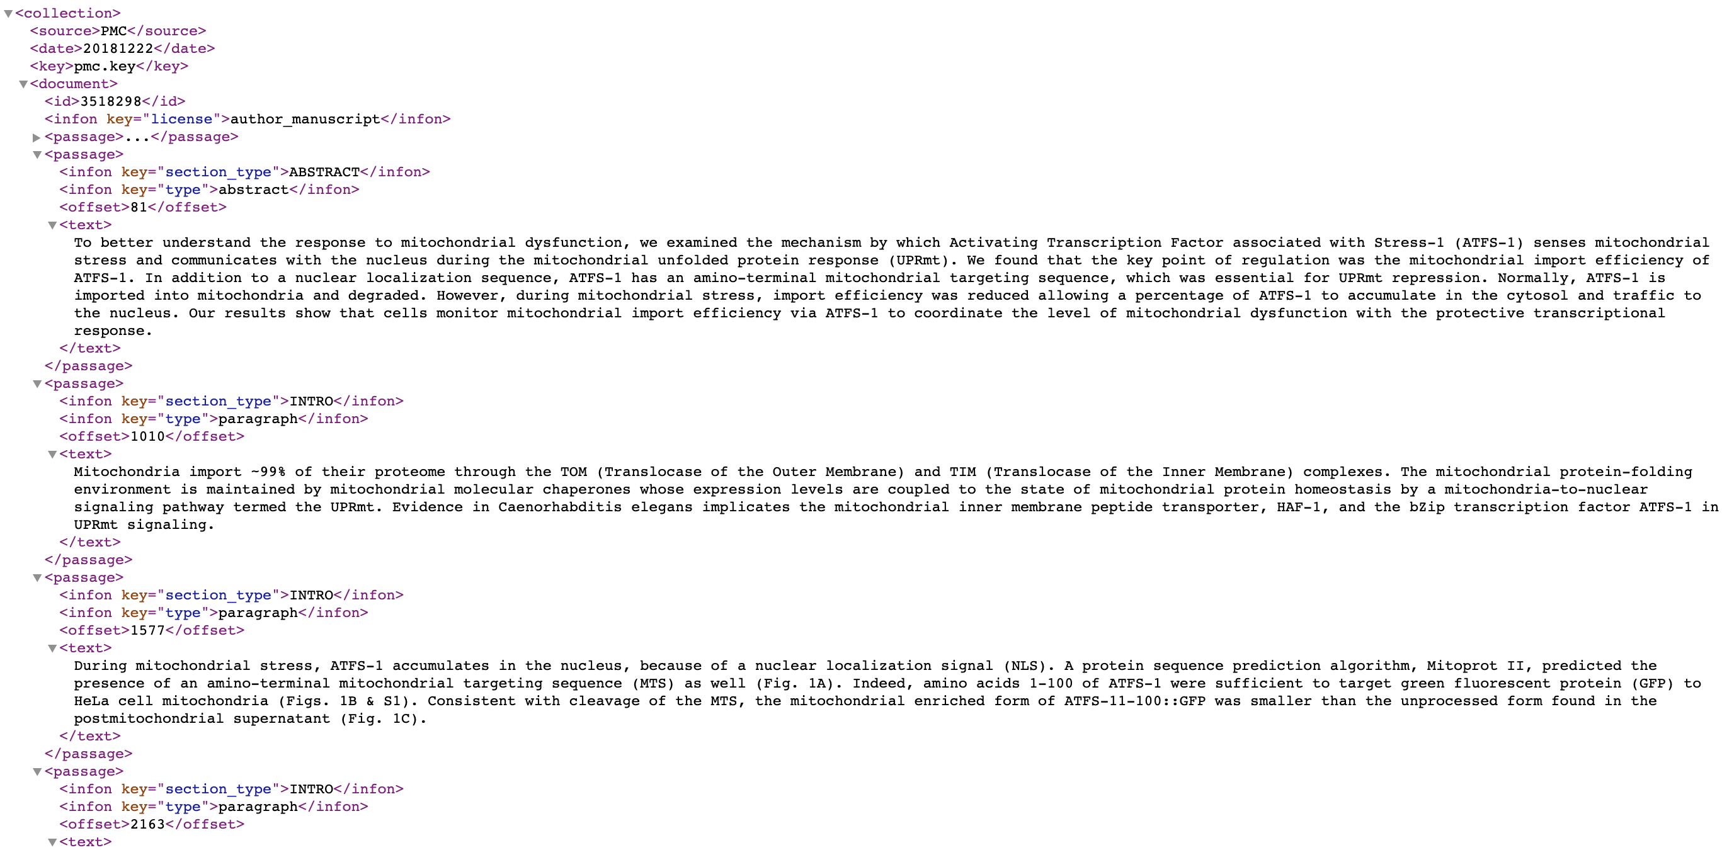
BioC format：semi-structured text
Abstracts (PubMed publications) or full text (PMC publications, part of PubMed publications) can be converted to Bio-C files
They can be converted to XML or JSON files with the tools below
They can be encoded with Unicodec or ASCII
To facilitate text mining and text processing, as well as information retrieval research
Abstract:
https://www.ncbi.nlm.nih.gov/research/bionlp/RESTful/pubmed.cgi/BioC_[format]/[PMID]/[encoding]
Full text:
https://www.ncbi.nlm.nih.gov/research/bionlp/RESTful/pubmed.cgi/BioC_[format]/[PMID]/[encoding]
Article info
Passage: Authors, etc.
Passage: Abstract
Property: section_type: Abstract
Property: type: Abstract
Passage: Main text
Property: section_type: Intro
Main text
Property: type: Paragraph
Notes:
https://www.ncbi.nlm.nih.gov/research/bionlp/APIs/BioC-PubMed/
https://biocreative.bioinformatics.udel.edu/media/store/files/2014/2_BioC_bc2014_final.pdf

Slide 4
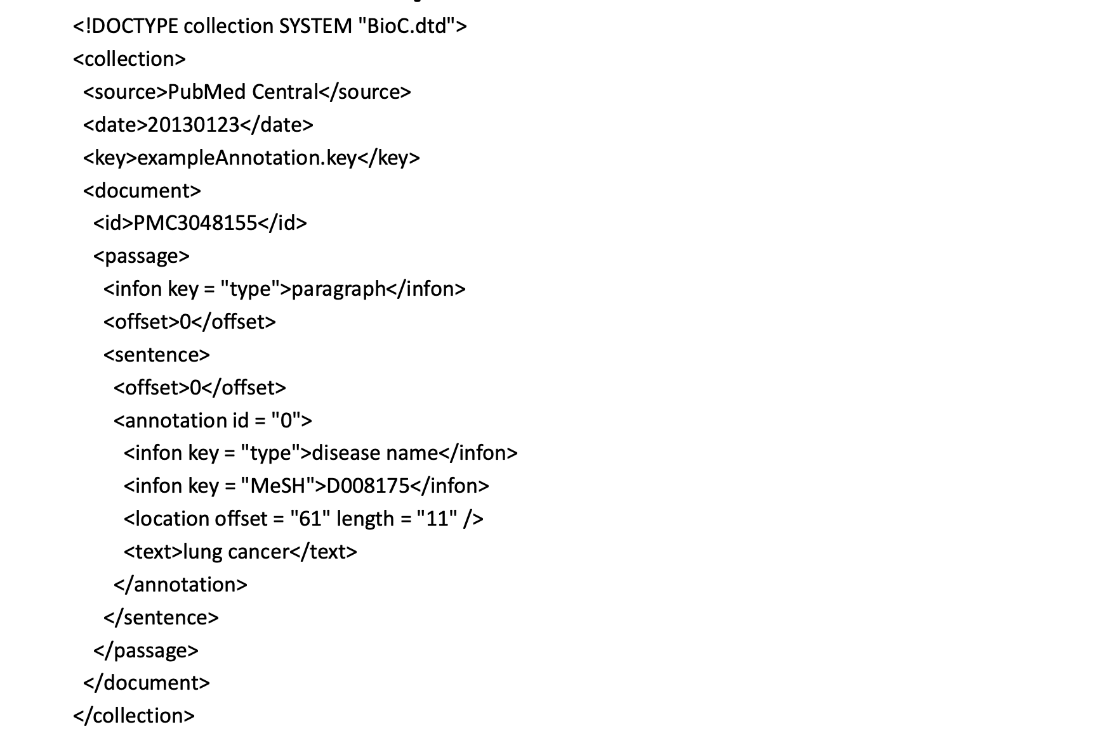
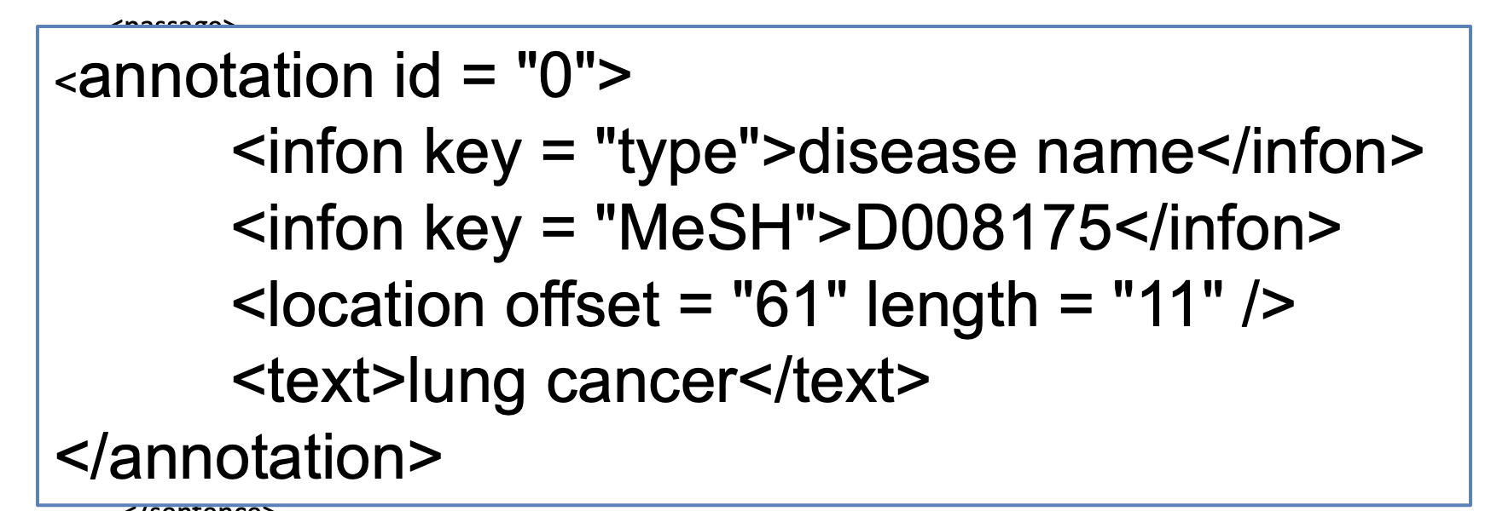
BioC format supports rich annotation types
Tools such as PTC can generate BioC-formatted file with rich annotations with NER
BioC-formatted outputs from PTC
PubMed Publications
For eg.: PMID1001
PubTatorCentral
NER Module
Entity type
Entity ID
Entity mention
Bio-C formatted Outputs
Including the mention, ID and type of the entities annotated as genes, chemical, diseases, mutations or species with NER module from PMID1001.
Notes:
https://www.ncbi.nlm.nih.gov/research/bionlp/APIs/BioC-PubMed/
https://biocreative.bioinformatics.udel.edu/media/store/files/2014/2_BioC_bc2014_final.pdf

Slide 5
Flowchart of PTC entity disambiguation module
(For each article)
Context
Write out to 3 feature files: Preceding context, Succeeding context, and Other features
Read in Bio-C formatted file output by PTC NER module
Isolate entities (target mention) annotated to more than one type (mutations/species/genes /chemicals/diseases)
Text2seq
Keras.Tokenizer
Keras.sequence.pad_sequences
⇩
(20000, 1000)
Entity Extraction
Feature Generation
Parse features
Abbreviations
Output result
Input info
Prediction model
Exception values
Lookup
table
Output final type
1：disease
2：gene
3：chemical
4：mutation
0：species
argmax
(of
probability
matrix)
Write out to filename.PMID2Mention, with format:
PMID\tTarget_mention\ttype[0]|type[1] |type[2]
Notes:
Tokenize时设定的vocabulary数量为20000。1000是pad出来的，一般不会有1000这么长。

Slide 6
Rules for feature generation in PTC entity disambiguation module
Context features: bags of words
Abbreviation confidence
For the sentence the targeted mention is in, take the NUM_SURROUNDING_TOKEN neighboring words in preceding and succeeding context, and the targeted mention itself.
For abbreviations, predict the full name with Ab3P package. If the prediction confidence score is larger than 0.95, the prediction result is added as a feature.
For example：
Sentence=“In the model the observed north-south atmospheric concentration gradient can be maintained only if sinks for CO₂ are greater in the Northern than in the Southern Hemisphere.”
NUM_SURROUNDING_TOKEN=3
Generates features：
feature_pre: if: 1, sinks: 1, for: 1, CO2: 1
feature_post: are: 1, greater: 1, in: 1, CO2: 1
Count all neighboring words article-wise. If one word is present, it is counted as 1. The times of presence is not counted.
For example：
If the Prediction result is: CO2, carbon dioxide, 0.4(Made-up value)
it is not considered as a feature.
If Prediction result is: CO2, carbon dioxide, 0.98(Made-up value)，Then include feature：
F:carbon_dioxide
Further, if the full name is present in the original article and identified and annotated by PTC NER module, we include feature:
FT:chemicals
Parse features: Prefix & Suffix
Input info
Remove all spaces. Take the target mention, 1st char, 1st-2nd, and 1st-3rd chars, last char, second to last-last, third to last-last chars of the target mention as features respectively.
Type and ID of the target mention annotated/predicted by NER module.
For example： (CO2 annotated as carbon dioxide)
BID:D002245
Predict:Chemical
For example：CO2-> [C, CO, CO2, O2, 2]
In which CO2 appeared 3 times but we kept only 1
Notes:
目标实体词为了embedding？
特征存储在dict里，无序（自带hash排序）。

Slide 7
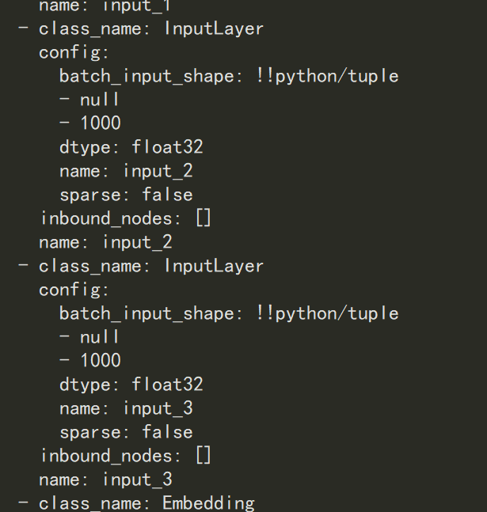
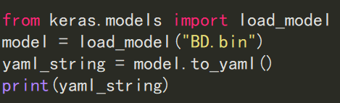
CNN model structure in PTC entity disambiguation module
In the original codebase, the CNN model is serialized to binary file. We extracted the model with `keras.models.load_model` and convert the model to human-readable format with `to_yaml()`
Batch_input_shape:(None,1000)
Name:input_2

Slide 8
CNN model structure in PTC entity disambiguation module
embedding_2
input_dim: 20000
input_length: 1000
output_dim: 200
conv1d_1
activation: relu
kernel_size: 5
padding: valid
strides: 1
filters: 100
conv1d_2
activation: relu
kernel_size: 5
padding: valid
strides: 1
filters: 1000
Input_1
(None, 1000),
max_pooling1d_1
padding: valid
pool_size: 5
strides: 5
global_max_pooling1d_1
dropout_1
rate: 0.2
Input_2
(None, 1000),
(Word2Vec)
conv1d_3
activation: relu
kernel_size: 5
padding: valid
strides: 1
filters: 100
conv1d_4
activation: relu
kernel_size: 5
padding: valid
strides: 1
filters: 1000
max_pooling1d_2
padding: valid
pool_size: 5
strides: 5
global_max_pooling1d_2
dropout_2
rate: 0.2
concatenate_1
embedding_1
input_dim: 20000
input_length: 1000
output_dim: 200
dense_1
concatenate_1
activation: relu
units: 200
conv1d_5
activation: relu
kernel_size: 5
padding: valid
strides: 1
filters: 100
conv1d_6
activation: relu
kernel_size: 5
padding: valid
strides: 1
filters: 1000
Input_3(None, 1000),
max_pooling1d_3
padding: valid
pool_size: 5
strides: 5
global_max_pooling1d_3
dropout_3
rate: 0.2
dense_2
concatenate_1
activation: relu
units: 5
1x1000x200
100x996x1
100x199x1
100x199x1
1000x195x1
1000x1
Input1: other features
Input2: preceding context features, as bags of words
Input3: succeeding context features, as bags of words
mutations/species/genes/chemicals/diseases
Notes:
Global_max_pooling: Pool_size=steps.
class GlobalMaxPooling1D(_GlobalPooling1D):
"""Global max pooling operation for temporal data.
# Input shape
3D tensor with shape: `(samples, steps, features)`.
# Output shape
2D tensor with shape: `(samples, features)`.
"""
def call(self, x, mask=None):
return K.max(x, axis=1)

Slide 9
References
Convolutional Neural Networks for NLP
In the case of NLP tasks, i.e., when applied to text instead of images, we have a 1 dimensional array representing the text. Here the architecture of the ConvNets is changed to 1D convolutional-and-pooling operations.
One of the most typically tasks in NLP where ConvNet are used is sentence classification, that is, classifying a sentence into a set of pre-determined categories by considering nn-grams, i.e. it’s words or sequence of words, or also characters or sequence of characters.

Slide 10
References
PubTator central: automated concept annotation for biomedical full text articles
https://www.ncbi.nlm.nih.gov/research/bionlp/APIs/BioC-PubMed/
https://biocreative.bioinformatics.udel.edu/media/store/files/2014/2_BioC_bc2014_final.pdf
Convolutional Neural Networks for Sentence Classification
http://www.davidsbatista.net/blog/2018/03/31/SentenceClassificationConvNets/

