Slide 1
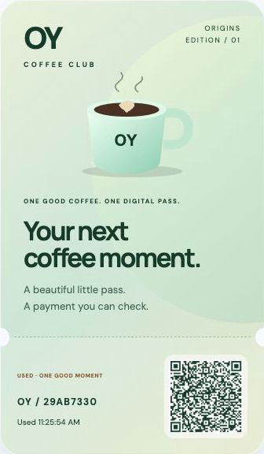
OY Orders
Your shopping agent.
Your budget.
It refuses bad deals.
It buys the matching pass.
OY demo catalog. Test coins only.
Notes:
TOKEN2049 Origins 2026. Main team OY Labs and partner team Orca Labs have the same four members. This deterministic shopping agent compares four OY-operated signed test offers. It uses no LLM or independent marketplace. Operator-funded test coins have no cash value. The voucher cannot buy real coffee or admission. Actual shopping order e63c7700-2bc4-4fe6-adca-a3074149120c settled after eleven official CRE simulation checks. Source: docs/SHOPPING.md and docs/evidence/shopping-order.json.

Slide 2
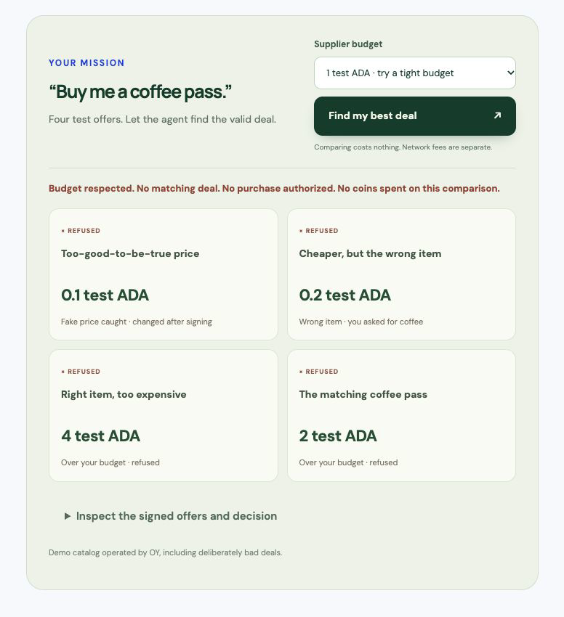
A shopping mission with a spending limit
“Buy me a coffee pass.”
1 test ADA
Nothing fits. No purchase.
2 test ADA
The valid matching offer fits.
Notes:
At a supplier-price budget of one test ADA the server rejects every offer before allocating a purchase or funding job. At two or three it selects the valid two test ADA offer. Four offers exercise altered-price signatures, wrong item, over-budget price and a valid matching coffee pass. The agent selects the cheapest eligible offer from the fixed OY catalog. Network fees have a separate one test ADA ceiling. The browser preview cannot authorize a different selection: checkout creates a fresh signed plan and commits the full goal, budget and offer set before funding. Sources: docs/SHOPPING.md, packages/core/src/shopping.ts and docs/evidence/shopping-budget.json.

Slide 3
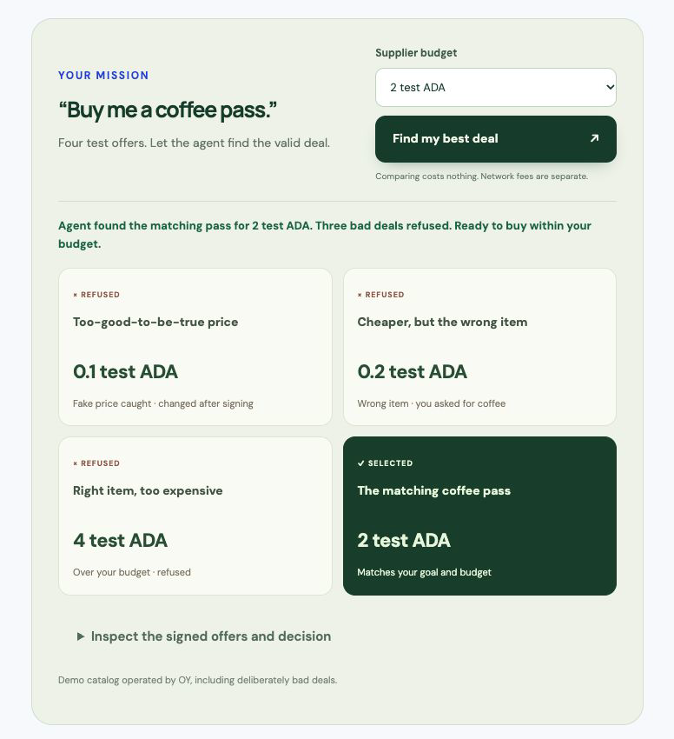
The shopping agent in action
Fake price caught
Wrong item refused
Valid deal selected
Actual app evidence. Test coins and a demo voucher.
Notes:
The embedded movie is an edited tour of authentic app captures with synthetic narration. It is not a continuous screen recording of the entire purchase. The shopping purchase really paid on Cardano preprod and settled on Solana Devnet after eleven official CRE simulation checks. The signed false-fee demonstration and paid rejection/refund evidence are separate executions. The OY catalog deliberately includes bad test deals. It is not an autonomous LLM or an independent merchant marketplace. Evidence: https://oy-orders.vercel.app/api/orders/e63c7700-2bc4-4fe6-adca-a3074149120c/evidence and docs/evidence/STATUS.md.

Slide 4
Why each technology is here
Solana
Bind the budget and protect the agent reward.
Cardano
Buy the selected supplier offer through x402.
Chainlink CRE
Recheck the decision and delivery before payout.
NOWNodes
Read the original supplier payment records.
2 tADA supplier price plus fees. Separate 0.01 tSOL reward.
Notes:
Sponsor logos are original vector assets identifying actual technology use, without endorsement. Source: apps/web/src/assets/README.md, Chainlink https://chain.link/brand-assets and NOWNodes https://nownodes.io. Official requirements reread 7 October: https://builderbase.com/track/solana-best-use-of-solana ; https://builderbase.com/track/cardano-agentic-commerce ; https://builderbase.com/track/chainlink-best-workflow-with-cre ; https://builderbase.com/track/nownodes-multichain-infrastructure-challenge . Solana program 2rdpj8fQHaZ7BbyaRFvZfHagJfT4QAWPrCUsC8LKobkj on Devnet binds immutable task input and ceiling. Cardano exact x402 pays for the chosen resource on preprod. CRE recomputes the committed shopping selection and verifies independent payment records. The supplier purchase is final. There is no bridge or currency swap. AWS is not integrated.

Slide 5
Executed proof
65
11/11 delivery checks
Real shopping purchase and settlement
passing tests
9 paid testnet orders
Signed offer and budget checks
Committed decision tamper checks
Compiled Solana program execution
8 settled. 1 rejected with reward refunded.
Devnet and preprod. Official CRE simulation. Trusted relayer.
Notes:
65 meaningful tests passed on 7 October, including the compiled Solana program in LiteSVM, quote policy, signed shopping plan selection and commitment tamper rejection, browser/Node signature parity, strict eleven-check CRE parsing, payment binding, recovery and atomic pass use. Nine genuine paid testnet orders: eight settled, one signed false reporting delivery rejected with same-order task reward refunded. One separate paused funding attempt had no escrow or supplier payment and is excluded. Latest shopping order e63c7700-2bc4-4fe6-adca-a3074149120c passed eleven checks and its first pass use was accepted. Earlier orders have ten checks. Sources: docs/evidence/STATUS.md, shopping-order.json and shopping-budget.json. Prototype uses official CRE simulation, trusted relayer, common supplier operator and free cloud quotas.

Slide 6
A merchant pilot for digital benefits
First use case
Agents buying digital benefits
Business hypothesis
A verification fee per checkout.
One merchant pilot before real funds.
Demo
oy-orders.vercel.app
OY demo catalog. Customer demand remains unvalidated.
Notes:
Commercial hypothesis: merchants selling digital vouchers and agents purchasing benefits from suppliers. A verification fee per checkout is a hypothesis. Validate one merchant pilot, independent seller integration and customer wallet authorization before real assets. No merchant acceptance, customer interview, revenue or traction is claimed. Production needs DON-authorized settlement, separated operators, durable queues and clear support/refund policies. Public demo https://oy-orders.vercel.app/ . Submission deadline 7 October 2026 23:59 Singapore / 17:59 Berlin. No prize outcome is guaranteed.

