Slide 1
OY Orders
A signed answer
can still be wrong.
Proof before payday.
Orca Labs · TOKEN2049 Origins 2026
Notes:
Orca Labs, TOKEN2049 Origins 2026. Product renamed OY Orders. The MVP buys deterministic Solana and Cardano wallet reports; it does not implement an LLM or general truth verification. Public app: https://oy-orders.vercel.app. Recorded proof and the live challenge are separate.

Slide 2
Who checks the answer before payday?
THE SIGNATURE PASSES. THE FACT DOES NOT.
30,000,001
≠
30,000
What the claim says
What the records show
Pay for checked work.
Protect the task reward when the facts fail.
A bounded reporting task · actual testnet payment and refund evidence
Notes:
First use case: operations teams buying wallet transaction reports. Independent verification is limited to recorded blockchain facts, paid service terms and escrow. This is a controlled adversarial demo, not an allegation about a third-party supplier. Real example from the public challenge: a signed Solana transaction fee claim of 30,000,001 lamports disagrees with the independently read 30,000.

Slide 3
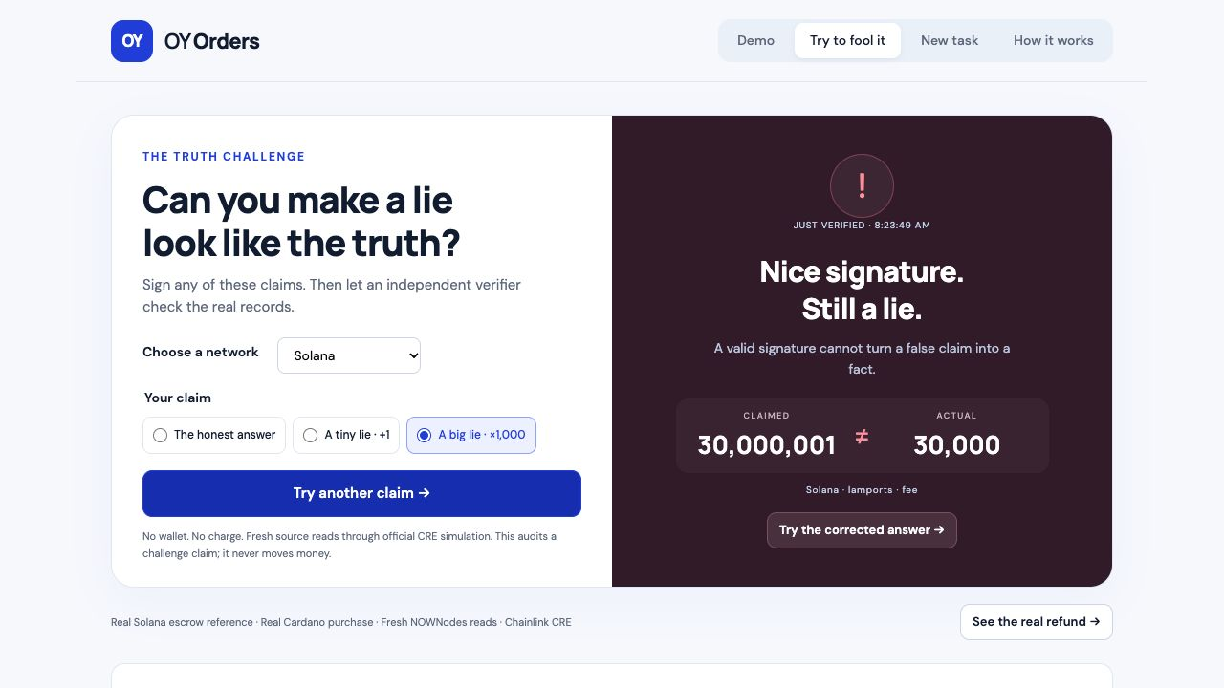
Try to fool it. Then correct it.
Live claim audit + recorded money protection
Change a claim
Try Solana or Cardano.
No wallet or charge.
See the difference
Fresh CRE checks.
Actual source values.
Notes:
Play the embedded narrated edited screenshot tour. Authentic app screenshots show a new signed claim audit, valid signature with false facts, a fresh corrected-claim check, actual settled testnet proof, and the confirmed reward refund from the same rejected order. The audit itself never changes an order or moves money. It uses a separate challenge signer and official CRE CLI simulation. Video uses synthetic narration and edited still holds, not a continuous execution recording. Native PowerPoint/Keynote movie playback and the organizer’s acceptance of PPTX remain unverified.

Slide 4
Four sponsors. One necessary flow.
Solana
Lock the task reward. Pay checked work. Refund after expiry.
Cardano
The agent buys the reporting resource through x402.
NOWNodes
Supply real facts from both chains; read them again to check.
Chainlink CRE
Independently verify the purchase, signature and facts.
Separate test-asset payments · Solana Devnet + Cardano preprod
Cardano supplier purchase is final. Only the task reward is refundable.
Notes:
Official track rules: https://builderbase.com/track/solana-best-use-of-solana ; https://builderbase.com/track/cardano-agentic-commerce ; https://builderbase.com/track/chainlink-best-workflow-with-cre ; https://builderbase.com/track/nownodes-multichain-infrastructure-challenge . x402 alone is an eligible Cardano route; Sokosumi listing approval is optional for that route. Successful CRE simulation qualifies; production deployment is optional. Role evidence and exact hashes: docs/evidence/STATUS.md.

Slide 5
Real execution. Inspectable evidence.
47
Actual payments + protected reward
Recorded Cardano x402 purchases
Solana settlements and confirmed refund
passing tests
Escrow VM + independent source checks
Budget and transaction reuse guards
Fresh signed-claim audit tests
Cloud demo + live challenge
Vercel backend and persistent state
Fresh reads. Downloadable proof.
Test assets · official CRE simulation · trusted relayer · free-quota limits
Notes:
47 meaningful tests pass across native Solana program LiteSVM, core verification, spend guards, payment reuse, recovery and full CRE return-value parsing. Live challenge: fresh official CRE simulations catch a thousand-fold Solana lie and a one-unit Cardano lie while signatures pass. Production frontend/API runs on Vercel with a persistent Sandbox and Drive. Cold starts and Hobby free quotas apply. The trusted relayer and shared operator-controlled seller remain prototype assumptions. No DON deployment, production SLA, customer traction or general truth oracle is claimed.

Slide 6
Make agents earn trust before money.
First users
Blockchain operations teams buying
repeatable transaction reports.
Business hypothesis
Verification fee per task, or a team subscription.
Validate reporting errors, budgets and audit cost.
Try the challenge
oy-orders.vercel.app
Orca Labs · TOKEN2049 Origins 2026
Notes:
Business model is a hypothesis: a verification fee per task or a team subscription. Initial customer target: blockchain operations teams buying repeatable wallet activity reports. No interviews, revenue, partnerships or traction are claimed. Next validation: ask three operators about actual reporting errors, spending approvals and audit cost, then narrow to a recurring paid job. Judging gates remain GitHub sign-in/publication, Drive judge access, partner check-in status and exact stage-format/movie playback. Submission deadline Oct 7 2026 23:59 Singapore / 17:59 Berlin. The user will submit with us; no submission has been made.

