Slide 1
Orca Orders
Give your agent a job.
Keep control of the spend.
A bounded purchase. A signed receipt.
A task reward released after verification.
Orca Labs · TOKEN2049 Origins 2026
Notes:
Orca Labs — TOKEN2049 Origins 2026. Open with the need for bounded agent spending and independently verified results. This deck accompanies the implemented rehearsal. Actual sponsor execution remains pending. Never present the rehearsal as deployed chain activity.

Slide 2
Payment is only half the task.
An agent can buy a report.
Who checks the spend and the answer?
01
Bound the purchase
Reserve the supplier, price and deadline before signing.
02
Check the deliverable
Bind the receipt to the order; independently re-fetch facts.
03
Protect the task reward
Reject altered reports; refund the reward after expiry.
First use case: paid Solana + Cardano wallet transaction reports.
Notes:
Use case hypothesis: blockchain operations teams commissioning repeatable wallet reports. No interviews, revenue or traction have been collected. An agent can pay for a service but still needs a defined budget and a verified output. Separate test-asset payments: Solana task reward and Cardano supplier spend; no bridge or exchange-rate claim.

Slide 3
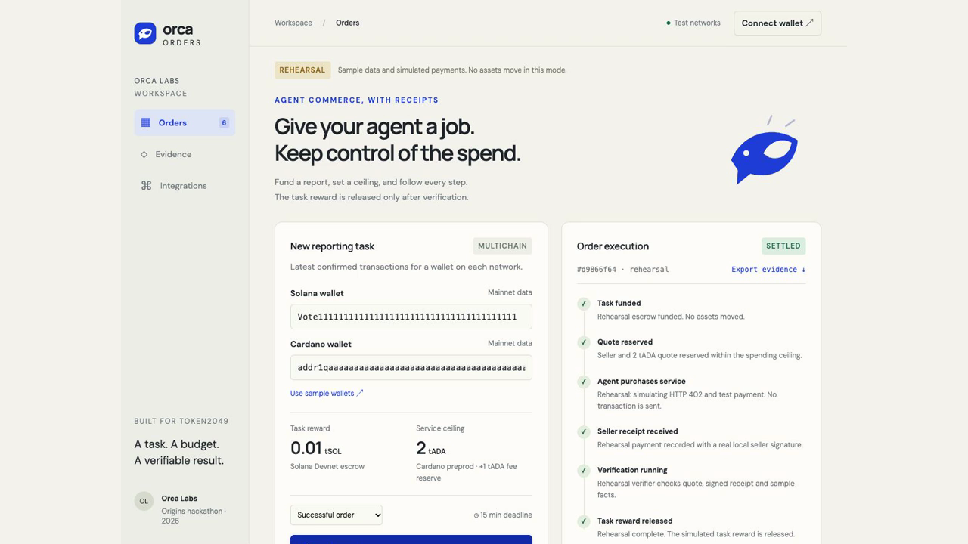
The working prototype
Recorded rehearsal · sample data · no assets moved
Success
Reward released after checks.
Tampering
Changed facts are rejected.
Expiry
Buyer reward is refunded.
Notes:
Play the embedded 52.7-second rehearsal recording on this slide. It was captured from the actual local interface in success, tampered-report and expiry/refund scenarios. Idle time between clips is removed; no assets move, and no sponsor executions are shown. Speak over the clip: immutable budget, reserved quote, seller signature, independent verification, rejection, refund. The movie is embedded in PPTX; playback in legacy PPT and the actual stage player must still be verified.

Slide 4
Four sponsors. One necessary flow.
Solana
Task escrow, quote reservation, settlement and expiry refund.
Cardano
The agent buys the reporting resource through x402.
NOWNodes
Confirmed Solana and Cardano mainnet facts.
Chainlink CRE
Independent escrow, payment, signature and fact checks.
Solana Devnet + Cardano preprod · separate test-asset payments
CRE local simulation + trusted relayer; no DON deployment claimed.
Notes:
Integration source: docs/ARCHITECTURE.md and implemented adapters. Event track pages: https://builderbase.com/track/solana-best-use-of-solana ; https://builderbase.com/track/cardano-agentic-commerce ; https://builderbase.com/track/chainlink-best-workflow-with-cre ; https://builderbase.com/track/nownodes-multichain-infrastructure-challenge . This describes implemented live architecture, not completed sponsor execution. CRE independently reads escrow and payment plus NOWNodes facts. The prototype uses a local simulation and trusted relayer, not a production DON.

Slide 5
Tested locally. Live proof comes next.
29
Compiled artifacts
Native Solana program · tested in LiteSVM
CRE verification workflow · WebAssembly
passing tests
Escrow VM checks
Receipt and payment binding
Tamper rejection and recovery
Still required
Sponsor API access and CRE login
Funded test wallets + actual chain execution
Stable demo + accessible source repository
The available recording is rehearsal evidence; sponsor eligibility is pending.
Notes:
29 tests passed on 6 October 2026. They include compiled Solana ELF execution in LiteSVM and CRE verifier fixture tests. The native program compiled using Solana Playground; CRE compiled to WebAssembly with the official SDK/Javy compiler. This is not deployed program evidence or a successful CRE CLI simulation. NOWNodes €15 credit was redeemed but plan/API activation is pending. Cardano preprod wallet funding and Blockfrost key are pending. No actual live integration, transaction hashes, or user traction are claimed. See docs/evidence/STATUS.md.

Slide 6
From one report to repeatable operations.
First users
Blockchain operations teams buying
repeatable wallet activity reports.
Business hypothesis
Per-task verification fee or team subscription.
Validate budgets, reporting errors and audit needs first.
Next milestone
One genuine end-to-end order, then a judge-ready recording.
Submission target: Oct 7, 22:00 Singapore / 16:00 Berlin
Notes:
Business model hypothesis only: per-task execution/verification fee or team subscription. No paying customers or interview findings are claimed. First validation: speak to blockchain ops teams about reporting errors, budget approvals and audit needs. Prioritize one genuine end-to-end execution before scope expansion. Deadline verified in event dashboard: 7 October 2026 23:59 Singapore / 17:59 Berlin. Internal target 22:00 Singapore / 16:00 Berlin. Stage deck should contain the recorded technical demo rather than a live technical demo. https://builderbase.com/event/token2049-origins-hackathon

