Slide 1
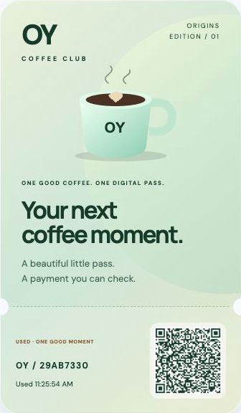
OY Orders
A coffee.
Paid with crypto.
An agent buys your digital pass.
A checker confirms delivery before payout.
Demo voucher. Test coins only.
Notes:
TOKEN2049 Origins 2026. Main dashboard team OY Labs; partner dashboard team Orca Labs with the same four members. Retail is a demo voucher using operator-funded test coins and cannot buy real coffee or admission. The actual checkout used separate Solana Devnet and Cardano preprod funds. The agent is deterministic. No customer traction or awards are claimed. Evidence: docs/evidence/retail-pass.json and https://oy-orders.vercel.app/api/orders/29ab7330-93fa-4aef-b74e-02bca9495b3a/evidence .

Slide 2
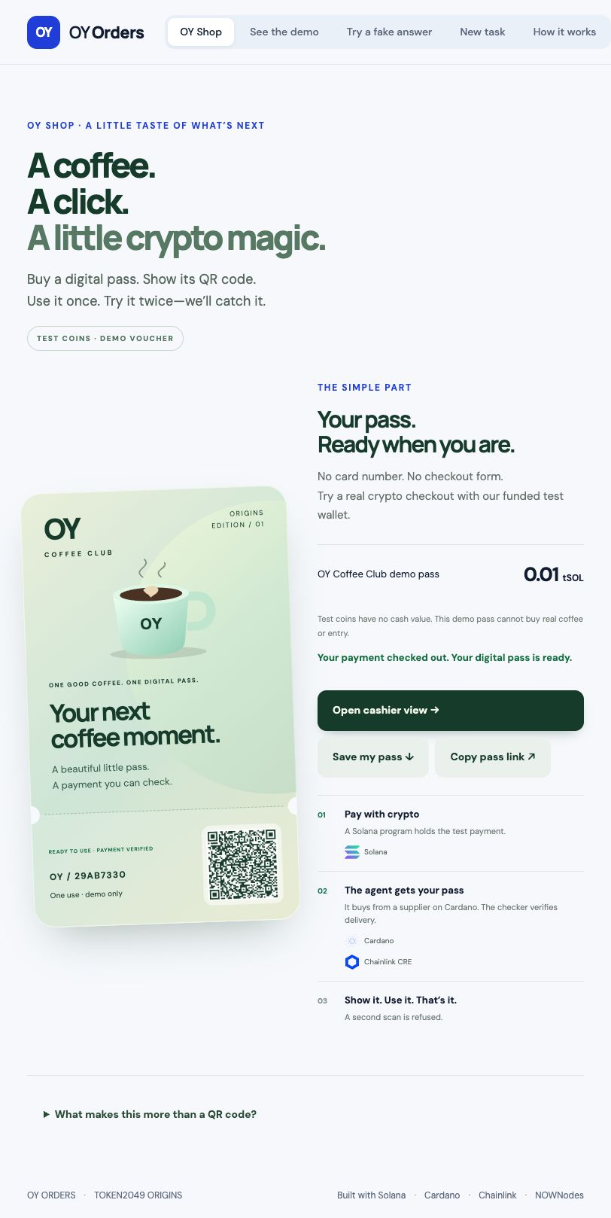
The retail checkout
01 Buy a demo pass
A funded test wallet makes the
crypto checkout easy to try.
02 Check the payment and pass
03 Accept one scan. Refuse reuse.
Notes:
The pass is a bearer ticket. Its commitment is fixed in the funded input and merchant-signed delivery. The QR is issued only after actual payment verification and settlement. The first cashier request accepts one use. Subsequent requests refuse it. Pass use is an atomic SQLite write with persistence, not on-chain redemption or an NFT. The photograph-style ticket art is a native SVG visual rendered in the actual app.

Slide 3
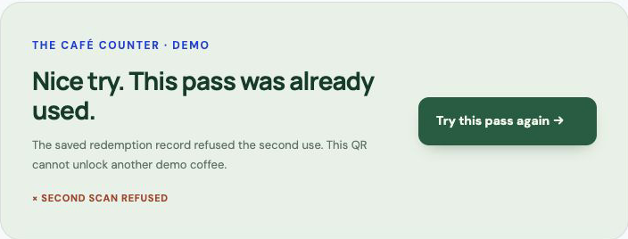
Coffee pass in action
First scan accepted
Same pass refused
Inspect the
actual payment
Recorded actual testnet evidence. Demo voucher only.
Notes:
Play the embedded edited authentic screen tour. It contains genuine UI result captures and a live duplicate-check screen recording, with synthetic narration. It does not claim a continuous recording of the full purchase. Actual retail order: 29ab7330-93fa-4aef-b74e-02bca9495b3a. The free signed-lie challenge is separate and does not move money. The recorded rejected-task refund is from a different paid reporting order and is labeled separately. Native movie playback must be checked before the stage pitch.

Slide 4
Why each technology is here
Solana
Protect the task payment with immutable on-chain terms.
Cardano
Let the agent purchase the supplier-signed pass through x402.
Chainlink CRE
Independently check the escrow, purchase and promised pass.
NOWNodes
Read the original payment records and both-network report facts.
0.01 tSOL task payment. Separate 2 tADA supplier funds.
Notes:
Sponsor logos are original bundled vector assets identifying actual technology use, without endorsement. Source: apps/web/src/assets/README.md; Chainlink brand assets https://chain.link/brand-assets and NOWNodes https://nownodes.io. Rules reread 7 October: https://builderbase.com/track/solana-best-use-of-solana ; https://builderbase.com/track/cardano-agentic-commerce ; https://builderbase.com/track/chainlink-best-workflow-with-cre ; https://builderbase.com/track/nownodes-multichain-infrastructure-challenge . Solana program 2rdpj8fQHaZ7BbyaRFvZfHagJfT4QAWPrCUsC8LKobkj on Devnet. Cardano uses exact x402 on preprod. CRE is official CLI simulation plus a trusted relayer. The Cardano supplier payment is final. There is no bridge or currency swap.

Slide 5
What we actually proved
57
10/10 delivery checks
Real retail payment and signed pass
passing tests
8 paid testnet orders
Spending limits and wrong-chain checks
Pass reuse and restart protection
Compiled Solana program execution
7 settled. 1 rejected with reward refunded.
Devnet and preprod. Official CRE simulation. Trusted relayer.
Notes:
57 tests passed on 7 October. They include compiled Solana program execution in LiteSVM, receipt/input/payment binding, wrong-chain rejection, spending and transaction reuse guards, exact official CRE output parsing, pass credential isolation, two-cashier contention and persistent one-use records. Eight paid testnet orders are documented: seven settled, one rejected and refunded. Latest retail order passed ten official CRE checks and survived a controlled idle cloud session stop/resume in 8.525 seconds with used state and token commitment preserved. Sources: docs/evidence/STATUS.md, retail-pass.json, retail-persistence.json. VM/fixture tests are distinguished from actual public-network executions. Prototype assumptions: trusted relayer, common operator and supplier process, serial worker, Hobby cold starts/free quotas.

Slide 6
Retail delivery with inspectable payments
First use case
Digital vouchers that shops can verify
Business hypothesis
A verification fee per checkout.
One merchant pilot before real funds.
Try the demo
oy-orders.vercel.app
Demo voucher only. Customer demand remains unvalidated.
Notes:
Initial commercial hypothesis: merchants selling digital vouchers, or agents buying digital benefits from suppliers. A per-checkout verification fee is a hypothesis. Validate one merchant pilot and customer wallet onboarding before real assets. No merchant integration, acceptance of the demo voucher, interview, revenue or traction is claimed. Pass redemption is server-side. Production needs DON-authorized settlement, independent seller operation, customer authorization, durable queues and appropriate support/refund policies. Public demo https://oy-orders.vercel.app/ . Submission deadline 7 October 2026 23:59 Singapore / 17:59 Berlin. No prize outcome is guaranteed.

